Slide 1
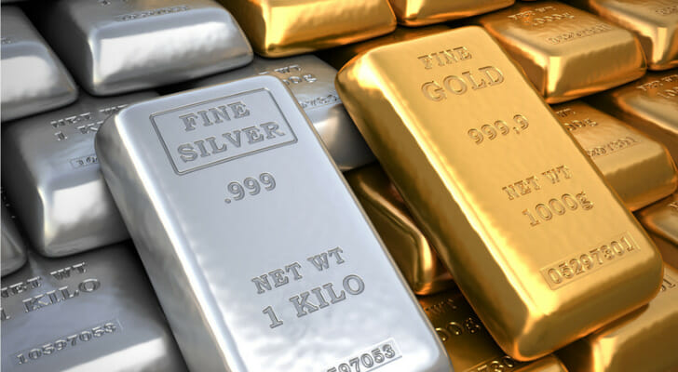
Haggai Part III Give Careful thought to your ways
The silver is mine, and the gold is mine
I am going to shake the heavens and the earth

Slide 2
Historical Introduction: Ezra
Ezra 1:1-4 Cyrus says it is time to return, and to rebuild.

Slide 3
The Cyrus Cylinder

Slide 4
Ezra 2 Captives return to Jerusalem

Slide 5
Ezra 3 temple foundation laid

Slide 6
Ezra 4 But… Satan has not taken a nap
Ezra 4:5 The work stopped

Slide 7
Ezra 6:1-12
King Darius: Why have you not built your temple?
How embarrassing!

Slide 8
Haggai
Message: Build up the house of the Lord, not your own house. (Matt 6:19-21)

Slide 9
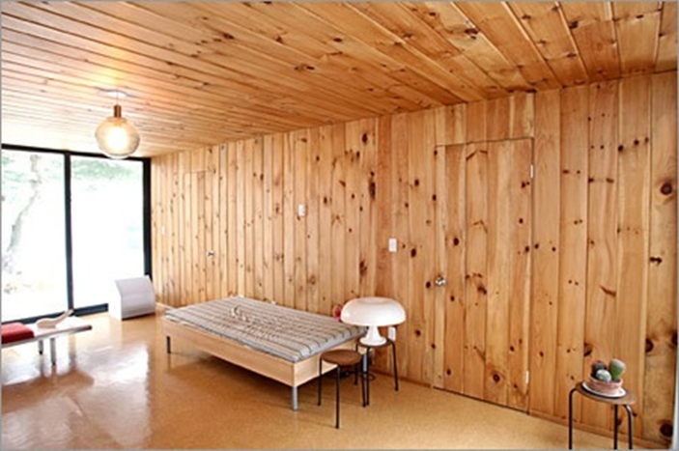
Haggai 1:1-4 The People’s Excuse
Haggai 1:2 We’re too busy to build the temple.
Haggai 1:3-4 Hmmm…. You seem to have time to build your house.
Haggai 1:5-6 You have
planted much but
harvested little.

Slide 10
God’s Solution
“Indifference to the things of God produces calamity.”
1. Haggai 1:7 Give careful thought to your ways.
2. Haggai 1:8 Bring down timber and build God’s temple.
Haggai 1:12-15 The people obeyed, the leaders led, the people’s spirits were inspired and the work got started.

Slide 11
Haggai 2:6-9 Time to build
Two great memory verses:
Haggai 2:6
“In a little while I will once more shake the heavens and the earth, the sea and the dry land.”
Haggai 2:8
“'The silver is mine and the gold is mine,’ declares the Lord Almighty.”

Slide 12
Haggai 2:10-14 parable of defiled flesh
Does coming into contact with clean meat make you clean? No!
Does coming into contact with defiled meat make you unclean? Yes!
Defilement is a thing. Holiness is a lack of a thing.
Sin is contagious. Holiness is not contagious.
We need to deal with the plague of materialism.

Slide 13
Haggai 2:15-19
Give careful thought to your ways…
Things have not been going well. Ask yourself why.
But if you repent and return, I will restore and rebuild.
v. 18 From this day on I will bless you.

Slide 14
Haggai 2:19-23
If we repent, God will bless us.
“I will shake the heavens and the earth. I will overturn royal thrones and shatter the power of the foreign kingdoms. I will overthrow chariots and their drivers; horses and their riders will fall, each by the sword of his brother.”

