Slide 1
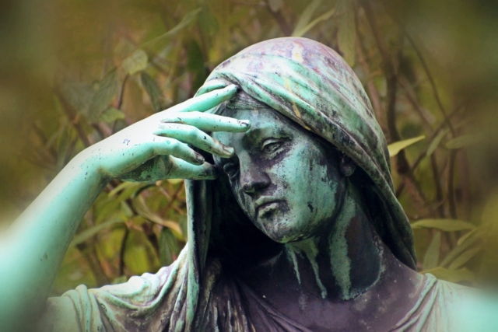
Job and the Problem of suffering

Slide 2
Theodicy: Is God Good?
Why is there evil in the world?
Why is there suffering in the world?
Why, in particular, do we Christians suffer?

Slide 3
Questions!
What should we do when we suffer and when others suffer?
How do I process my grief?
Where should we go in the Bible to answer these questions?

Slide 4
Job 1:1-5
Job was blameless and upright. He feared God and shunned evil.
The greatest man among all the people of the East
A spiritual and loving father.
Surely, God will show favor to Job and bless him only with good things!

Slide 5
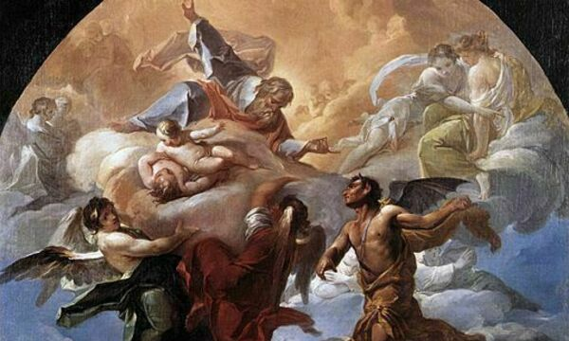
Job 1:6-12 Who is satan?
Satan is a “fallen angel” with access to God and with free will.
Satan: Job is in it for himself. He does not really love you!

Slide 6
Job 1:12 Why? Why did God “sic” Satan on Job?
To show Satan?
To test Job?
So that Job can prove to God and to himself how faithful he is?
For our sake?

Slide 7
The skeptic’s challenge:
Q: Is God of the Bible all-powerful?
Q: Is God of the Bible all-loving?
Skeptic’s conclusion: Given all the pain and suffering in the world, the God you believe in is not real.

Slide 8
Kinds of Suffering
Physical pain: acute and chronic
Disease: acute and chronic
Broken relationships
Poverty, hunger, etc.
Violence; terrorism, genocide, violent crime, etc.
Chronic fear (rape, natural disasters, abuse, etc.)
Disappointment, feelings of failure, loss of hope
Death of a loved one, mourning

Slide 9
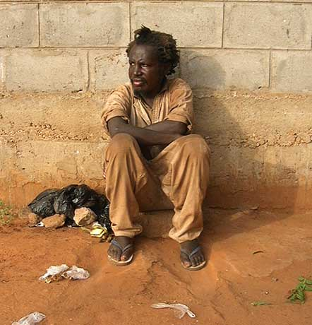

Slide 10
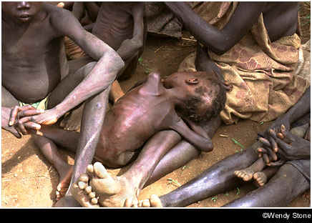

Slide 11
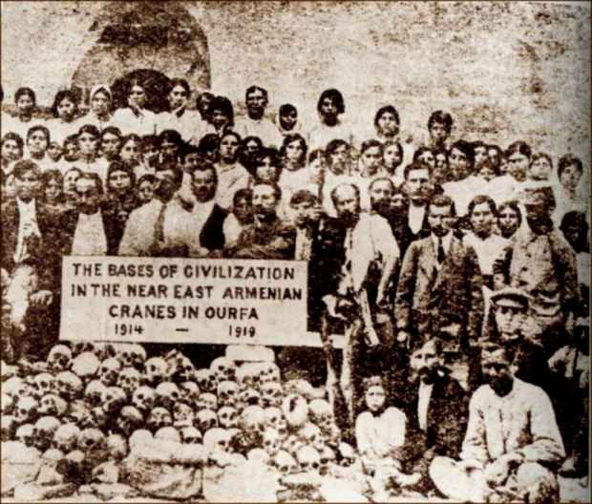

Slide 13
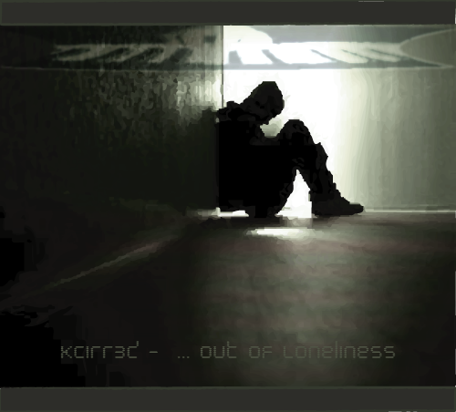

Slide 14
Bottom line, there is a lot of pain and suffering in the world.
Question: Is this because God does not care, or is this because he is not sufficiently powerful to prevent human suffering and evil in the world?
Caution: There is no simple answer.

Slide 15
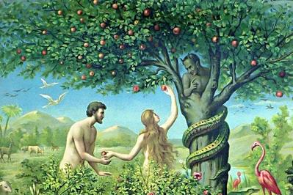
Causes of Suffering
Cause of Suffering #1
Free Will →
Evil and Sin

Slide 16
Why is there evil if god is good?
Answer: Because God loves us!
Love gives a choice.
Genesis 3:1-7
Why did God put that pesky tree in the Garden?
Sin is desireable.

Slide 17
Free Will: God Gives Us a Choice Because he loves us. The result: We rebelled and brought evil into the world.
Free Will: Deuteronomy 30:18-20
The Garden of Eden
Question: What is the alternative?
God took a huge risk…

Slide 18
Augustine on Evil
“Evil arises from the corruption of a nature which is essentially good. What is called evil is good corrupted; if it were not corrupted it would be wholly good; but even when it is corrupted, it is good in so far as it remains a natural thing, and bad only in so far as it is corrupted.”

Slide 19
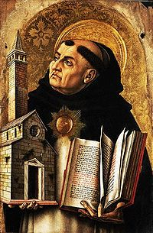
Thomas Aquinas on free will:
“God, therefore, is the first cause, who moves causes both natural and voluntary. And just as by moving natural causes He does not prevent their actions from being natural, so by moving voluntary causes He does not deprive their actions of being voluntary; but rather is He the cause of this very thing in them, for He operates in each thing according to his own nature.”

Slide 20
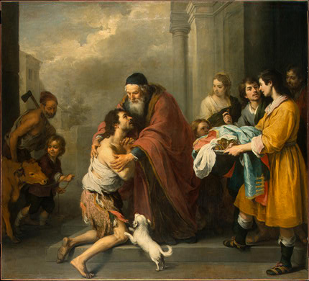
Free Will, An Illustration: The Prodigal Son

Slide 21
Christianity and the Problem of Evil
Evil is real. Indirectly, it is the product of God’s love. God loved us so much that he loved us and that he gave us a choice. We chose evil, and thus evil came into the world.

Slide 22
Cause of Human Suffering and Evil: SIN
The great majority (but not all) of suffering is the result of sin
Addiction, lack of self-control
Sexual immorality, perversion and abuse
Anger, violence
Greed
Pride, arrogance, jealousy, desire for control
Selfishness

Slide 23
God’s Moral Law is Simple: Sin Produces Suffering
Exodus 20:5-6 You shall not bow down to them (the idols you have made) or worship them; for I, the Lord your God, am a jealous God, punishing the children for the sin of the fathers to the third and fourth generation of those who hate me, but showing love to thousands who love me and keep my commands.
Ezekiel 18:19-20

Slide 24
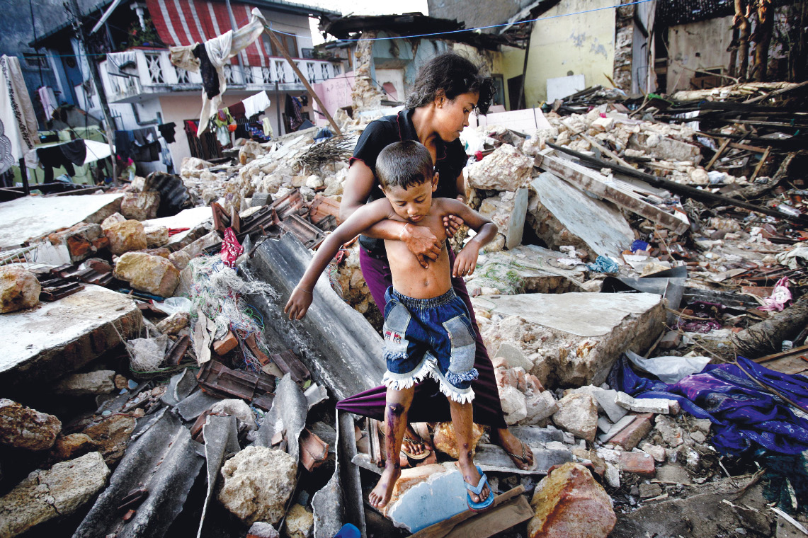
Tsunami off Sumatra in 2004: Whose sin was this a punishment for?

Slide 25
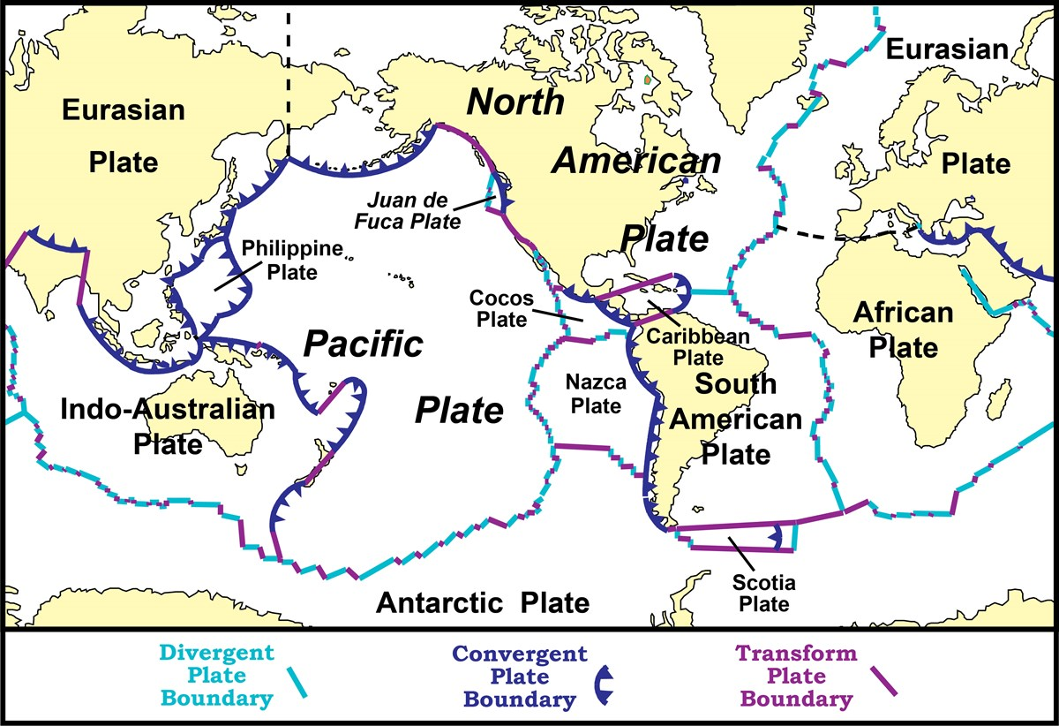
Causes of Suffering #2: Natural Causes
Plate Tectonics
Weather
Bacteria

Slide 26
Conclusion so far
We need to find a healthy way to deal with suffering and loss and grief.
The existence of evil and suffering does not mean that God does not love us or has stopped loving us.
There are no simple answers.
Mourning for loss and suffering is OK
But we need to find a way to trust God in all this.

Slide 27
Job 1:13-19 Satan tempts job
What would Satan do to tempt you to deny God?
Satan underestimated Job.
Is he underestimating you?

Slide 28
Job 1:20-22 Job’s response
v. 20 Job went into mourning. Do we know how to mourn?
v. 22 Job is faithful. “In all this, Job did not sin…”

Slide 29
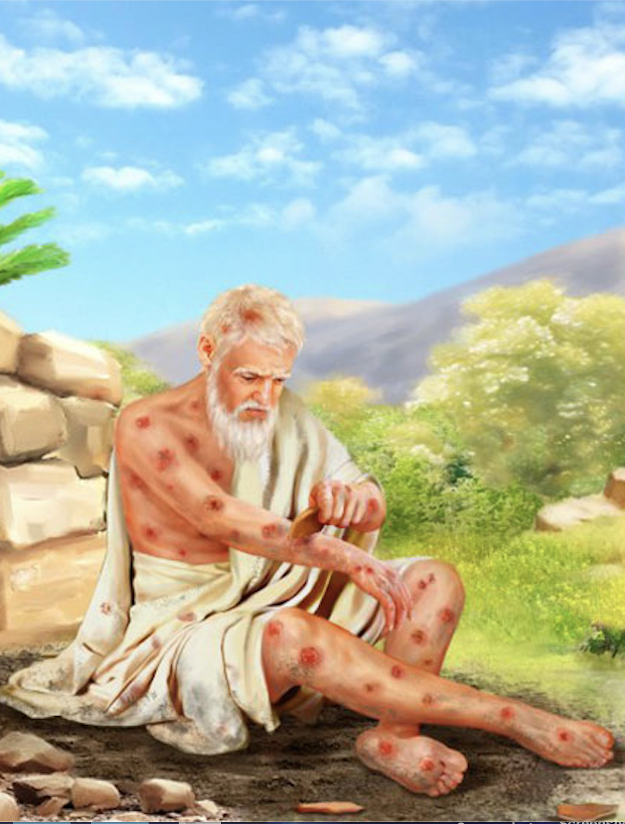
Job 2:1-8
Have you considered my servant Job
“Skin for skin” A man will give anything in exchange to save his skin.
Satan is very confident!!!

Slide 30
Job 2:9 Job’s wife
Curse God and die!
Thanks a lot, wife!

Slide 31
Our God is an Awesome God

Slide 32
Our God, is an awesome God
He reigns
From Heaven above with wisdom, power and love
Our God is an awesome God
(x4)

Slide 33
Our God is an awesome God
Our God is and awesome God
Our God is an awesome God! [End]

