Slide 1
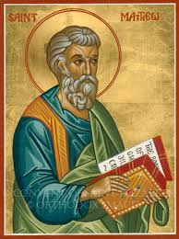
Matthew XV
Matthew 23
Weightier Matters

Slide 2
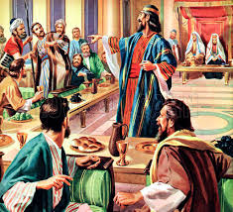
Coming Into the Kingdom Matthew 22:1-14 Parable of the Banquet
The kingdom of heaven is like a king who prepared a great banquet…

Slide 3
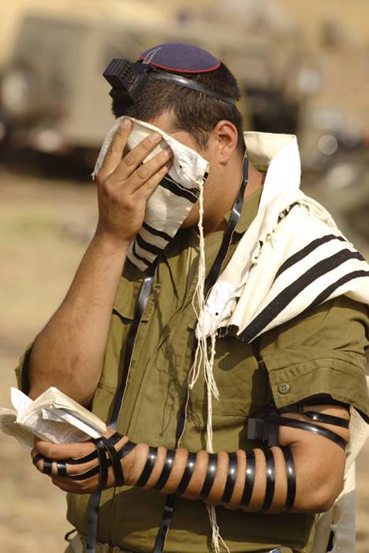
Matthew 23:1-39 Seven Woes on the Pharisees
Matthew 23:1-12
v. 4 They tie heavy burdens….
Jesus Matthew 11:28-30 My burden is light.
What are these burdens?
Religious duty not based on love.
Matt 22:35-40

Slide 4
What Matters?
Gal 5:6 The only thing that matters is faith, expressing itself through love.
Coll 2:20-23 Human-based rules “lack any value.”

Slide 5
Phylacteries

Slide 6
Matthew 23:11-12
Summary: The greatest among you will be your servant.
Matt 5:5 Blessed are the meek.
Matt 5:44 Love your enemies.
Matt 18:4 Whoever takes the lowly position of a child is the greatest.
Matt 18:12 Leave the 99 and go for the 1.
Matt 20:25-28 Who would be first must be servant of all.

Slide 7
Matthew 23:13-39 Seven Woes
v. 13 You shut the door…
v. 23 You neglect the weightier matters: justice, mercy and faithfulness
v. 24 You strain out the gnat, but swallow a camel. You major in the minors.

Slide 8
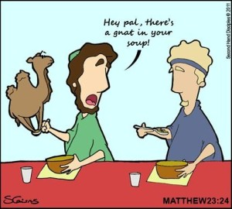
Gnats and Camels
Camels:
Justice
Mercy
Faithfulness
Gnats:
Outer things, rules

Slide 9
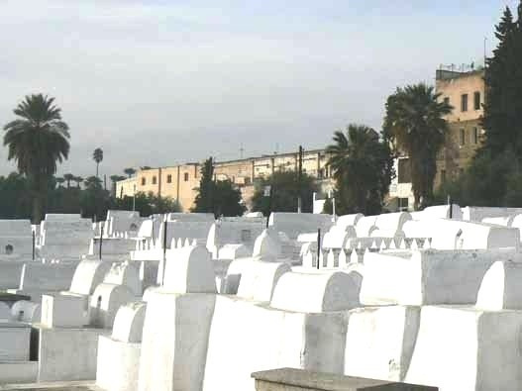
Whitewashed Tombs
What is going on on the inside?

Slide 10
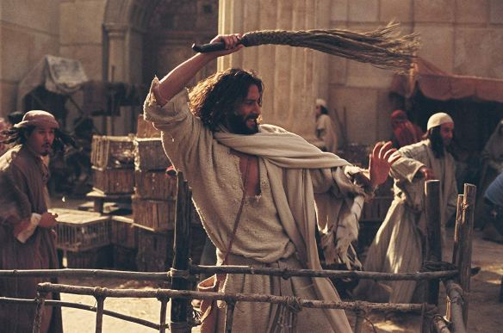
Vipers and Snakes
A Question:
What makes you angry?

Slide 11
Matthew 24:35
From the blood of Abel (Genesis 4)…
…to the blood of Zechariah Son of Berekiah 2 Chronicles 24:44
ie the whole time!

Slide 12
Matthew 23:37-39 Jesus Loves the Pharisees
How I longed to gather you in as a hen gathers in her chicks, but you were not willing.
Will you accept the invitation to the banquet? Are you clothed with Christ?
Are you willing to be gathered in?

Slide 13
Weightier Matters: Questions For Us
1. What really matters to you? Is it faithfulness (hesed) to God and mercy toward people, or is it doctrine and religious rules?
2. Are you willing? Are you willing to be gathered under the wings of Jesus? (and to accept his definition of what really matters)

