Slide 1
Welcome!

Slide 2
Thank You, Lord
(700)

Slide 3
Thank You, Lord for loving me;
And thank You Lord for blessing me.
Thank you Lord for making me whole and saving my soul.

Slide 4
Than you Lord, for loving me.
Thank you Lord, for saving my soul

Slide 5
Let us all with accord sing praises to Christ the Lord.
Lets us all unite in song and praise Him all day long.

Slide 6
Than you Lord, for loving me.
Thank you Lord, for saving my soul

Slide 7
Please reveal Your will for me so I can serve You for eternity.
Use my life in every way, take hold of it today.

Slide 8
Than you Lord, for loving me.
Thank you Lord, for saving my soul
[End]

Slide 10
Reckless Love

Slide 11
Before I spoke a word, You were singing over me
You have been so, so good to me
Before I took a breath, You breathed Your life in me
You have been so, so kind to me

Slide 12
O, the overwhelming, never-ending, reckless love of God
O, it chases me down, fights 'til I'm found, leaves the ninety-nine
I couldn't earn it, and I don't deserve it, still, You give Yourself away
O, the overwhelming, never-ending, reckless love of God

Slide 13
When I was Your foe, still Your love fought for me
You have been so, so good to me
When I felt no worth, You paid it all for me
You have been so, so kind to me

Slide 14
O, the overwhelming, never-ending, reckless love of God
O, it chases me down, fights 'til I'm found, leaves the ninety-nine
I couldn't earn it, and I don't deserve it, still, You give Yourself away
O, the overwhelming, never-ending, reckless love of God

Slide 15
There's no shadow You won't light up
Mountain You won't climb up
Coming after me
There's no wall You won't kick down
Lie You won't tear down
Coming after me
(x4)

Slide 16
O, the overwhelming, never-ending, reckless love of God
O, it chases me down, fights 'til I'm found, leaves the ninety-nine
I couldn't earn it, and I don't deserve it, still, You give Yourself away
O, the overwhelming, never-ending, reckless love of God
[End]

Slide 18
Oceans

Slide 19
You call me out upon the waters
The great unknown where feet may fail
And there I find You in the mystery
In oceans deep my faith will stand

Slide 20
I will call upon Your Name
And keep my eyes above the waves
When oceans rise
My soul will rest in Your embrace
For I am Yours and You are mine

Slide 21
Your grace abounds in deepest waters
Your sovereign hand will be my guide
Where feet may fail and fear surrounds me
You’ve never failed and You won’t start now

Slide 22
I will call upon Your Name
And keep my eyes above the waves
When oceans rise
My soul will rest in Your embrace
For I am Yours and You are mine

Slide 23
Spirit lead me where my trust is without borders
Let me walk upon the waters
Wherever You would call me
Take me deeper than my feet could ever wander
And my faith will be made stronger
In the presence of my Savior

Slide 24
I will call upon Your Name
Keep my eyes above the waves
My soul will rest in Your embrace
I am Yours and You are mine
I am Yours and You are mine
[End]

Slide 25
Welcome
Ken!

Slide 26
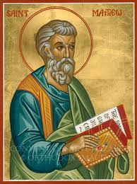
Matthew XIX Prophecies about the Death, Burial and Resurrection of Jesus

Slide 27
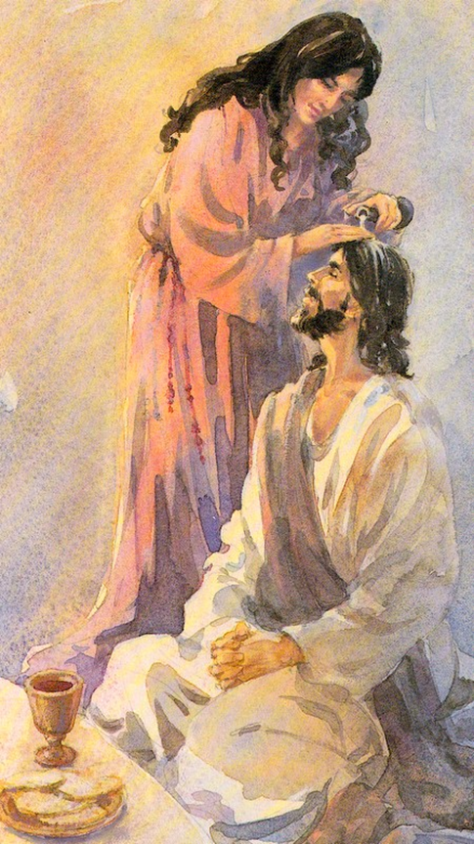
Matthew 26:6-13
Matthew 26:6-13 Why is Jesus anointed with expensive perfume?
“to prepare me for burial.”
Mary is anointing Jesus Daniel 9:24 anoint = meshioch
What extravagant thing will you do for Jesus?

Slide 29
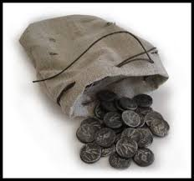
Matthew 26:14-16 Why 30 pieces of silver?
Zechariah 11:8-14
The handsome price at which they priced me.
Jesus gave his life as a ransom for slaves

Slide 30
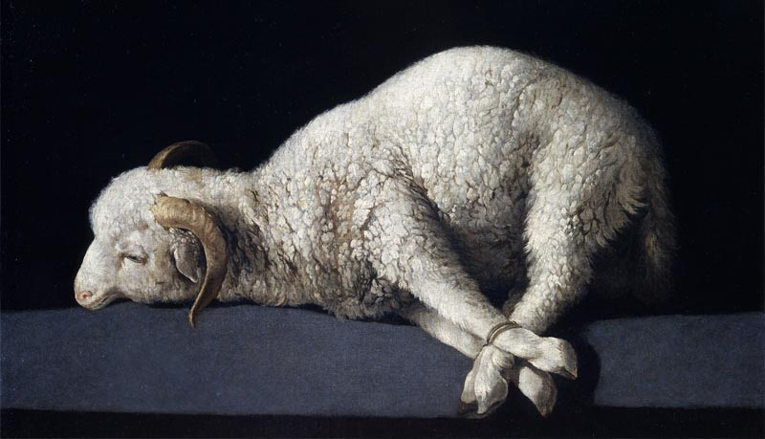
Matthew 26-28 Death, Burial and Resurrection of Jesus Prophesied
Matthew 26:1-2 Why must the Messiah be crucified on the eve of the Passover?

Slide 31
Jesus the Passover Lamb This is my blood…

Slide 32
Matthew 26:31-35, 56
Zechariah 13:7
Strike the shepherd and the sheep will be scattered.

Slide 33
Matthew 26:36-44 Jesus in the Garden
Psalm 22:1 My God, my God, why have you forsaken me.
Matthew 26:54-56 The Scripture must be fulfilled. Which one? All of them!
Jesus, not Judas or the Jewish leaders, is in control.

Slide 34
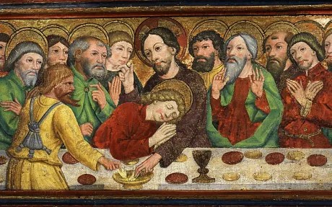
Matthew 26:47-53 Betrayal
The one who dips his hand in the bowl with me will betray me…

Slide 35
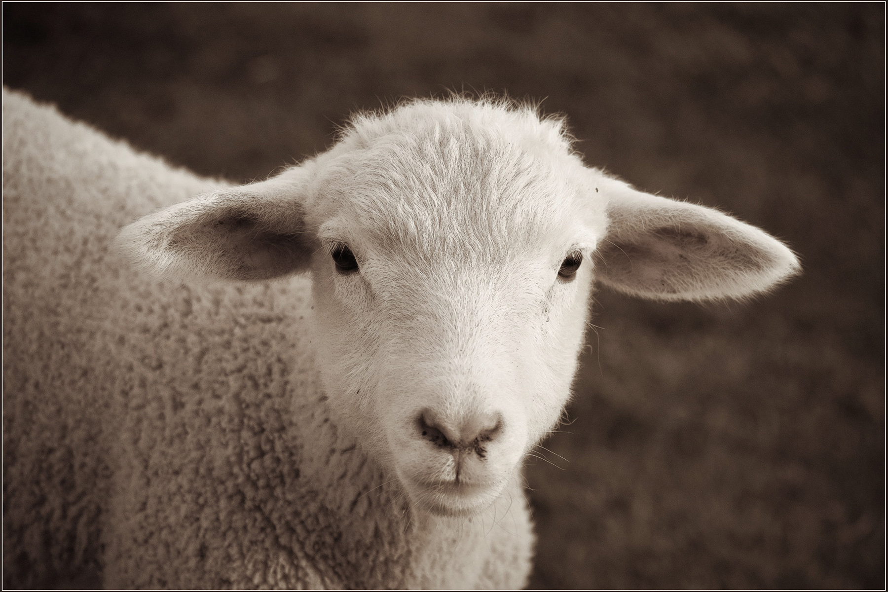
Matthew 26:59-64
Isaiah 53:6-7 Like a sheep before her shearers is silent, so he did not open his mouth.
From now on you will see the Son of Man sitting at the right hand of the Mighty One (Psalm 110:1) and coming on the clouds of heaven (Daniel 7:13).

Slide 36
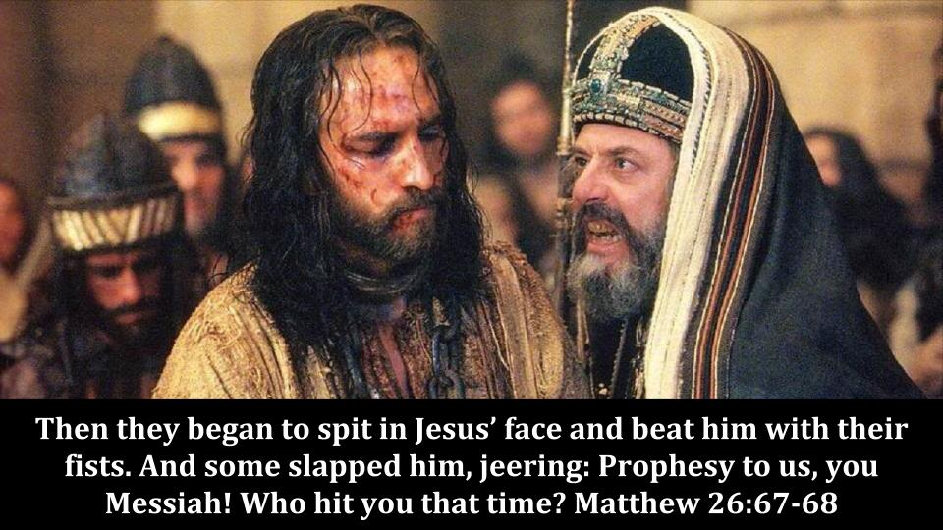
Matthew 26:65-68 Despised and Rejected
Isaiah 53:3 He was despised and we held him in low esteem.
They spit in his face and struck him with their fists

Slide 37
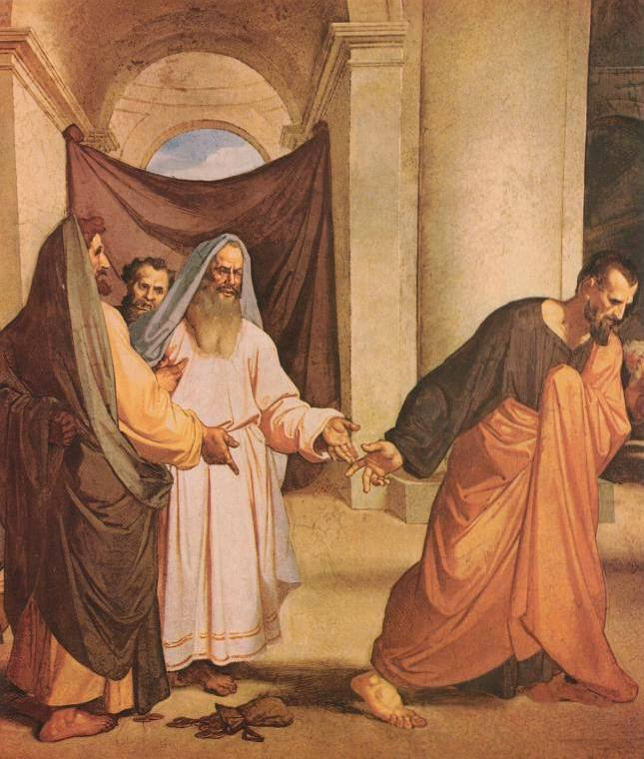
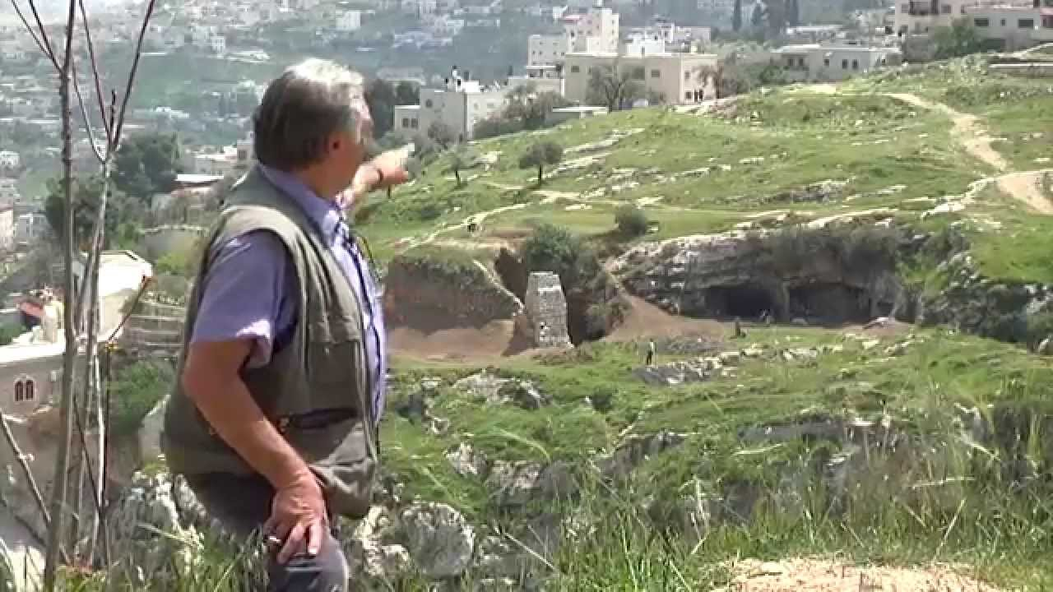
Matthew 27:1-10 The Potter’s Field
Zechariah 11:12-13
And the Lord said to me, “Throw it to the potter.”

Slide 38
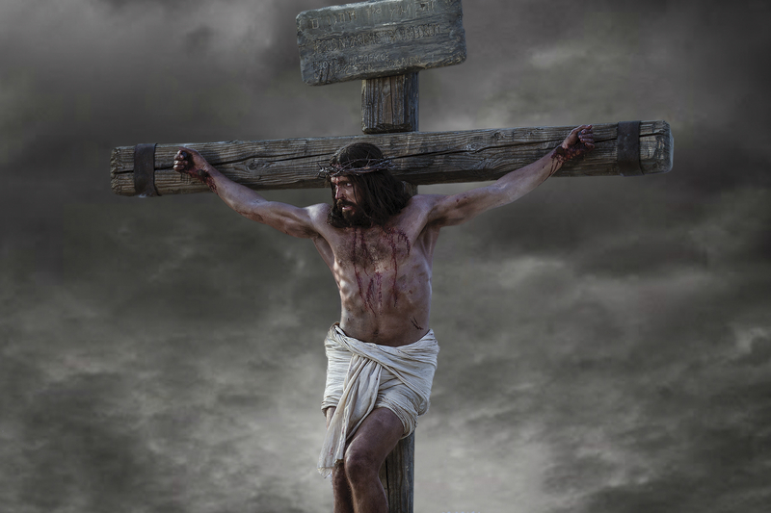
Matthew 27:32-44 Crucifixion!
Leviticus 4:11-12
Psalm 69:21
Psalm 22:16
They have pierced my hands and my feet.
Psalm 22:18 Divided my garments

Slide 39
Matthew 27:32-35
Leviticus 4:11-12 Sin offering must be carried outside the city.
Wine mixed with gall Psalm 69:21
Psalm 22:18 They divided my garments among them and cast lots for my clothing.

Slide 40
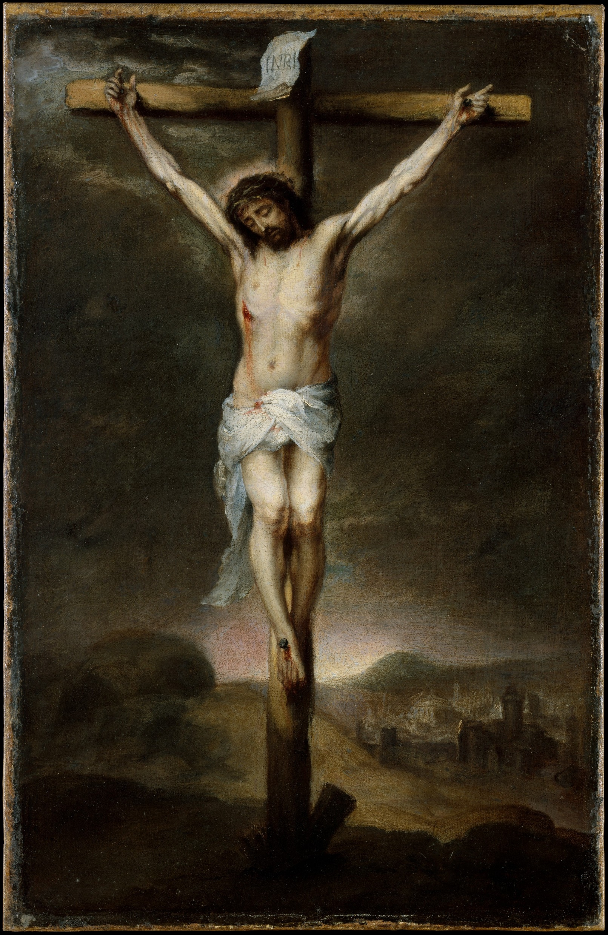
Matthew 27:45-54
Psalm 22:1 My God, my God, why have your forsaken me?
Zech 12:10 They will look on me, the one they have pierced.

Slide 41
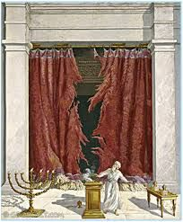
Matthew 27:51
The curtain is torn in two. Hebrews 10:19
We now have access to the Holy of Holies!

Slide 42
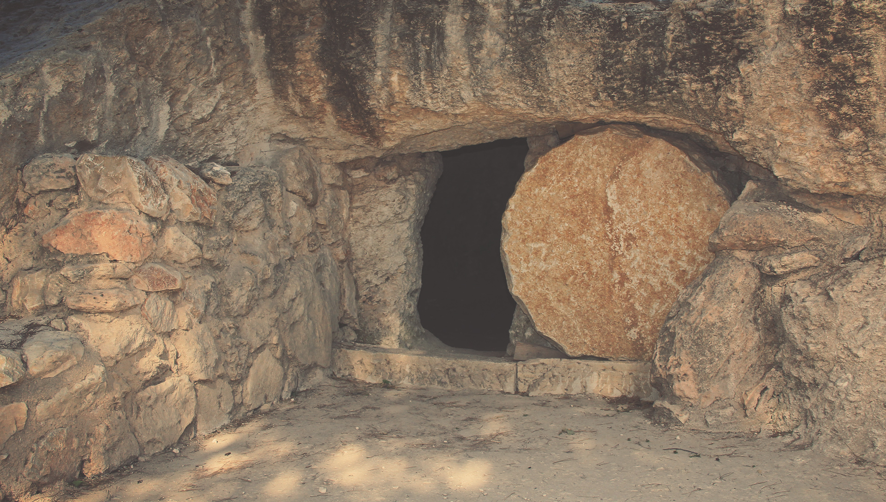
Matthew 27:57-60
Isaiah 53:9 He was assigned a grave with the wicked, and with the rich in his death.

Slide 43
Matthew 281-7 Resurrection Foretold
Matthew 17:22-23 I will rise on the 3rd day.
John 2:19 Destroy this temple and I will raise it again in three days.
Matthew 12:40 As Jonah was three days and three nights in the belly of a huge fish…
Genesis 22:1-16 On the third day…

Slide 44
Matthew 281-7 Resurrection Foretold
16th of Nisan The feast of firstfruits
Leviticus 23:10-15
Jesus is the firstfruits from the dead
1 Cor 15:20-22

Slide 45
What did Jesus do for you?
betrayal abandonment false accusation mocking spitting scourging crucifixion shame humiliation torture forsaken by his Father took the sins of the whole world on his shoulders
What will you do for Jesus

Slide 46
For Those Tears I Died
(362)

Slide 47
You said you’d come and share all my sorrows
You said you’d be there for all my tomorrows
I came so close to sending you away
But just like you promised you came here to stay
I just had to pray

Slide 48
And Jesus said:
“Come to the water, stand by my side I know you are thirsty, you won’t be denied.
I felt every tear drop
When in darkness you cried,
And I strove to remind you
That for those tears I died.”

Slide 49
Your goodness so great, I can’t understand.
And dear Lord, I know that all this was planned
I know you’re here now, and always will be.
Your love loosed my chains and in you I’m free
But Jesus why me?

Slide 50
And Jesus said:
“Come to the water, stand by my side I know you are thirsty, you won’t be denied.
I felt every tear drop
When in darkness you cried,
And I strove to remind you
That for those tears I died.”

Slide 51
Jesus, I give you my heart and my soul
I know that without God I’ll never be whole
Savior you opened all the right doors
And I thank you and praise you from Earth’s humble shores
Take me, I’m yours

Slide 52
And Jesus said:
“Come to the water, stand by my side I know you are thirsty, you won’t be denied.
I felt every tear drop
When in darkness you cried,
And I strove to remind you
That for those tears I died.”
[End]

Slide 53
Communion

Slide 54
Announcements
Bible Talk UCM Tues 12:00
Bible Talk at Oakes Tues 7:30
Bible Talk MC Wed 12:00
Midweek Wed 7:30 UCM GLCR 120
Women’s and Men’s Devotional Friday 7:00 Game Night and Prayer Night at UCMerced

Slide 55
Coming Up
Sat 2/10 9:00 Food the needy at Catholic Charities
Will the Real Jesus Please Stand Up UCM Feb 16th
“Barbie” Sister’s encouragement night Fresno Feb 17th
Love Feast Sun Feb 18th
Campus Retreat March 22-24 Sierra Christian Camp
Singles Conference in Yosemite Park May 31-June 2
ICMC Aug 1-4 North Carolina!
Notes:
2-24

Slide 58
Take The Lord With You
(733)

Slide 59
You’ve got to take the Lord with you children, everywhere you go
You’ve got to take the Lord with you children, everywhere you go
You’ve got to take the Lord with you children, everywhere you go

Slide 60
In the street
(In the street) In the home
(In the home) On the job (On the job) All alone (All alone)

Slide 61
Highway
(Highway)
By the way (By the way)
Everywhere you go

Slide 62
You’ve got to make disciples daily children, everywhere you go
You’ve got to make disciples daily children, everywhere you go
You’ve got to make disciples daily children, everywhere you go

Slide 63
In the street
(In the street) In the home
(In the home) On the job (On the job) All alone (All alone)

Slide 64
Highway
(Highway)
By the way (By the way)
Everywhere you go

Slide 65
You’ve got to love your brothers daily children everywhere you go
You’ve got to love your brothers daily children everywhere you go
You’ve got to love your brothers daily children everywhere you go

Slide 66
In the street
(In the street) In the home
(In the home) On the job (On the job) All alone (All alone)

Slide 67
Highway
(Highway)
By the way (By the way)
Everywhere you go
[End]

