Slide 1
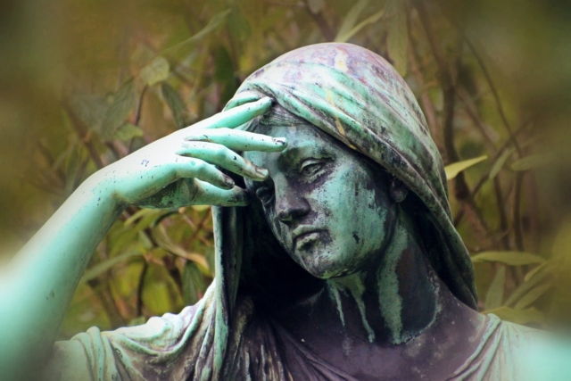
The Book of Job: Is God Good?
God and Suffering II

Slide 2
Job and Theodicy: Is God Good?
Why is there evil in the world?
Why is there suffering in the world?
Why do we Christians suffer?
What should we do when we suffer and when others suffer?

Slide 3
Job 1:12 Why? Why did God “sic” Satan on Job?
To show Satan?
To test Job?
So that Job can prove to God and to himself how faithful he is?
For our sake? James 5:11

Slide 4
Job 1:13-20
Job is having a really bad day!
Would you be doubting God’s goodness at this point?

Slide 5
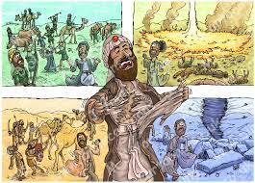
Job 1:20-22 Job’s response
Job 1:20 Job went into mourning. Do we know how to mourn?
Job worshipped God
Job 1:22 Job is faithful. “In all this, Job did not sin”

Slide 6
Mourning

Slide 9
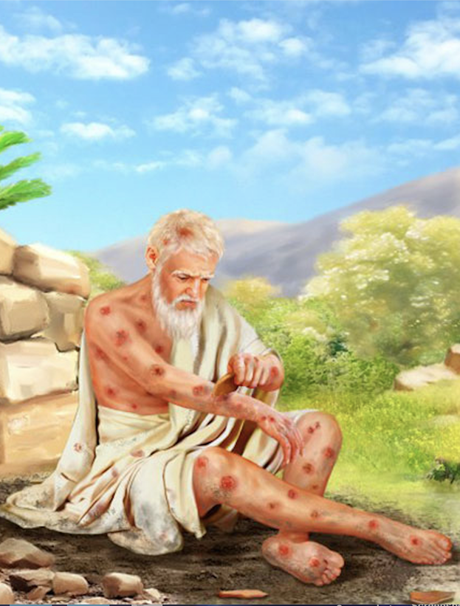
Job 2:1-10
Skin for skin = property for person
2:9 Thanks a lot, wife!!! Proverbs 18:24
2:10 Shall we accept good from God and not trouble?

Slide 10
A question for us
Can you love a God you cannot control?
Psalm 77:19

Slide 11
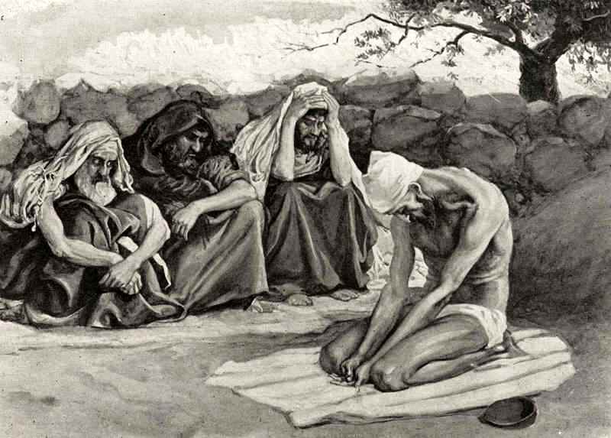
Eliphaz, Bildad and zophar
They sympathized and comforted him.
No one said a word to him.
It will be OK
You will get through this
God will use this for your benefit
He/She is with God now
They wept aloud with him.

Slide 12
Why Do We Suffer?
a. Sin of others (Exodus 34:6-7)
b. Our own sin (Exodus 34:6-7)
c. Natural Causes
d. No suffering, no joy Psalm 30:5
e. Helps us to grow and be more reliant on God (James 1:2-4)
f. Our godly response gives glory of God (John 9:3)
g. Come to know Christ (Colossians 1:24)

Slide 13
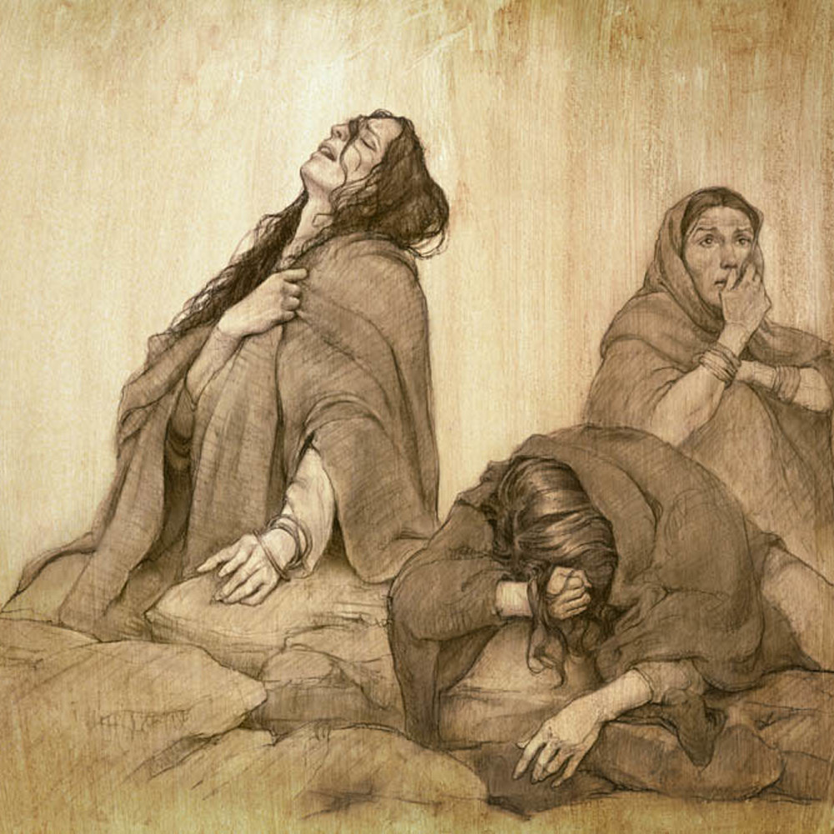
Job 3:1-26 Job is mourning! Lament
Job is discouraged, angry at God, depressed, lamenting…
But, Is Job sinning?
2/3 of Psalms are laments.
What about Lamentations? (Lamentations 3:22-23)

Slide 14
summary
Experiencing grief, loss or suffering does not mean God does not love us
It is not our job to “fix” those who are feeling loss
Suffering is one of God’s greatest gifts
Can you love a God you cannot control?

