Slide 1
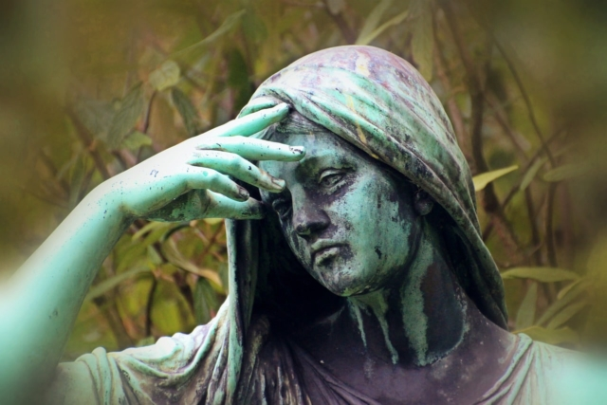
The Book of Job: Is God Good?
God and Suffering III

Slide 2
Job and Theodicy: Is God Good?
Why is there evil in the world?
Why is there suffering in the world?
Why do we Christians suffer?
What should we do when we suffer and when others suffer?

Slide 3
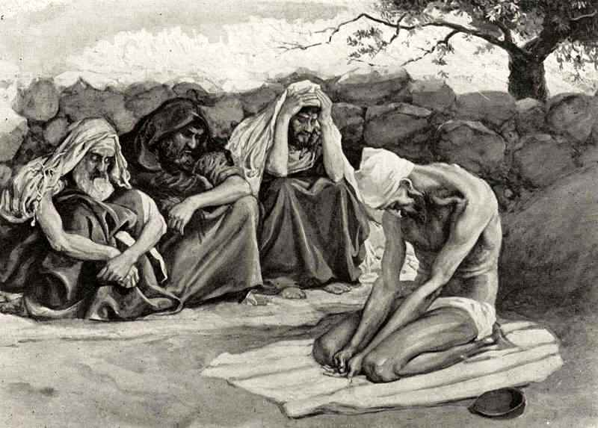
Job 2:11-13 Eliphaz, Bildad and Zophar A Model
They sympathized and comforted him.
No one said a word to him.
They wept aloud with him.

Slide 4
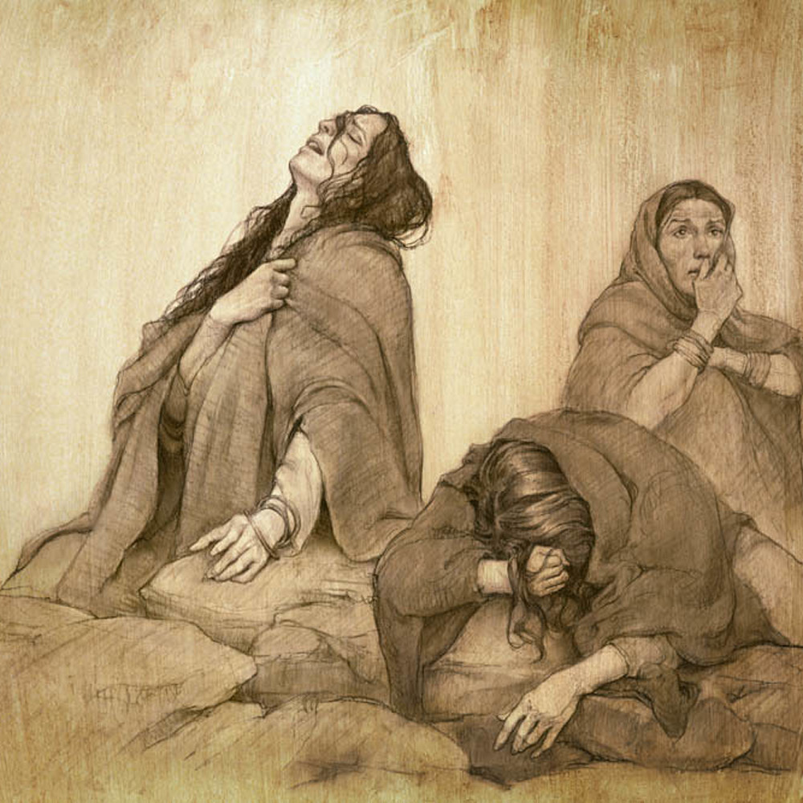
Job 3:1-26 Job is mourning! Lament
Job is discouraged, angry at God, depressed, lamenting…
But, Is Job sinning?
2/3 of Psalms are laments.

Slide 5
Job 4 & 5 Eliphaz speaks
Job 4:1-9 The innocent will not be destroyed.
You are reaping what you have sowed.
Our suffering is due to our own sin.
But Eliphaz is wrong!
Job 5:8 Appeal to God based on your righteousness.

Slide 6
Job 6 & 7 Job replies
Job 6:1-3 If you were in my sandals. How about a little support!
Job 6:14-21 You are lousy friends!
Job 6:22-30 I am a righteous man and deserve none of this suffering.
Job 7:17-21 I am innocent. God is unfair.

Slide 7
Job 8 Bildad agrees with eliphaz
Job 8:1-7
How dare you challenge God.
Your children got what they deserved.
If you stop sinning, God will restore you. Ouch!

Slide 8
Job 9 & 10 Job replies to bildad
Job 9:20-22 I am blameless. God destroys the blameless.
Job 10:1-8 You treat the wicked better than me.
I am not guilty!

Slide 9
Job 11 Zophar’s turn
Job 11:13-19 If you are sufficiently devoted, if you stop sinning and repent, everything will be awesome. God will give you only blessings.
Job 13:13-19 Job’s response: Repent of what? I will be vindicated.

Slide 10
Job 29 job’s defense
Job 29:7-20 I am actually quite awesome.
I, I, I, I, I, I did this and I did that.
Job has a little to learn about humility and compassion.
Job 31:1-6 I am blameless (again).

Slide 11
Job 30 Job reaches rock bottom
Job 30:16-23
v. 19 God threw me in the mud.
v. 21 God turned on me ruthlessly.
v. 23 God, you are killing me.

Slide 12
Job 32 & 33 Elihu weighs in
Job 32:1-5, Job 33:8-27
Job should not justify himself before God.
E, B & Z You are too judgmental. Don’t condemn Job
God’s ways are a mystery. He will let you know why you are suffering.

Slide 13
Job 38-40 God finally speaks
30+ chapters of lament, 3 chapters of questions, 1 chapter of answers.
Job 38:1-18 Brace yourself like a man. Who do you think you are?
77 Questions
Job 40:1-2 Will you correct me? Will you accuse me?

Slide 14
Job 42 Job repents
Job 42:3-6 God, your ways are a mystery.
v. 5 Now my eyes have see you.
Job will never be the same again. Job has come out stronger at the end, even, than at the beginning.

Slide 15
Job 42:10-17 Epilogue
After all this, “The Lord blessed the later part of Job’s life more than the former part.”

Slide 16
summary
Suffering, grief and loss are an opportunity to connect with God.
Job became a better person through suffering. So can you.
We will mourn and lament when we suffer loss. It is OK and good.
Suffering and loss do NOT demonstrate God does not love us. On the contrary, they are how God refines us—part of how we come to know Him.
.

