Slide 1
Welcome,
Malcom Inskeep

Slide 2
One Thing Mark 10:17-31

Slide 3
One Thing
The Rich Young Ruler walked away from Jesus because of One thing
To avoid his fate, Jesus calls us to have One God
One Why
Remember with God there is one outcome

Slide 4
Mark 10:17-22
“And as he was setting out on his journey, a man ran up and knelt before him and asked him, “Good Teacher, what must I do to inherit eternal life?” And Jesus said to him, “Why do you call me good? No one is good except God alone. You know the commandments: ‘Do not murder, Do not commit adultery, Do not steal, Do not bear false witness, Do not defraud, Honor your father and mother.’” And he said to him, “Teacher, all these I have kept from my youth.” And Jesus, looking at him, loved him, and said to him, “You lack one thing: go, sell all that you have and give to the poor, and you will have treasure in heaven; and come, follow me.” Disheartened by the saying, he went away sorrowful, for he had great possessions.”
‭‭

Slide 5
Mark 10:17
In the time of Jesus; wealth was considered a blessing based on righteousness
This makes the question he asked Jesus shocking!
“What must I do to inherit eternal life?
From the outside he looks like he’s on the way there

Slide 6
Ten Commandments (Ex 20)
Have no other Gods before me
Do not worship graven images
Do not take the Lord's name in vain
Remember the Sabbath and keep it holy
Honor your father and mother
Do not murder
Do not commit adultery
Do not bear false witness
Do not covet

Slide 7
One God
The Rich Young Ruler is the only person Jesus is said to have loved in Mark
That love looked like telling a hard truth
What would Jesus say to you?

Slide 8
One God
Allow people in your life to speak truth to you (Proverbs 12:15)
Let Word of God speak to you (2nd Timothy 3:16)
Fast and allow the Spirit to speak to you (John 14:26)

Slide 9
Mark 10:23-27
“And Jesus looked around and said to his disciples, “How difficult it will be for those who have wealth to enter the kingdom of God!” And the disciples were amazed at his words. But Jesus said to them again, “Children, how difficult it is to enter the kingdom of God! It is easier for a camel to go through the eye of a needle than for a rich person to enter the kingdom of God.” And they were exceedingly astonished, and said to him, “Then who can be saved?” Jesus looked at them and said, “With man it is impossible, but not with God. For all things are possible with God.””
‭‭

Slide 10
One Why
Jesus wants us to ask “ who then can be saved?
“With man it is impossible, but not with God. For all things are possible with God.”
Without God at the center sacrifice is temporary

Slide 11
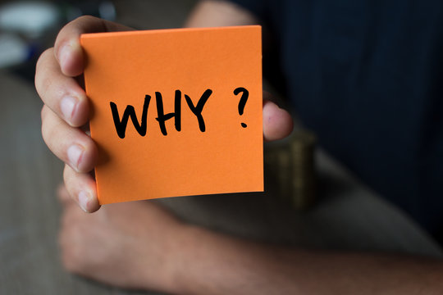
One Why
Sacrifice needs a why
2nd Corinthians 8:9
We were the why of Jesus
Is Jesus your why?

Slide 12
One Why
It's not hard to decide what you want your life to be about. What's hard, she said, is figuring out what you're willing to give up in order to do the things you really care about.” Shauna Niequist

Slide 13
Mark 10:29-31
“Peter began to say to him, “See, we have left everything and followed you.” Jesus said, “Truly, I say to you, there is no one who has left house or brothers or sisters or mother or father or children or lands, for my sake and for the gospel, who will not receive a hundredfold now in this time, houses and brothers and sisters and mothers and children and lands, with persecutions, and in the age to come eternal life. But many who are first will be last, and the last first.””
‭

Slide 14
With God One Outcome
Remember the outcome of sacrifice
Jesus promises sacrifice bears fruit (Mark 4:20)
Jesus calls us to sacrifice with purpose (John 12:24)
Every choice we make has an impact

Slide 15
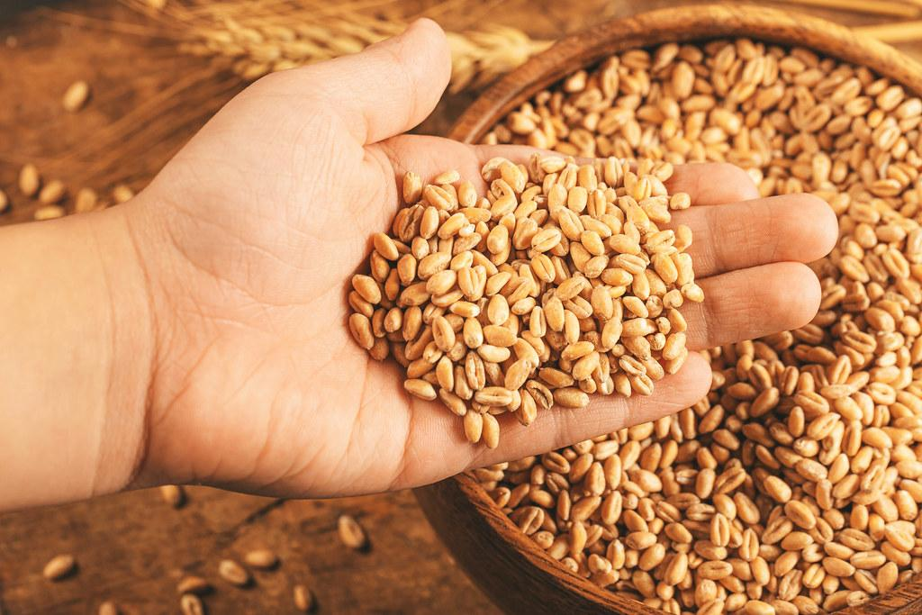
With God One Outcome

Slide 16
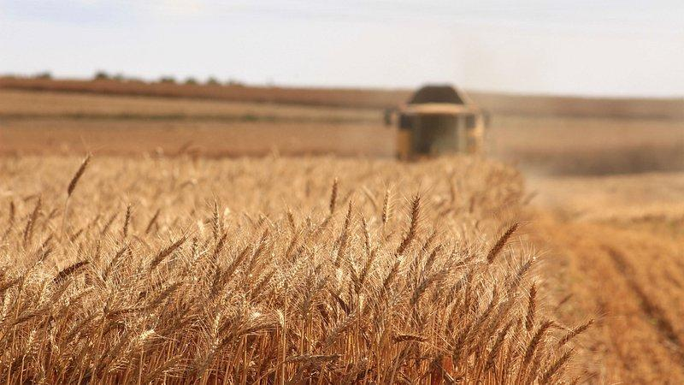
With God One Outcome

Slide 17
With God One Outcome
He doesn’t call us to blindly sacrifice but instead Jesus modeled sacrifice and laid down his life for us
Seeking to be first and hold onto everything means we will be last and lose everything
Remember no matter what God might be calling us to sacrifice today what lies beyond is much richer than we can ever imagine.

