Slide 1
Psalm 42
Psalms of Lament

Slide 2
Psalms

Slide 3
Psalms
150 Psalms
73 of David
12 of Asaph
11 of “Sons of Korah”
2 of Solomon
1 of Ethan 1 of Heman
50 unattributed

Slide 4
Kinds of Psalms
1. Psalms of lament Psalm 13, 42, 73
2. Imprecatory Psalms Calls for God to judge his enemies. Psalm 35, 69, 109
3. Psalms of Praise Psalm 19, 100, 147-148
4. Psalms of Confession Psalm 32, 51
5. Historical Psalms Psalm 78, 105-106
6. Wisdom Psalms Psalm 1, 37, 112, 119, 127-128
7. Royal Psalms/Messianic Psalms Psalm 22, 110, 118

Slide 5
Psalms of Lament
Psalmist feels fear, loss, sorrow
Pattern:
A complaint
A petition
A statement of faith in God
A vow to praise and thank God

Slide 6
Psalm 42:1-2 A Psalm of lament

Slide 7
Psalm 42:3-11 Lament
- My tears have been my food.
-Waves have swept over me.
-God has forgotten me.
Faith ↓
Doubts ↑

Slide 8
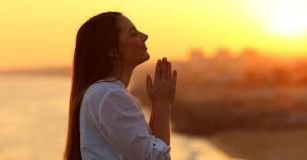
Then… v. 5,8,11
He put his hope in God.
He went and met with God.
He remembered

Slide 9
Psalm 46:10
Be still and know that I am God

Slide 10
Psalm 84:10-12 Better is one day in your coursts than a thousand elsewhere

Slide 11
Let us say with the Psalmist:
My soul pants for you, O my God!
My soul thirsts for God, for the living God!
When can I go and meet with God?

