Slide 1
Welcome!

Slide 2
Announcements
Bible Talk UCM Tues 12:00
Bible Talk at Oakes Tues 7:30
Bible Talk MC Wed 12:00
Bible Talk Th 7:00 at Guy’s
Midweek next Wed. Christian Apologetics.
Fri 7:00 Game night and Late Night Prayer

Slide 3
Coming Up
Food Bags at Catholic Charities Sat 4/6 9:00
Hike Sat 4/13 8:30
Women’s Day Fresno Sat April 20th 2:00 Fresno
Earth Day/Cleanup Sat April 20th 10:00
Singles Conference in Oakdale May 31-June 2 Elevate
ICMC Aug 1-4 North Carolina!
Notes:
2-24

Slide 8
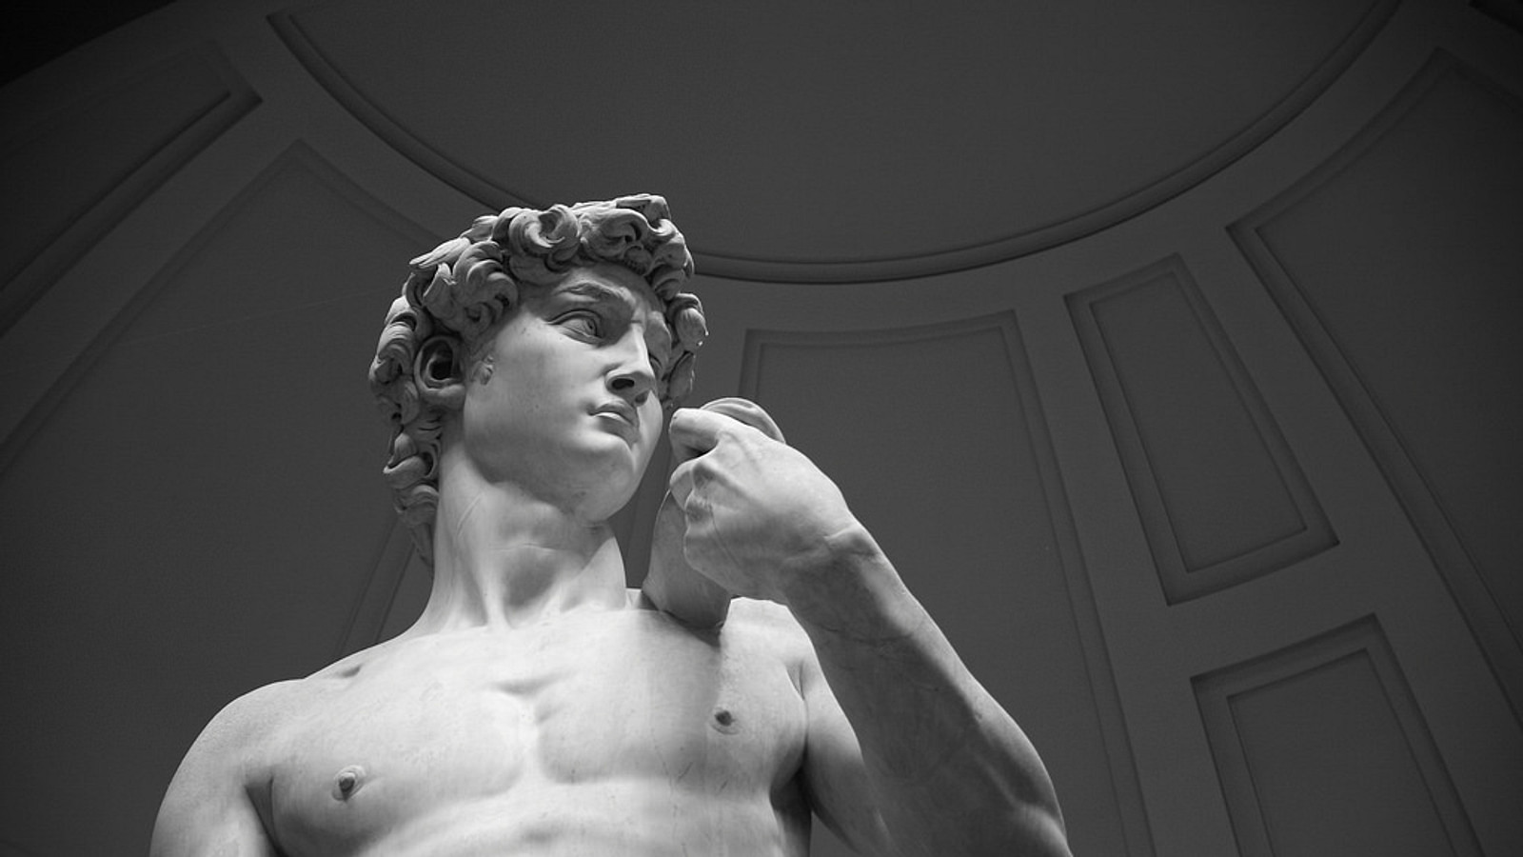
Lessons from David
A Man after God’s own heart

Slide 9
David, King of Israel
Son of Jesse, born in Jerusalem
From the tribe of Judah
Paradigmatic king of Israel
Prefigure of Christ
Ruddy, handsome

Slide 10
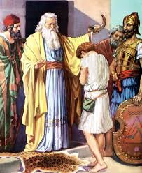
1 Sam 16:1-13
Samuel anoints David
David’s career? Shepherd!
1 Samuel 17:34-37 David was a very good shepherd!!!

Slide 11
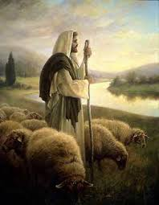
Psalm 23 The Lord is my Shepherd
David, the very good shepherd, saw himself as a sheep, with God as his shepherd.
Humble reliance

Slide 12
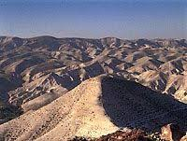
He makes me lie down in green pastures
Judean Hills

Slide 13
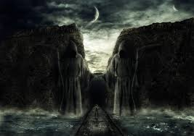
David trusts God, not himself, for protection.
Even though I walk through the darkest valley I will fear no evil.

Slide 14
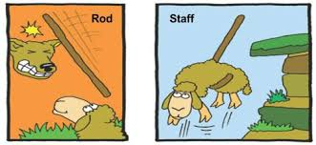
Your rod and your staff—both comfort me.
The rod: to gently keep you on the correct, narrow path.
The staff: To protect against and possibly to kill your enemies.

Slide 15
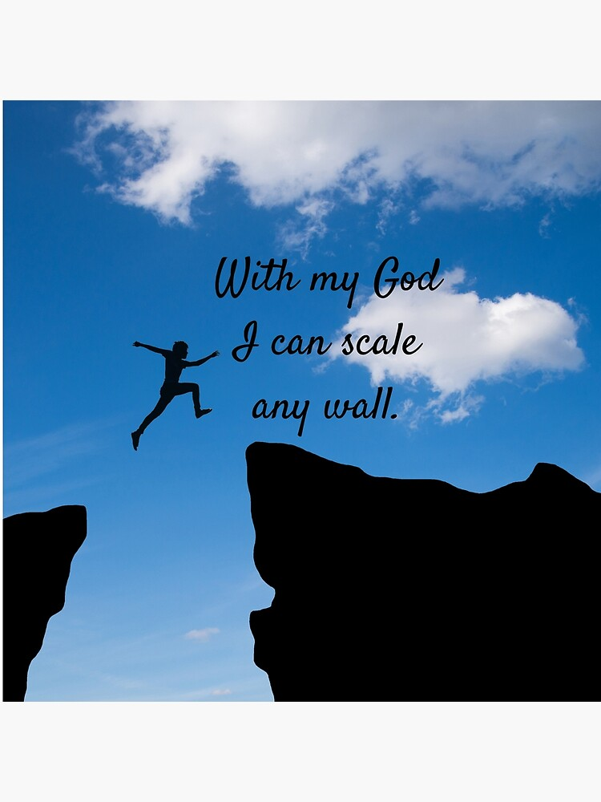
David: A God-reliant man
Psalm 23:5 You prepare a table for me in the presence of my enemies.
Psalm 18:25-29 With my God I can scale a wall. With your help, I can advance against a troop.

Slide 16
Why did God choose David?
1 Sam 13:7-14 A man after God’s own heart.
Trust
Zeal
Simple-hearted
In touch with his emotions and relatable
Able to forgive great offenses
Quick to repent

Slide 17
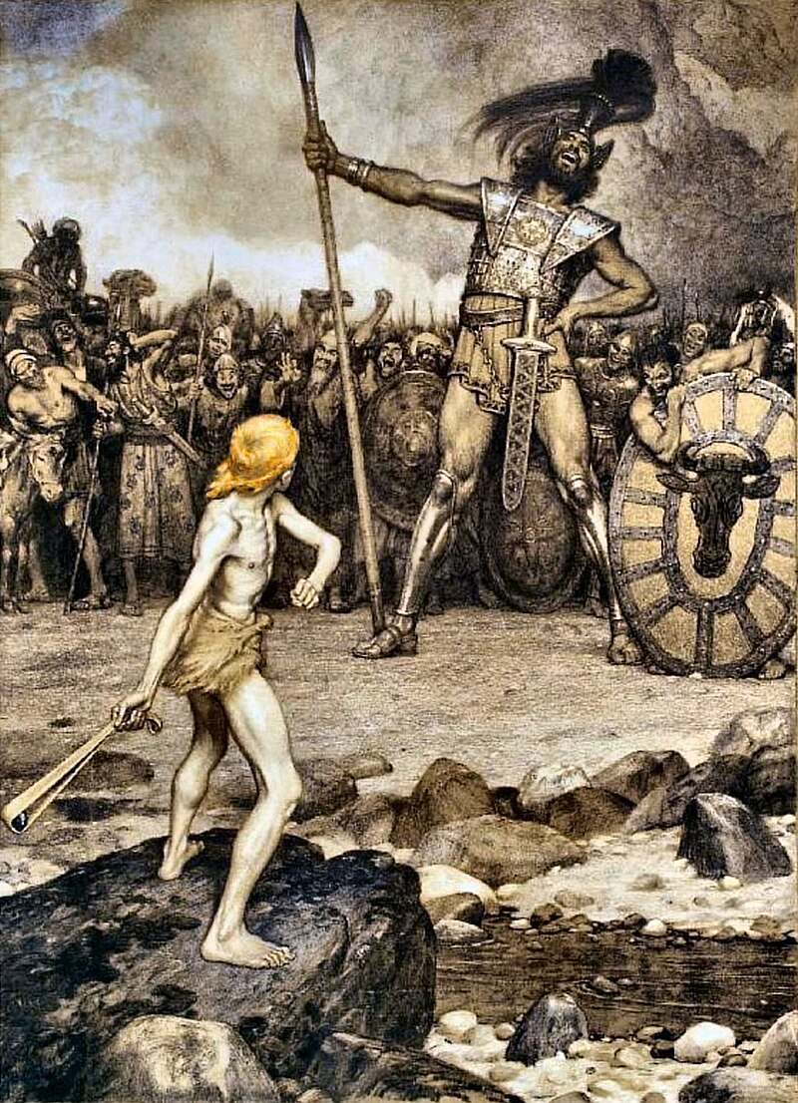
1 Sam 17 Goliath
Who is this uncircumcised Philistine?
The Lord will rescue me from the hand of this Philistine.

Slide 18
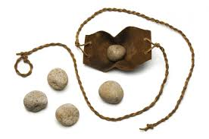
1 Sam 17:40 David chose five smooth stones

Slide 19
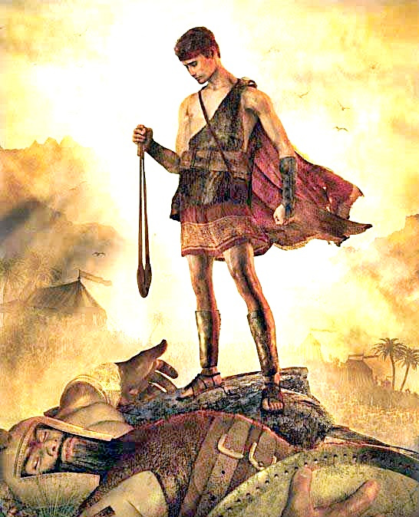
1 Samuel 17:45-47
‘All those gathered here will know that it is not by sword or spear that the Lord saves; for the battle is the Lord’s, and he will give all of you into our hands.”

Slide 20
Summary: David, a man after God’s own heart
Radical, humble reliance on God
Deep, emotional relationship with God.
Great courage in the face of adversity
Zeal for God

Slide 21
Discussion Questions
1. What trait or traits of David would you like to imitate?
2. How will you need to change to be like David in this way?

