Slide 1
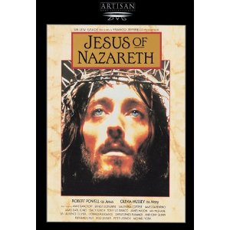
Who Is the Real Jesus?
Dr. John Oakes,
UC Merced
Spring, 2024

Slide 2
Who Was Jesus?
Sage
Prophet
Liar
Crazy person
Messiah
Son of Man
God in the flesh
Legend/Myth
Man (ie. mere man)
An important religious leader among many

Slide 3
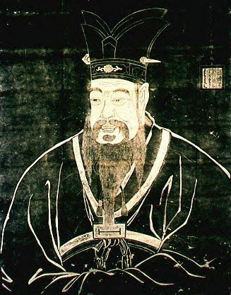
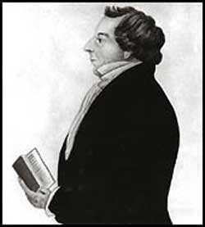
I. Is Jesus just one of many similar religious leaders?
Confucius
Joseph Smith

Slide 4
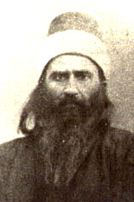
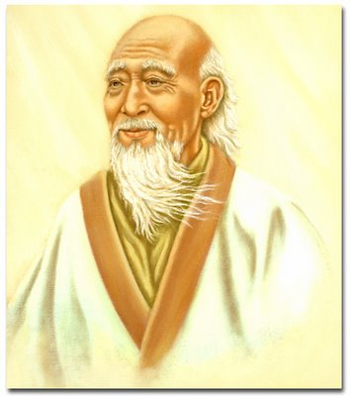
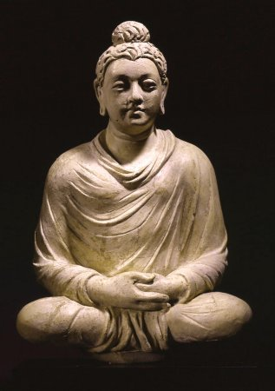
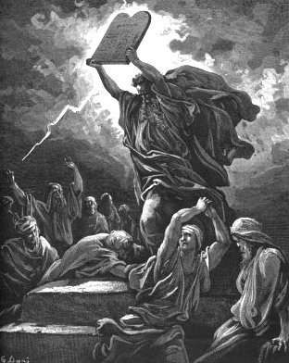
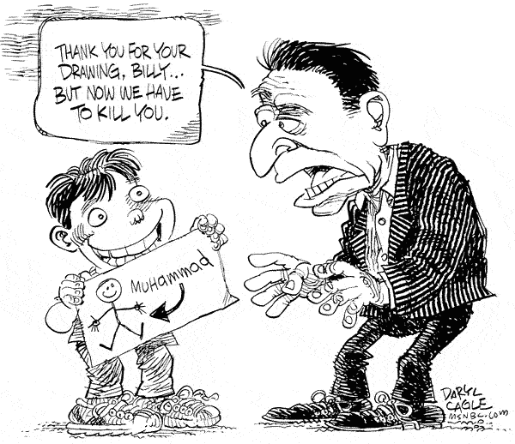
Lao Tzu
Baha’u’llah
Buddha
Moses
Is Jesus a Guru?
A Great Prophet?
One of Many Important Spiritual Leaders?
Muhammad?

Slide 5
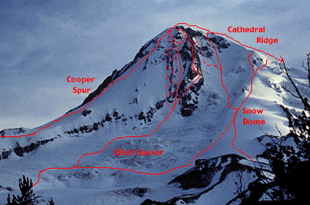
Another Point of View: Different Paths to the Same Goal?
God
Islam
Ba’hai
Mysticism
Buddhism

Slide 6
Our Outline
I. The Claims of Jesus
II. Messianic Prophecies
III. The Resurrection

Slide 7
II. The Claims of Jesus
If we can assume the gospels faithfully record the claims of Jesus then he is either:
  Crazy
  A manipulative liar Or
  The Messiah and Son of God.

Slide 8
Jesus:
“ These are the scriptures that testify about me” John 5:39
Imagine the audacity!

Slide 9
Who Does This Man Think He Is?
The Claims of Jesus
John 6:35, 51 I am the bread of life
Response: They argued among themselves
John 8:46 Can anyone prove me guilty of sin?
Response: Is this guy crazy?
John 8:58 Before Abraham was born, I AM
Response: Picked up stones to stone him.
John 10:30 I and the Father are one.
Response: Picked up stones to stone him.

Slide 10
The Claims of Jesus
John 11:25-26 I am the resurrection and the life
Response (v.45-47, 53) Killed him.
Matthew 28:18 All authority in heaven and earth has been given to me.

Slide 11
Was Jesus Insane?
Mark 3:20-30
His family: “He is out of his mind.” (v. 21)
Rabbis: “He is possessed by a demon.” (v. 22)
Jesus: This is totally illogical
Question: How do crazy people act? Did Jesus act this way?

Slide 12

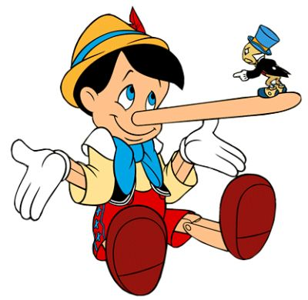
Was Jesus a Liar?
What do liars do?

Slide 13
VIII. Messianic Prophecies
Luke 24:44
He said to them, “This is what I told you while I was still with you: Everything must be fulfilled that is written about me in the Law of Moses, the Prophets and the Psalms.
John 5:39-40
You diligently study the Scriptures because you think that by them you possess eternal life. These are the Scriptures that testify about me, yet you refuse to come to me to have life.

Slide 14
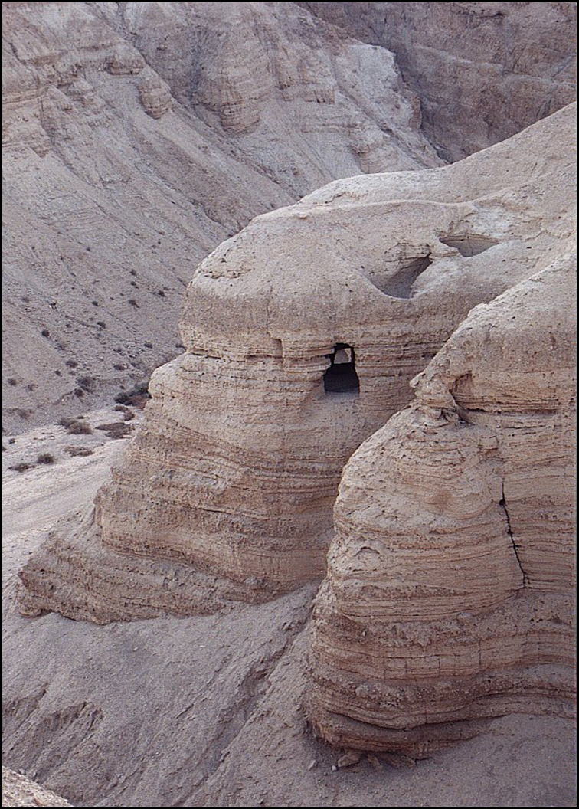
Question #1: Were these prophecies really written hundreds of years before the events?
Septuagint translation of the Old Testament into Greek 220-150 BC
Dead Sea Scrolls.250-50 BC

Slide 15
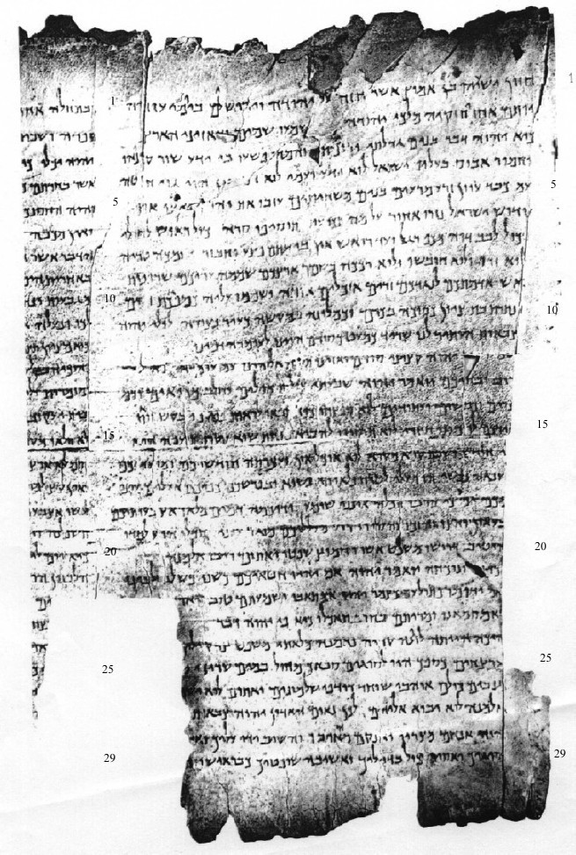
Column I
The Great Qumran Isaiah Scroll
150 BC

Slide 16
Question #2: How do I know these things really happened?
Josephus: “When Pilate, at the suggestion of the principal men among us, had condemned him to the cross, those that loved him at the first did not forsake him… And the tribe of Christians so named from him are not extinct to this day.”
Cornelius Tacitus: “Hence, to suppress the rumor, [Nero] falsely charged with the guilt and punished with the most exquisite tortures, the persons commonly called Christians, who were hated for their enormities. Christus, the founder of the name, was put to death by Pontius Pilate, procurator of Judea in the reign of Tiberius…
Jewish Talmud “On the eve of the Passover they hanged Yeshu and the herald went before him for forty days saying Yeshu… has practiced sorcery and beguiled and led astray Israel.

Slide 17
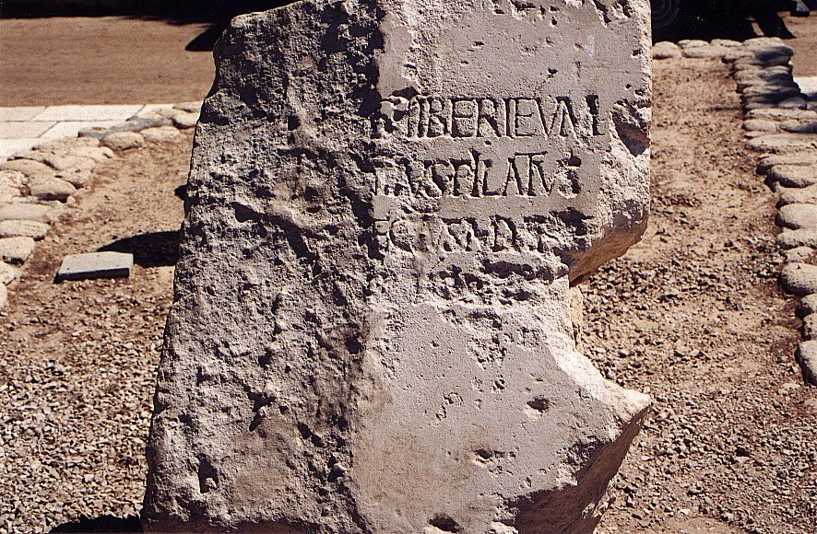
Tiberius Pontius Pilatus Procurator Judea

Slide 18
Question #3 Are these, in fact, prophecies of the Messiah? (or are we taking them out of context)
Hint: If the Jews themselves acknowledged them to be messianic, that is very strong evidence.

Slide 19
Question #4 Could Jesus, planning on deceiving the people into believing he was the Messiah, have read the Old Testament and tried to fulfill all the prophecies?

Slide 20
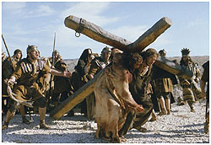

Slide 21
Isaiah 53:1-13:
He was despised and rejected by men, a man of sorrows, familiar with suffering. (v. 3)
But he was pierced for our transgressions, he was crushed for our iniquities; the punishment that brought us peace was upon him, and by his wounds we are healed. (v. 5) (John 19:31-37)
He was oppressed and afflicted, yet he did not open his mouth; he was led like a lamb to the slaughter and as a sheep before her shearers is silent, so he did not open his mouth. (v. 7)

Slide 22
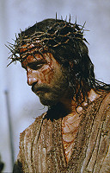

Slide 23
Micah 5:2
But you, Bethlehem Ephrathrah, though you are small among the clans of Judah, out of you will come for me one who will be ruler over Israel, whose origins are from old, from ancient times.
Isaiah 9:1,6
In the past he humbled the land of Zebulun and the land of Naphtali, but in the future he will honor Galilee of the Gentiles, by the way of the sea, along the Jordan…. For to us a child is born… And he will be called Wonderful Counselor, Mighty God, Everlasting Father, Prince of Peace.

Slide 24
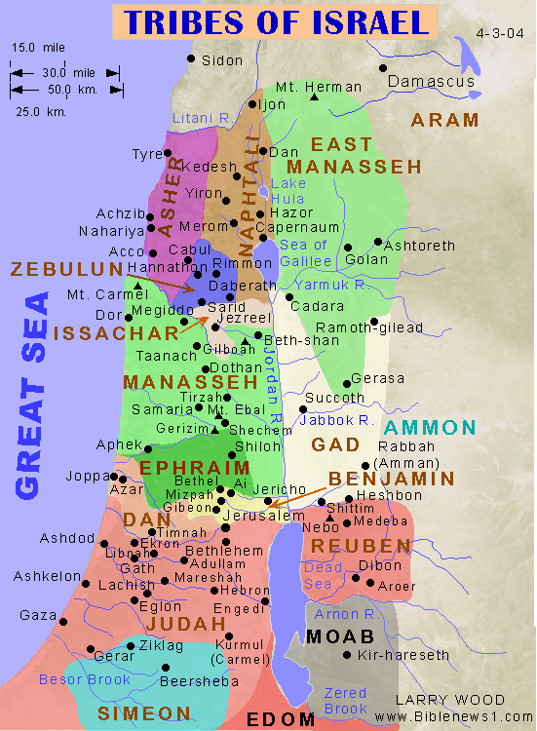

Slide 25
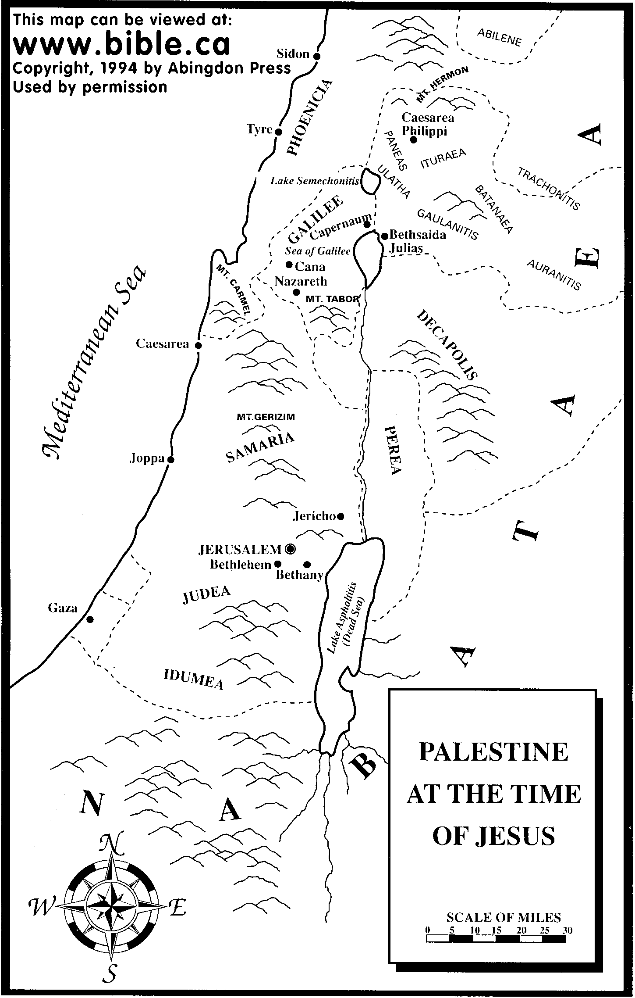

Slide 26
Psalm 22:16-18
Dogs have surrounded me;
a band of evil men have encircled me,
they have pierced my hands and my feet.
I can count all my bones; (John 19:3-37)
people stare and gloat over me.
They divide my garments among them
and cast lots for my clothing. (John 19:23,24)

Slide 27
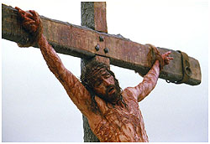

Slide 28
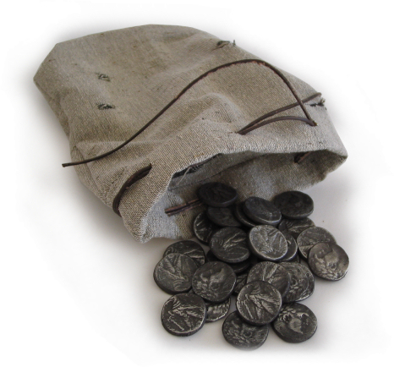
Zechariah 11:12,13
I told them, “If you think it best, give me my pay; but if not, keep it.” so they paid me thirty pieces of silver. (Matthew 26:14-16)
And the Lord said to me, “Throw it to the potter”—the handsome price at which they priced me! So I took the thirty pieces of silver and threw them into the house of the Lord, to the potter. (Matthew 27:3-8)

Slide 29
Daniel 9:24-26
Seventy ‘sevens’ are decreed for your people and your holy city to finish transgression, to put an end to sin, to atone for wickedness, to bring in everlasting righteousness, to seal up vision and prophecy and to anoint the most holy.
Know and understand this: From the issuing of the decree to restore and rebuild Jerusalem, until the Anointed One, the ruler comes, there will be seven ‘sevens’ and sixty two ‘sevens’
Decree of Artaxerxes (Ezra 7:12-26) 458 BC
458 BC - 490 years = -32 (no zero BC)

Slide 30
According to the Old Testament, the Messiah must:
Be born in Bethlehem
Be raised in Galilee near Nazareth
Be despised and rejected by men
Be meek and silent before his accusers
Be “pierced”
Be crucified
Have his garments divided and gambled over
Be betrayed for 30 pieces of silver
Come to Jerusalem to make atonement for sin in about AD 33
And many more….
Was all this an accident, or did God plan all along for the death of Christ for forgiveness of sins? What do you think?
Man, Myth or Messiah?

Slide 31
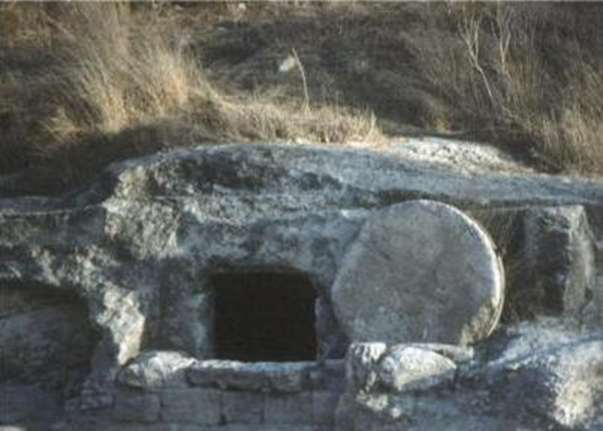
The Resurrection of Jesus from the dead
John 3:19 “Destroy this temple, and I will raise it again in three days.”
Fact: The tomb was empty.
Fact: The resurrection was preached, beginning in Jerusalem.
Fact: There were more than 500 eye-witnesses to the resurrection. 1 Cor 15:3-6.

Slide 32
Fact #1
Jesus of Nazareth was crucified under Pontius Pilate in Jerusalem

Slide 33
Josephus AD 38-100
About this time there lived Jesus, a wise man. For he was one who wrought surprising feats and was a teacher of such people as accept the truth gladly. He won over many Jews and many of the Greeks. When Pilate, upon hearing him accused by men of the highest standing amongst us, had condemned him to be crucified, those who had in the first place come to love him did not give up their affection for him. The prophets of God had prophesied these and countless other marvelous things about him. And the tribe of Christians, so called after him, has still to this day not disappeared.
Antiquities 18:3:3

Slide 34
Cornelius Tacitus approx. AD 114
To squelch the rumor [that he had started the Great fire in Rome], Nero created scapegoats and subjected to the most refined tortures those whom the common people called ‘Christians,’ [a group] hated for their abominable crimes. Their name comes from Christ, who, during the reign of Tiberius, had been executed by the procurator Pontius Pilate.
Annals 15.44

Slide 35
Talmud (1st and 2nd Century AD)
On the eve of Passover they hung Yeshu
Babylonian Sanhedrin 43a-b

Slide 36
Fact #2
From the very beginning, the church unanimously claimed that Jesus was resurrected
Acts 2:24 But God raised him from the dead…
How else to explain the growth of the church?

Slide 37
Fact #3
The tomb was empty
If not….
They could not have preached the resurrection

Slide 38
Fact #4?
1 Cor 15:6 After this he appeared to more than five hundred of the brothers at the same time, most of whom are still living, though some have fallen asleep.

Slide 39
Question:
What is the most reasonable explanation of the facts?
Jesus’ body was taken from the tomb.
Jesus did not actually die (swoon theory).
Jesus was bodily resurrected from the dead.

Slide 40
The Stolen Body Theory
Who would have stolen the body?
  The Jews?
  The Romans?
  The disciples?
Could they have stolen the body?
Did they, in fact, steal the body?

Slide 41
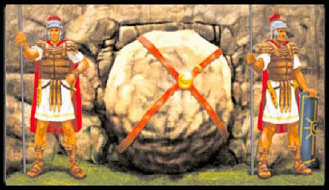
Matthew 27:62-66

Slide 42
The Swoon Theory
Beaten to the point of near death.
No food or water for more than two days.
Crucified and died.
Pierced with a sword.
Separated blood and “water” (plasma)

Slide 43
The Mass Hallucination Theory
The women at the tomb.
Peter and John.
The twelve apostles, including doubting Thomas.
Many other appearances.
Over 500 witnesses.
Do hallucinations eat fish?

Slide 44
The Resurrection Simplifies Things
But what about those who never heard?
But what about the supposed contradiction in the Bible?
Jesus was raised from the dead…..

Slide 45
Conclusion
Because Jesus fulfilled the prophecies of the Messiah and because he was resurrected, the only reasonable conclusion is that Jesus is who he said he is. Messiah, Lord, God-in-the flesh and the one with all authority in our lives.
What is your response?

