Slide 1
Palms V Wisdom Psalms Psalm 119 Oh! How I Love Your Word

Slide 2
Psalm 119: A Wisdom Psalm
An acrostic 22 Hebrew letters x 8 = 176 verses.
Imagine writing eight poetic verses startine with the letter x or q!

Slide 3
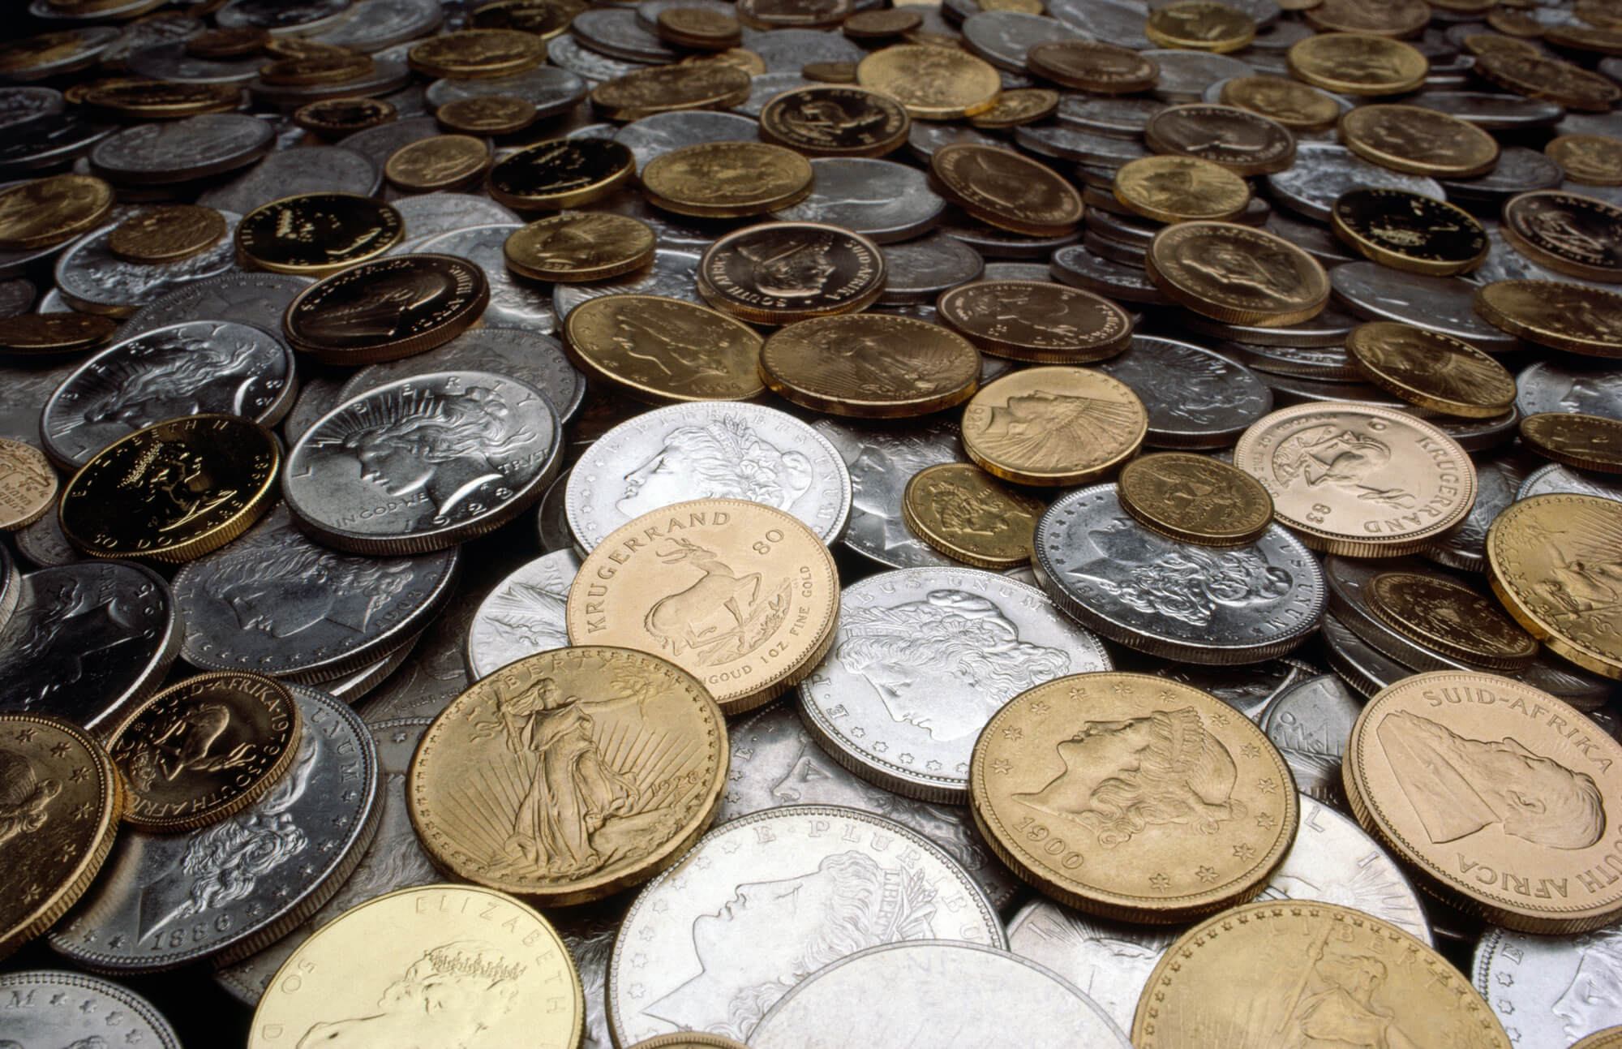
Psalm 119:72
The law from your mouth is more precious to me than thousands of pieces of silver and gold.
1. The law from your mouth.
2. Is precious to me

Slide 4
The Law From Your Mouth… Psalm 119:160
All your words are true; all your righteous laws are eternal.
1. All true
2. Eternal

Slide 5
All True: An Example
Jesus-only baptism: A proof text?
Hermeneutical “rules.”
4. Interpret a passage in its context.
7. Interpret every passage in light of all other relevant passages.
8. All passages on a subject must be studied before a conclusion is drawn.

Slide 6
All Your Words Are True
Q: What New Testament passage might lead to a different conclusion—that true, saving baptism is not “Jesus only?”
Answer: ___________________

Slide 7
Suggestions for New/Strange Teachings:
1. Consider the source.
2. Ask yourself it a passage might be taken out of context, and whether there are other relevant passages. Acts 17:11.
3. Talk to an expert.
Ephesians 4:11-15

Slide 8
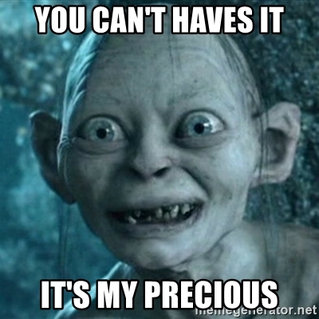
Back to Psalm 119:72
…precious to me.
What is precious to you?
Your spare time
Your health
Your mode of transportation
Your 401-K
Your home

Slide 9
Psalm 119:97
Oh how I love your law!
I meditate on it all day long.
1. I love your law.
2. I meditate on it
all day long.
Suggestion: memorize Scripture

Slide 10
Psalm 119:16
I delight in your decrees: I will not neglect your word.
Are you guilty of neglecting God’s word?
Antidote: 1. Love His Word. 2. Meditate on it all day.

Slide 11
Psalm 119:53
Indignation grips me because of the wicked who have forsaken your law.

Slide 12
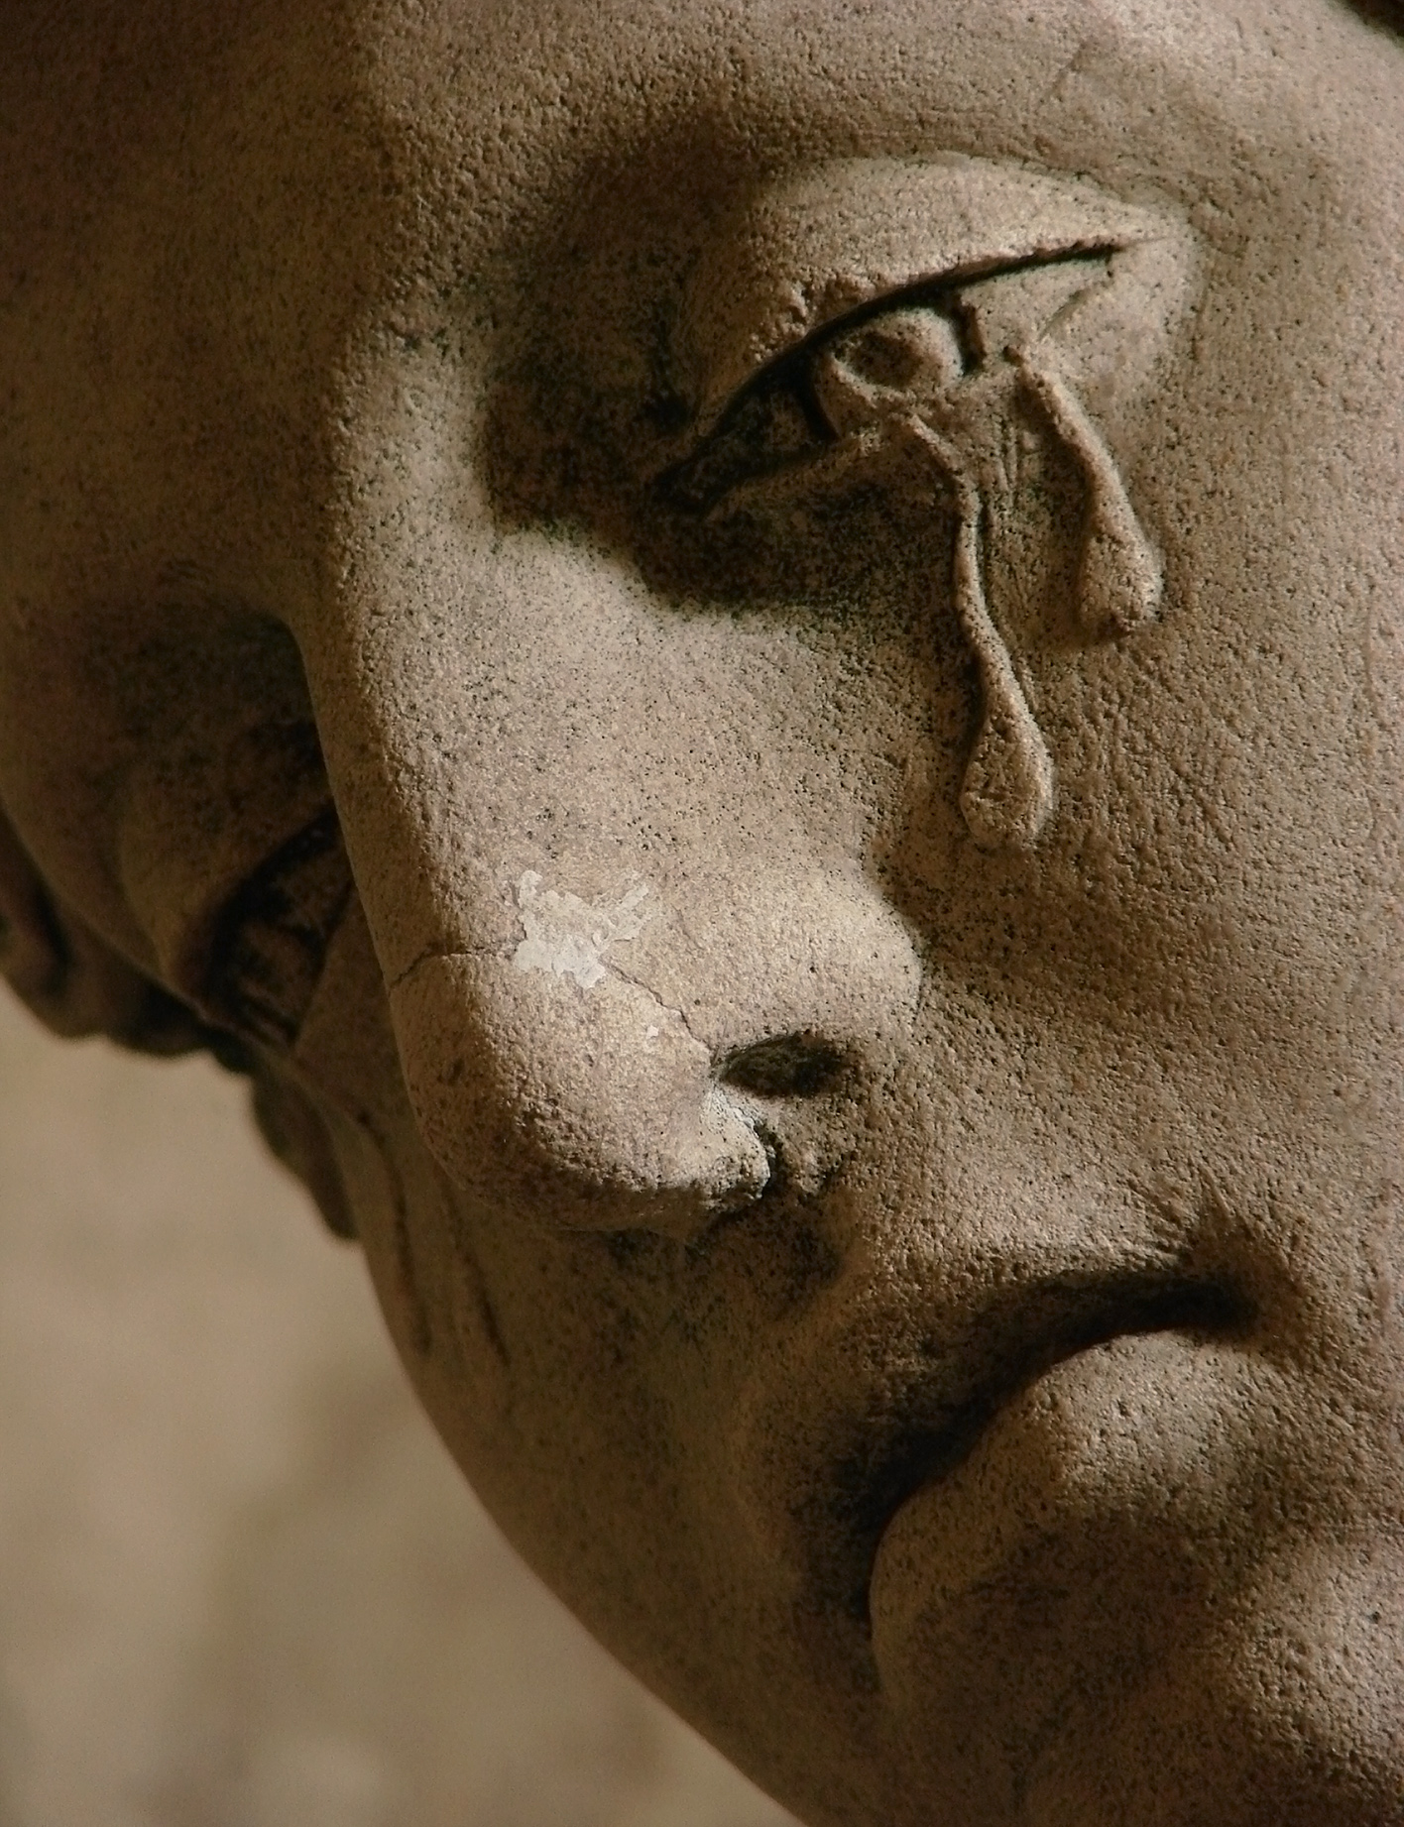
Psalm 119:136
Streams of tears flow from my eyes, for your law is not obeyed.
anger
sadness

Slide 13
Psalm 119:139
My zeal wears me out, for my enemies ignore your words.
anger
sadness
zeal

Slide 14
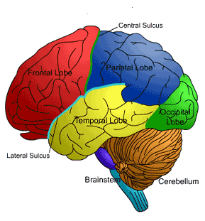
Psalm 119:9
How can a young man keep his way pure? By guarding it according to your word.
Who do I hang with?
What do I read?
What career to pursue?

Slide 15
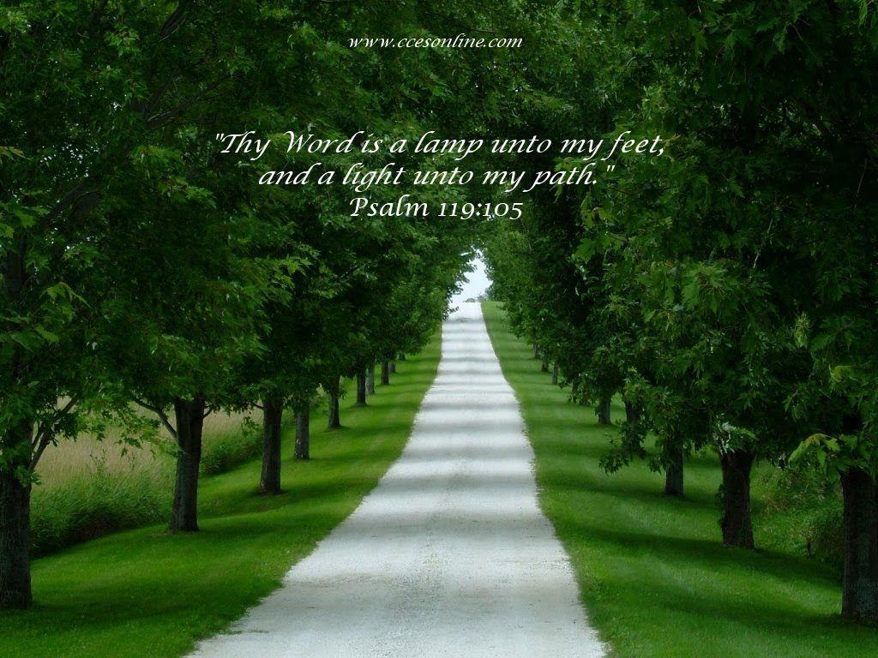
Psalm 119:105
Your word is a lamp to my feet and a light unto my path.
Thy Word

