Slide 1
Psalm 19 Psalms of Praise

Slide 2
Kinds of Psalms
1. Psalms of lament Psalm 13, 42, 73, 74
2. Imprecatory Psalms Calls for God to judge his enemies. Psalm 35, 69, 109
3. Psalms of Praise Psalm 19, 100, 147-148
4. Psalms of Confession Psalm 32, 51
5. Historical Psalms Psalm 78, 105-106
6. Wisdom Psalms Psalm 1, 37, 112, 119, 127-128
7. Royal Psalms/Messianic Psalms Psalm 22, 110, 118

Slide 3
Psalm 19:1-4
The heavens declare the glory of God; the skies proclaim the work of his hands.
Day after day they pour forth speech; night after night they reveal knowledge.
They have no speech, they use no words; no sound is heard from them.
Yet their voice goes out into all the earth; their words to the ends of the world.

Slide 4
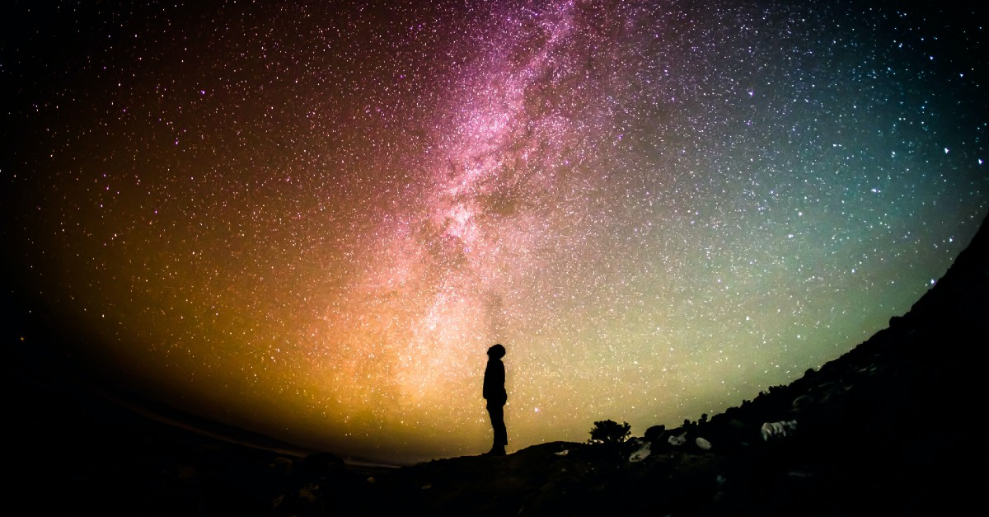
Psalm 19 The Heavens Declare the Glory of God!!!

Slide 5
Their voice goes out to all the earth!

Slide 8
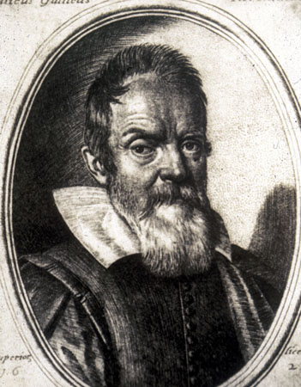
Galileo Galilei General Revelation
“The Bible was written to tell us how to go to heaven, not how the heavens go”
“For the Holy Bible and the phenomena of nature proceed alike from the divine Word, the former as the dictate of the Holy Spirit and the latter as the observant executor of God’s commands.”

Slide 9
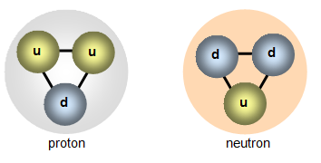
The Smallest Things Declare the Glory of God
Quark: 10⁻¹⁸ m

Slide 10
x 1,000,000

Slide 11
Electron 10⁻¹² m

Slide 12
x 10,000

Slide 13
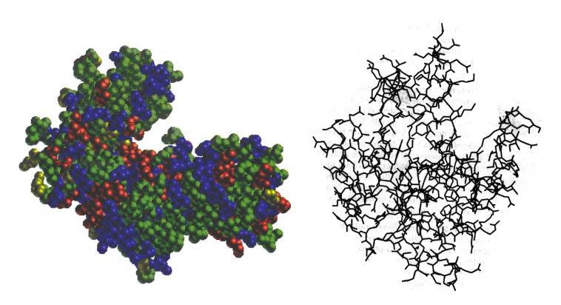
Protein Molecule 10⁻⁸ m

Slide 14
x 100,000

Slide 15
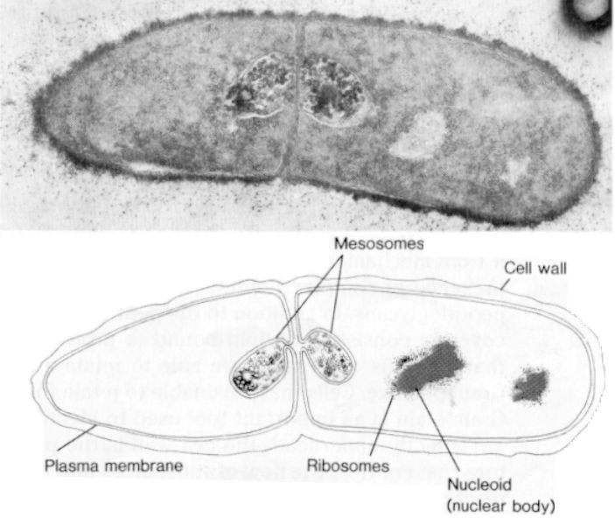
Cell 10⁻³ m

Slide 16
x 100,000

Slide 17
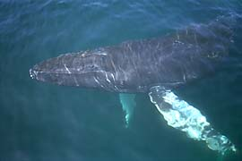
Blue Whale 10² m

Slide 18
x 100,000

Slide 19
The Earth 10⁷ m

Slide 20
x 100,000

Slide 21
The Solar System 10¹² m

Slide 22
x 10,000,000

Slide 23
The Andromeda Galaxy 10²¹ m

Slide 24
x 10,000

Slide 25
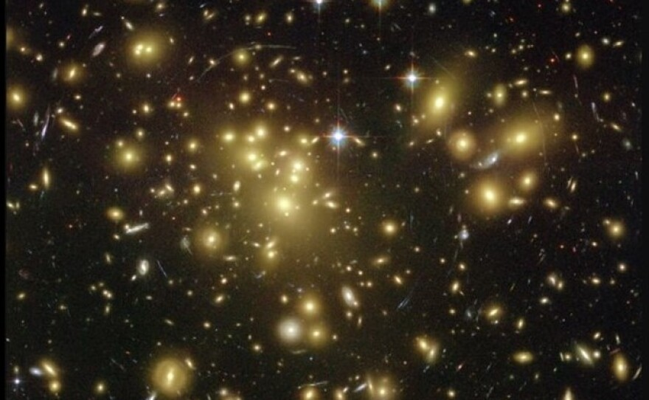
A Supercluster of Galaxies 10²⁵ m
The heavens declare the glory of God.

Slide 26
x 1,000

Slide 27
The Universe 10³¹ m 100,000,000,000 galaxies each with 100,000,000,000 stars Truly The heavens declare the glory of God

Slide 28
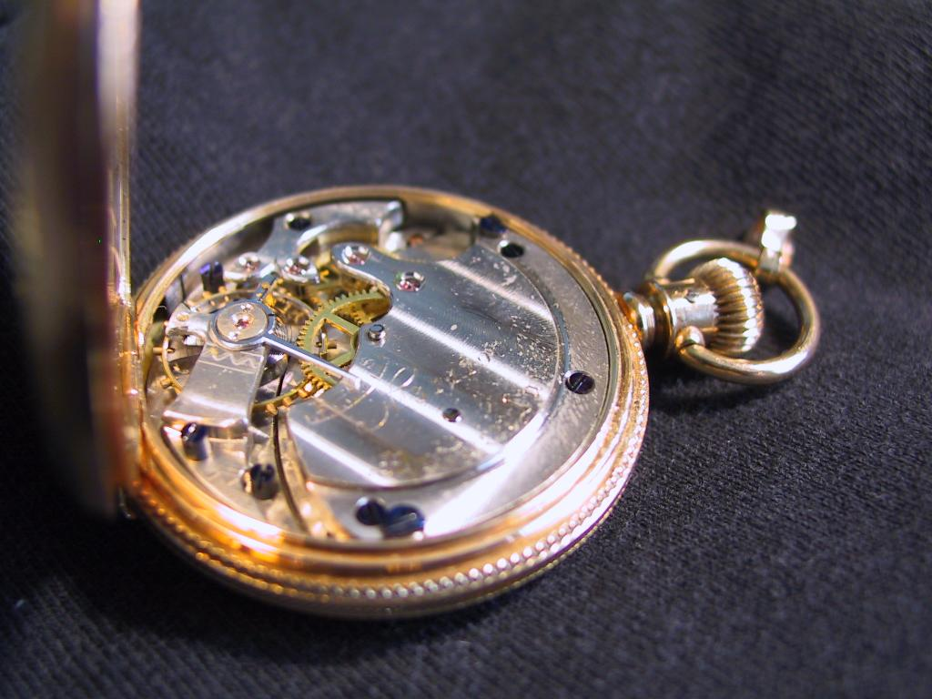
The Designed Universe
The Anthropic Principle
William Paley
Notes:
28

Slide 29
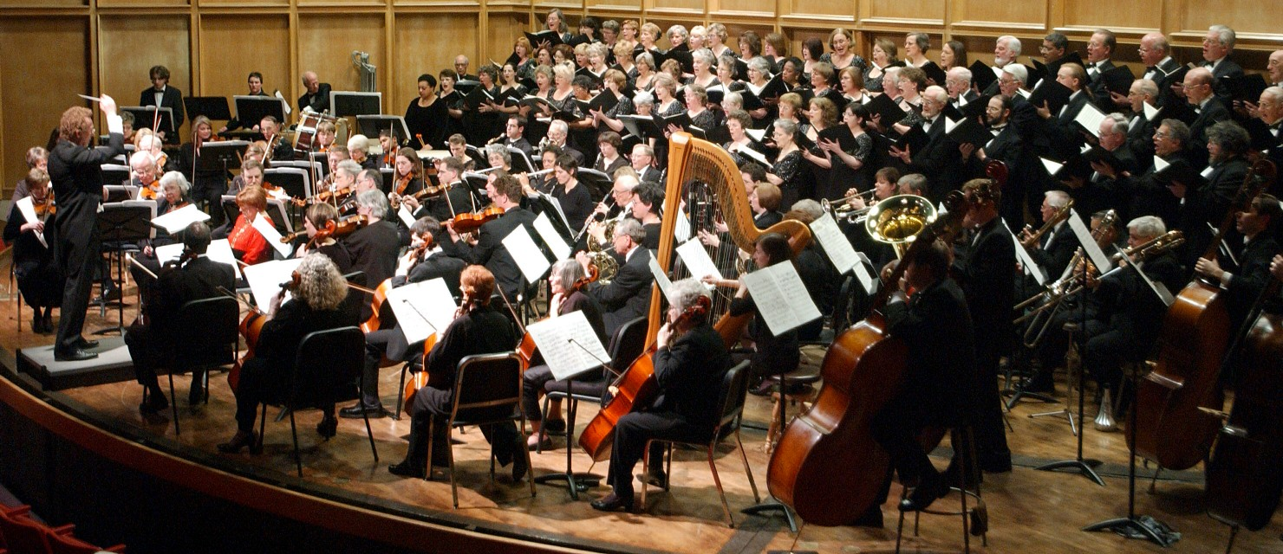
Physics:
The Finely Tuned Universe
Notes:
29

Slide 30
Fine Tuning of the Gravitational Constant
.00000000000000000000000000000000000000000000000000000000000001
Notes:
30

Slide 31
Gravity
Dominant force on astronomical size scale.
If gravity weaker by 1 in 10⁶⁰, universe expands too quickly, no galaxies or stars.
If gravity stronger by 1 in 10⁶⁰, universe collapses without forming galaxies or stars.
Gravity is fine-tuned to 1 part in 10^{60.}

Slide 32
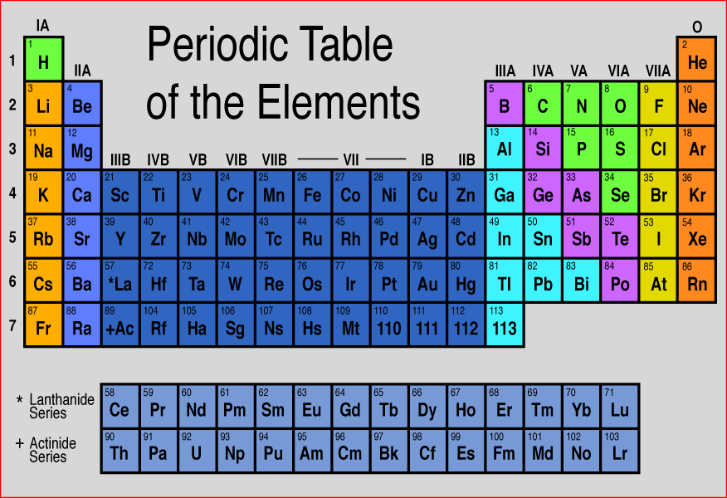
Designed Elements?
Notes:
32

Slide 33
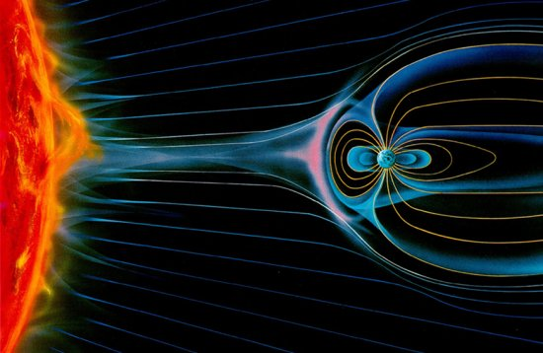
Iron: an essential element

Slide 34
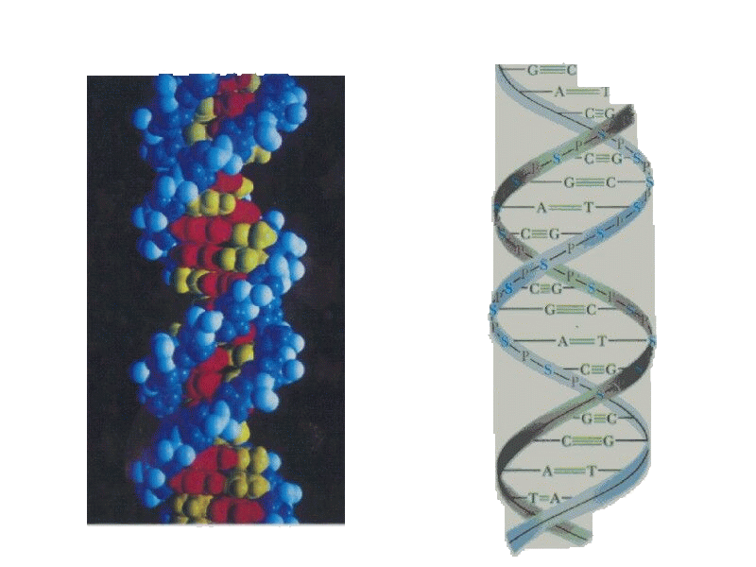
DNA
a)
b)
Notes:
34

Slide 35
Protein
Notes:
35

Slide 36
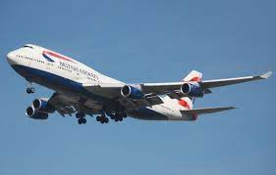
Fred Hoyle on Living Things
“The chance that higher life forms might have emerged [by chance] is comparable with the chance that a tornado sweeping through a junk-yard might assemble a Boeing 747 from the materials therein.”

Slide 37
Creation Declares the Glory of God
Romans 1: 18-20 The wrath of God is being revealed from heaven against all the godlessness and wickedness of people, who suppress the truth by their wickednesss, since what may be known about God is plain to them, because God has made it plain to the. For since the creation of the universe God’s invisible qualities—his eternal power and divine nature—have been clearly seen,being understood from what has been made, so that people are without excuse.

Slide 38
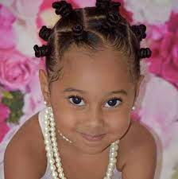
Psalm 139:13-14
For you created my inmost being; you knit me together in my mother’s womb, I praise you because I am fearfuly and wonderfully made; your works are wonderful, I know that full well.

Slide 39
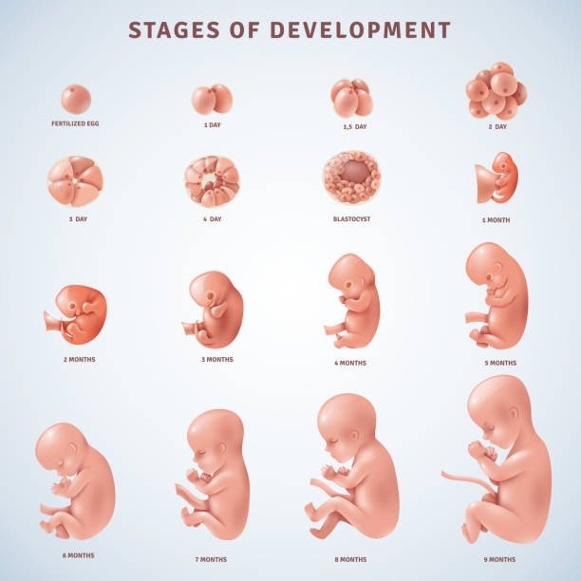
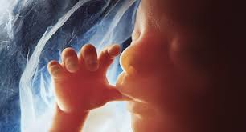
Fearfully and wonderfully made
Praise God!!!

Slide 40
Psalm 19:7-11 Not only that…
The Law of the Lord is perfect
The statutes of the Lord are trustworthy
The precepts of the Lord are right
The commands of the Lord are radiant
The decrees of the Lord are firm
Praise God!!!

Slide 41
Psalm 148 Praise the Lord
Hallelujah, praise Jehovah, from the heavens praise His Name;
Praise Jehovah in the highest, all His angels, praise proclaim.
All His hosts, together praise Him, sun and moon and stars on high;
Praise Him, O you heav’ns of heavens, and you floods above the sky.
Refrain:
Let them praises give Jehovah, for His Name alone is high,
And His glory is exalted, and His glory is exalted,
And His glory is exalted far above the earth and sky.

Slide 42
Psalm 148 Praise the Lord
Let them praises give Jehovah, they were made at His command;
Them forever He established, His decree shall ever stand,
From the earth, O praise Jehovah, All ye floods, ye dragons all,
Fire and hail and snow and vapors, stormy winds that hear Him call.
Refrain:
Let them praises give Jehovah, for His Name alone is high,
And His glory is exalted, and His glory is exalted,
And His glory is exalted far above the earth and sky.

Slide 43
Psalm 148 Praise the Lord
All you fruitful trees and cedars, all you hills and mountains high,
Creeping things and beasts and cattle, birds that in the heavens fly,
Kings of earth, and all you people, princes great, earth’s judges all;
Praise His Name, young men and maidens, aged men, and children small.
Refrain:
Let them praises give Jehovah, for His Name alone is high,
And His glory is exalted, and His glory is exalted,
And His glory is exalted far above the earth and sky.

Slide 44
Psalm 147 Praise the Lord
He builds up Jerusalem. Praise the Lord
He gathers the exiles Praise the Lord
He heals the brokenhearted Praise the Lord
He lifts up the humble, casts down the prideful. Praise God!!!
He gives weather and food to eat. Let’s praise the Lord
He reveals himself us. Amen and Praise God

Slide 45
Psalm 138 I Will Praise You, LORD
v. 2 Unfailing love Praise God for that!
v. 3 When we pray, God answers prayer. Praise God for that!
v. 6 The exalted God looks kindly on the lowly. Praise God for that!
v. 7 He preserves our life. Praise God for that!
v. 8 God will vindicate us! Praise God for that!
v. 8 His love endures forever. Psalm 30:5 Praise God for that!

Slide 46
Praise God
Creator, redeemer, lover, helper, builder, provider, protector, prayer-answerer, law-giver, vindicator, unmoved one, powerful one, faithful one, exalted one!

Slide 47
Psalm 100 Praise God
Shout for joy to the Lord, all the earth
Serve the Lord with gladness;
Come before him with joyful songs.
Know that the Lord is God
It is he who has made us, and we are His;
We are his people, the sheep of his pasture.
Enter his gates with thanksgiving, and his coursts with praise.
Give thanks to him and praise his name.
For the Lord is good and his love endures forever;
His faithfulness continues through all generations.
Shout for joy!

Slide 48
We Praise Thee O God Psalm 149
We praise Thee O God, for the Son of thy love,
For Jesus who died and is now gone above.
Hallelujah! Thine the glory.
Hallelujah! Amen
Hallelujah! Thine the glory,
Revive us again

Slide 49
We praise Thee, O God, for Thy Spirit of light,
Who has shown us our Savior, and scattered our night.
Hallelujah! Thine the glory.
Hallelujah! Amen
Hallelujah! Thine the glory,
Revive us again

Slide 50
All glory and praise, to the Lamb that was slain,
Who has borne all our sins, and has cleansed every stain.
Hallelujah! Thine the glory.
Hallelujah! Amen
Hallelujah! Thine the glory,
Revive us again

Slide 51
All glory and praise to the God of all grace,
Who has bought us and sought us and guided our ways.
Hallelujah! Thine the glory.
Hallelujah! Amen
Hallelujah! Thine the glory,
Revive us again

Slide 52
Revive us again, fill each heart with Thy love,
May each soul be rekindled with fire from above.
Hallelujah! Thine the glory.
Hallelujah! Amen
Hallelujah! Thine the glory,
Revive us again (end)

