Slide 1
Psalms IV Psalms of Confession Psalm 51 Create In Me a Clean Heart O God!

Slide 2
Psalm 19:1-4
The heavens declare the glory of God; the skies proclaim the work of his hands.
Day after day they pour forth speech; night after night they reveal knowledge.
They have no speech, they use no words; no sound is heard from them.
Yet their voice goes out into all the earth; their words to the ends of the world.

Slide 3
Types of Psalms
Lament
Imprecatory
Praise
Confession
Historical
Wisdom
Royal/Messianic

Slide 4
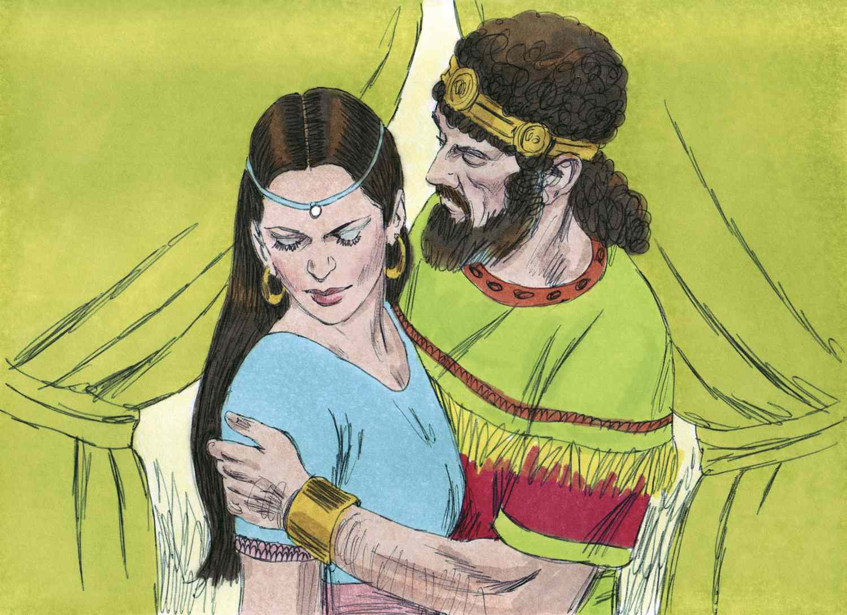
2 Samuel 11 & 12 David, Bathsheeba and Nathan

Slide 5
The Downward Spiral of Sin
James 1:14 Each person is tempted when they are dragged away by their own evil desire and enticed. Then, after desire has conceived, it gives birth to sin; and sin, when full-grown, gives birth to death.

Slide 6
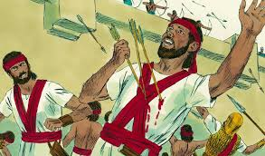
From Bad to Worse
David sends for Uriah

Slide 7
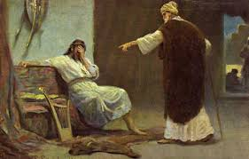
2 Sam 12 Thank God For Nathan
Nathan to David: You are the man!
Are you willing to be a Nathan?

Slide 8
Psalm 51 Confession, Repentance and Renewal
Psalm 51:1-5
Confession: “Against you, only, have I sinned!”
“I was sinful at birth.” Original Sin?
Technically, both are not true. This is hyperbole!

Slide 9
Psalm 51:6-12 Repentance
Cleanse me with hyssop and I will be clean.
Hide your face from my sins.
Create in me a pure heart, O God.
hyssop

Slide 10
Psalm 51:12-19 Renewal
Restore to me the joy of my salvation.
My mouth will declare your praise.
My sacrifice will be a broken and contrite heart… a willing spirit
Then… You will build the walls of Jerusalem!

Slide 11
Summary
Our fleshly desired lead to temptation that leads to sin and, ultimately, will lead to death.
But David teaches us that there is a way out!
Confession and Repentance leads to
Forgiveness and Renewal

