Slide 1
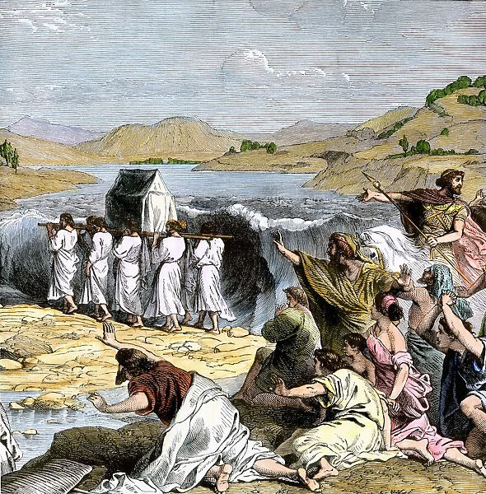
Historical Psalms Psalm 105-106

Slide 2
Kinds of Psalms
1. Psalms of lament Psalm 13, 42, 73, 74
2. Imprecatory Psalms Calls for God to judge his enemies. Psalm 35, 69, 109
3. Psalms of Praise Psalm 19, 100, 147-148
4. Psalms of Confession Psalm 32, 51
5. Wisdom Psalms Psalm 1, 37, 112, 119, 127-128
6. Royal Psalms/Messianic Psalms Psalm 22, 110, 118
7. Historical Psalms Psalm 78, 105-106

Slide 3
Purpose of Historical Psalms
1. To proclaim and remember the mighty deeds of God.
2. To remind us of our human failings—as warning for us to rely on God.

Slide 4
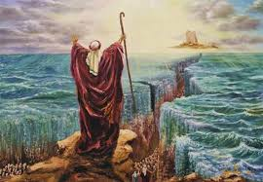
Psalm 105:1-5
Make known among the nations what he has done.
Remember the wonders and miracles he has done.
Seek his face always

Slide 5
Psalm 105:6-7
Who should “Remember the wonders he has done?”
Galatians 3:7,29, Romans 9:8-9 We should!
We are the children of Abraham

Slide 6
Psalm 105:8-15
History tells us that God will not forget his promises.
What promises has God kept with you?
v. 12 They were few in number…

Slide 7
Psalm 105:16-22
For a time, it looked pretty bad…
Genesis 50:20

Slide 8
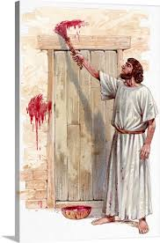
Psalm 105:23-38
Plagues led to deliverance
Jesus is the second Moses.
God will do this in Merced!

Slide 9
Psalm 105:39-45
He brought his people out with rejoicing;
His chosen ones with shouts of joy.
He gave them the lands of the nations.

Slide 10
Psalm 106:1-5
Who can proclaim the mighty acts of the Lord?
Answer: We can!!!
This is the main point of the historical pslams.

Slide 11
Psalm 106:6-12
v. 6-7 We blew it big time?
v. 8 But God delivered us nevertheless because we are so amazing!
Not!
v. 9 God did crazy stuff.
But he has stopped doing such things.
Not!

Slide 12
Ps 106:13-23
It got pretty rough for them. The people were faithless.
v. 13 Let us remember the miracles
v. 16 And let us not grumble or rebel

Slide 13
Psalm 106:24-48
Even if we forsake God, he will not forsake us.
2 Tim 2:11-13

Slide 14
Group Activity
What wonders has God already done in your life?
What might he still do?

