Slide 1
Love Sandwiches

Slide 2
All In With King Jesus

Slide 3
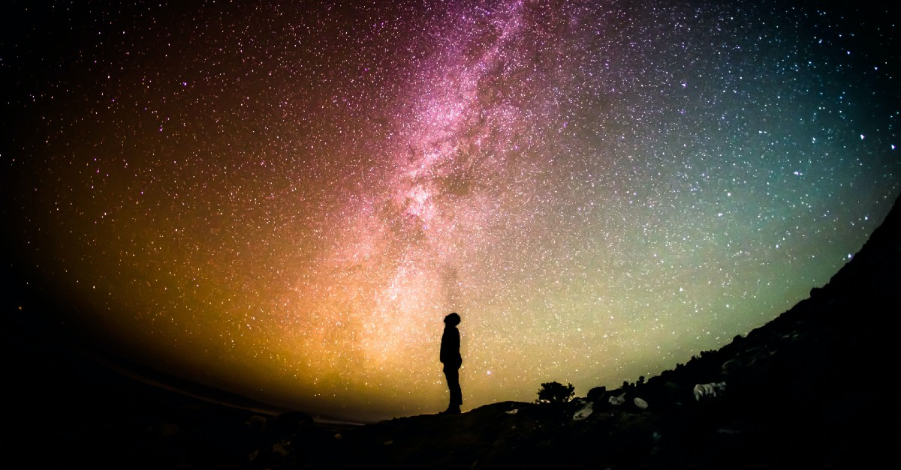
Psalm 110 A Priest Forever

Slide 4
Psalm 2:1-6 King Jesus Reigns
Why do the nations conspire and the peoples plot in vain?
The kings of the earth rise up and the rulers band together against the Lord and against his anointed saying,
Let us break their chains and throw off their shackles.
The One enthroned in heaven laughs; the Lord scoffs at them.
I have installed my King on Zion, my holy mountain.

Slide 5
Psalm 2 Fulfilled: Acts 4:1-31
They were greatly disturbed because the apostles were teaching the people.
By what power or name did you do this?
Mistake city!
It is by the name of Jesus Christ of Nazareth!

Slide 6
Psalm 118:22-24
The stone you builders rejected has become the cornerstone

Slide 7
Stop Preaching!!!
Salvation is found in no one else!!!
…they were unschooled, ordinary men. But…
They had been with Jesus!!!
Do not speak or teach at all in the name of Jesus
Mistake city!
We cannot help speaking about what we have seen and heard.
v. 29 Enable your servants to speak your word with great boldness.

Slide 8
Psalm 2:7-12
Ps 2:7 You are my son. Today I have become your father.
Acts 13:33
Psalm 16:10 You will not let your faithful one see decay.
Psalm 89:3-4, 35-37 I have sworn to David my servant, “I will establish your line forever.”

Slide 9
Psalm 22 They killed King Jesus, But…
v. 1 My God, my God, why have you forsaken me?
Psalm 31:5 Into your hands I commit my spirit.
v. 7-8 They mock me and hurl insults at me.
v. 14-18 They have pierced my hands and my feet.
They divide my garments among them, and cast lots for my clothing.

Slide 10
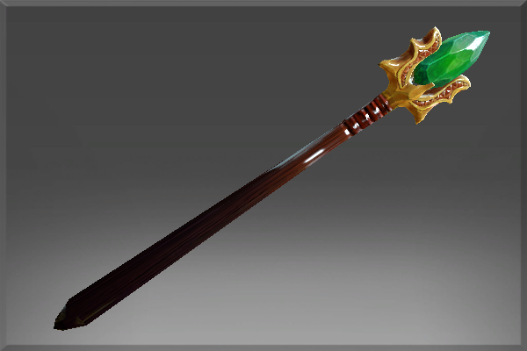
Psalm 110
The Lord (father) said to my Lord (Son, Jesus, Messiah) Sit at my right hand…
The Lord will extend your mighty scepter from Zion.

Slide 11
Psalm 110:3
Your troops will be willing on your day of battle. Arrayed in royal splendor.
Are you willing?

Slide 12
Psalm 110:4
You are a priest forever in the order of Melchizedek
(Hebrews 7)
Jesus is Priest and King
Let is “speak God’s word with great boldness
Let us stand with Priest and King Jesus

