Slide 1
Commitment to the Body/Family of Christ.
MCC Midweek 7/10/24

Slide 2
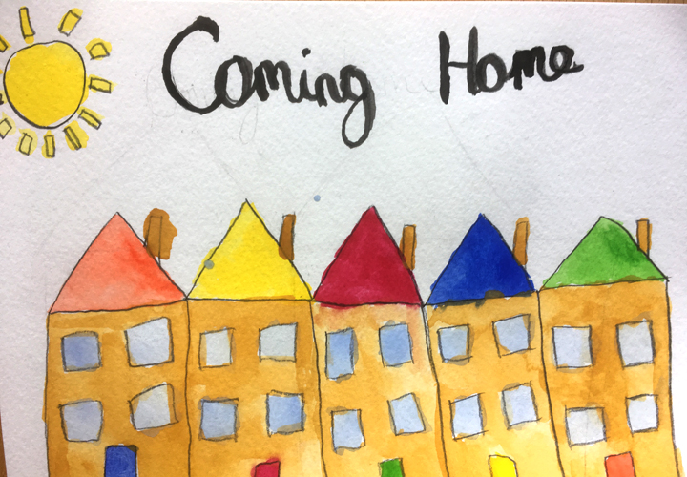
Ephesians 5:25-32
v. 25 Christ loved the Church.
He gave himself up for her.
v. 27 He presents us radiant to God.
He wants us to do the same. Have you been doing that?

Slide 3
What is church?
1. Church (capital C). The thing that Jesus died for. It is the thing we enter when we are baptized into Christ. (Eph 5:25)
2. church (small c). A local body of believers who submit to a local leadership, who put the one another passages into effect, and who become the city on a hill that seekers are attracted to. (Romans 16:3-5)
Which do we love, give ourselves up for and make radiant?

Slide 4
Hebrews 10:22-25
God did this: Cleansed us of a guilty conscience.
God wants us to do this: Spur one another on and not forsake meeting together.
Is this too much to ask?

Slide 5
Hebrews 3:12-13
Caught up in sin recently?
Encourage one another daily.
How often? Daily.

Slide 6
Matthew 6:33
What are you “seeking first” in your life? Does the family of God come first?

Slide 7
1 John 3:1, 16-18, 4:7-12 We Are Family
3:1 God did his part. He lavished his love on us.
3:16-18 So let us lay down our lives for our sisters and brothers.
4:7-12 Do you love the family of God? How does this show in your life?

Slide 8
Discussion Questions
1. Do you need to do any reevaluating your priorities as to attending church family events (BT, worship, midweek)
2. What can you do to more encourage one another and to spur one another on to love and good deeds?
3. Does your love for the body of Christ reflect his love for you?

