Slide 1
Ecclesiastes II Wisdom from Solomon
Ecclesiastes I:
Under the sun, life is
Meaningless, Meaningless!

Slide 2
Without God:
Knowledge is meaningless
Wisdom is meaningless
Pleasure is meaningless
Accomplishments are meaningless
They are chasing after the wind

Slide 3
Ecclesiastes 3:1-8 A Time for Everything
Balance
Work Rest
Weeping Laughing
Careful Risky
Control Let go
Keep Throw away
Anger Forgive
Hate (really?) Love

Slide 4
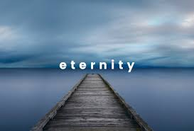
Ecclesiastes 3:9-11
Made in God’s image
God has set eternity in the human heart.

Slide 5
Ecclesiastes 3:16-22
Life’s not fair!
But God will judge
Romans 12:17-19
Ashes to Ashes,
Dust to Dust

Slide 6
Ecclesiastes 4:9-12 Two are Better Than One
And a cord of three strands is even much stronger…

Slide 7
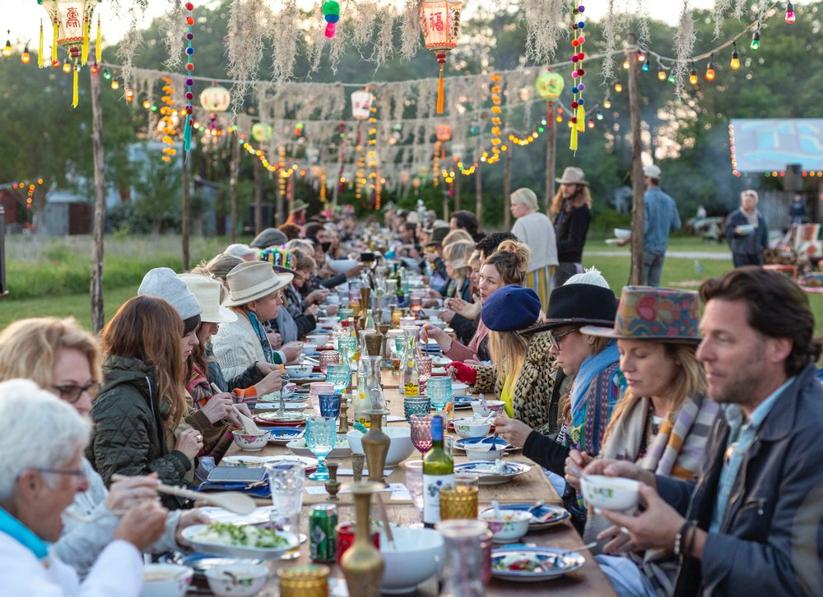
Ecclesiastes 7:2 Mourning Is Better Than Feasting

Slide 8
Ecclesiastes 12:1-7
Remember your Creator
in the days of your youth
I don’t have time!
I am too busy!
I have to study!

Slide 9
Ecclesiastes 12:8-14 The End of the Matter
Life under the sun: Meaningless, Meaningless!
Life under God: Meaningful! Meaningful!
So…
Remember your Creator in the days of your youth.

Slide 10
Wisdom From Solomon
Find balance in the way you live.
Life is not fair. Trust God.
Two are better than one. Make strong relationships.
Do not avoid thinking about your mortality.
Embrace mourning.
Seek God with all your heart while you are young.
Only through God is meaning found in life.

