Slide 1
Ecc. I Life Under the Sun
Living a life of meaning and purpose.

Slide 2
Solomon Asks the Big Questions
How did I get here?
Why am I here?
What is my purpose?
What is the meaning of life?
What is my value?
What is the right thing to do?

Slide 3
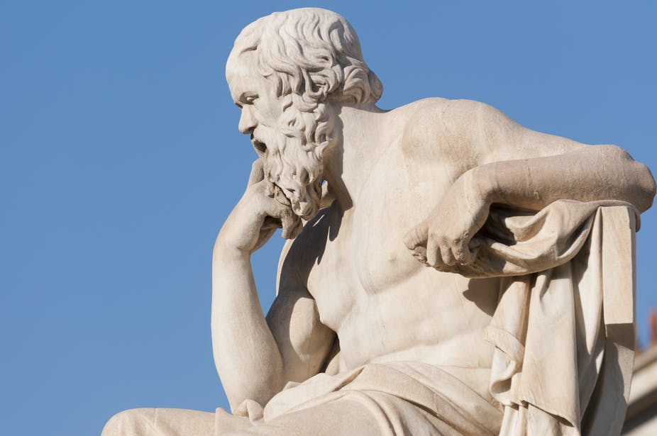
Ecclesiastes: A Book of Wisdom… Most of the Bible: God speaking to humans. Psalms: Humans speaking to God. Ecclesiastes: Humans speaking to humans

Slide 4
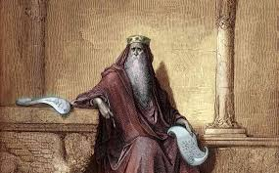
Why Solomon?
1 Kings 3:4-15 Solomon asks for wisdom
If anyone would know…

Slide 5
Ecclesiastes 1:1-11 Life Under the Sun
Meaningless, Meaningless
Why? In view of time.
0.000000125% Insignificant!
There is nothing new under the sun.

Slide 6
OK, But What About Wisdom? Ecclesiastes 1:12-18
Meaningless!
“Ignorance is bliss”
What is crooked cannot be fixed.
Ecc 2:12-16 Wisdom is better than folly, but…
The same fate overtakes them both

Slide 7
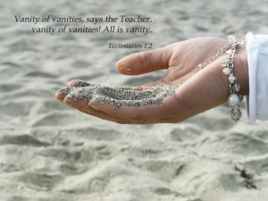
Are You Chasing After the Wind?

Slide 8
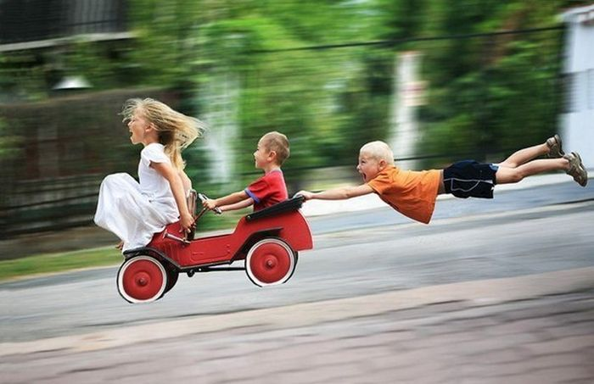
Ecclesiastes 2:1-10 Well, at least we can have fun!
Solomon: Been there, done that!
Ecc 3:11-13

Slide 9
Ecclesiastes 2:12-23 Great Accomplishments Give Meaning, Right?
Solomon: Vanity, Vanity.
You can’t take it with you.
Rehoboam

Slide 10
Chariots of Fire
Eric Liddle
and
Harold Abrahams

Slide 11
Ecclesiastes 12:8-14 The End of the Matter
Now all has been heard; here is the conclusion of the
matter: Fear God and keep his commandments, for this
is the whole duty of mankind.
Without God: Meaningless!
With God: Great meaning, purpose and value.

