Slide 1
Proverbs: Wisdom from God
What kind of person do you want to be?

Slide 2
Form and Style of Proverbs
Almost impossible to outline.
Couplets:
A. Parallel
Pride goes before destruction: A haughty spirit before a fall.
B. Contrast
The wages of the righteous is life, but the earnings of the wicked are sin and death.

Slide 3
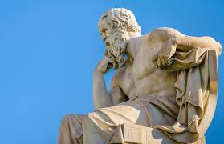
Our Outline: Categories
I. Wisdom, generally
II. Self-discipline
III. Laziness, finances
IV. Pride vs. Humility
V. Taking advice.
VI. Relationships
VII. The Poor

Slide 4
Wisdom
Fear is the beginning of wisdom/knowledge.
Prov 1:7
Prov 9:10
Prov 14:27
Prov 15:18
Do you respect God?

Slide 5
Wisdom
Prov 3:5 Give God your heart
Prov 4:23 Guard your heart.
Trust: The other side of the fear/reverence coin.

Slide 6
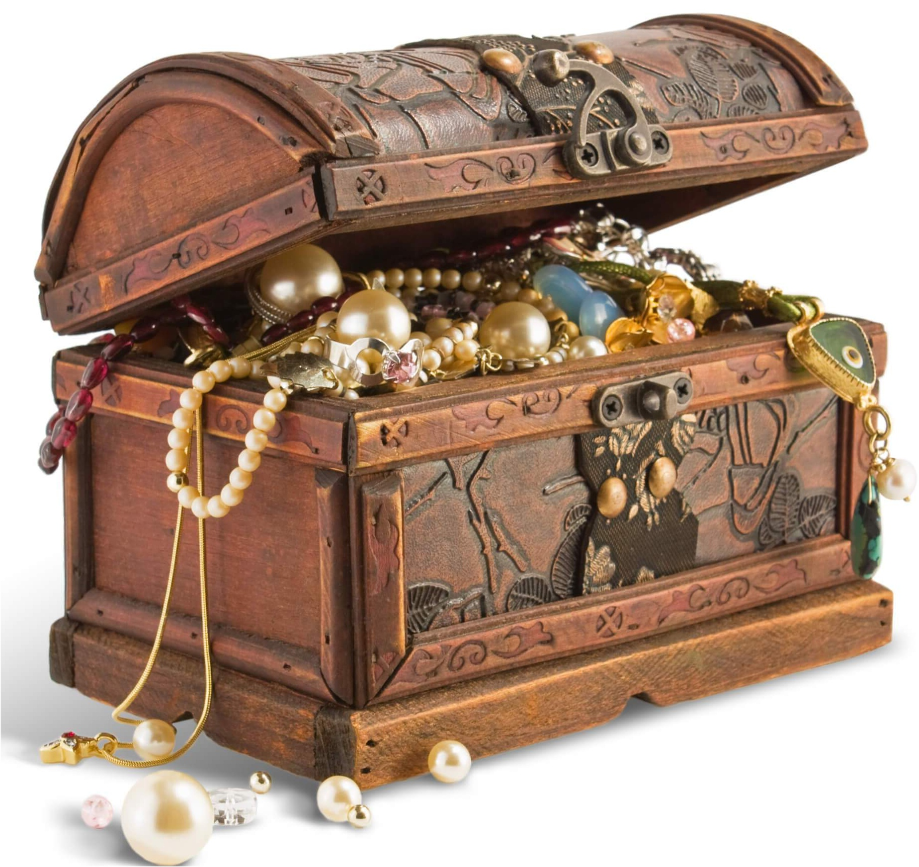
Get Wisdom!
Prov 3:13 Like silver and gold
Prov 4:7-8 Cherish her.
Prov 10:14 Store up knowledge. Pay attention!
Prov 11:30 Save lives.
Prov 13:20 Walk with the wise.

Slide 7
Wisdom in our plans
Prov 14:12, 16:25 There is a way which seems right, but in the end it leads to death.
Prov 16:9 In their hearts humans plan their course, but the Lord establishes their steps.
Prov16:3 Commit to the Lord whatever you do, and he will establish your plans.
James 4:13-17

Slide 8
Self-Discipline
Prov 5:22-23 Discipline over our desires.
Prov 16:32 Patience and self-control
Prov 28:1 Discipline and boldness

Slide 9
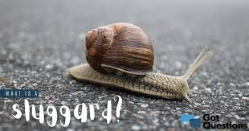
Don’t Be a Sluggard!
Sluggard def: A habitually lazy person
Prov 6:6-11 Go to the ant
Prov 10:4
Prov 12:11, 28:19

Slide 10
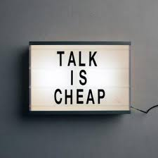
Some Say, “Works for Jerks”
Are you a diligent worker?
Prov 14:23
Prov 18:9
Prov 20:4

Slide 11
No Sluggards!
Prov 19:24 Lazy
Prov 24:33 A little sleep…
Prov 22:13, 26:13-16
Excuses:
There’s a lion outside!

Slide 12
What kind of person do you want to be? Want wisdom?
Fear God
Trust God
Seek wisdom and pay attention
Ask what God’s will is likely to be on a decision
Walk with the wise
Live a self-disciplined life
Work hard

Slide 13
Proverbs and Wealth
Proverbs 13:11 Dishonest money dwindles away, but whoever gathers money little by little makes it grow.
Don’t go for quick money schemes.
Work hard and build wealth slowly.

