Slide 1
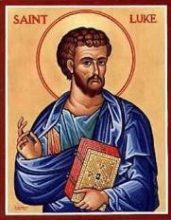
Luke Part IX
Jesus Comes to Jersualem

Slide 2
Luke 9:51 The Turning Point
Jesus resolutely set out for Jerusalem.

Slide 3
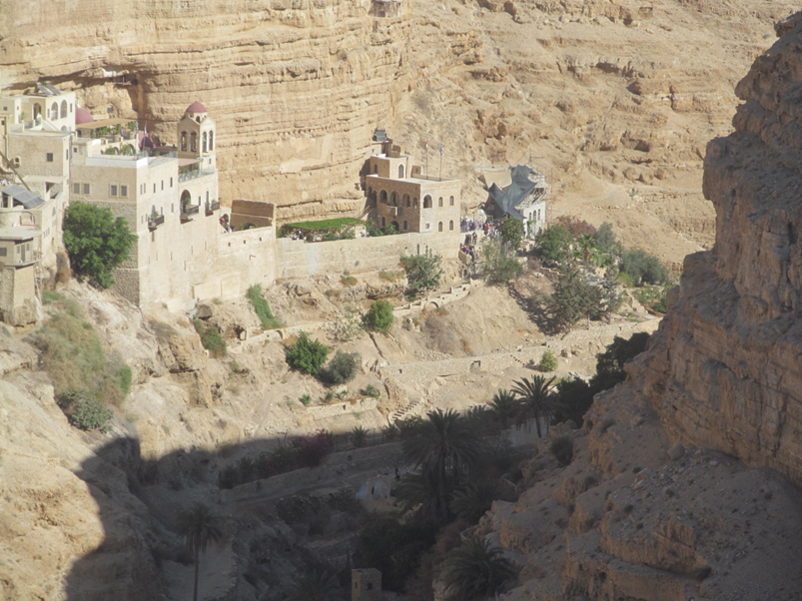
The Good Samaritan:
Who is my neighbor?
Luke 10:36 Who has acted as a neighbor?
“The one who showed mercy/compassion.”
The one who DID mercy.
Jesus: Go and DO mercy

Slide 4
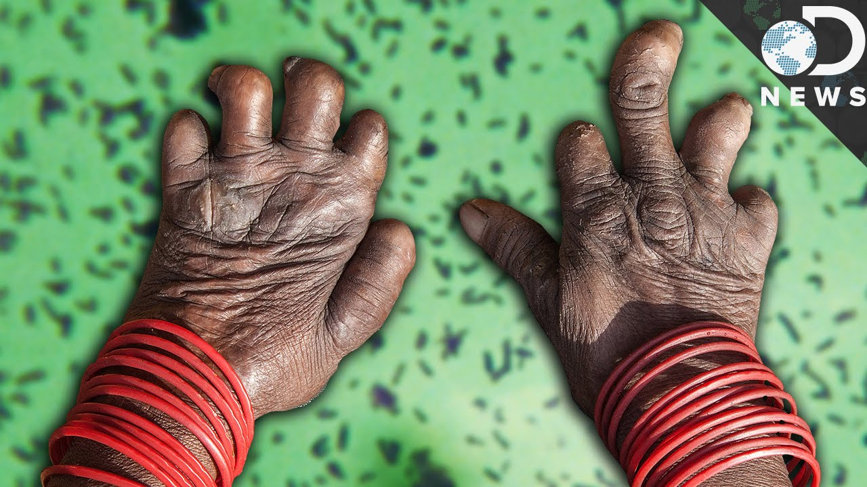
Luke 17:11-19 Jesus Heals 10 Lepers
Unclean!
Unclean!
Lepers are the ultimate outsiders.
Leviticus 13:9-14, 45

Slide 5
The Leper as a Metaphor
Q: Who is it that you do not want to touch?
Luke 17:16 Only one returned, and he was a Samaritan!!!
v. 18 A foreigner!!!
Jesus loves foreigners and foreigners love Jesus.

Slide 6
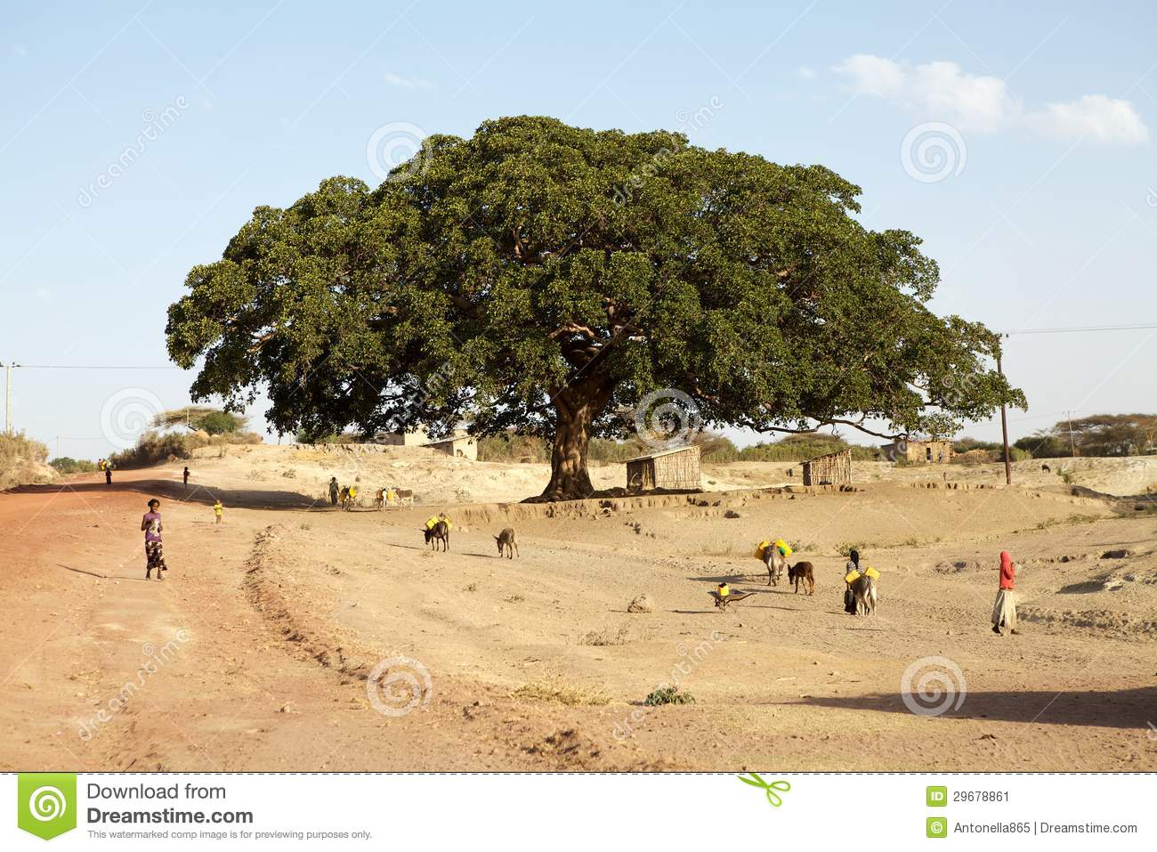
Luke 19:1-10 Zacchaeus
Zacchaeus: A chief tax collector!
This is Jesus’ kind of guy: a repentant outsider.

Slide 7
Why does Jesus like Zacchaeus so much?
He is a sinner.
He knows it.
He is willing to repent. 2 Cor 7:11
Earnestness
Eagerness to clear himself
Readiness to see justice done.
Luke 19:10 If you are like Zacchaeus, Jesus came for you!

Slide 8
Jesus Loves the Outsiders
If anyone really knew me…
But I struggle with….
But I am so distant from God…
Jesus came to seek and save the lost… YOU!!!

Slide 9
Luke 9:21-19:28 Jesus On the Way to Jerusalem.
The Son of Man Must Suffer
Luke 9:21-22 Suffer, be rejected and killed
Luke 9:43-45 Betrayed
Luke 11:29-32 Only the sign of Jonah
Luke 13:31-35 Prophets die in Jerusalem
Luke 18:31-34 Everything must be fulfilled

Slide 10
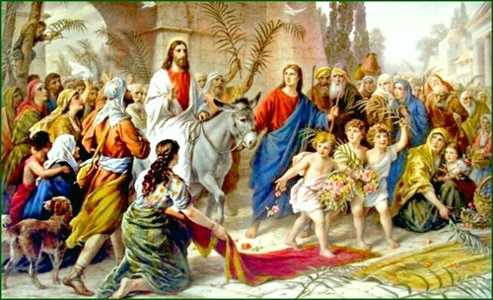
IV. Luke 19:28-21:38 Jesus in Jerusalem
Luke 19:28-40
Jesus fulfills 2 Sam 6:12-15
Jesus fulfills Zechariah 9:9
But also
Jesus reverses
2 Sam 6:14-15

Slide 11
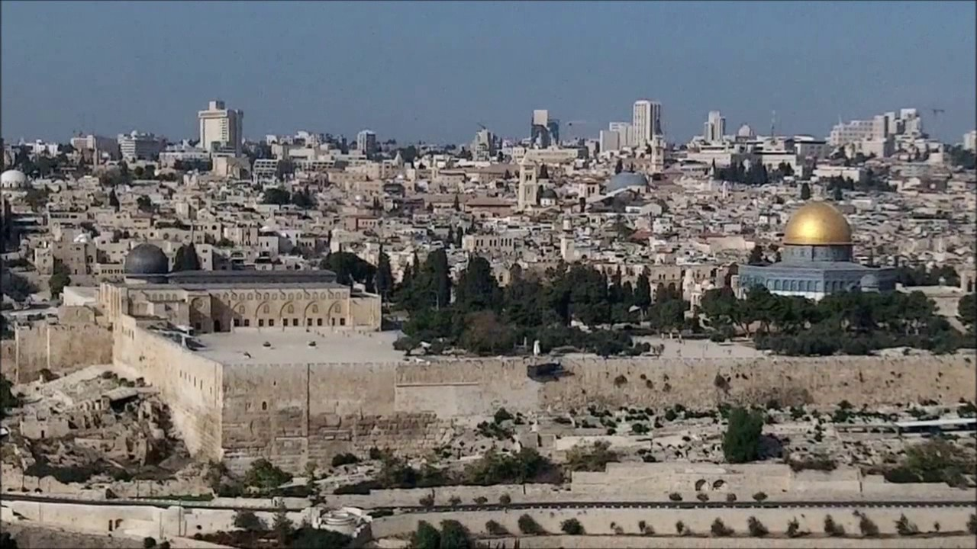
Jerusalem from the Mount of Olives
Luke 19:41-44 O, Jerusalem, Jerusalem

Slide 12
Jesus Weeps Over Jerusalem
Why?
He knows we will reject him and kill him.
He knows that God will destroy the city because we did not recognize him as king.

Slide 13
Jesus Comes Back to Jerusalem
Reversing Ezekiel 11:22-23 when God left Jersualem, going up the Mount of Olives.
Reversing 2 Sam 15:13-17 when David ignominiously left Jerusalem.

Slide 14
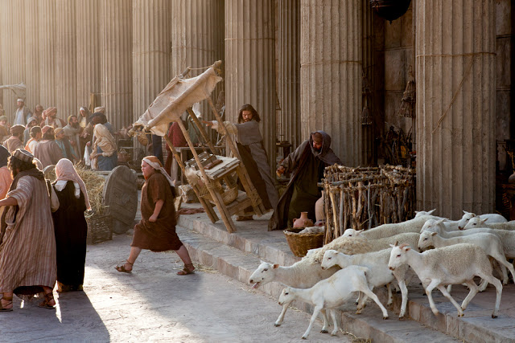
Luke 19:45-48 Jesus at the Temple
Jesus drives out the merchants from the temple.
Fulfilling Zechariah 14:21

Slide 15
Summary
Are/were you an outsider? A leper, a Samaritan, a tax-collector?
If you are prepared to repent, you are Jesus’ kind of person. He wants to come to your house today.
But… You need to be prepared to follow Jesus to Jersualem, because that is where your salvation will happen.

