Slide 1
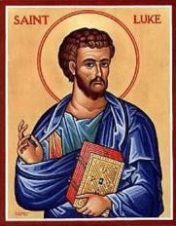
Luke Part X
Jesus in Jerusalem
Or
Conflict in Jerusalem

Slide 2
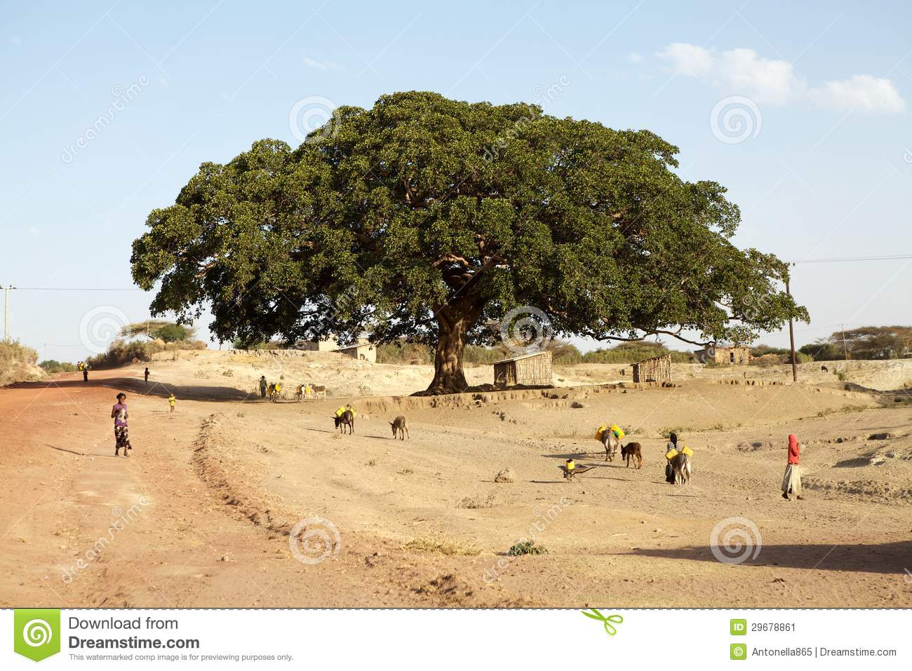
Last Sunday: Luke 19:1-10 Zacchaeus
Zacchaeus: A chief tax collector!
This is Jesus’ kind of guy: a zealous, repentant outsider.
Jesus: I am coming to your house today!

Slide 3
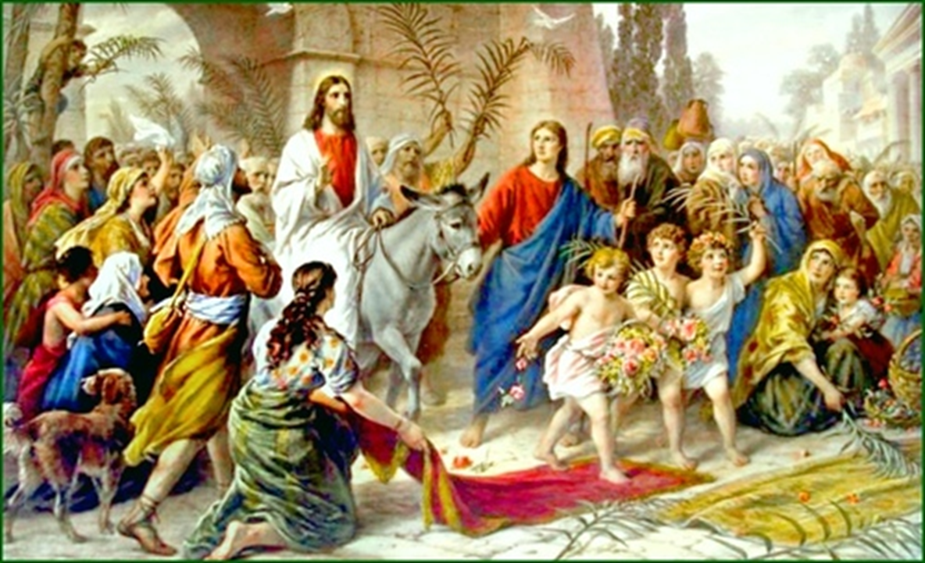
Luke 19:28-40 Jesus Comes Back to Jerusalem
Reversing Ezekiel 11:22-23 when God left Jersualem, going up the Mount of Olives.
Reversing 2 Sam 15:13-17 when David ignominiously left Jerusalem.

Slide 4
Luke 19:28-40 Jesus Comes Back to Jerusalem
Jesus fulfills Zechariah 9:9-10 The king comes to Jerusalem.
Jesus fulfills 2 Samuel 6:12-15 David brought God to Jerusalem.

Slide 5
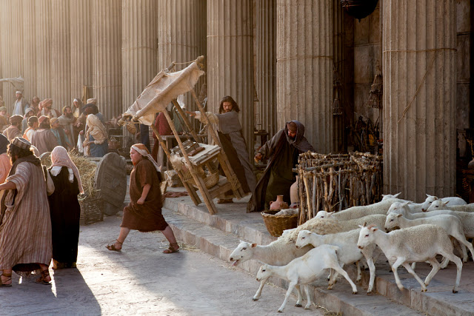
Luke 19:45-48 Jesus at the Temple
Jesus drives out the merchants from the temple.
Fulfilling Zechariah 14:21

Slide 6
Luke 20 Conflict in Jerusalem
Luke 20:1-8
v. 2 By what authority. The gall!!!
Wiley Jesus:
John’s baptism: Is if from God or from man?

Slide 7
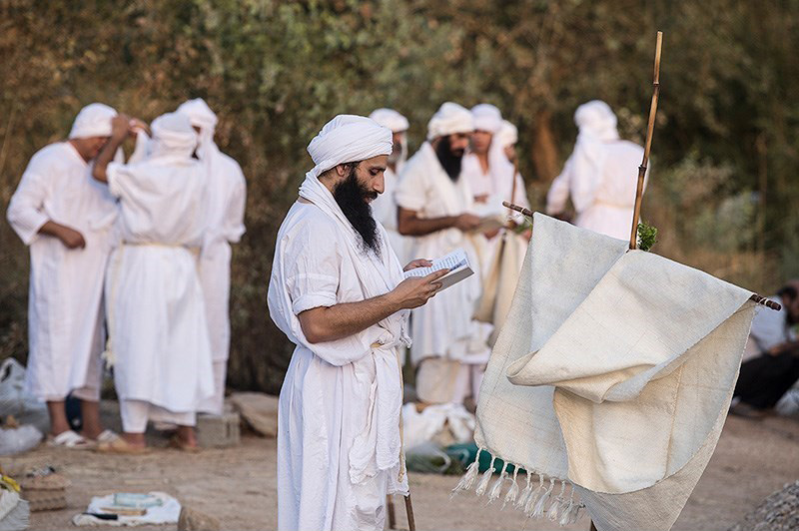
Mandaeans

Slide 8
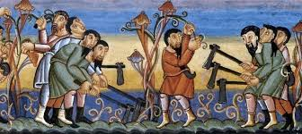
Luke 20:9-19 Parable of the Tenants
A man planted a vineyard…
…He sent a servant to the tenants

Slide 9
Luke 20:9-19 Parable of the Tenants
The man is God.
The tenants are Israel, but they are also us!
The servants are the prophets.
Guess who the Son is!

Slide 10
Luke 20:9-19 Parable of the Tenants
The Stone the builders rejected has become the capstone.
Let us not have the stone fall on us!
Let us go with Jesus to Jerusalem where suffering and death, but also renewal and resurrection happen.

Slide 11
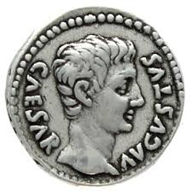
Luke 20:20-26
The Teachers of the Law Test Jesus
The trap:
Should we pay taxes to Caesar?
Jesus: Give to Caesar what is Caesar’s and to God what is God’s
My kingdom is not of this world.

Slide 12
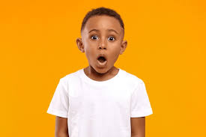
Are You Astonished at Jesus?

Slide 13
Luke 20:27-33
The Sadducees Take Their Shot at Jesus
Levirate Marriage: Deuteronomy 25:5-10
1. Allowed the blood line of the older son to continue.
2. Took care of the widowed woman—gave her a home. (Ruth and Boaz)

Slide 14
Luke 20:27-33
The Sadducees Take Their Shot at Jesus
Gotcha Jesus!!!!
Wise Jesus uses the Pentateuch to prove the resurrection.
Exodus 3:6 I am the God of Abraham, Isaac and Jacob.
Question: Do you think you are smarter than Jesus? Are you sure?

Slide 15
Jesus in Jerusalem
Jesus has proclaimed good news to the poor.
Jesus has proclaimed freedom to the prisoners.
Jesus has healed the blind.
Jesus has set the oppressed free.
He has proclaimed the Lord’s favor.
TODAY, he has brought salvation to God’s people.
He reached out to the poor, to women, to the outcast.
He set out resolutely for Jerusalem.
NOW he is in Jerusalem, giving his life for you.

Slide 16
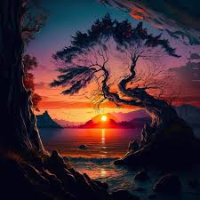
Jesus in Jerusalem
If you will follow Jesus to Jerusalem…
TODAY is a day of God’s favor on you.

