Slide 1
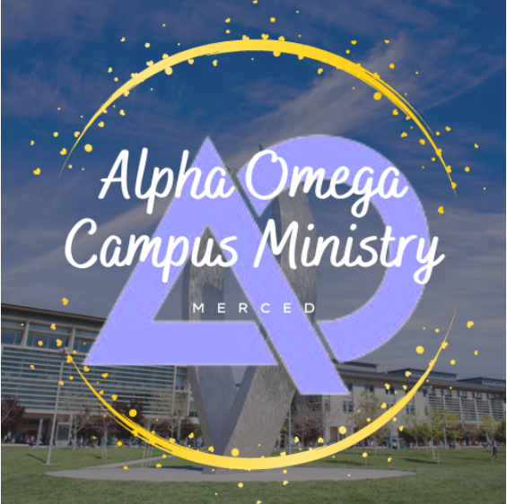
Welcome to the Alpha Omega Club Midweek!

Slide 2
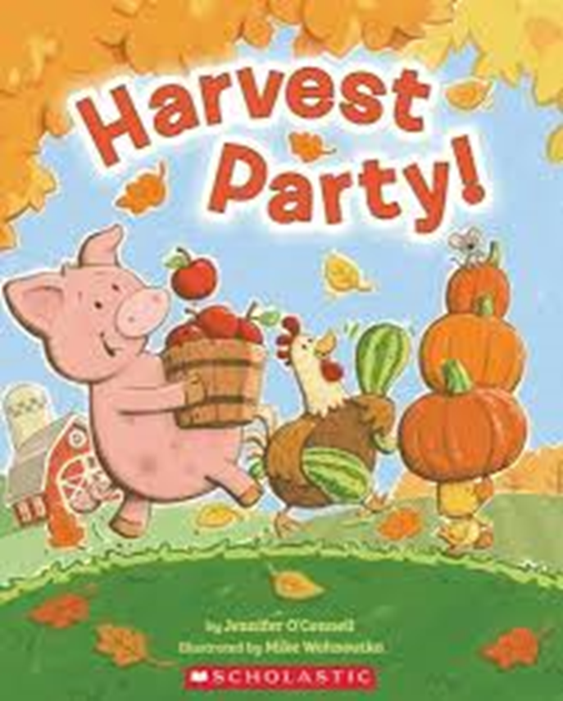
Announcements
Tu 12:00 Bible Talk UCM Pavilion Lawn
Wed 11:30 Bible Talk MC Quad
Midweek Wed 7:30 UCM GLCR 120 Book of Revelation!
Friday 7:00 Harvest Party with a 50’s thee at 1195 Pinnacle Dr.

Slide 3

Coming Up
Harvest Party
Fri. 7:00
50’s Theme
Costume contest
Pumpkin carving
Games and more…

Slide 4
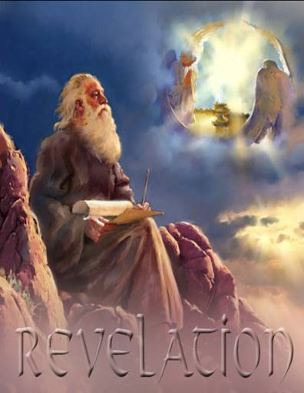
The Book of Revelation
Class #1
Jesus, The Alpha and the Omega
Dr. John Oakes
Merced
Fall, 2024

Slide 5
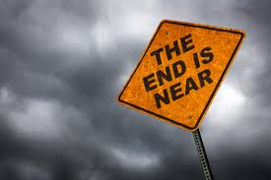
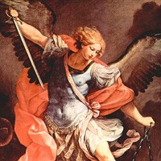
Apocalyptic Literature
Rev 1:1 The revelation of Jesus Christ
revelation = apokalupsis αποκαλυψισ
= unveiling.
Apocalyptic literature is an unveiling
Vision as a literary device

Slide 6
Purpose of Apocalyptic Writing
To show in dramatic fashion that God is in control.
“The purpose of these writings was to stress the virtue of loyalty and of stimulate faith by showing in vivid fashion the certain overthrow of evil and final victory for God’s righteous cause.” (Summers: Worthy is the Lamb)

Slide 7
Characteristis of Apocalyptic Literature
1. Written in times of trouble
2. Cryptic in style
3. Prophecy vs Apocalyptic
4. Always has a definite historical setting
5. Symbolic
Other literature: Assume literal unless
the context demands symbolic.
Apocalyptic: Assume symbolic unless the
context demands literal.

Slide 8
Numbers in Apocalyptic Literature
2 = strength, courage, energy
3 = divine number. Number of God.
4 = the world, the cosmos, creation.
6 = sinister, Satan 6 falls one short of seven. Doom.
7 = perfection, completeness
3-1/2 = incomplete, partial (1260 days, “time, times and half a time”)

Slide 9
Numbers in Apocalyptic Literature (cont.)
10 = completeness
1000 = 10x10x10 = ultimate completeness
12 = Number of religion. God’s people. 12 tribes, 12 apostles.
144,000 = 12x12x10x10x10 All of God’s people

Slide 10
Colors in Apocalyptic Literature
Red war, sacrifice Zech 6:2, Rev 6:4, Is 63:1-6, Joel 2:31, Rev 12:3, 17:3
White purity and innocence Dan 7:9, Rev 1:14, Zech 6:3,6 Rev 7:9,13-14, 19:?
Purple royalty or voluptuous ease Jer 10:9, Rev 17:4, 18:12
Blue heaven, sky, Holy Spirit Rev 9:17
Black famine, death, distress Zech 6:2, 6 Rev 6:5,12,
Pale yellow near the end of life Rev 9:17
Pale death, terror-stricken Jer 30:6, Dan 10:8 Rev 6:8
Crimson blood, atonement
Gold divinity, splendor Rev 1:13 15:6
Green death? 6:8, 8:7, 9:4

Slide 11
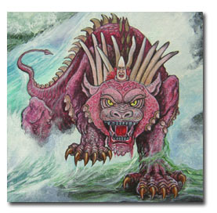
Αποκαλυφισ Characteristics Continued
6. Dramatic.
Arguably, the chief aspect of the Apocalyptic is that it is dramatic.
Dramatic, vivid,
forceful, terrifying,
grotesque
A cosmic graphic novel

Slide 12
Summary: How to Interpret Apocalyptic:
There will be a definite historical setting and cause for the visions. Interpret in light of this setting and cause.
About the imagery: get the big picture and do not get too caught up in the details—do not “push” the details.
After correctly observing the first two steps, you can apply apocalyptic passages to all people and all situations and all times.

Slide 13
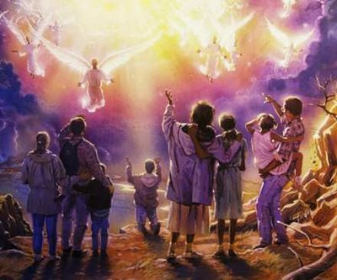
End-Time Theories (Eschatology)
Preterist
  Most or all of Revelation Already fulfilled
Amillenialism
  No physical millenial reign
Dispensational Premillenialism
  Jesus comes back before the millenium
Postmillenialism
  Milennium happens, then Jesus comes back

Slide 14
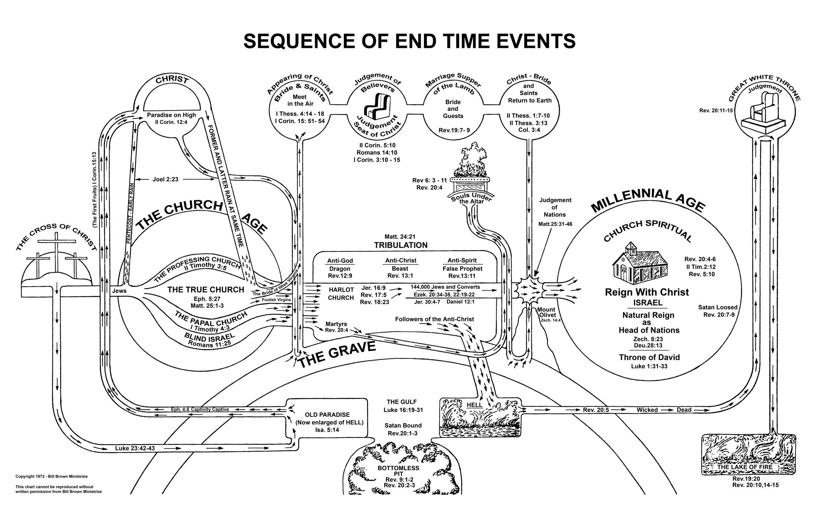
Dispensational Premillenialism

Slide 15
Sir Isaac Newton
The folly of Interpreters has been, to foretell times and things, by this Prophecy, as if God designed to make them Prophets. By this rashness they have not only exposed themselves, but brought the Prophecy also into contempt. The design of God was much otherwise. He gave this and the Prophecies of the Old Testaments, not to gratify men's curiosities by enabling them to foreknow things, but that after they were fulfilled they might be interpreted by the event; and his own Providence, not the Interpreters, be then manifested thereby to the world. For the event of things predicted many ages before, will then be a convincing argument that the world is governed by providence

Slide 16
Historical Background to Revelation
Revelation 1:9 I, John, your brother and companion in the suffering and kingdom and patient endurance that are ours in Jesus, was on the island of Patmos because of the word of God and the testimony of Jesus.
Persecutions of the Church:
Nero AD 64
Domitian 95-97 *
Trajan 98-117
Septimus Severus 202-211
Decius 249-251
Valerian 257-261
Diocletian and Galerian 303-311

Slide 17
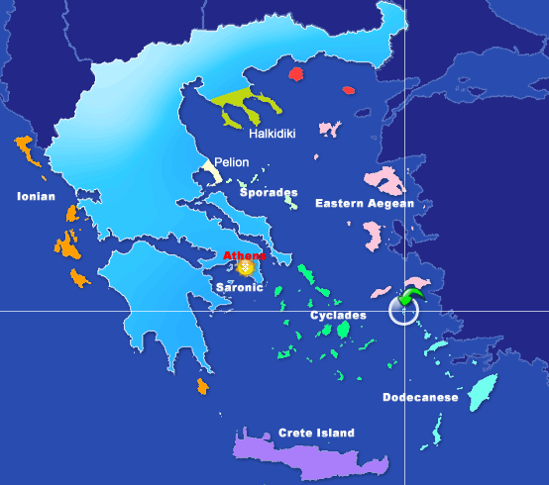

Slide 18
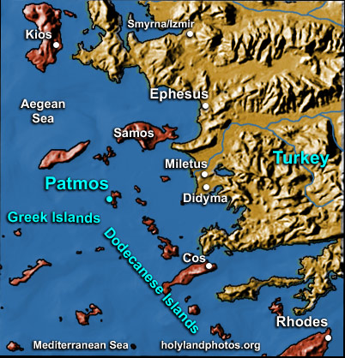

Slide 19
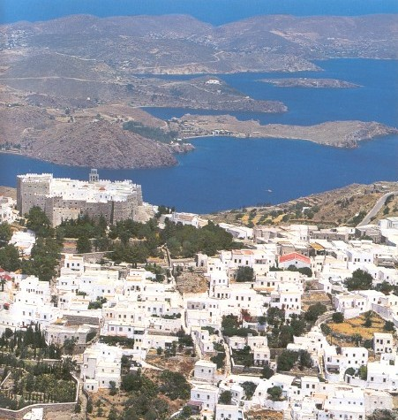

Slide 20
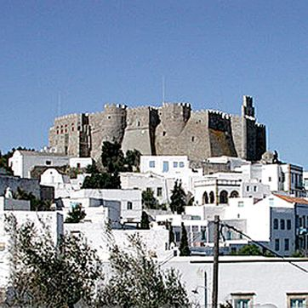
Monastery of St. John, Patmos

Slide 21
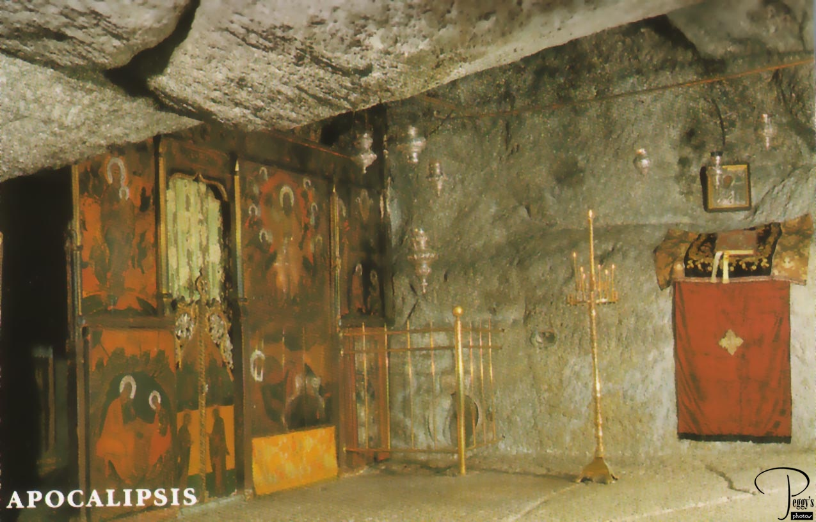
John’s cave?

Slide 22
Theme, Message and Objective of Revelation
Theme of Revelation: Peel back the layers of history and even the terrible persecutions and what do we find? The lamb is on the throne and God is in control.
Message of Revelation: Be encouraged and faithful to Jesus Christ. Jesus, not Caesar, is Lord.
Objective: to comfort persecuted Christians.

Slide 23
Theme, Message and Objective of Revelation
Description of Revelation: A “divine picture-book”. “Spiritual cartoons,” representing the historical development of the early Christian church.
Romans appeals to the intellect/mind
Psalms appeals to the emotions
Revelation appeals to the imagination.

Slide 24
Outline of Revelation
Ch 1 Prologue
Ch 2-3 Letters to the seven churches
Ch 4-7 The Seven Seals
Ch 8-11 The Seven Trumpets
Ch 12-16 Seven Mystical Figures
Ch 15-16 The Seven Vials
Ch 17-20 Enemies of the Church Overthrown
Ch 21-22 The Kingdom of God Revealed

Slide 25
An Outline of the Bible
I. Genesis 1 God created the universe and the earth. It was very good.
II. Genesis 2 God created man so that we could have an intimate relationship with him.
III. Genesis 3 - 11 We messed up very badly—destroying that relationship.
Genesis 12 - Rev 20 God is repairing the damage done by sin.
V. Rev 21-22 God has fixed the problem and we are back in a
relationship with him.

Slide 26
Revelation Chapter 1 Prologue
Revelation 1:1 The revelation of Jesus Christ which God gave to him to show to his servants what must soon come to pass (things it is necessary to come to pass shortly).
Dei δει “must” morally necessary. God’s justice requires that these prophecies must be fulfilled soon
Rev 1:1, 22:6 must soon take place
Rev 1:3, 22:10 the time is near/at hand
Compare to Daniel 9:26 which concerns “the distant future.” (written 550 BC about 167 BC)
Is it about things 2000 years later? No!

Slide 27
Seven Beatitudes in Revelation
Rev 1:3 Blessed is he who reads this prophecy and takes it to heart.
Rev 14:13 Blessed are the dead who die in the Lord.
Rev 16:15 he who watches and is prepared for the Lord’s coming.
Rev 19:9 those invited to the Lamb’s wedding supper.
Rev 20:6 those who have a part in the first resurrection.
Rev 22:7 he who keeps the words of this book.
Rev 22:14 those who wash their robes in the blood of the lamb.

Slide 28
Revelation 1 Prologue (cont.)
Rev 1:4-8,11
Who from? God the father, the Holy Spirit (the seven spirits) and Jesus Christ
Who to? v. 4 the seven churches in the province of Asia
v. 11 Ephesus, Smyrna, Pergamum, Thyatira, Sardis, Philadelphia and Laodicea.
1:3 to all who hear 2:7 to anyone who has an ear.
… what the Spirit says to the churches.

Slide 29
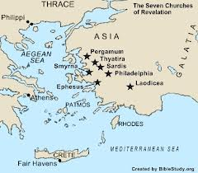

Slide 30
Revelation 1 Prologue (cont.)
Rev 1:9 John can relate to the persecutions that the church will soon be going through.
Why on Patmos? Because of the Word of God.
1:10 On the Lord’s day = Sunday
When you see Jesus, what do you see?

Slide 31
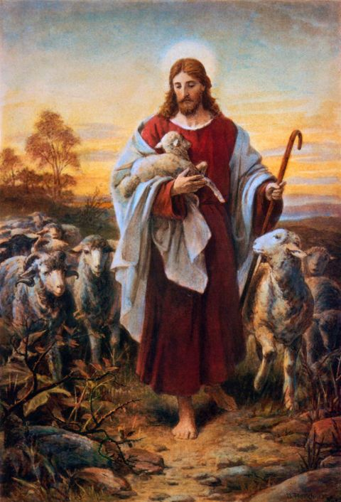

Slide 32
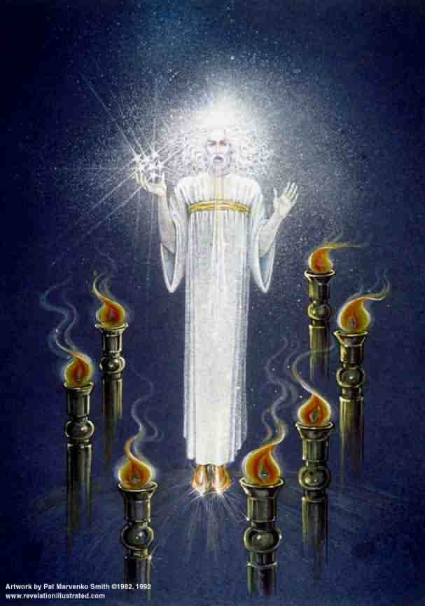
Revelation 1 Prologue (cont.)
Rev 1:12-18
Similar to Daniel 7:9-10
Voice “like a trumpet” A loud and clear message
Blazing eyes See everything
Double-edged sword in his mouth Authority and power of his words
Q: How does this picture of Jesus make you feel?

Slide 33
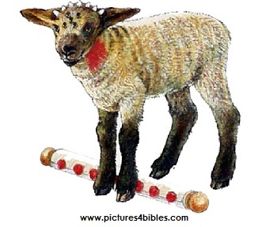
Revelation Ch. 5 The Lion and the Lamb
Jesus is a lion regal, powerful, a danger to enemies
Jesus is a lamb gentle, humble, sacrificial
7 horns = perfect in power
7 eyes = perfect in knowledge

Slide 34
Which is the Real Jesus Christ?
Jesus the ultimate powerful superhero
Jesus the ferocious king
Jesus the gentle, sacrificial lamb

Slide 35
Revelation 2 & 3 Letters to the Churches in Asia
Pattern:
1. Greeting
2. A description of Jesus
3. A commendation (except Sardis and Laodicea)
4. A criticism (except Smyrna and Philadelphia)
5. An appeal and a warning
6. Exhortation and promise

Slide 36
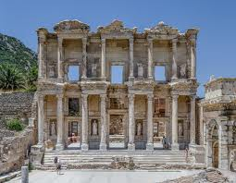
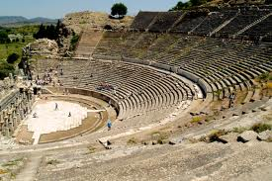
Revelation 2:1-7 Ephesus

Slide 37
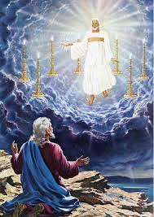
Ephesus
Rev 2:1
…holds the seven stars in his hand
…walking among the golden lampstands
The capital of Christian Asia.

Slide 38
Ephesus: Commendations
Rev 2:2-3,6
Hard work
Perseverence
Staunch opposition to sin and false doctrine
Nicolaitins Acts 6:5?
They had not grown weary
Q: Is this possible, even when we have lost our first love?

Slide 39
Ephesus: Admonitions
Rev 2:4-5
Remember, this is the church John himself was responsible for!
Lost their first love.
Q: What, exactly, had they lost? What was their day-to-day Christian life like?
The solution: Remember and repent!
Do what you did at first. Do it the way you did it.

Slide 40
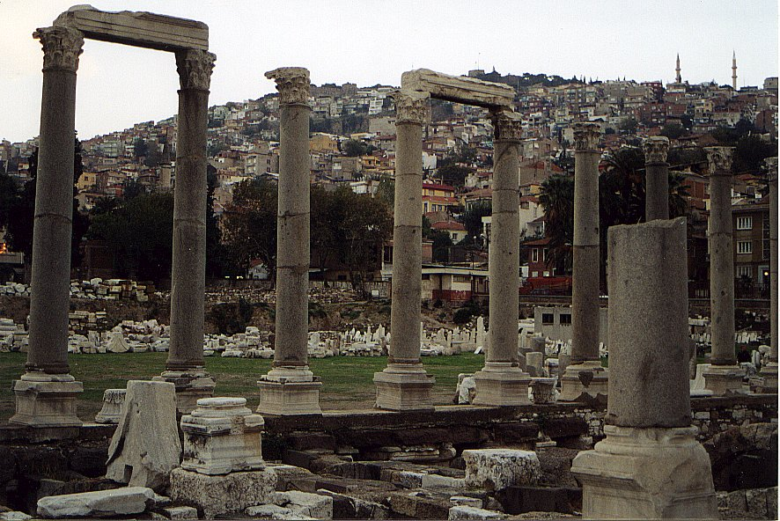
Revelation 2:8-11 Smyrna

Slide 41
Smyrna: Commendations Only
Rev 2:9 Poor but rich.
Q: Do you feel poor? Why? Do you feel rich? Why? 1 Tim 6:8
The Synagogue of Satan Jewish persecution.
Admonition: Stay faithful, even unto death …you will receive a crown
…you will be untouched by the second death (Rev 20:14)

Slide 42
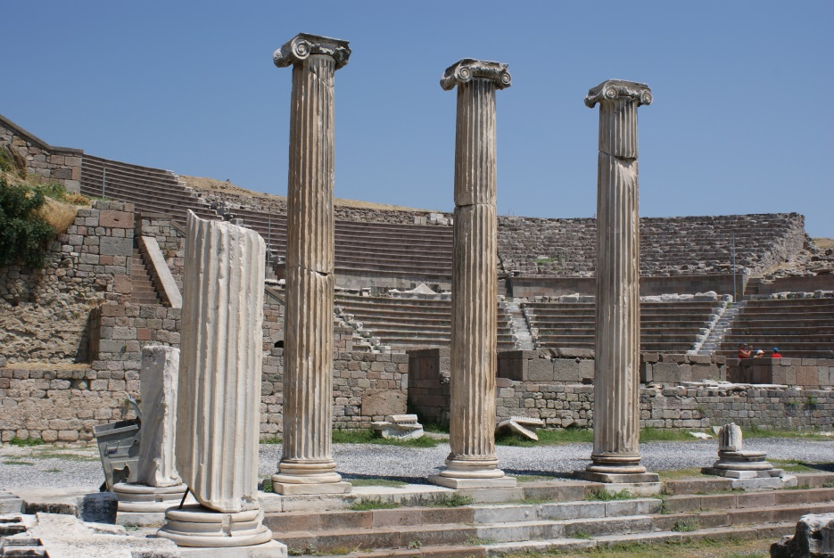
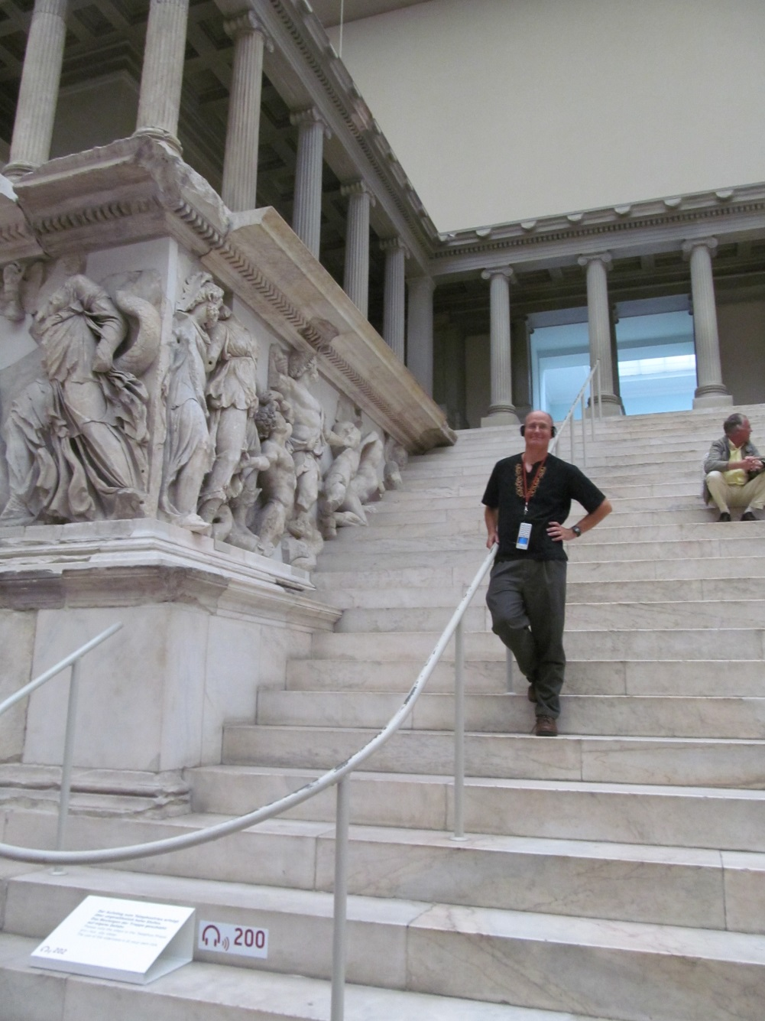
Revelation 2:12-17 Pergamum

Slide 43
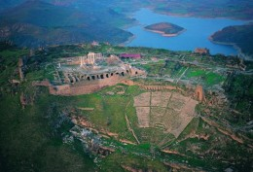
Pergamum
Largest city in Asia at the time
Capital of Roman power
Seat of paganism in Ionia
“Throne” of Satan = Temple of Zeus
Pergamum Library

Slide 44
Pergamum: Commendations
Rev 2:12 the sharp, double-edged sword. Watch out!
2:13 Pergamum is a tough city to build a church!
How would you like to live where Satan lives?
You have endured extreme persecution
Antipas witness = martarus

Slide 45
Pergamum: Warnings
Some hold to Balaam’s teaching.
Some hold to the teachings of the Nicolaitins
Their problem: lack of church discipline
Q: Is tolerance a Christian virtue?
Q: Does Jesus get angry?
God expects the church to discipline these teachers. Q: Why doesn’t he just deal with them?

Slide 46
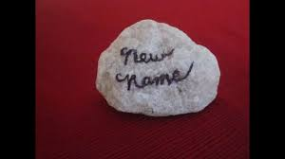
Pergamum: Reassurance
Rev 2:17
Hidden manna
A white stone
Symbol of acquittal in a trial
Symbol of being freed from slavery
A name known only to him who receives it.

Slide 47
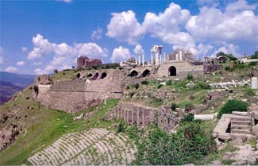
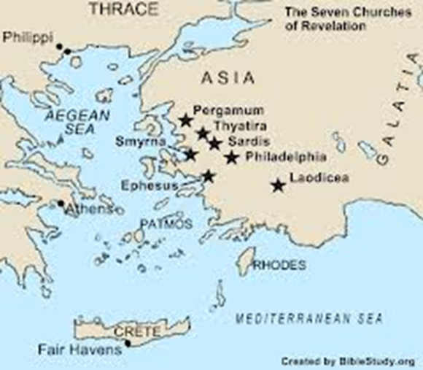
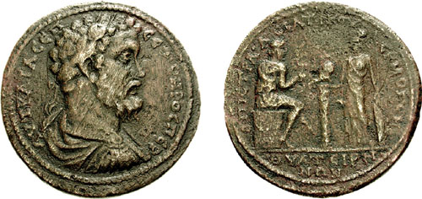
Revelation 2:18-29 Thyatira
Hephaestus: the god of the foundry

Slide 48
Thyatira
Thyatira a city of trades and unions/guilds
Specialized in purple cloth (Lydia)
Specialized in bronze craft
Being in a guild required participation in pagan sacrifices, including fornication.

Slide 49
Thyatira: Commendation
Jesus: Eyes like blazing fire, feet like burnished bronze.
Rev 2:19
Giving
Serving
Growing!
But…. The seeds of spiritual disaster had already been planted!

Slide 50
Thyratira: Warnings
Rev 2:20 You tolerate that woman Jezebel
Probably a prominent and charismatic woman
Her sin? Probably encouraging participation in the idolatry required to keep a job in one of the trades in Thyratira
Those who “committed adultery” with her and “her children” are those who accepted her teaching.
A warning against divisiveness

Slide 51
Thyratira: Warnings and Encouragement
Rev 2:21-23
I have given her time to repent
I will deal with Jezebel (unlike in Pergamum)
2:24 “deep teaching” a reference to Gnosticism
2:25 Assurance: Hold on until the end… I will
give you authority over nations (1 Cor 6:2-4)

Slide 52
Discussion Questions
1. Which of the pictures of Jesus (powerful superhero, lion, lamb) is most encouraging to you and why?
2. How are you doing in the area of “maintaining the love you had at first?”
3. Do you tolerate sin?

Slide 53
Letter to the Churches
Summary so far
Ephesus: Hard work, sound doctrine
But… Lost first love.
Smyrna: Poor but rich.
Pergamum: Endured extreme persecution faithfully
But… They are tolerating sin. No church discipline
Thyatira: Giving, serving, growing
But… Tolerating idol worship and Gnostic teaching

Slide 54
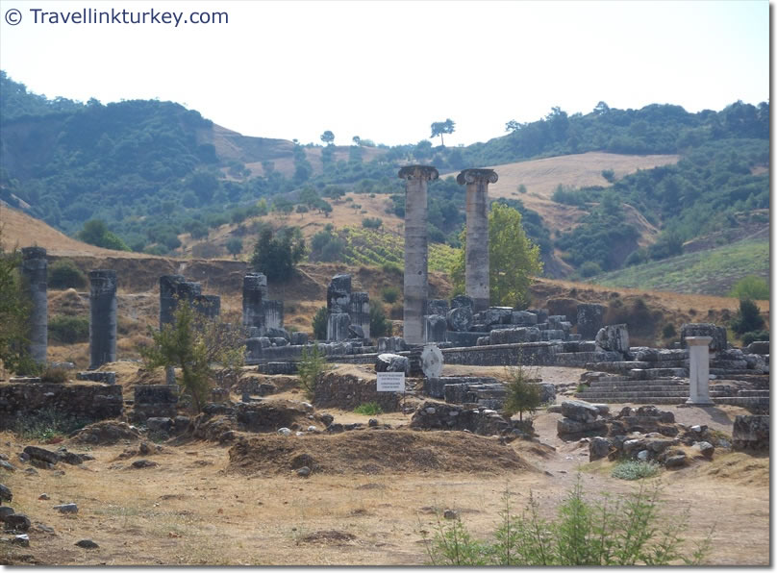
Revelation 3:1-6 Sardis

Slide 55
Sardis
Capital of Lydia and of King Croesus
On a very steep mountain—thought to be impregnable
Nevertheless, conquered by Cyrus 549 BC
Conquered by Antiochus III 218 BC
A symbol of overconfidence and unjustified pride. Living on past greatness.
Famous for robbers.

Slide 56
Sardis: Warnings First!
Rev 3:1 You have a great reputation, but you are dead, spiritually!
Their problem was not sin, per se, but lack of doing things God expected them to do.
Q: What about you?
Rev 3:2 Solution? WAKE UP!!!! (Hebrews 2:1)
Remember, obey and repent.
I will come like a thief

Slide 57
Sardis: Encouragement
No encouragement to the church as a whole
3:4 Yet you have a few in Sardis…
Even in a dead church, some will be alive. Despite what Jesus is saying to the churches, we are saved individually.
3:5 To all disciples: He who overcomes will, like the few faithful Sardisians, be dressed in white.

Slide 58
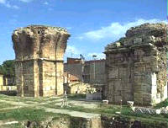
Revelation 3:7-13 Philadelphia

Slide 59
Philadelphia
A significant Jewish population. The Synagogue of Satan
Rev 3:7 Jesus holds the key of David.
Isaiah 22:21-22 A messianic prophecy

Slide 60
Philadelphia: Encouragements Only
Rev 3:8 You are small and weak, but doing great!
3:9 You are the true Jews
The Jews will fall at your feet some day. Wow!
I will give you a crown
I will make you a pillar
You will never again have to leave it
Your will have a new name.
All these are relevant to specifics of Philadelphia

Slide 61
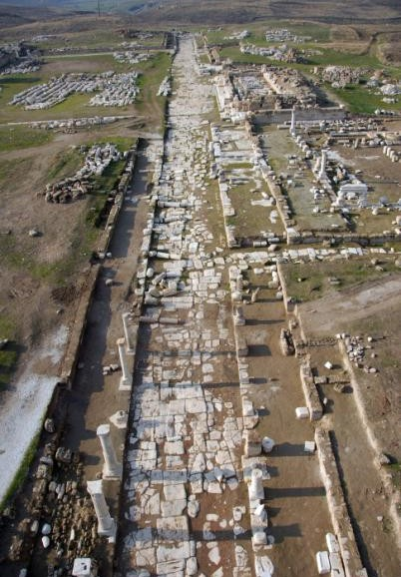
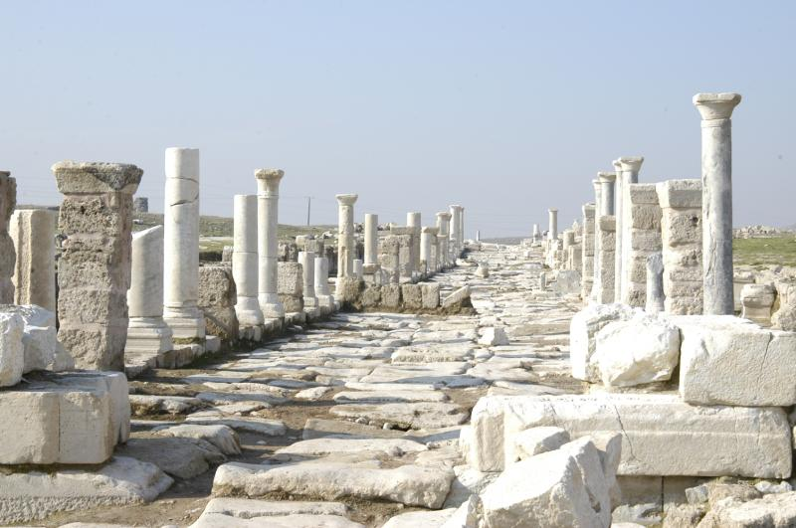
Revelation 3:14-22 Laodicea

Slide 62
Laodicea
A center of banking. A very rich city
A center of the wool industry. Black wool.
Most famous school of Medicine. Famous for their eye salve.
All these are used by Jesus in his admonition

Slide 63
Laodicea: Warnings Only
Their sin? Lukewarmness. Hypocrisy
Jesus: You make me want to throw up!
Wouldn’t it be better to be a half-hearted Christian than a blatant pagan?
Why not?

Slide 64
Laodicea: Lukewarm Christianity
Rev 3:17 How do we become lukewarm?
By relying on self rather than God.
You say you are rich
You say you need nothing (from God)
Q: Do they actually say this?
Reality check: You are wretched, pitiful, poor, blind and naked.

Slide 65
Laodicea: It’s Not Too Late!
1. Admit you are wretched, pitiful, poor blind and naked.
2. Rev 3:18 Buy gold from Jesus.
3. Apply the eye-salve of Jesus John 9:31
Q: Do you need some of this salve to see
your need for God?
4. Rev 3:19 Accept God’s rebuke and
discipline

Slide 66
Laodicea: Summary
Repent!
I stand at the door and knock.
Jesus is waiting, but he will not force his people to eat with him.
Does this prove that we can pray Jesus into our hearts?
Message of Revelation: To him who overcomes, I will give the right to sit with me on my throne
We are about to get a view of that throne!

Slide 67
Revelation Ch 4
Trust in God
Revelation Ch 5 Trust Also In Me

Slide 68
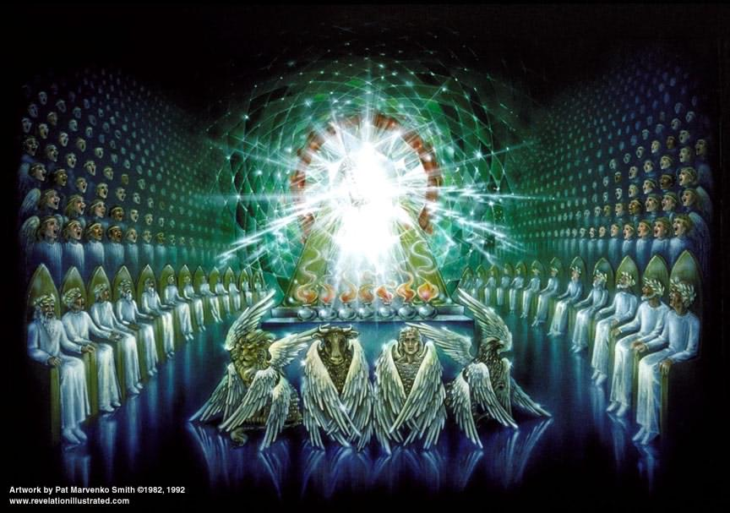
Revelation Chapter 4
Enter the Throne Room

Slide 69
Revelation Chapter 4
Now the visions begin.
Be prepared to use your imagination.
Revelation Ch 4 Believe in God
Revelation Ch 5 Believe also in Jesus (John 14:1)
How does the vision begin? God is on his throne!!!!!!

Slide 70
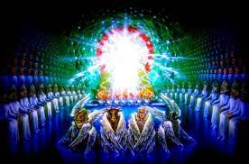
Ch 4 The Throne Room
Jasper white Holiness
Carnelian red Justice
Rainbow God’s promise/covenant
emerald/green: life
Throne 38 times in Rev
Throne 17 times in Ch 4-5

Slide 71
The Throne Room (cont.)
v. 4 24 elders: 12 tribes and 12 apostles
12 (God’s people) x 2 (power)
The elders represent us!
v. 5 lightning and thunder Judgment
v. 6 Sea of crystal = separation of holy from profane.

Slide 72
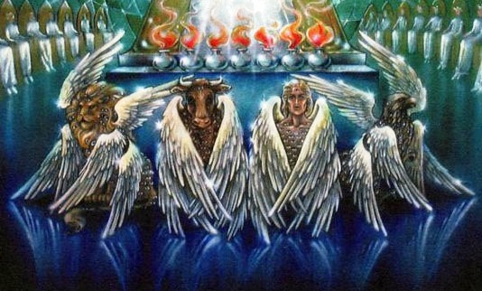
The Throne Room (cont.)
The four Cherubim:
Eyes = vigilance
Lion Ox Man Eagle power!

Slide 73
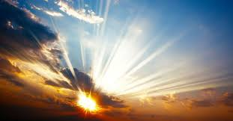
Holy, Holy Holy (Isaiah 6:3)

Slide 74
Discussion Questions
1. Have you been guilty of lukewarmness recently? In what way? What will you do?
2. Given the vision of God in Revelation 4, what do you think about God?

Slide 75
Revelation Ch. 5 Enter Jesus!
The Lion and the Lamb
Ch 4 Trust in God.
Ch 5 Trust also in me.
A scroll with seven (perfect) seals which no one was worthy to open.

Slide 76
Enter: Jesus Christ!!!
Jesus is a lion Royal, Triumphant Gen 49:8-11
Jesus is the Root of Jesse Messiah Is 11:1-5
Jesus is a lamb A humble sacrifice
7 horns = perfect in power
7 eyes = perfect in knowledge

Slide 77
Worship the Lamb who was slain
Harps = singing to the Lamb
Incense = prayers of the saints
Rev 5:9-14 A New Song
v. 10 A kingdom of priests. Exodus 19:6 has been fulfilled!
Romans 15:15-16 Our priestly duty
Worthy is the lamb who was slain!!!!!!

Slide 78
Revelation 6 The Lamb opens the Scroll
Now the action really begins!
Structure of Revelation 6-20:
Seven seals Revelation 6-7
Seven trumpets Revelation 8-9
Seven symbolic creatures Revelation 10-14
Seven bowls Revelation 15-16
God’s enemies judged Revelation 17-20

Slide 79
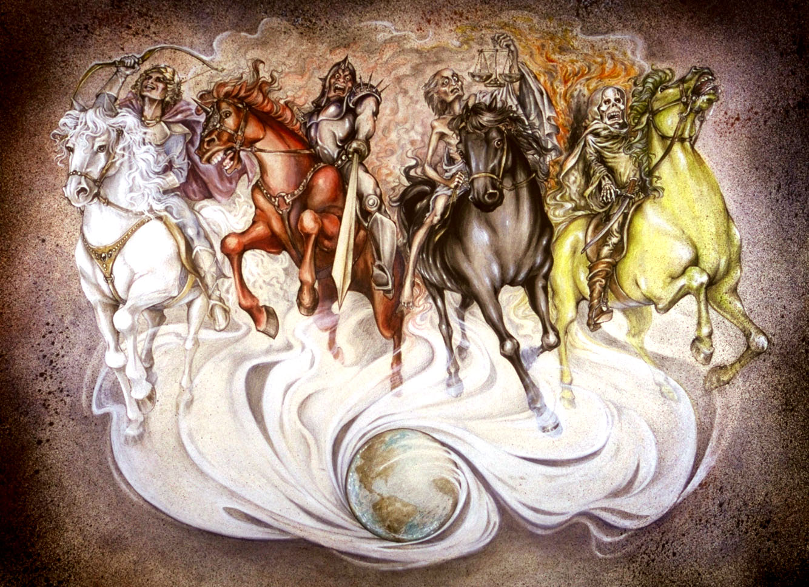
Revelation 6: The Seven Seals
The Four Horsemen
Revelation 6:1 Come!!! Come see the vision.
Hoofbeats are heard in the distance…

Slide 80
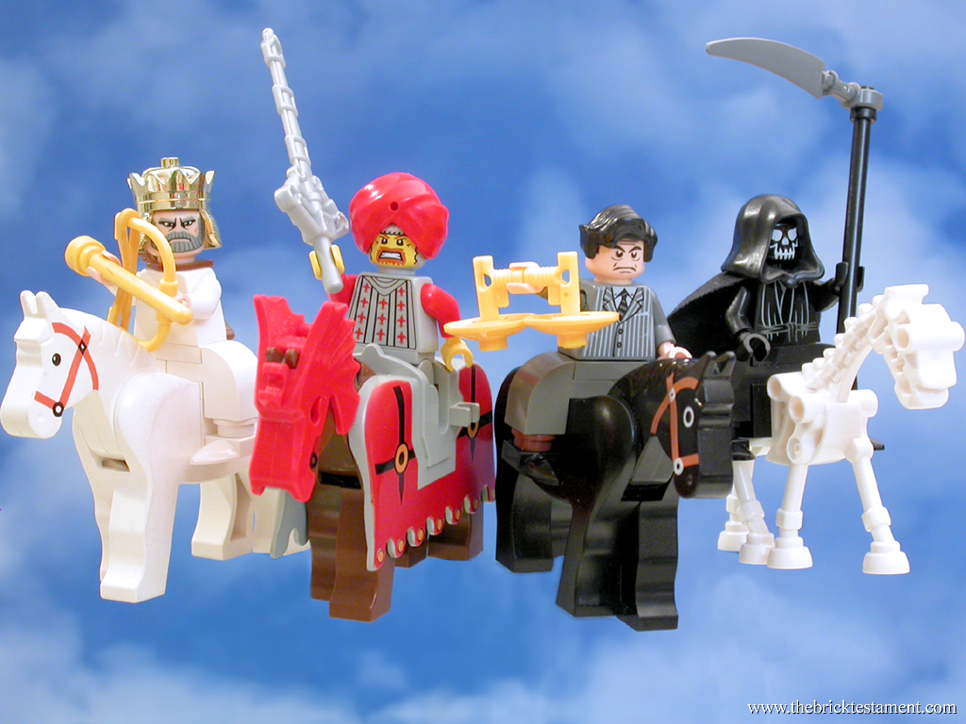
The Four Horsemen

Slide 81
Revelation 6 Four Horsemen
Seal #1 A rider on a white horse. A crown and a bow. A Parthian symbol of victory (over Rome)
Seal #2 Red horse = War “the power to take peace from the earth.” Represents persecution to the church.
Seal #3 Black horse = Famine Scale to measure food. Oil and wine available: The rich are still doing fine.
Seal #4 Pale yellow-green horse = Death Martyrdom in the church.

Slide 82
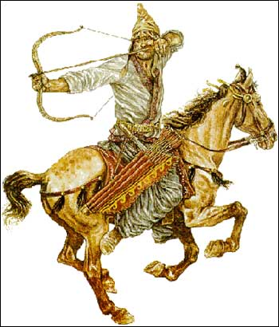
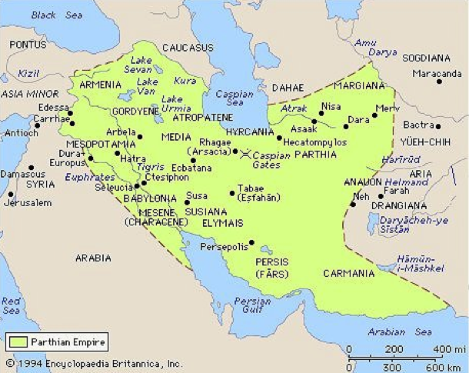
Revelation 6:2 Parthia

Slide 83
Revelation 6 Seal #5,6
Rev 6:9-11 The fifth seal. Martyrs before the throne of God.
How long… before God judges the wicked?
Retribution for God’s people Psalm 94:1-3 Rev 16:5-6
Do you long to see vengeance on God’s enemies?
Romans 12:17-21
God’s answer: Rev 6:11 Not yet.

Slide 84
The Sixth Seal: The Day of the Lord
Rev 6:12-17 The sixth seal.
Earthquake, sun turns black, moon turns red, stars fall from the sky, the sky recedes like a scroll and the mountains removed. Everyone hides in caves and among the rocks.
Judgment is coming. The Day of the Lord is here. Hide!
Rev 6:17 Who can stand under this? Answer: Revelation 7!

Slide 85
Revelation 7
Interlude #1: The Saints are Sealed
Four angels hold back the winds. Winds = the action of God to judge his enemies.
The sealing of the 144,000 Ezekiel 9:1-4
Seal = ownership
12 x 12 x 10 x 10 x 10 All of God’s people. Every single one!!!
A multitude no one could count is the same people: Those saved from the coming wrath of God.
Sealed: The Holy Spirit Ephesians 1:13-14.

Slide 86
The 144,000 Sealed
The 144,000 are “a great multitude no one could count. White robes = pure, forgiven, righteous
Palm branches = joy The Feast of Tabernacles Celebrating salvation and living in a relationship with God.
Rev 7:10-15 A fantastic worship service breaks out
Salvation belongs to our God.
Rev 7:15 God spreads his tabernacle over us.

Slide 87
Summary
Circumstances may get bad.
God’s enemies may seem victorious.
But God will judge his/our enemies.
God will save us from the tribulation. We are in his tent/tabernacle.

Slide 88
Discussion Questions
1. What do you learn about Jesus from Revelation 5? How does this make you feel?
2. Are you comfortable with the elders in Rev 6:10 calling on God to come and judge—to avenge the blood of the martyrs.
3. What is your response to the sealing of the 144,000 in Rev. 7. What does it mean to you?

Slide 89
Revelation 8-9 The Seven Trumpets
Structure of Revelation 6-20:
Seven seals Revelation 6-7
Seven trumpets Revelation 8-9
Seven symbolic creatures Revelation 10-14
Seven bowls Revelation 15-16
God’s enemies judged Revelation 17-20

Slide 90

Revelation 8 & 9 The Seven Trumpets
Rev 8:1 The seventh seal is the seven trumpets
Trumpets:
Warning of impending judgment
Feast of Trumpets/Rosh Hashanah
Rabbis: Stay awake all night
Matthew 25:32-31 1 Thess 4:13-14 The trumpet call

Slide 91
Revelation 8 The First Four Trumpets
Judgment on Nature
Rev 8:7 Trumpet #1 Hail, fire and blood Egypt plague #7 God goes after the crops of the persecutors of.
1/3 = a limited judgment
Rev 8:8-9 Trumpet #2 Sea turns to blood Plague #1 God goes after the means of commerce
Rev 8:10-11 Trumpet #3 Wormwood God goes after the fresh water. Jer 9:15 wormwood
Rev 8:12 Trumpet #4 God goes after the heavenly objects. Plague #9

Slide 92
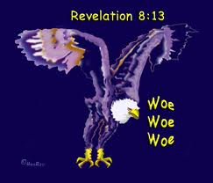
Rev 8:13 Woe!
An Eagle says woe, woe, woe. Three woes are coming (trumpet #5,6,7)
Trumpet #1-4 Judgments on the earth. Trumpet #5,6 Judgment on people

Slide 93
Revelation 9 Trumpet #5,6 Woes!
Rev 9:1-12 Trumpet #5. Judgments on men. Locusts (plague #8)
Fallen Star = Satan who holds the key to the Abyss
Locusts = Demons who torment those who do not
worship God.

Slide 94
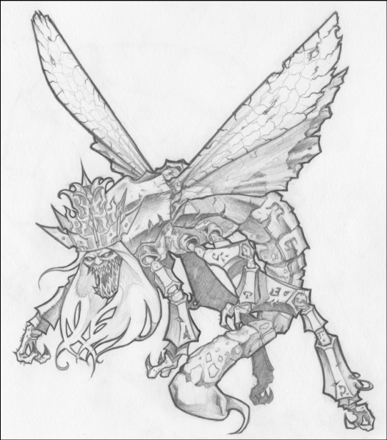
Trumpet #5 (cont.)
Rev 9:7-10 Bizarre locusts!!!
Satan is their king!
Summers: “The locusts represent the hellish rottenness, the internal decadence in the Roman Empire.”

Slide 95
Revelation 9:13-20 Trumpet #6 Woe #2
War comes to Rome
9:14 bound at the River Euphrates = Parthia: the chief military rival of Rome.
Rev 9:21 A depressing result. Rome did not repent. It is time for the 7th trumpet and the seven bowls!

Slide 96
Revelation 10:1-11:14
A Second Encouraging Interlude
10:5 NO MORE DELAY Judgment is at hand.
v. 9-11 Eat the scroll (which is the rest of Revelation)
Tasted sweet (it is God’s word after all!
Turned sour in the stomach (bad news for the saints)

Slide 97
Rev 11:1-6 Two Witnesses
God measures the temple courts, but not the court of the Gentiles.
God will protect the heart of the church, but he will give Rome some freedom to go after his saints.
v. 2 The court of the Gentiles will be trampled for 42 months. Limited persecution of the church—allowed by God.

Slide 98
3-1/2 Years/Days in the Bible
1. The period the church will be persecuted Rev 11:2
2. The period during which the two witnesses will testify Rev 11:3
3. The period over which the Woman is nourished in the wilderness Rev 12:6,14
4. The period of the Beast’s authority Rev 13:5
5. The period the little horn persecutes the saints Daniel 7:25
6. The period of the abomination of desolation by Antiochus Ephiphanes Dan 12:11

Slide 99
Rev 11:3-6 The Two Witnesses
The two witnesses are the “witness” of the church during the time of the trampling.
The two olive trees and the two lampstands: Zechariah 4:12-14 Joshua (priestly authority) and Zerubbabel (civic authority). Zechariah 4:4-6 The witness of the Holy Spirit.
v. 5-6 The Church’s testimony will be very powerful!!

Slide 100
Rev 11:7-12 The Serpent Attacks the Church and is Defeated.
v. 7 Some saints will be killed.
v. 8 Sodom/Egypt/Jerusalem = Rome
v. 9-10 The “world” will gloat over the defeat of the church, but only for 3-1/2 days.
v. 11-12 But the church will come back, seemingly from the dead. The saints will be victorious!!!!!

Slide 101
Rev 12 Now We Look Behind the Scene
Rev Ch 1-11 Act I The view from the perspective of the church—up front.
Rev Ch 12-22 Act II The view of matters from the perspective of heaven—behind the scene.
Rev 12:1 A wondrous sign appeared in heaven

Slide 102
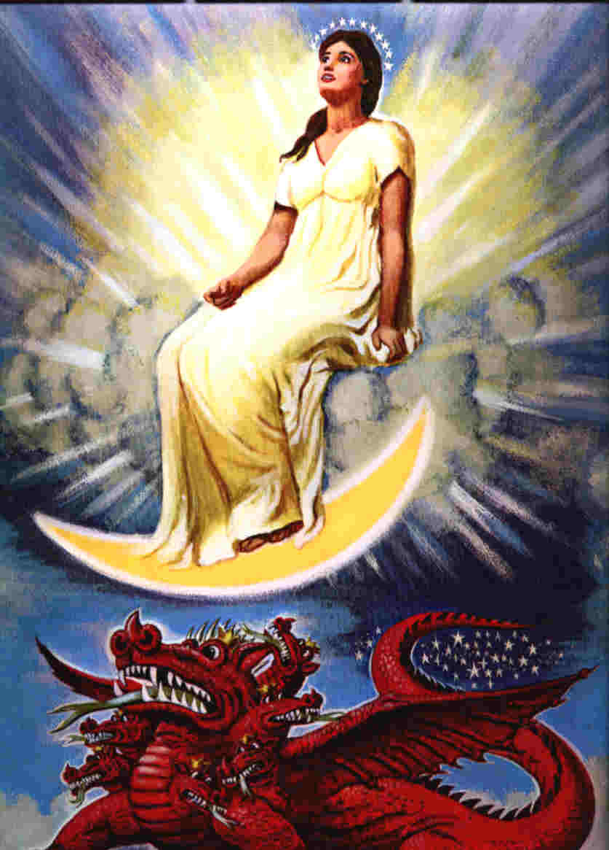
Revelation 12 The Woman and the Beast

Slide 103
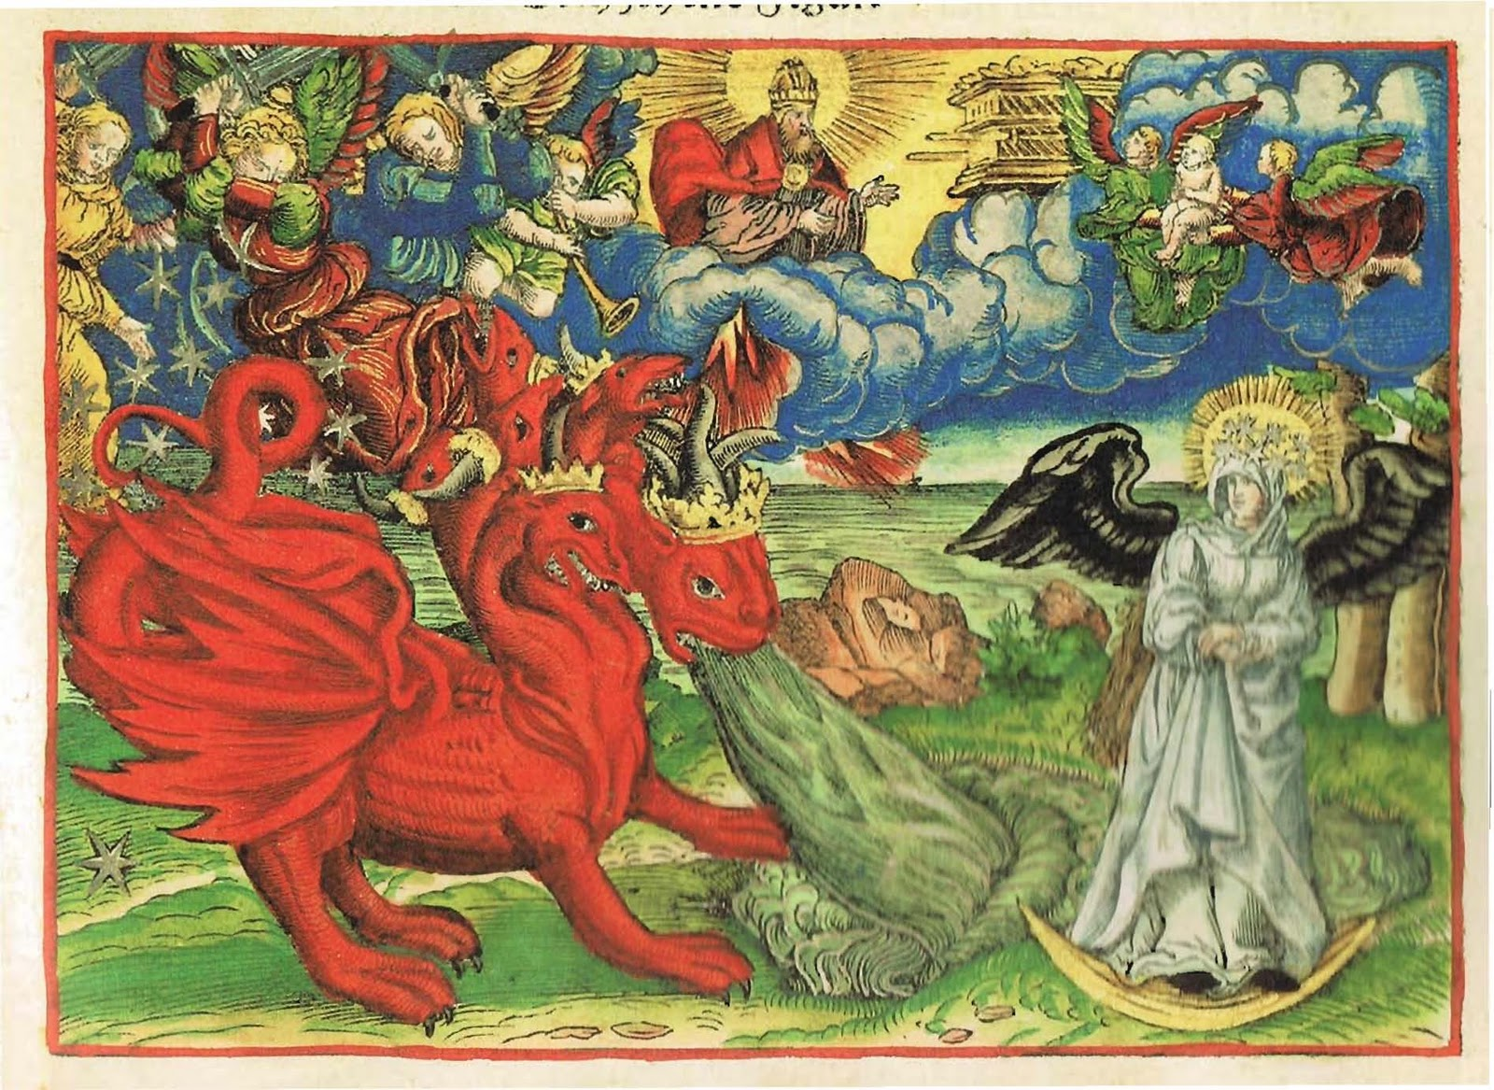

Slide 104
Revelation 12:1-3
A great and wondrous sign.
Who is the woman?
She is Israel—about to give birth to the Messiah
She is the Church—about to be persecuted
She is God’s kingdom in any of its aspects.
Another sign: An enormous red dragon.
7 heads (great wisdom)
10 horns (very powerful)
7 crowns (great authority (on the earth at least))
Satan! Rome! (Rev 17)

Slide 105
Rev 12:4-6 Satan Goes After the Son and, Later, His Church
12:4 Satan tries to devour the child when the woman (Israel/Mary) gives birth. Herod kills the children of Bethlehem.
v. 5 The child “who will rule all the nations” is snatched up to heaven.
v. 6 The woman (the Church) flees to the desert and is cared for by God for 1260 days. Persecuted but protected.

Slide 106
Rev 12:7-17 Spiritual War in Heaven… and On Earth
12:7-10. Satan is defeated and cast down to the earth.
Q: Is this a good thing for the Church?
The result: vicious persecution of the church! (12:13)
The Devil: Deceiver (9:9) Accuser (9:10)
Q: Which method does Satan use with you?

Slide 107
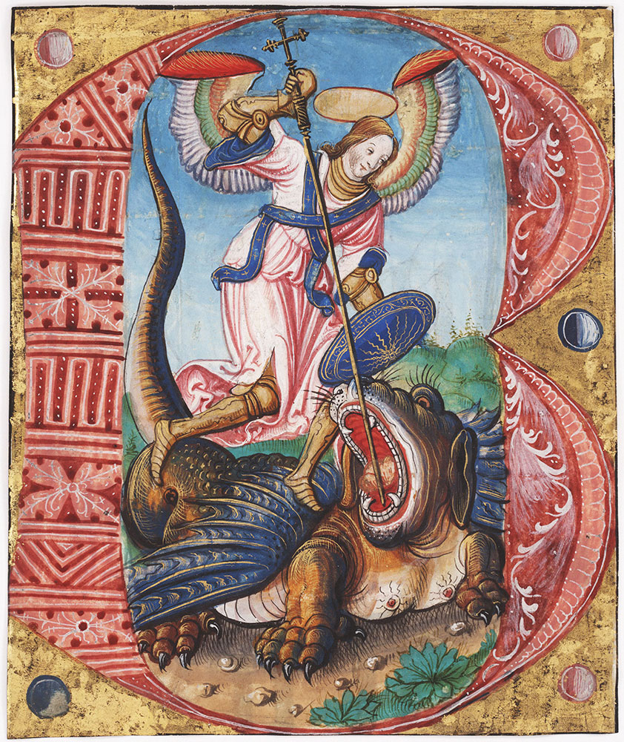

Slide 108
How Do We Overcome the Work of Satan in Our Lives? (Rev 12:11)
1. By the blood of Jesus.
2. By the word of our testimony.
Remember the two witnesses.
3. By our willingness to give up our very lives rather than worshipping the Beast. They “loved not their lives”
Rev 12:14-16 The Church will be protected from the Serpent 3-1/2 years.

Slide 109
Summary
God will protect his people
We have a powerful testimony
There is a spiritual battle going on
But we will overcome
-by the blood of Jesus
-by the word of our testimony
So let us not love our lives so as to shrink back from death.
We will triumph over the Serpent/Devil.

Slide 110
Discussion Questions
1. Are you ever tempted to think that Satan/the world has won and to give up?
2. What do you learn from the two faithful witnesses and from what God does for/through them?
3. What has been the “word of your testimony” recently?

Slide 111
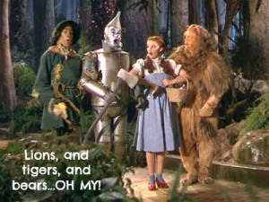
666, Armageddon, and the Millennium, Oh My!

Slide 112
Revelation 13 The Two Beasts
Rev 13:1 The dragon stood on the shore of the sea.
Rev 13:2 A beast from the sea = Rome!
7 horns = Augustus, Tiberius, Claudius, Caligula, Nero, Vespasian and Titus Rev 17:9
One head seems to have a fatal wound. Nero
But the would has been healed. Domitian

Slide 113
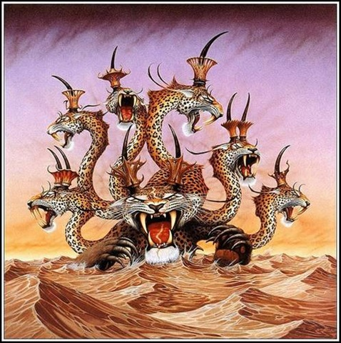
The Beast From the Sea

Slide 114
The First Eleven Emperors of Rome
The Ten Horns and the Seven Heads
Emperor
Dates of Rule
Significance to Biblical Events
Augustus
27 BC-14 AD
Birth of Christ
Tiberius
14 AD-37 AD
Crucifixion of Christ
Gaius (Caligula)
37 AD-41 AD
Claudius
41 AD-54 AD
Jews Exiled from Rome
Nero
54 AD-68 AD
First persecutions, Execution of Paul and Peter
Galba
68 AD-69 AD
One of the three overcome by Vespasian
Otho
69 AD-70 AD
One of the three…
Vitellius
69 AD-70 AD
One of the three…
Vespasian
69 AD-79 AD
Attack on Jerusalem
Titus
79 AD-81 AD
The general who destroyed Jerusalem
Domitian
81 AD-96 AD
First Systematic Persecutor of the Church

Slide 115
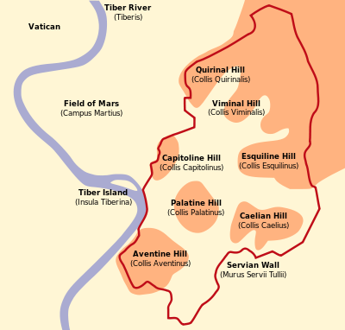
Rev 17:7-11 Seven Hills, Seven Kings and an eighth King.
Augustus
Tiberius
Caligula
Claudius
Nero
Vespasian
Titus
Domitian The 8th King
Domitian is the Beast

Slide 116
The Beast From the Sea
v. 5-7 Domitian given temporary power over the saints (42 months) and to make war on the saints.
v. 8 Everyone (except the Saints, of course) will worship Domitian—the Beast. This was literally true.
This is very scary for the church!!!!!

Slide 117
Assurance For the Saints
v. 8 Those who do not worship the beast will have their name written on The Lamb’s book of life!!!
v. 9-10 But…. Reality check here…. Some who refuse to worship the beast will be put in jail and some will be killed.
v. 11 This calls for patient endurance of the Saints. I would say so!!!

Slide 118
Revelation 13:11-18 The Beast Out of the Earth: Roman Religion
Rev 13:11 Another beast. The religious power of Rome.
It caused the Roman people to worship Rome/Domitian.
False miracles
13:17 The mark of the beast was not a literal mark, but it was an official document declaring that you made the sacrifice
Domitian’s number is 666. He is Satan’s man.

Slide 119
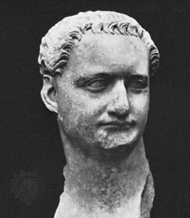
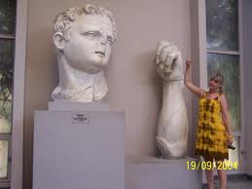
Domitian (c. 81-96 AD)
The Beast out of the Earth
666

Slide 120

Rev 13:17 The Mark of the Beast
Do Not Worship the Beast

Slide 121
Rev 16:16-23 The Final Bowl
v. 16 A war at Har Megiddo.
1. Israel defeated Jabin Judges 4,5
2. Gideon defeated the Midianites. Judges 7,8
3. Saul defeated by the Philistines.
4. Ahaziah defeated by Hazael and killed by Jehu.
5. Necho slew Josiah (2 Chron 35:20-25)

Slide 122


Megiddo

Slide 123
Armageddon
A literal battle?
300 million + soldiers
Between Parthia and Rome?
Rev 16:19 An Earthquake. Rome is divided and destroyed.

Slide 124
Revelation 18-20:10 The Enemies of God and of the Church Are Destroyed
Revelation 18 The Great Prostitute is judged and destroyed.
Revelation 19 The Beast and the False Prophet are judged and destroyed.
Revelation 20:1-10 The Serpent/Satan is judged and destroyed.

Slide 125
Rev 18:1-8 Fallen is Babylon the Great
Babylon/The Great Prostitute: Rome in its materialistic aspect. It is “the world” of 1 John 2:15-17
Rev 18:4 God’s advice about the world: Come out of her!
Q: Why is “the world” so enticing? Rev 18:3 she made them rich.
18:6-8 The fate of the world. Advice: Make sure this does not apply to you!

Slide 126
Revelation 18:9-24 The World is Weeping
Rev 18:2 Fallen is Babylon the Great (Rome)!
Rev 18:9 Crying over the destruction of Babylon/Rome. Why? v. 11-13 Greed! This is worldly grief.
Rev 18:15-16 Sad because they lost $$$
Rev 18:17-24 This is literally what happened to Rome.
The population dropped from 1.5 million (AD 120) to about 15 thousand (AD 800)

Slide 127
Discussion Questions
1. Have you been clothed with Christ? When?
2. What does it mean in Rev 16:15 “Blessed is the one who stays awake and remains clothed?”
3. Did you learn anything new tonight about 666, the mark of the beast or Armageddon?

Slide 128
Revelation 19
The Fall of the Beast and the False Prophet
Rev 19:1-9 Worship #7
Q: How many times does Hallelujia appear in the Bible? (4 times, all in Rev 19)
Rev 19:6-9 Now, what are they cheering about? We are getting married to Christ!
2 Cor 11:2 Now we are engaged to Christ.
19:7 Our fine linen is righteous deeds.
19:9 Right now, we have only been invited. The marriage has not yet been consummated.

Slide 129

Revelation 19 (cont)
Rev 19:11-16 Jesus a warrior on a white horse.
We are in this army!
Rev 19:20-21 The Beast and the False Prophet thrown into the fiery lake.

Slide 130
Revelation 20:1-3 Satan is Bound
v. 2 Satan “chained.” for 1000 years.
1000 years is symbolic—a long time
In what sense was/is Satan bound? A partial and temporary limitation of his power to deceive?
He certainly was not completely bound!
A possible explanation: He no longer has the Beast, the False Prophet and the Great Prostitute to use to attack the saints. (which actually happened after AD 325)

Slide 131
Revelation 20:3-6
Rev 20:3 After the 1000 years of binding, Satan will be “set free” of the chain “for a short time.”
Rev. 20 implies this “short time” will end with the second coming of Jesus.
Likely interpretation: An outburst of state-based persecution of fairly short duration may break out at the end of time.

Slide 132
Revelation 20:7-10 Satan thrown into the lake of burning sulfur
Revelation 20:7 A Fast-Forward to the final resurrection at the end of time. Similar to Daniel 12:1
End Times Have Arrived.

Slide 133
Summary
There is an invisible spiritual battle.
The “world” (political, economic, religious) is in service to Satan.
But God has put is mark on us—the Holy Spirit
Do not bow to the “gods” of this world.
The second death has no power over us. We will reign with Christ!!!

Slide 134

Revelation 20:11-15 Judgment Day
The Great White Throne

Slide 135
Revelation 20:11-15 Judgment Day
Parallel verse: Daniel 12:1-4
v. 12 the dead, both great and small…
No favoritism
1 Pet 1:17 Since you call on a Father who judges each person’s work impartially, live our your time as foreigners here in reverent fear.

Slide 136

Are You a Big Wig?
And I saw the dead, both great and small…

Slide 137

Two Books
A book of works
The Lamb’s book of life

Slide 138

The Second Death
Rev 20:14-15 The lake of fire is the second death. Anyone whose name was not found written in the book of life was thrown into the lake of fire.
(also Rev 21:8)

Slide 139
Revelation 21-22 The New Jerusalem
Rev 21:1-8 Perfect fellowship with God
Rev 21:9-26 Perfect protection by God
Rev 22:1-5 Perfect provision from God

Slide 140

A New Heaven and a New Earth
I saw the Holy City, the New Jerusalem coming down out of heaven from God.
Heaven→
Earth→

Slide 141
Rev 21:1-8 Perfect Fellowship with God
Rev 21:1 No more sea. Full and free access to the throne.
Rev 21:3 The dwelling (tabernacle) of God is with men. How great is that?
Rev 21:4 tears wiped away, no more death or pain.
Rev 21:5 All is made new!!!
Rev 21:6 You can count on it!

Slide 142
Revelation 21:9-26 Perfect Protection
v. 12 …it had a great, high wall. Well protected
With twelve gates never shut. Lots of access.
v. 15 a measuring rod. Protection
v. 17 a wall 200 feet thick
v. 21 12 gates made of pearls.
v. 22 no temple in the city. The city is a temple.
v. 23 no sun needed
v. 25 Gates never shut. Security.

Slide 143

Gates of Pearl

Slide 144

Pearly Gates

Slide 145
Revelation 22:1-6 Perfect Provision
The Bible begins and ends with a garden—with man in perfect fellowship with his maker in a garden where every need is supplied by God.
We need water (crystal clear water v. 1), food (twelve crops of fruit v.2) and health (leaves for healing).
v. 3 What will we “do” in heaven? “his servants will serve him.” We will serve God.
In the New Jerusalem we have fellowship, protection, provision and an opportunity to serve the God.

Slide 146

Perfect Provision
We Are Back In The Garden

Slide 147
Revelation 22:17 Come!
22:17 The Spirit and the Bride say come!
What is our conclusion? Amen! Come Lord Jesus!
At the end of Revelation, what do we know?
Come what may, Christ is supreme. He is on the throne. Victory is his. And we can share in that victory. Amen, Come, Lord Jesus.

Slide 148
Discussion Questions
1. What is your understanding of the fact that Satan is (partially) bound for 1000 years?
2. Of the three “perfects” (perfect fellowship, perfect protection, perfect provision), which appeals to you the most and why?
3. What is your personal picture of what the New Earth/Heaven is like?

