Slide 1
Welcome to the Alpha Omega Club Midweek!

Slide 2
Announcements
Tu 12:00 Bible Talk UCM Pavilion Lawn
Wed 11:30 Bible Talk MC Quad
Midweek Wed 7:30 UCM GLCR 120 Book of Revelation!
Fri 7:00 Gym Night
Sat 5:45 AM Yosemite Hike 1195 Pinnacle Dr.
Gym Night

Slide 4
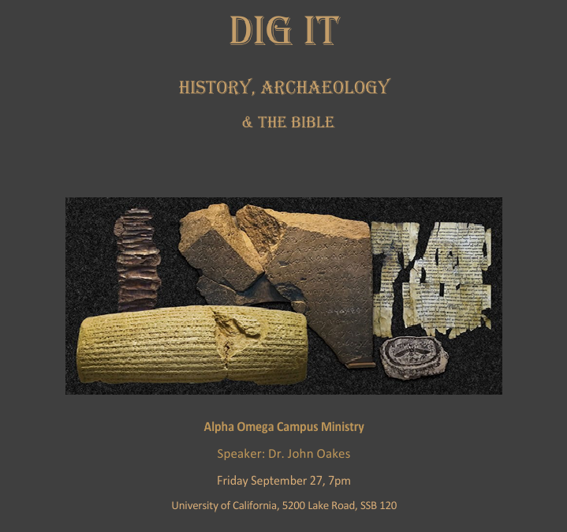
Coming Up
Dig It!!! History, Archaeology and the Bible with Fresno Fri 9/27 Invite your friends.
Campus Retreat Oct 25-27 Registration soon

Slide 5
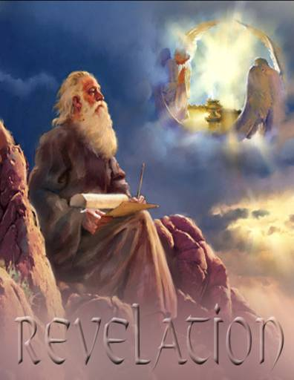
The Book of Revelation
Class #1
Jesus, The Alpha and the Omega
Dr. John Oakes
Merced
Fall, 2024

Slide 6
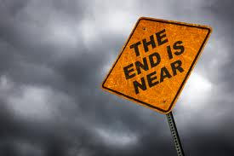
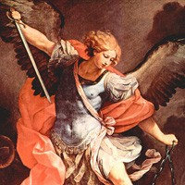
Apocalyptic Literature
Rev 1:1 The revelation of Jesus Christ
revelation = apokalupsis αποκαλυψισ
= unveiling.
Apocalyptic literature is an unveiling
Vision as a literary device

Slide 7
Purpose of Apocalyptic Writing
To show in dramatic fashion that God is in control.
“The purpose of these writings was to stress the virtue of loyalty and of stimulate faith by showing in vivid fashion the certain overthrow of evil and final victory for God’s righteous cause.” (Summers: Worthy is the Lamb)

Slide 8
Characteristis of Apocalyptic Literature
1. Written in times of trouble
2. Cryptic in style
3. Prophecy vs Apocalyptic
4. Always has a definite historical setting
5. Symbolic
Other literature: Assume literal unless
the context demands symbolic.
Apocalyptic: Assume symbolic unless the
context demands literal.

Slide 9
Numbers in Apocalyptic Literature
2 = strength, courage, energy
3 = divine number. Number of God.
4 = the world, the cosmos, creation.
6 = sinister, Satan 6 falls one short of seven. Doom.
7 = perfection, completeness
3-1/2 = incomplete, partial (1260 days, “time, times and half a time”)

Slide 10
Numbers in Apocalyptic Literature (cont.)
10 = completeness
1000 = 10x10x10 = ultimate completeness
12 = Number of religion. God’s people. 12 tribes, 12 apostles.
144,000 = 12x12x10x10x10 All of God’s people

Slide 11
Colors in Apocalyptic Literature
Red war, sacrifice Zech 6:2, Rev 6:4, Is 63:1-6, Joel 2:31, Rev 12:3, 17:3
White purity and innocence Dan 7:9, Rev 1:14, Zech 6:3,6 Rev 7:9,13-14, 19:?
Purple royalty or voluptuous ease Jer 10:9, Rev 17:4, 18:12
Blue heaven, sky, Holy Spirit Rev 9:17
Black famine, death, distress Zech 6:2, 6 Rev 6:5,12,
Pale yellow near the end of life Rev 9:17
Pale death, terror-stricken Jer 30:6, Dan 10:8 Rev 6:8
Crimson blood, atonement
Gold divinity, splendor Rev 1:13 15:6
Green death? 6:8, 8:7, 9:4

Slide 12
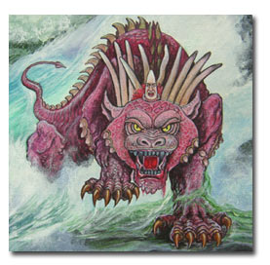
Αποκαλυφισ Characteristics Continued
6. Dramatic.
Arguably, the chief aspect of the Apocalyptic is that it is dramatic.
Dramatic, vivid,
forceful, terrifying,
grotesque
A cosmic graphic novel

Slide 13
Summary: How to Interpret Apocalyptic:
There will be a definite historical setting and cause for the visions. Interpret in light of this setting and cause.
About the imagery: get the big picture and do not get too caught up in the details—do not “push” the details.
After correctly observing the first two steps, you can apply apocalyptic passages to all people and all situations and all times.

Slide 14
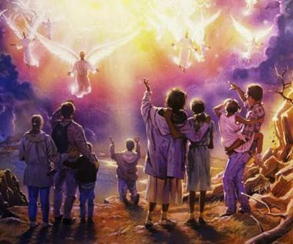
End-Time Theories (Eschatology)
Preterist
Most or all of Revelation Already fulfilled
Amillenialism
No physical millenial reign
Dispensational Premillenialism
Jesus comes back before the millenium
Postmillenialism
Milennium happens, then Jesus comes back

Slide 15
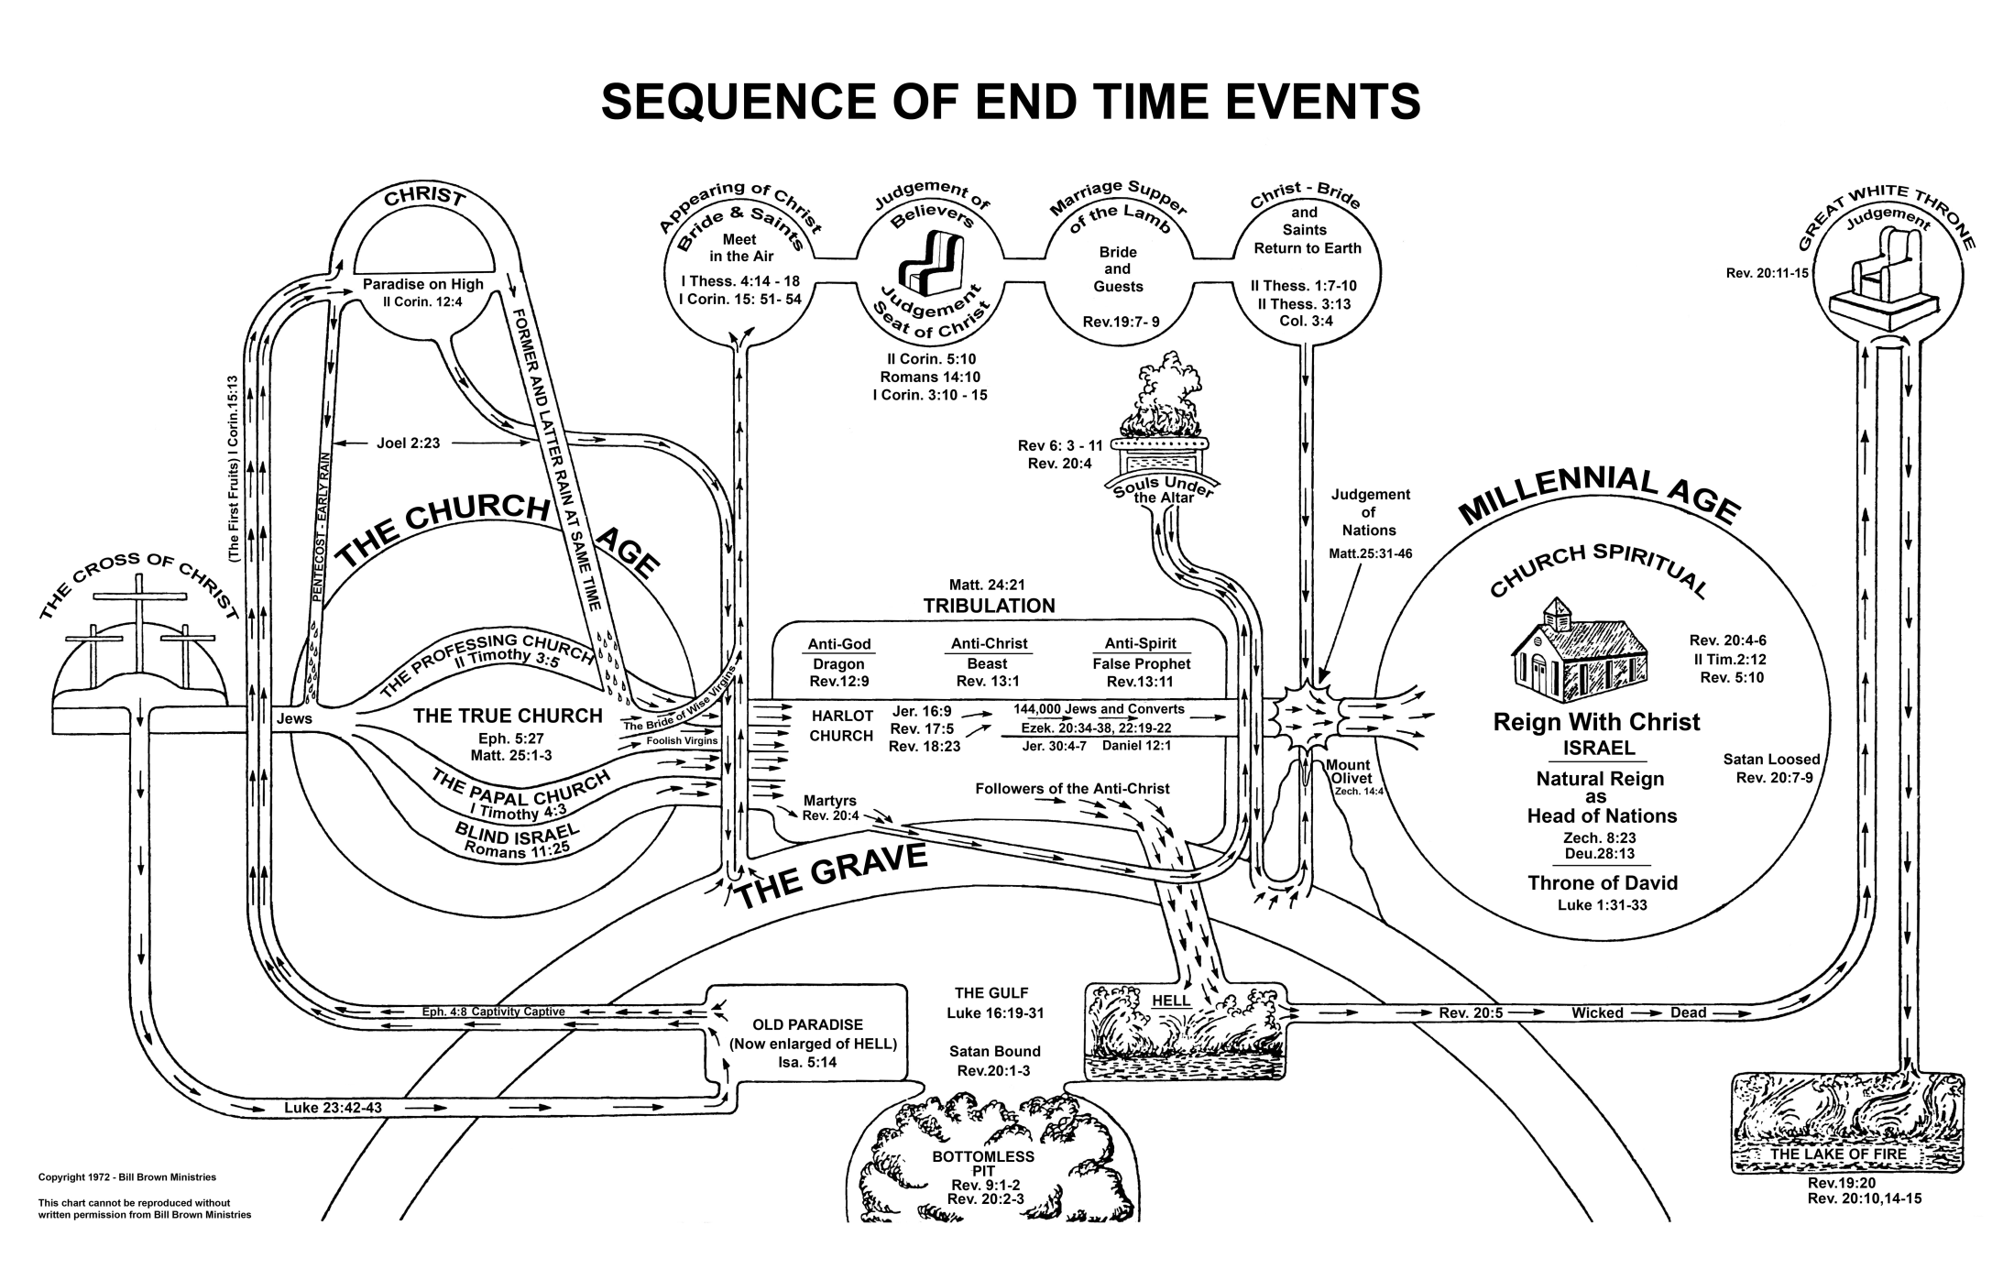
Dispensational Premillenialism

Slide 16
Sir Isaac Newton
The folly of Interpreters has been, to foretell times and things, by this Prophecy, as if God designed to make them Prophets. By this rashness they have not only exposed themselves, but brought the Prophecy also into contempt. The design of God was much otherwise. He gave this and the Prophecies of the Old Testaments, not to gratify men's curiosities by enabling them to foreknow things, but that after they were fulfilled they might be interpreted by the event; and his own Providence, not the Interpreters, be then manifested thereby to the world. For the event of things predicted many ages before, will then be a convincing argument that the world is governed by providence

Slide 17
Historical Background to Revelation
Revelation 1:9 I, John, your brother and companion in the suffering and kingdom and patient endurance that are ours in Jesus, was on the island of Patmos because of the word of God and the testimony of Jesus.
Persecutions of the Church:
Nero AD 64
Domitian 95-97 *
Trajan 98-117
Septimus Severus 202-211
Decius 249-251
Valerian 257-261
Diocletian and Galerian 303-311

Slide 18
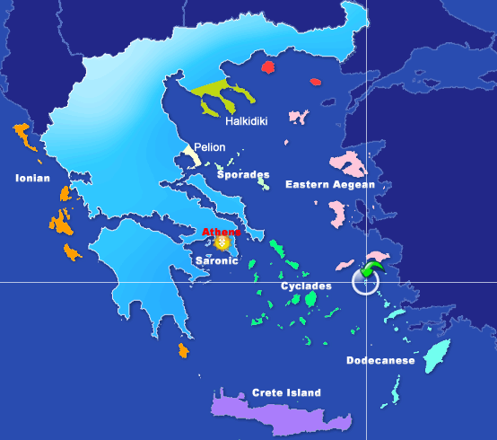

Slide 19
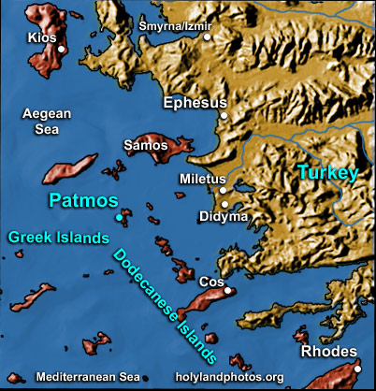

Slide 20
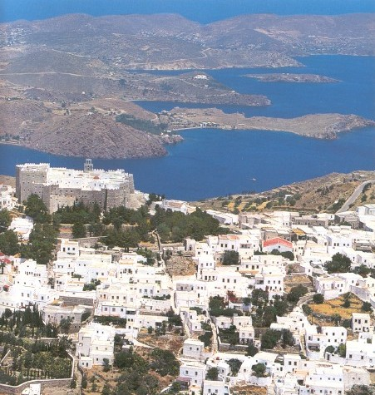

Slide 21
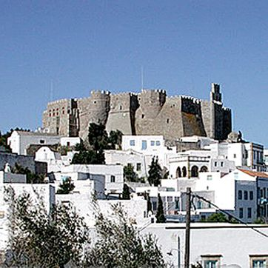
Monastery of St. John, Patmos

Slide 22
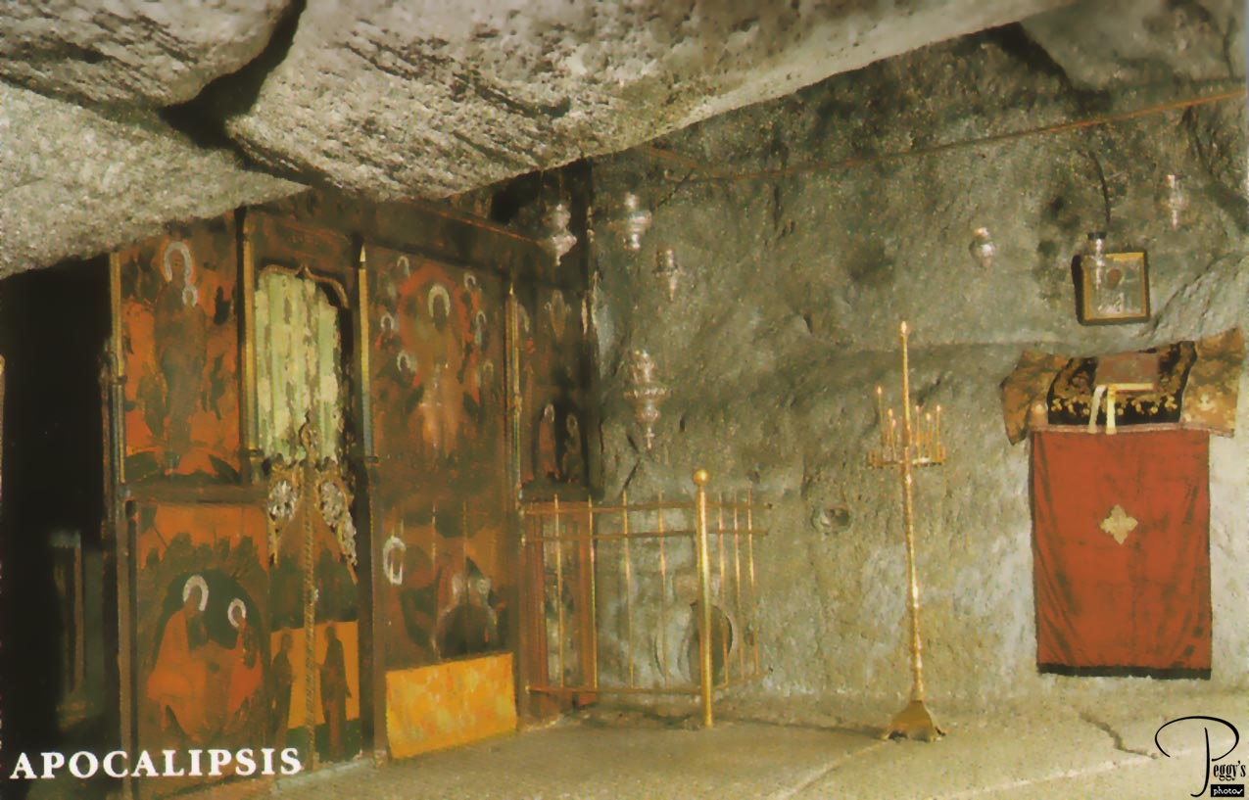
John’s cave?

Slide 23
Theme, Message and Objective of Revelation
Theme of Revelation: Peel back the layers of history and even the terrible persecutions and what do we find? The lamb is on the throne and God is in control.
Message of Revelation: Be encouraged and faithful to Jesus Christ. Jesus, not Caesar, is Lord.
Objective: to comfort persecuted Christians.

Slide 24
Theme, Message and Objective of Revelation
Description of Revelation: A “divine picture-book”. “Spiritual cartoons,” representing the historical development of the early Christian church.
Romans appeals to the intellect/mind
Psalms appeals to the emotions
Revelation appeals to the imagination.

Slide 25
Outline of Revelation
Ch 1 Prologue
Ch 2-3 Letters to the seven churches
Ch 4-7 The Seven Seals
Ch 8-11 The Seven Trumpets
Ch 12-16 Seven Mystical Figures
Ch 15-16 The Seven Vials
Ch 17-20 Enemies of the Church Overthrown
Ch 21-22 The Kingdom of God Revealed

Slide 26
An Outline of the Bible
I. Genesis 1 God created the universe and the earth. It was very good.
II. Genesis 2 God created man so that we could have an intimate relationship with him.
III. Genesis 3 and 4 We messed up very badly—destroying that relationship.
Genesis 5-Rev 20 God is repairing the damage done by sin.
V. Rev 21-22 God has fixed the problem and we are back in a
relationship with him.
Revelation is the culmination of the Bible story

Slide 27
Revelation Chapter 1 Prologue
Revelation 1:1 The revelation of Jesus Christ which God gave to him to show to his servants what must soon come to pass (things it is necessary to come to pass shortly).
Dei δει “must” morally necessary. God’s justice requires that these prophecies must be fulfilled soon
Rev 1:1, 22:6 must soon take place
Rev 1:3, 22:10 the time is near/at hand
Compare to Daniel 9:26 which concerns “the distant future.” (written 550 BC about 167 BC)
Is it about things 2000 years later? No!

Slide 28
Seven Beatitudes in Revelation
Rev 1:3 Blessed is he who reads this prophecy and takes it to heart.
Rev 14:13 Blessed are the dead who die in the Lord.
Rev 16:15 he who watches and is prepared for the Lord’s coming.
Rev 19:9 those invited to the Lamb’s wedding supper.
Rev 20:6 those who have a part in the first resurrection.
Rev 22:7 he who keeps the words of this book.
Rev 22:14 those who wash their robes in the blood of the lamb.

Slide 29
Revelation 1 Prologue (cont.)
Rev 1:4-8,11
Who from? God the father, the Holy Spirit (the seven spirits) and Jesus Christ
Who to? v. 4 the seven churches in the province of Asia
v. 11 Ephesus, Smyrna, Pergamum, Thyatira, Sardis, Philadelphia and Laodicea.
1:3 to all who hear 2:7 to anyone who has an ear.
… what the Spirit says to the churches.

Slide 30
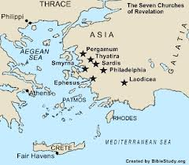

Slide 31
Revelation 1 Prologue (cont.)
Rev 1:9 John can relate to the persecutions that the church will soon be going through.
Why on Patmos? Because of the Word of God.
1:10 On the Lord’s day = Sunday
When you see Jesus, what do you see?

Slide 33
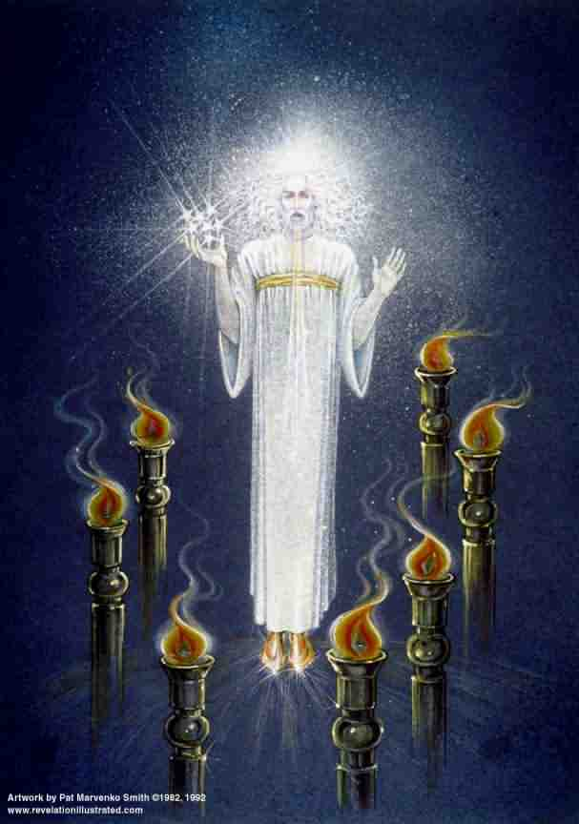
Revelation 1 Prologue (cont.)
Rev 1:12-18
Similar to Daniel 7:9-10
Voice “like a trumpet” A loud and clear message
Blazing eyes See everything
Double-edged sword in his mouth Authority and power of his words
Q: How does this picture of Jesus make you feel?

Slide 34
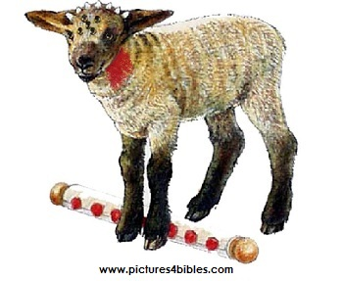
Revelation Ch. 5 The Lion and the Lamb
Jesus is a lion regal, powerful, a danger to enemies
Jesus is a lamb gentle, humble, sacrificial
7 horns = perfect in power
7 eyes = perfect in knowledge

Slide 35
Which is the Real Jesus Christ?
Jesus the ultimate powerful superhero
Jesus the ferocious king
Jesus the gentle, sacrificial lamb

Slide 36
Revelation II
Letters to the Churches
Dr. John Oakes
Bakersfield
9/19/21

Slide 38
Revelation 2 & 3 Letters to the Churches in Asia
Pattern:
1. Greeting
2. A description of Jesus
3. A commendation (except Sardis and
Laodicea)
4. A criticism (except Smyrna and
Philadelphia)
5. An appeal and a warning
6. Exhortation and promise

Slide 39
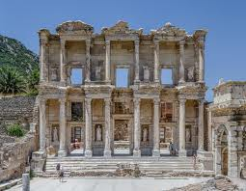
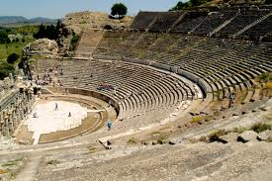
Revelation 2:1-7 Ephesus

Slide 40
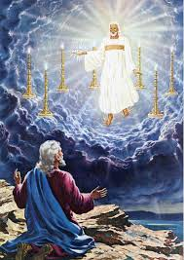
Ephesus
Rev 2:1
…holds the seven stars in his hand
…walking among the golden lampstands
The capital of Christian Asia.

Slide 41
Ephesus: Commendations
Rev 2:2-3,6
Hard work
Perseverence
Staunch opposition to sin and false doctrine
Nicolaitins Acts 6:5?
They had not grown weary
Q: Is this possible, even when we have lost our first love?

Slide 42
Ephesus: Admonitions
Rev 2:4-5
Remember, this is the church John himself was responsible for!
Lost their first love.
Q: What, exactly, had they lost? What was their day-to-day Christian life like?
The solution: Remember and repent!
Do what you did at first. Do it the way you did it at first.

Slide 43
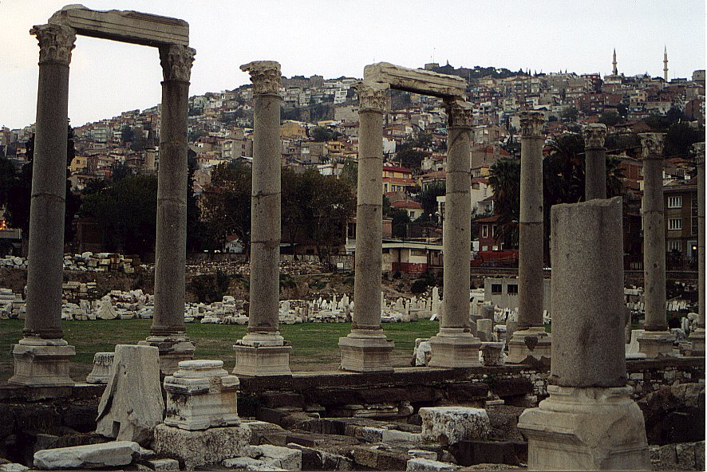
Revelation 2:8-11 Smyrna

Slide 44
Smyrna: Commendations Only
Rev 2:9 Poor but rich.
Q: Do you feel poor? Why? Do you feel rich? Why? 1 Tim 6:8
The Synagogue of Satan Jewish persecution.
Admonition: Stay faithful, even unto death …you will receive a crown
…you will be untouched by the second death (Rev 20:14)

Slide 45
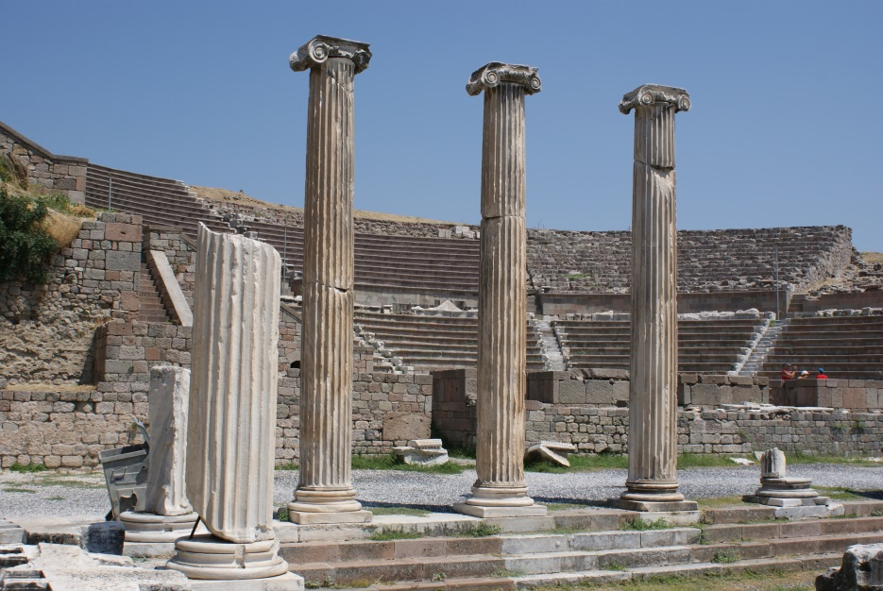
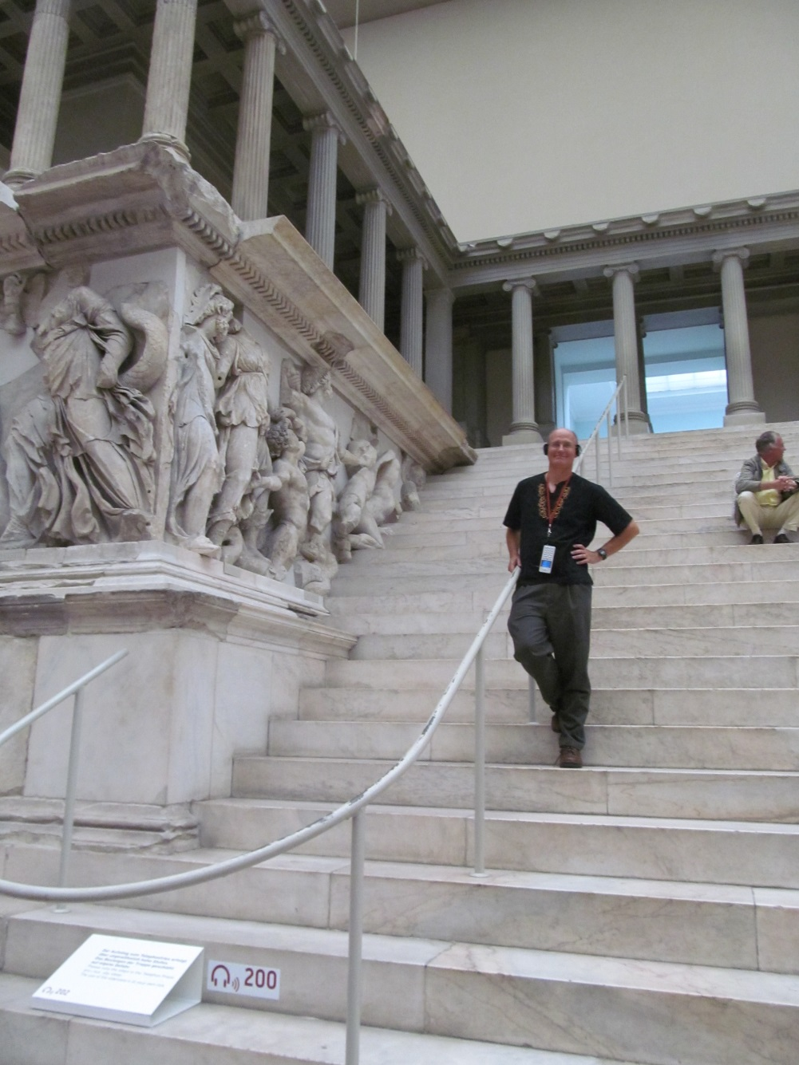
Revelation 2:12-17 Pergamum

Slide 46
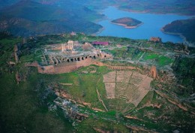
Pergamum
Largest city in Asia at the time
Capital of Roman power
Seat of paganism in Ionia
“Throne” of Satan = Temple of Zeus
Pergamum Library

Slide 47
Pergamum: Commendations
Rev 2:12 the sharp, double-edged sword. Watch out!
2:13 Pergamum is a tough city to build a church!
How would you like to live where Satan lives?
You have endured extreme persecution
Antipas witness = martarus

Slide 48
Pergamum: Warnings
Some hold to Balaam’s teaching.
Some hold to the teachings of the Nicolaitins
Their problem: lack of church discipline
Q: Is tolerance a Christian virtue?
Q: Does Jesus get angry?
God expects the church to discipline these teachers. Q: Why doesn’t he just deal with them?

Slide 49
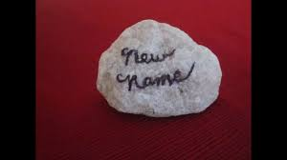
Pergamum: Reassurance
Rev 2:17
Hidden manna
A white stone
Symbol of acquittal in a trial
Symbol of being freed from slavery
A name known only to him who receives it.

Slide 50
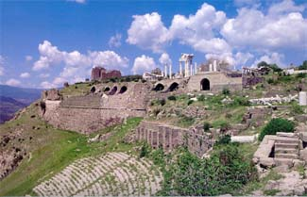
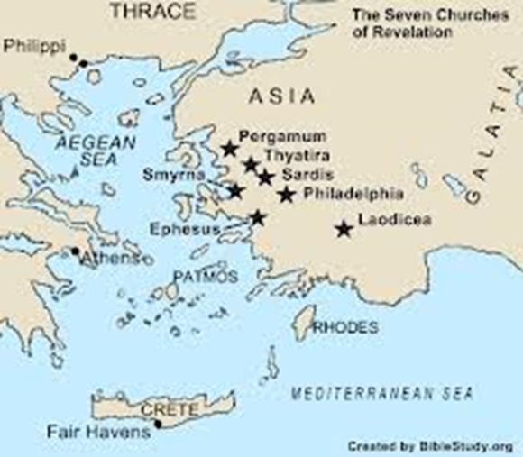
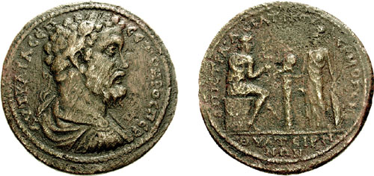
Revelation 2:18-29 Thyatira
Hephaestus: the god of the foundry

Slide 51
Thyatira
Thyatira a city of trades and unions/guilds
Specialized in purple cloth (Lydia)
Specialized in bronze craft
Being in a guild required participation in pagan sacrifices, including fornication.

Slide 52
Thyatira: Commendation
Jesus: Eyes like blazing fire, feet like burnished bronze.
Rev 2:19
Giving
Serving
Growing!
But…. The seeds of spiritual disaster had already been planted!

Slide 53
Thyratira: Warnings
Rev 2:20 You tolerate that woman Jezebel
Probably a prominent and charismatic woman
Her sin? Probably encouraging participation in the idolatry required to keep a job in one of the trades in Thyratira
Those who “committed adultery” with her and “her children” are those who accepted her teaching.
A warning against divisiveness

Slide 54
Thyratira: Warnings and Encouragement
Rev 2:21-23
I have given her time to repent
I will deal with Jezebel (unlike in Pergamum)
2:24 “deep teaching” a reference to Gnosticism
2:25 Assurance: Hold on until the end… I will
give you authority over nations (1 Cor 6:2-4)

Slide 55
Letter to the Churches Summary so far
-Remember, repent and recover that first love
-God knows our trials and suffering and will rescue us from them.
-Tolerance of sin is NOT a virtue. We need church discipline and unity in the face of sin
-If we do this God will give us a white stone!

Slide 56
Revelation III
Letters to the Churches
Dr. John Oakes
Bakersfield
9/19/21

Slide 57
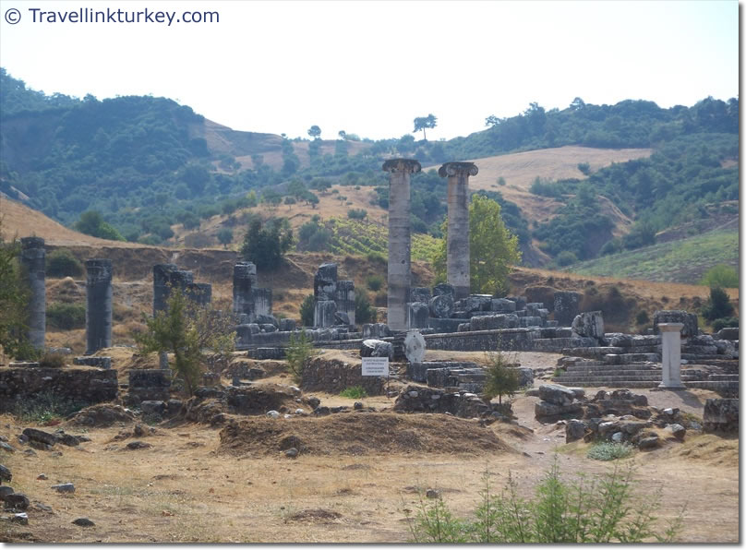
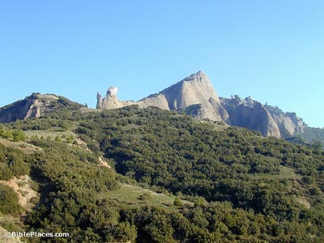
Revelation 3:1-6 Sardis

Slide 58
Sardis
Capital of Lydia and of King Croesus
On a very steep mountain—thought to be impregnable
Nevertheless, conquered by Cyrus 549 BC
Conquered by Antiochus III 218 BC
A symbol of overconfidence and unjustified pride. Living on past greatness.
Famous for robbers.

Slide 59
Sardis: Warnings First!
Rev 3:1 You have a great reputation, but you are dead, spiritually!
Their problem was not sin, per se, but lack of doing things God expected them to do.
Q: What about you?
Rev 3:2 Solution? WAKE UP!!!! (Hebrews 2:1)
Remember, obey and repent.
I will come like a thief

Slide 60
Sardis: Encouragement
No encouragement to the church as a whole
3:4 Yet you have a few in Sardis…
Even in a dead church, some will be alive. Despite what Jesus is saying to the churches, we are saved individually.
3:5 To all disciples: He who overcomes will, like the few faithful Sardisians, be dressed in white.

Slide 61
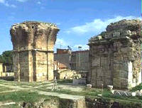
Revelation 3:7-13 Philadelphia

Slide 62
Philadelphia
A significant Jewish population. The Synagogue of Satan
Rev 3:7 Jesus holds the key of David.
Isaiah 22:21-22 A messianic prophecy

Slide 63
Philadelphia: Encouragements Only
Rev 3:8 You are small and weak, but you are doing great!
3:9 You are the true Jews
The Jews will fall at your feet some day. Wow!
I will give you a crown
I will make you a pillar
You will never again have to leave it
Your will have a new name.
All these are relevant to specifics of Philadelphia

Slide 64
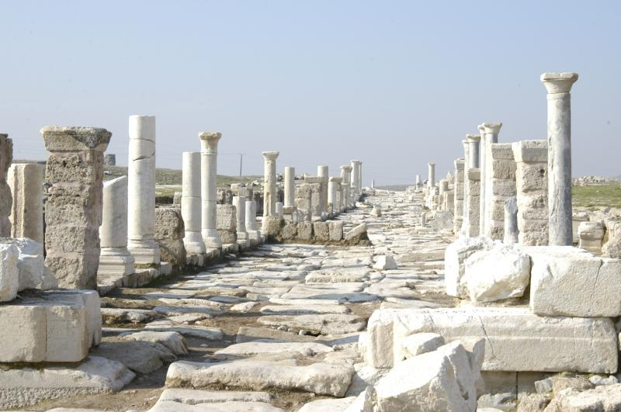
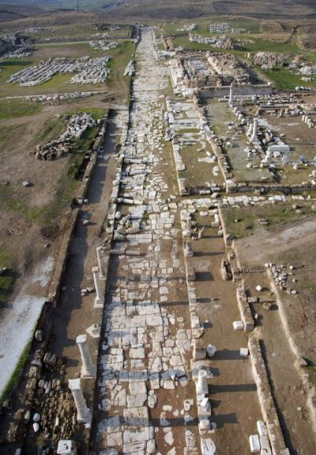
Revelation 3:14-22 Laodicea

Slide 65
Laodicea
A center of banking. A very rich city
A center of the wool industry. Black wool.
Most famous school of Medicine. Famous for their eye salve.
All these are used by Jesus in his admonition

Slide 66
Laodicea: Warnings Only
Their sin? Lukewarmness. Hypocrisy
Jesus: You make me want to throw up!
Wouldn’t it be better to be a half-hearted Christian than a blatant pagan?
Why not?

Slide 67
Laodicea: Lukewarm Christianity
Rev 3:17 How do we become lukewarm?
By relying on self rather than God.
You say you are rich
You say you need nothing (from God)
Q: Do they actually say this?
Reality check: You are wretched, pitiful, poor, blind and naked.

Slide 68
Laodicea: It’s Not Too Late!
1. Admit you are wretched, pitiful, poor blind and naked.
2. Rev 3:18 Buy gold from Jesus.
3. Apply the eye-salve of Jesus John 9:31
Q: Do you need some of this salve to see
your need for God?
4. Rev 3:19 Accept God’s rebuke and
discipline

Slide 69
Laodicea: Summary
Repent!
I stand at the door and knock.
Jesus is waiting, but he will not force his people to eat with him.
Does this prove that we can pray Jesus into our hearts?
Message of Revelation: To him who overcomes, I will give the right to sit with me on my throne
We are about to get a view of that throne!

Slide 70
Revelation IV
Trust in God Trust Also In Me
Dr. John Oakes
Bakersfield
10/3/2021

Slide 71
Theme, Message and Objective of Revelation
Theme of Revelation: Peel back the layers of history and even the terrible persecutions and what do we find? God is on the throne and in control. Jesus is in the center of the throne-room, interceding for us.
Message of Revelation: Be encouraged and faithful to Jesus Christ. Jesus is Lord, not Caesar.
Objective: to comfort Christians going through difficult times..

Slide 72
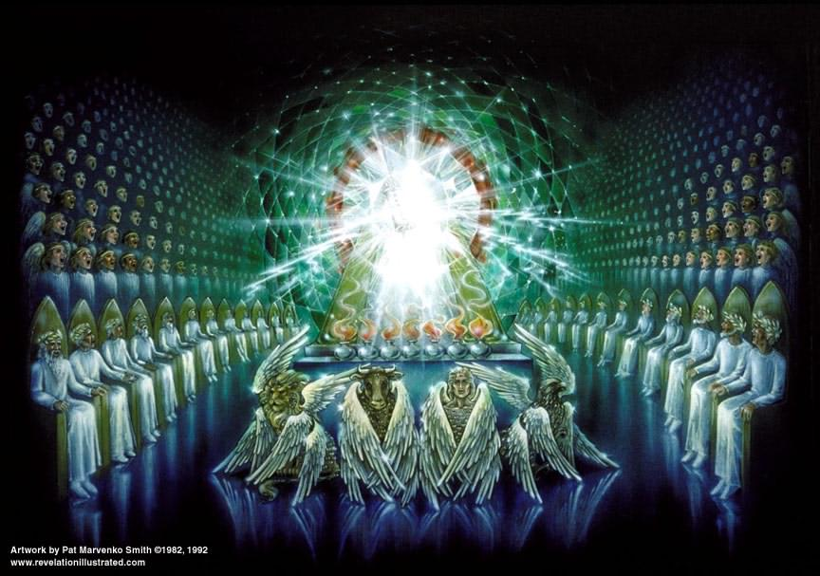
Revelation Chapter 4 Enter the Throne Room

Slide 73
Revelation Chapter 4
Now the visions begin.
Be prepared to use your imagination.
Revelation Ch 4 Believe in God
Revelation Ch 5 Believe also in Jesus (John 14:1)
How does the vision begin? God is on his throne!!!!!!

Slide 74
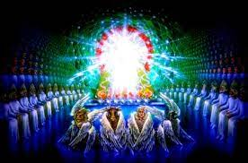
The Throne Room
Jasper white Holiness
Carnelian red Justice
Rainbow God’s promise/covenant
emerald/green: life
Throne 38 times in Rev
Throne 17 times in Ch 4-5

Slide 75
The Throne Room (cont.)
v. 4 24 elders: 12 tribes and 12 apostles
The elders represent us!
v. 5 lightning and thunder Judgment
v. 6 Sea of crystal = separation of holy from profane.

Slide 76
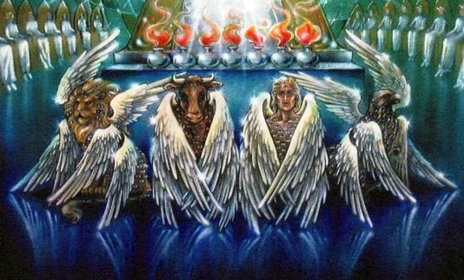
The Throne Room (cont.)
The four Cherubim Eyes = vigilance
Lion Ox Man Eagle

Slide 77
Holy, Holy Holy

Slide 78
Revelation Ch. 5 The Lion and the Lamb
Ch 4 Trust in God.
Ch 5 Trust also in me.
A scroll with seven seals which no one was worthy to open.

Slide 79
Enter: Jesus Christ
Jesus is a lion Royal, Triumphant Gen 49:8-11
Jesus is the Root of Jesse Messiah Is 11:1-5
Jesus is a lamb A humble sacrifice
7 horns = perfect in power
7 eyes = perfect in knowledge

Slide 80
Worship the Lamb who was slain
Harps = singing to the Lamb
Incense = prayers of the saints
Rev 5:9-14 A New Song
v. 10 A kingdom of priests. Exodus 19:6 has been fulfilled!
Romans 15:15-16 Our priestly duty
Worthy is the lamb who was slain.

Slide 81
Revelation V
Salvation Belongs to our God
Dr. John Oakes
Bakersfield
10/10/2021

Slide 82
Revelation 6 The Lamb opens the Scroll
Now the action really begins!
Structure of Revelation 6-20:
Seven seals Revelation 6-7
Seven trumpets Revelation 8-9
Seven symbolic creatures Revelation 10-14
Seven bowls Revelation 15-16
God’s enemies judged Revelation 17-20

Slide 83
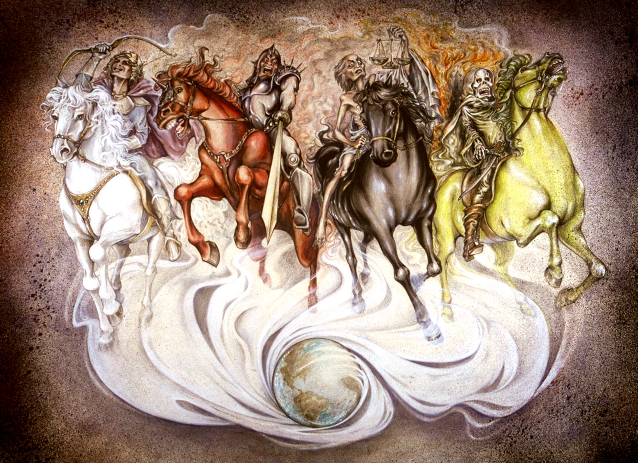
Revelation 6: The Seven Seals
Revelation 6:1 Come!!! Come see the vision.
Hoofbeats are heard in the distance
The Four Horsemen

Slide 84
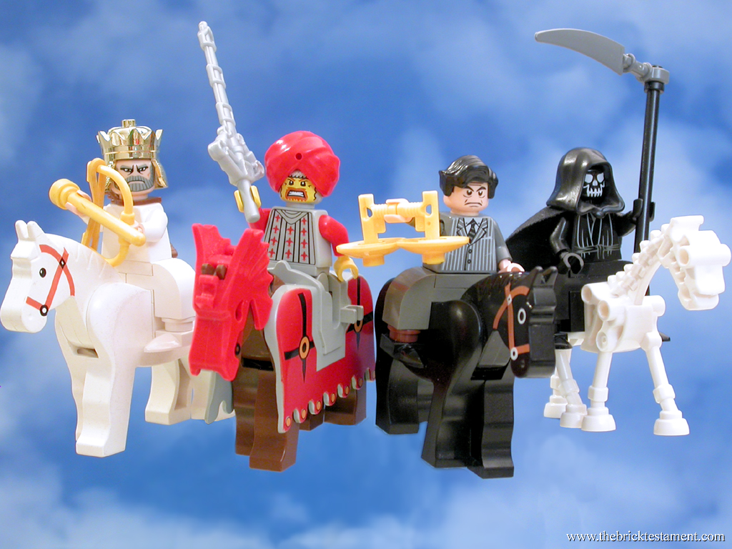
The Four Horsemen

Slide 85
Revelation 6 Four Horsemen
Seal #1 A rider on a white horse. A crown and a bow. A Parthian symbol of victory (over Rome)
Seal #2 Red horse = War “the power to take peace from the earth.” Represents persecution to the church.
Seal #3 Black horse = Famine Scale to measure food. Oil and wine available: The rich are still doing fine.
Seal #4 Pale yellow-green horse = Death Martyrdom in the church.

Slide 86
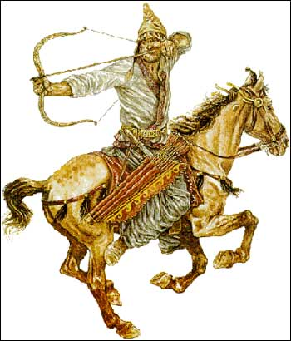
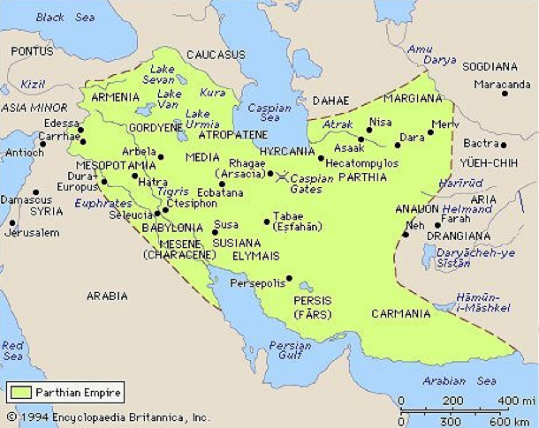
Revelation 6:2 Parthia

Slide 87
Revelation 6 Seal #5,6
Rev 6:9-11 The fifth seal. Martyrs before the throne of God.
How long… before God judges the wicked?
Retribution for God’s people Psalm 94:1-3 Rev 16:5-6
Do you long to see vengeance on God’s enemies?
Romans 12:17-21
God’s answer: Rev 6:11 Not yet.

Slide 88
The Sixth Seal: The Day of the Lord
Rev 6:12-17 The sixth seal.
Earthquake, sun turns black, moon turns red, stars fall from the sky, the sky recedes like a scroll and the mountains removed. Everyone hides in caves and among the rocks.
Judgment is coming. The Day of the Lord is here. Hide!
Rev 6:17 Who can stand under this? Answer: Revelation 7!

Slide 89
Revelation 7 Interlude: The Saints are Sealed
Four angels hold back the winds. Winds = the action of God to judge his enemies.
The sealing of the 144,000 Ezekiel 9:1-4
Seal = ownership
12 x 12 x 10 x 10 x 10 All of God’s people. Every single one!!!
A multitude no one could count is the same people: Those saved from the coming wrath of God.
Sealed: The Holy Spirit Ephesians 1:13-14.

Slide 90
The 144,000 Sealed
The 144,000 are “a great multitude no one could count. White robes = pure, forgiven, righteous
Palm branches = joy The Feast of Tabernacles Celebrating salvation and living in a relationship with God.
Rev 7:10-15 A worship service
Salvation belongs to our God.
Rev 7:15 God spreads his tabernacle over us.

Slide 91
Summary
Circumstances may get bad.
God’s enemies may seem victorious.
But God will judge his/our enemies.
God will save us from the tribulation. We are in his tent/tabernacle.

Slide 92
Revelation VI We Overcome By the Blood of the Lamb
Dr. John Oakes
Bakersfield
10/17/2021

Slide 93
Rev 11:1-6 Two Witnesses
God measures the temple courts, but not the court of the Gentiles.
God will protect the heart of the church, but he will give Rome some freedom to go after his saints.
v. 2 The court of the Gentiles will be trampled for 42 months. Limited persecution of the church—allowed by God.

Slide 94
3-1/2 Years in the Bible
1. The period the church will be persecuted Rev 11:2
2. The period during which the two witnesses will testify Rev 11:3
3. The period over which the Woman is nourished in the wilderness Rev 12:6,14
4. The period of the Beast’s authority Rev 13:5
5. The period the little horn persecutes the saints Daniel 7:25
6. The period of the abomination of desolation by Antiochus Ephiphanes Dan 12:11 (1290 days for some reason)

Slide 95
Rev 11:3-6 The Two Witnesses
The two witnesses are the “witness” of the church during the time of the trampling.
The two olive trees and the two lampstands: Zechariah 4:12-14 Joshua (priestly authority) and Zerubbabel (civic authority). Zechariah 4:4-6 The witness of the Holy Spirit.
v. 5-6 The Church’s testimony will be very powerful!!

Slide 96
Rev 11:7-12 The Serpent Attacks the Church and is Defeated.
v. 7 Some saints will be killed.
v. 8 Sodom/Egypt/Jerusalem = Rome
v. 9-10 The “world” will gloat over the defeat of the church, but only for 3-1/2 days.
v. 11-12 But the church will come back, seemingly from the dead. The saints will be victorious.

Slide 97
Rev 12 Now We Look Behind the Scene
Rev Ch 1-11 Act I The view from the perspective of the church—up front.
Rev Ch 12-22 Act II The view of matters from the perspective of heaven—behind the scene.
Rev 12:1 A wondrous sign appeared in heaven

Slide 98
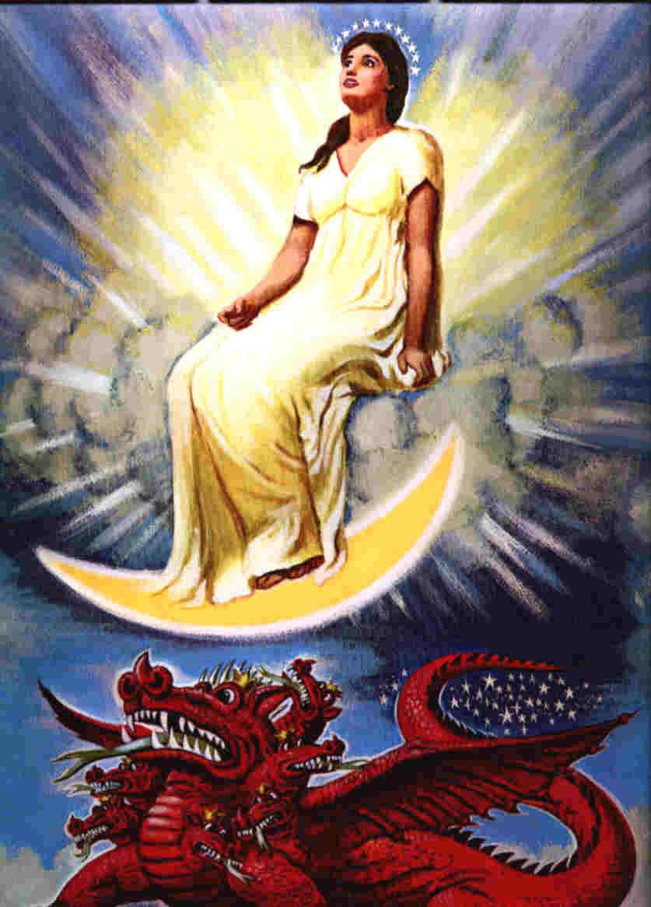
Revelation 12 The Woman and the Beast

Slide 99
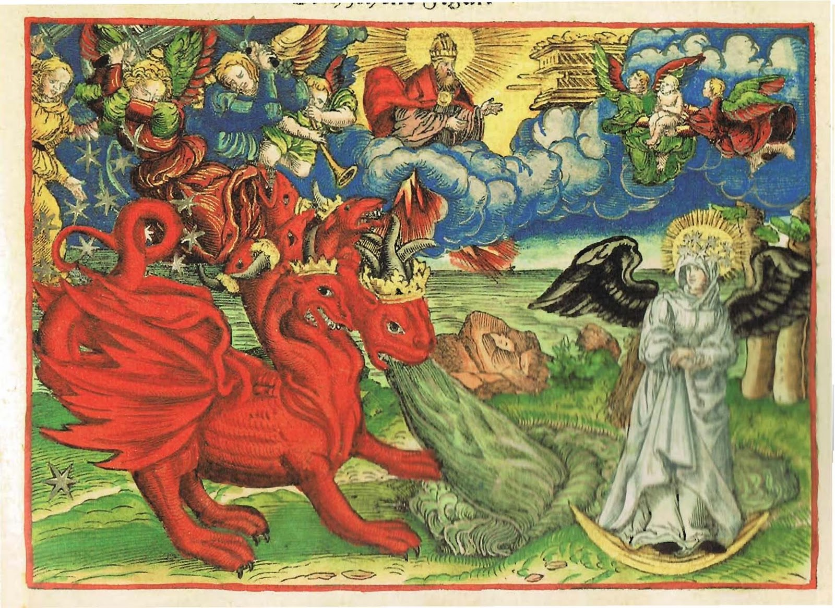

Slide 100
Revelation 12:1-3
A great and wondrous sign.
Who is the woman?
She is Israel—about to give birth to the Messiah
She is the Church—about to be persecuted
She is God’s kingdom in any of its aspects.
Another sign: An enormous red dragon.
7 heads (great wisdom)
10 horns (very powerful)
7 crowns (great authority (on the earth at least))
Satan! Rome! (Rev 17)

Slide 101
Rev 12:4-6 Satan Goes After the Son and, Later, His Church
12:4 Satan tries to devour the child when the woman (Israel/Mary) gives birth. Herod kills the children of Bethlehem.
v. 5 The child “who will rule all the nations” is snatched up to heaven.
v. 6 The woman (the Church) flees to the desert and is cared for by God for 1260 days. Persecuted but protected.

Slide 102
Rev 12:7-17 Spiritual War in Heaven… and On Earth
12:7-10. Satan is defeated and cast down to the earth.
Q: Is this a good thing for the Church?
The result: vicious persecution of the church! (12:13)
The Devil: Deceiver (9:9) Accuser (9:10)
Q: Which method does Satan use with you?

Slide 104
How Do We Overcome the Work of Satan in Our Lives? (Rev 12:11)
1. By the blood of Jesus.
2. By the word of their testimony.
Remember the two witnesses.
3. By our willingness to give up our very
lives rather than worshipping the Beast.
They “loved not their lives” Gal 2:20
Rev 12:14-16 The Church will be protected from the Serpent 3-1/2 years.

Slide 105
Summary
God will protect his people
We have a powerful testimony
There is a spiritual battle going on
But we will overcome
-by the blood of Jesus
-by the word of our testimony
So let us not love our lives so as to shrink back from death.
We will triumph over the Serpent/Devil.

Slide 106
Revelation VII 666, Armageddon and the Millennium, Oh My!
Dr. John Oakes
Bakersfield
10/24/2021

Slide 107
666, Armageddon, and the Millennium, Oh My!

Slide 108
Revelation 13 The Two Beasts
Rev 13:1 The dragon stood on the shore of the sea.
Rev 13:2 A beast from the sea = Rome!
7 horns = Augustus, Tiberius, Claudius, Caligula, Nero, Vespasian and Titus Rev 17:9
One head seems to have a fatal wound. Nero
But the would has been healed. Domitian

Slide 109
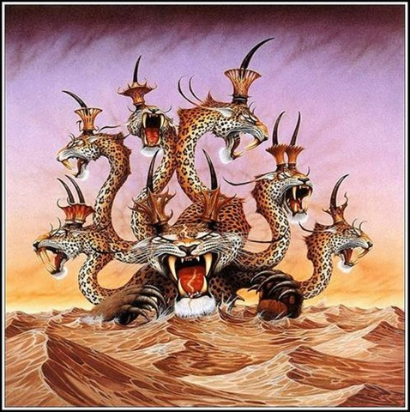
The Beast From the Sea

Slide 110
The First Eleven Emperors of Rome
The Ten Horns and the Seven Heads
Emperor
Dates of Rule
Significance to Biblical Events
Augustus
27 BC-14 AD
Birth of Christ
Tiberius
14 AD-37 AD
Crucifixion of Christ
Gaius (Caligula)
37 AD-41 AD
Claudius
41 AD-54 AD
Jews Exiled from Rome
Nero
54 AD-68 AD
First persecutions, Execution of Paul and Peter
Galba
68 AD-69 AD
One of the three overcome by Vespasian
Otho
69 AD-70 AD
One of the three…
Vitellius
69 AD-70 AD
One of the three…
Vespasian
69 AD-79 AD
Attack on Jerusalem
Titus
79 AD-81 AD
The general who destroyed Jerusalem
Domitian
81 AD-96 AD
First Systematic Persecutor of the Church

Slide 111
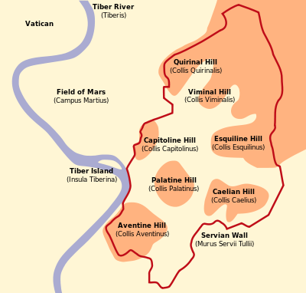
Rev 17:7-11 Seven Hills, Seven Kings and an eighth King.
Augustus
Tiberius
Caligula
Claudius
Nero
Vespasian
Titus
Domitian The 8th King
Domitian is the Beast

Slide 112
The Beast From the Sea
v. 5-7 Domitian given temporary power over the saints (42 months) and to make war on the saints.
v. 8 Everyone (except the Saints, of course) will worship Domitian—the Beast. This was literally true.
This is very scary for the church!!!!!

Slide 113
Assurance For the Saints
v. 8 Those who do not worship the beast will have their name written on The Lamb’s book of life!!!
v. 9-10 But…. Reality check here…. Some who refuse to worship the beast will be put in jail and some will be killed.
v. 11 This calls for patient endurance of the Saints. I would say so!!!

Slide 114
Revelation 13:11-18 The Beast Out of the Earth: Roman Religion
Rev 13:11 Another beast. The religious power of Rome.
It caused the Roman people to worship Rome/Domitian.
False miracles
13:17 The mark of the beast was not a literal mark, but it was an official document declaring that you made the sacrifice
Domitian’s number is 666. He is Satan’s man.

Slide 115
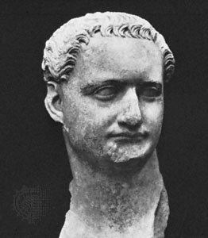
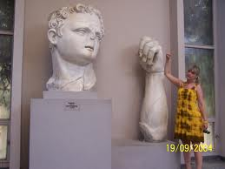
Domitian (c. 81-96 AD)
The Beast out of the Earth
666

Slide 116
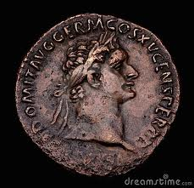
Rev 13:17 The Mark of the Beast
Do Not Worship the Beast

Slide 117
Rev 16:16-23 The Final Bowl
v. 16 A war at Har Megiddo.
1. Israel defeated Jabin Judges 4,5
2. Gideon defeated the Midianites. Judges 7,8
3. Saul defeated by the Philistines.
4. Ahaziah defeated by Hazael and killed by Jehu.
5. Necho slew Josiah (2 Chron 35:20-25)

Slide 118
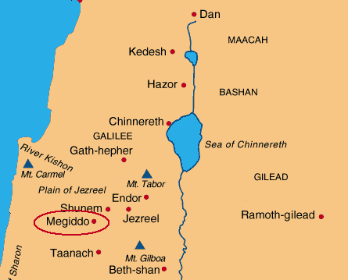
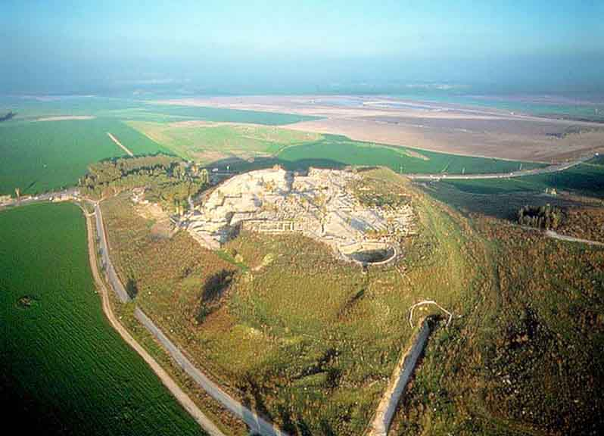
Megiddo

Slide 119
Armageddon
A literal battle?
300 million + soldiers
Between Parthia and Rome?
Rev 16:19 An Earthquake. Rome is divided and destroyed.

Slide 120
Revelation 18-20:10 The Enemies of God and of the Church Are Destroyed
Revelation 18 The Great Prostitute is judged and destroyed.
Revelation 19 The Beast and the False Prophet are judged and destroyed.
Revelation 20:1-10 The Serpent/Satan is judged and destroyed.

Slide 121
Revelation 20:1-10 The Dragon/Satan is Judged
What is the 1000 year reign/binding of Satan?
What it is not:
1. No mention of the second coming of Christ.
2. No mention of Jesus being on the earth.
3. No mention of a bodily resurrection.
4. No mention of a rapture.
5. No mention of people living in modern times
What it is:
A time of partial binding of Satan’s power on earth of unknown but significant length of time which began at a time near to when John wrote Revelation.

Slide 122
Revelation 20:1-3 Satan is Bound
v. 2 Satan “chained.” for 1000 years.
1000 years is symbolic—a long time
In what sense was/is Satan bound?
He certainly was not completely bound!
A possible explanation: He no longer has the Beast, the False Prophet and the Great Prostitute to use to attack the saints. (which actually happened after AD 325)

Slide 123
Revelation 20:3-6
Rev 20:3 After the 1000 years of binding, Satan will be “set free” of the chain “for a short time.”
Rev. 20 implies this “short time” will end with the second coming of Jesus.
Likely interpretation: An outburst of state-based persecution of fairly short duration may break out at the end of time.

Slide 124
The First Resurrection
A symbolic resurrection: Ezek 37:1-13
Don’t miss the main point. Satan is bound and the martyrs are free!
Revelation 20:7 A Fast-Forward to the final resurrection at the end of time. Similar to Daniel 12:1
End Times Have Arrived.

Slide 125
Summary
There is an invisible spiritual battle.
The “world” (political, economic, religious) is in service to Satan.
But God has put is mark on us—the Holy Spirit
Do not bow to the “gods” of this world.
The second death has no power over us. We will reign with Christ!!!

Slide 126
Revelation VIII
A New Heaven and a New Earth
Dr. John Oakes
Bakersfield
10/31/2021

Slide 127
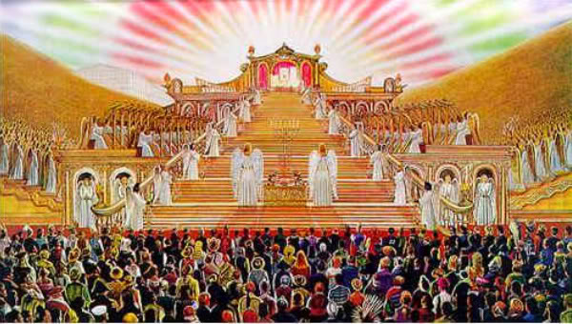
Revelation 20:11-15 Judgment Day The Great White Throne

Slide 128
Revelation 20:11-15 Judgment Day
Parallel verse: Daniel 12:1-4
v. 12 the dead, both great and small…
No favoritism
1 Pet 1:17 Since you call on a Father who judges each person’s work impartially, live our your time as foreigners here in reverent fear.

Slide 129
Are You a Big Wig?
And I saw the dead, both great and small…

Slide 130
Two Books
A book of works
The Lamb’s book of life

Slide 131
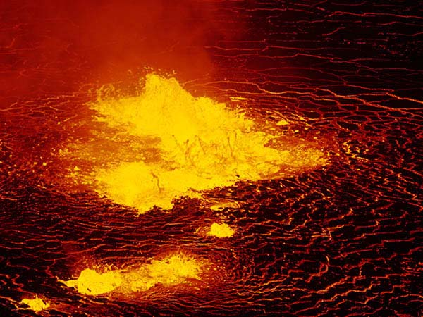
The Second Death
Rev 20:10 They will be tormented day and night for ever and ever…
Rev 20:15 Anyone whose name was not found written in the book of life…
Rev 21:8
Would a God of love do this?

Slide 132
Revelation 21-22 The New Jerusalem
Rev 21:1-8 Perfect fellowship with God
Rev 21:9-26 Perfect protection by God
Rev 22:1-5 Perfect provision with God

Slide 133
A New Heaven and a New Earth
Heaven→
Earth→

Slide 134
Rev 21:1-8 Perfect Fellowship with God
Rev 21:1 No more sea. Full and free access to the throne.
Rev 21:3 The dwelling (tabernacle) of God is with men. How great is that?
Rev 21:4 tears wiped away, no more death or pain.
Rev 21:5 All is made new!!!
Rev 21:6 You can count on it!

Slide 135
Revelation 21:9-26 Perfect Protection
v. 12 …it had a great, high wall. Well protected
With twelve gates never shut. Lots of access.
v. 15 a measuring rod. Protection
v. 17 a wall 200 feet thick
v. 21 gates made of pearls. The only jewel which is formed by pain.
v. 22 no temple in the city. The city is a temple.
v. 23 no sun needed
v. 25 Gates never shut. Security.

Slide 136
Revelation 22:1-6 Perfect Provision
Garden metaphor.
The Bible begins and ends with a garden—with man in perfect fellowship with his maker in a garden where every need is supplied by God.
We need water (crystal clear water v. 1), food (twelve crops of fruit v.2) and health (leaves for healing).
v. 3 What will we “do” in heaven? “his servants will serve him.” We will serve God.
In the New Jerusalem we have fellowship, protection, provision and an opportunity to serve the God.

Slide 137
Gates of Pearl

Slide 138
Pearly Gates

Slide 139
Perfect Provision We Are Back In The Garden

Slide 140
Revelation 22:17 Come!
22:17 The Spirit and the Bride say come!
What is our conclusion? Amen! Come Lord Jesus!
At the end of Revelation, what do we know?
Come what may, Christ is supreme. He is on the throne. Victory is his. And we can share in that victory. Amen, Come, Lord Jesus.

