Slide 1
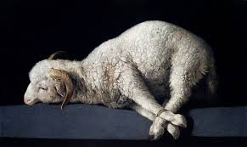
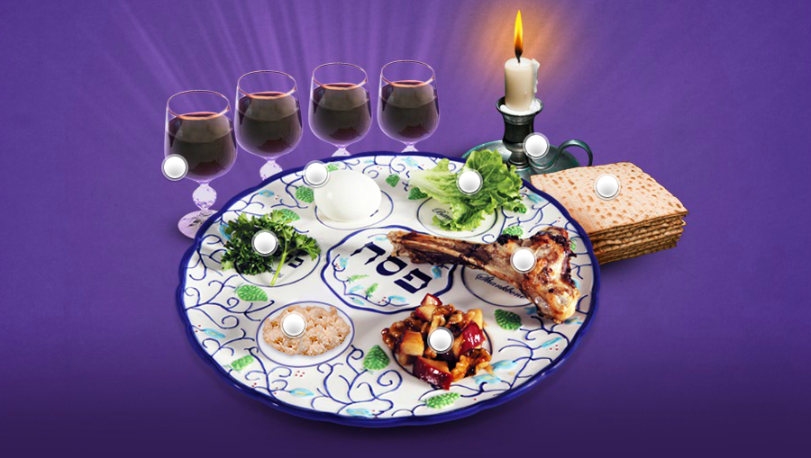
Exodus III The Passover Lamb

Slide 2
Exodus 5 God Lets It Be Hard!
Exodus 5:1-13 Who is YHWH? God hardens Pharaoh’s heart
Exodus 5:23 Moses: “Lord, why have you brought trouble on this people? You have not rescued your people at all!

Slide 3
God’s Promise to Us!
Exodus 6:6-8 I am the Lord, and I will bring you out from under the yoke of the Egyptians. I will free you from being slaves to them, and I will redeem you with an outstretched arm, and with mighty acts of judgment. I will take you as my own people, and I will be your God. Then you will know that I am the Lord your God, who brought you out from under the yoke of the Egyptians. And I will bring you to the land I swore… to Abraham. I will give it to you as a possession. I am the Lord.

Slide 4
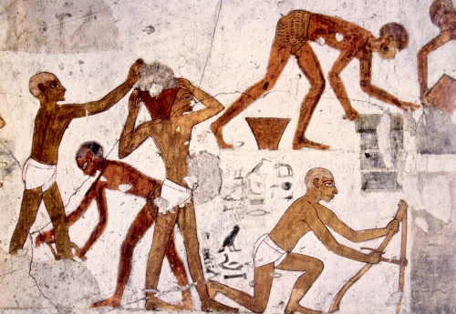
Exodus 5 Brick-making in Egypt
Scene from an Egyptian tomb

Slide 5
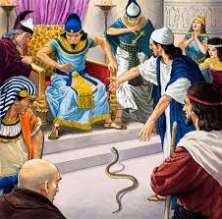
Exodus 7:1-13
God hardens Pharaoh’s heart, not to harm us but to save us and to reveal his glory

Slide 6
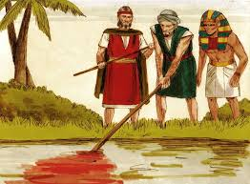
Plague #1 Blood Exodus 7:14-24
Exodus 7:20
Moses and Aaron did exactly as YHWH commanded
Lucky for us!

Slide 7
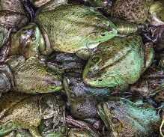
Plague #2 Frogs Exodus 8:1-15
Exodus 8:8 God: Help me out and I will for sure repent.
God helps him out and he changes his mind.
Typical!

Slide 8
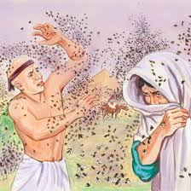
Plague #3 Gnats
Exodus 8:16-19

Slide 9
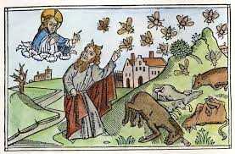
Plague #4 Flies
Exodus 8:20-23
Pharaoh: OK Do a one day sacrifice, but only in Egypt

Slide 10
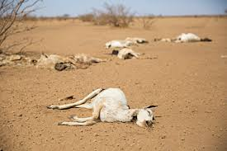
Plague #5 Livestock Exodus 9:1-7

Slide 11
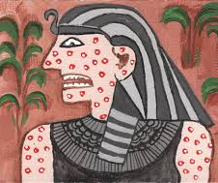
Plague #6 Boils
Exodus 9:8-12

Slide 12
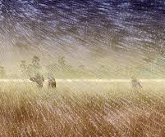
Plague 7 Hail Exodus 9:13-35
Exodus 9:15-16 I have raised you (Pharaoh) up for this very purpose: To give God glory

Slide 13
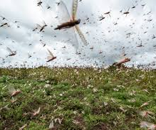
Plague #8 Locusts Exodus 10:1-20
Exodus 10:10
OK, but just the men…

Slide 14
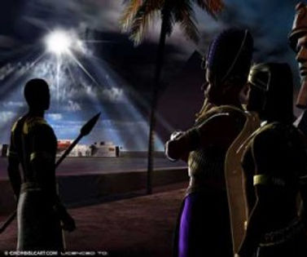
Plague #9 Darkness Exodus 10:21-29
Ex 10:24 OK The men, women and children, but not the livestock.
Ex 10:29 Last chance.

Slide 15
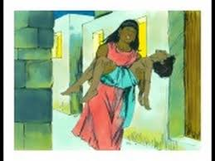
Plague #10 The Firstborn Sons Ex 11:1-9
Exodus 11:1-2, 4-5 “About midnight I will go throughout Egypt. Every firstborn son in Egypt will die, from the first-born son of Pharaoh, who sits on the throne, to the firstborn son of the female slave, who is at her handmill, and all the firstborn of the cattle as well.”

Slide 16
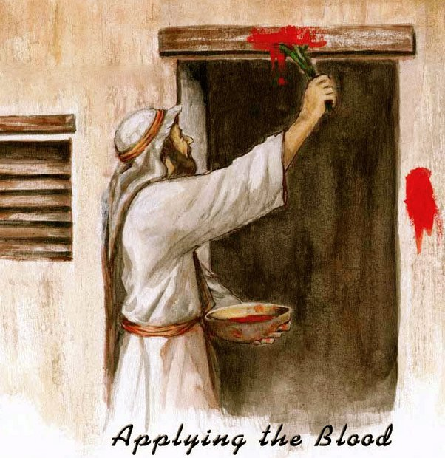
Ex 12:1-13 God will Pass Over Israel
Ex 12:3 10 Nisan set aside a lamb without blemish
Ex 12:5-7 14 Nisan Slaughter the lamb. Take the blood and put it on the doorframes of your houses
Ex 12:8 Bitter herbs
Exodus 12:13 When I see the blood, I will pass over you.

Slide 17
Ex 12:31-42 Further Instructions
Ex 12:34 Dough without yeast
Hurry!!! Get out of Egypt now!!!
Ex 12:46 Do not break any of the bones!

Slide 18
Luke 22:7-16 Timeline
10 Nisan Set aside the lamb or goat
14 Nisan Th eve Fri AM Crucifixion Fri sunset
15 Nisan Passover Fri eve Eat the Seder to Sat Sunset
16 Nisan Feast of Firstfruits Sun morning resurrection

Slide 19
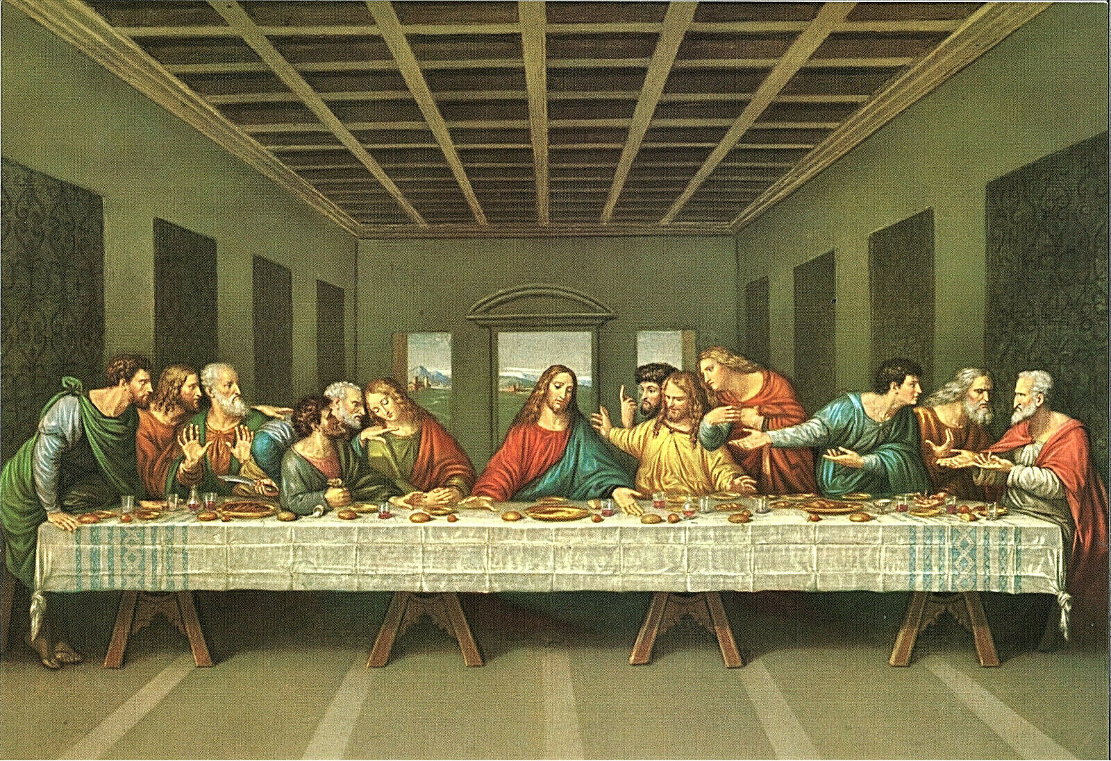
Passover/Pesach
Passover is a foreshadow of “Good Friday”
Passover is a foreshadow of the Lord’s Supper.
Passover is a remembrance of Israel being saved from the 10th plague

Slide 20
Passover as Foreshadow
The people were under a death sentence
We were under a death sentence
The blood of the Passover lamb saved the firstborn of Israel from physical death.
The blood of our Passover lamb saves us from spiritual death.
The Passover freed Israel from bondage in Egypt.
The death of Jesus frees us from bondage to sin

Slide 21
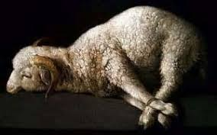
An Unblemished Lamb
1 Cor 5:7-8 Jesus, our Passover Lamb has been sacrificed. Therefore, let us keep the festival (Passover/Lord’s Supper)
Rev 13:8 A lamb slain from creation of the world.

Slide 22
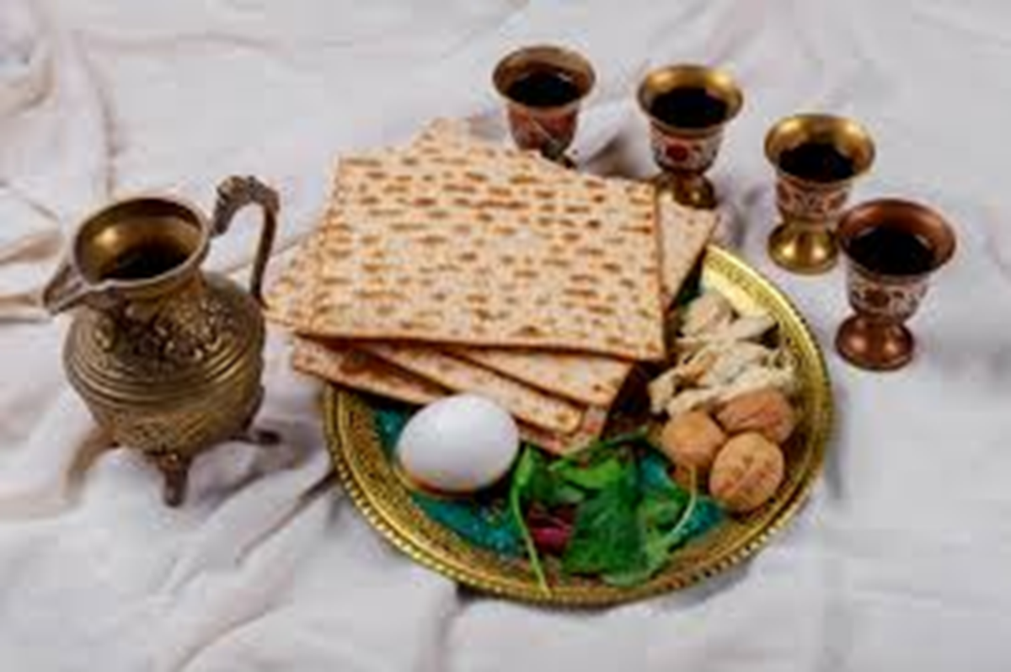
Passover and the Lord’s Supper
Luke 22:14-18
1. A remembrance. Exodus 12:14
2. Unleavened bread. Exodus 12:11, 33-34 1 Cor 5:7-8
3. A lamb without defect.
4. Bitter herbs. Exodus 12:8
5. Wine

Slide 23
The essence of the Passover is that of the Lord’s Supper. It is about remembering where we came from; the bitterness of enslavement and the price of our deliverance from enslavement; the blood of the Lamb, slain from the creation of the world.
-Philip Lester

