Slide 1
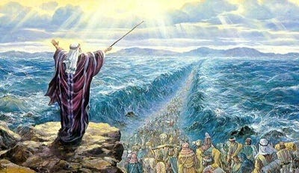
Exodus IV God Sets His People Free

Slide 2
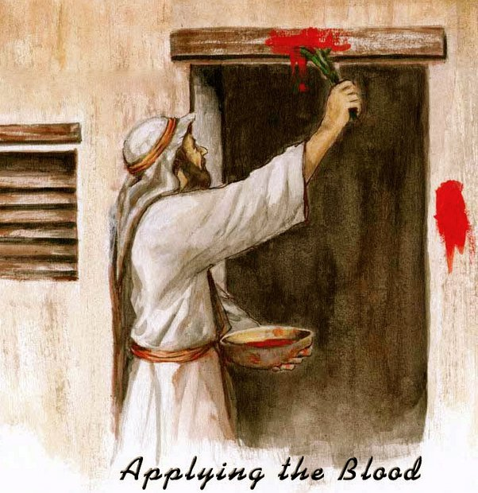
Last Week: Passover
Ex 12:5-7 14 Nisan Slaughter the lamb. Take the blood and put it on the doorframes of your houses

Slide 3
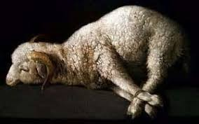
An Unblemished Lamb
1 Cor 5:7-8 Jesus, our Passover Lamb has been sacrificed. Therefore, let us keep the festival (Passover/Lord’s Supper)

Slide 4
The essence of the Passover is that of the Lord’s Supper. It is about remembering where we came from; the bitterness of enslavement and the price of our deliverance from enslavement; the blood of the Lamb, slain from the creation of the world.
-Philip Lester

Slide 5
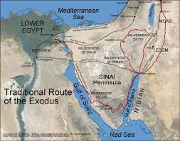
Exodus 13:17-22
A problem:
They are still in Egypt!

Slide 7
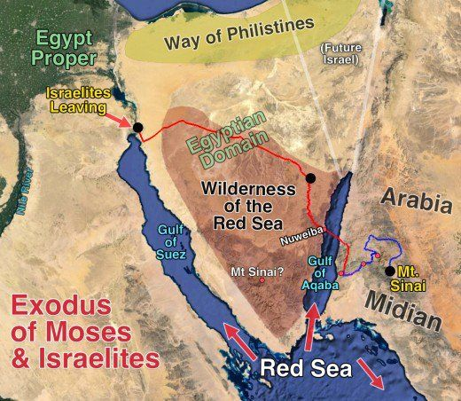
The Red Sea/ The Reed Sea
Where is it?

Slide 8
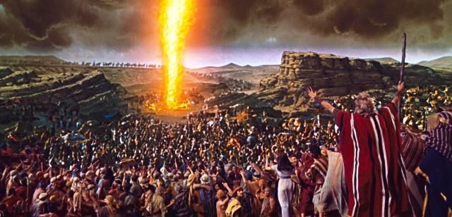
The Pillar of Fire

Slide 9
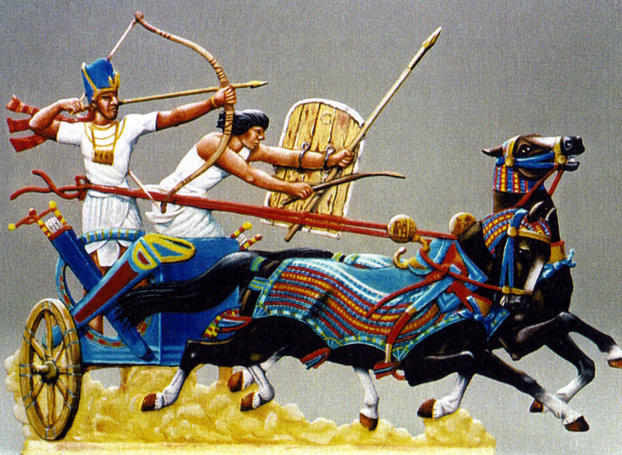
Exodus 14:1-9
Pharaoh does not want to let us leave Egypt!
Israel is trapped
We are looking back to Egypt

Slide 10
Exodus 14:14
The Lord will fight for you;
You need only to be still.
Exodus 14:15 Move on.
Which is it? Be still or move on?

Slide 11
Exodus 14:19-31
Israel finally leaves Egypt by God’s mighty hand.
THE moment in the history of Israel.

Slide 13
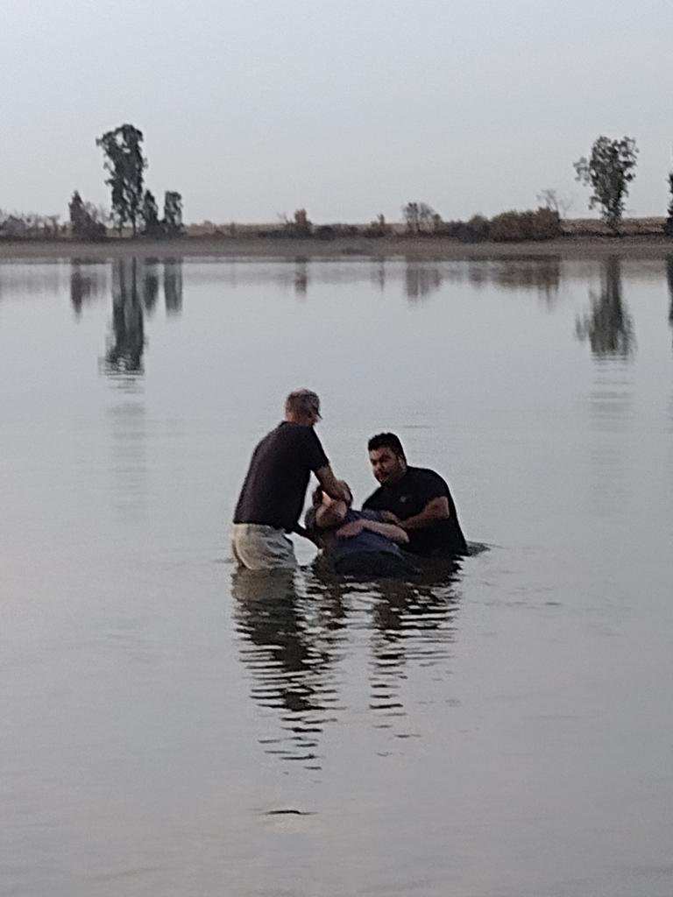
You do not escape Egypt until you pass through the water!
1 Cor 10:2 They were all baptized into Moses in the cloud and in the sea.
For me: Dec 13, 1978

Slide 14
Exodus 15:1-18 The Songs of Moses and Miriam
v. 1 Our sins have been washed away
v. 2 God has become our Savior
v. 5 Deep waters have covered our sins.
v. 9 Pharaoh boasted but has been defeated.
v. 11 YHWH is awesome and majestic.
v. 17 God will lead us through the Wilderness to the Promised Land!

Slide 15
Exodus 16 God Gives Us Bread
Exodus 16:1-6 We are grumbling.
Exodus 16:16-20 God gives us manna anyway!!!
But do not take more than you need.
Deuteronomy 8:3 Man does not live by bread alone, but by every Word that comes from the mouth of YHWH.

Slide 16
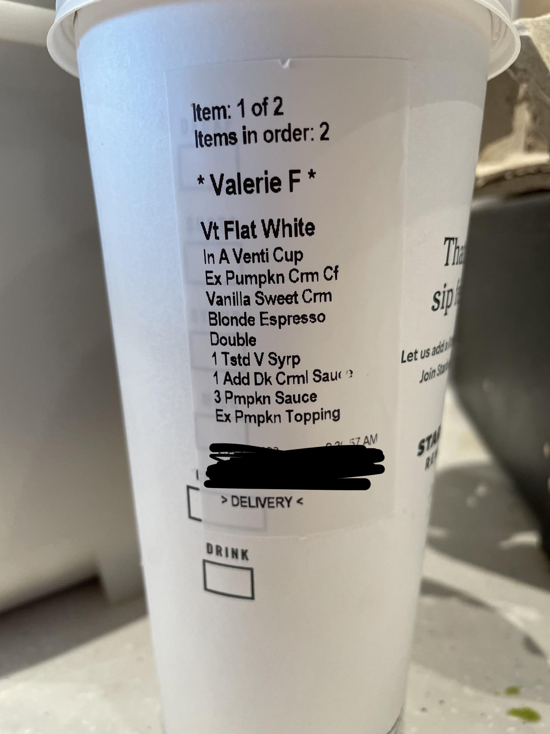
All we need, but no more than we need.

Slide 17
Exodus 17 God Gives Us Water
Ex 17:2-3 The people quarrel with Moses.
Ex 17:6 But God blesses them with water anyway!
John 7:37-38 Whoever is thirsty come to me and drink. Whoever believes in me… rivers of living water will from from within them.

Slide 18
Summary
God wants to set us free by His might hand.
To get out of Egypt, you have to pass through the water.
God will provide bread and water for us while we wander in the wilderness.
Drink the water and eat the bread!!!

