Slide 1
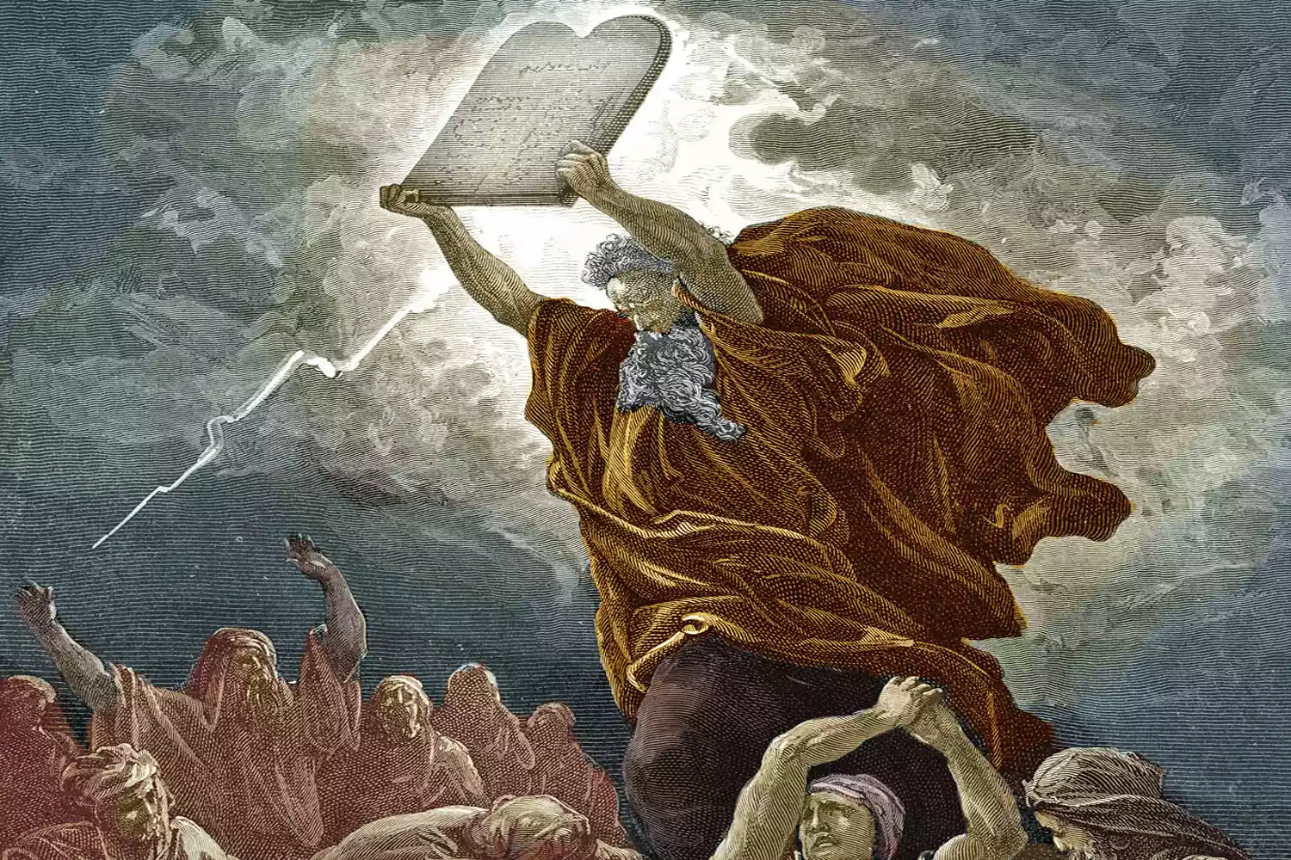
Exodus V God Gives a Covenant at Sinai

Slide 2
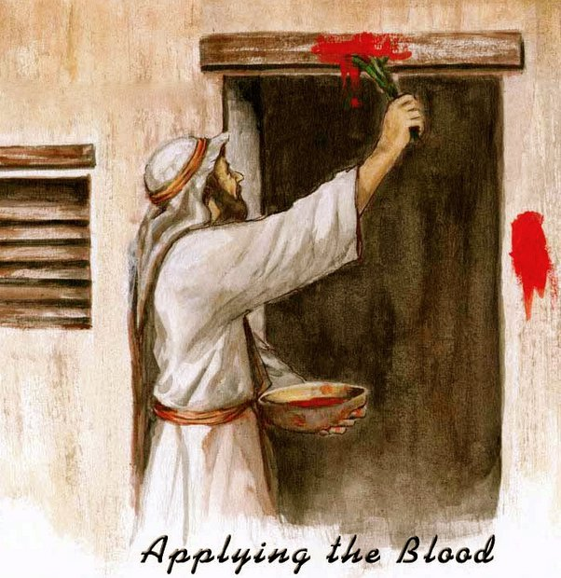
An Unblemished Passover Lamb

Slide 3
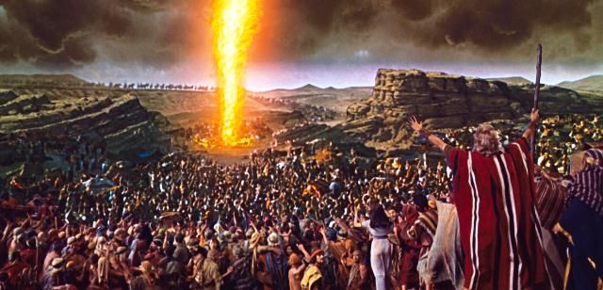
The Pillar of Fire

Slide 4
Exodus 14:19-31
Israel finally leaves Egypt by God’s mighty hand.
THE moment in the history of Israel.

Slide 6
Exodus 16 God Gives Us Bread
Exodus 16:1-6 We are grumbling.
Exodus 16:16-20 God gives us manna anyway!!!
But do not take more than you need.
Deuteronomy 8:3 Man does not live by bread alone, but by every Word that comes from the mouth of YHWH.

Slide 7
Exodus 17 God Gives Us Water
Ex 17:2-3 The people quarrel with Moses.
Ex 17:6 But God blesses them with water anyway!
John 7:37-38 Whoever is thirsty come to me and drink. Whoever believes in me… rivers of living water will from from within them.

Slide 8
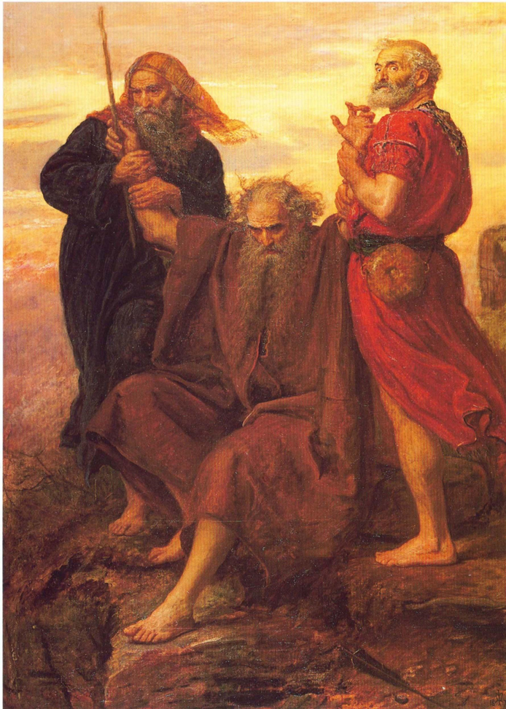
Exodus 17:8-16 War With Amelek
Message: Victory is of God. YHWH nissi
YHWH Our Banner

Slide 9
Exodus 18:1-27 Jethro
Message: Leaders need to be willing to delegate?
Better: When God does not speak directly to a question or issue, we need to seek wise, godly advice.

Slide 10
Outline of Exodus
Exodus 1-18 Moses/Jesus as Savior God sets his people free from slavery/sin.
Exodus 19-40 Moses/Jesus as lawgiver-as one who establishes covenant between God and his elect people.

Slide 11
Exodus 19:1-6
The purpose of the covenant at Sinai:
1. A treasured possession.
2. A kingdom of priests.
3. A holy nation.
But… “If you obey me fully.” Lev 18:5
Ex 19:7-8 “We will do everything the Lord has said.”
Good luck!

Slide 12
1 Peter 2:9
Treasured possession = chosen people
Kingdom of priests = a royal priesthood
A holy nation = a holy nation
The difference: In Christ you ARE these things!

Slide 13
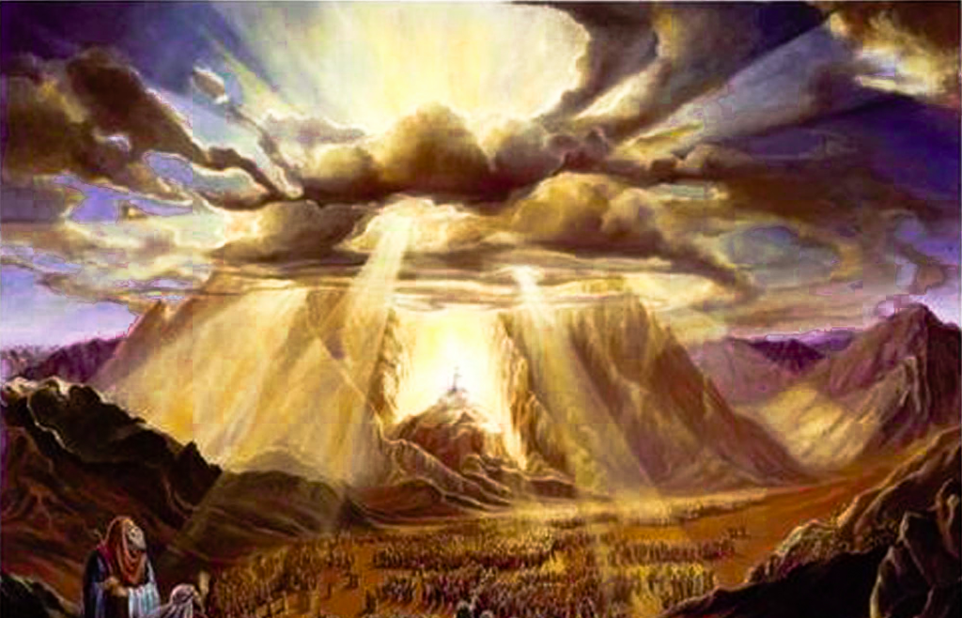
Exodus 19:9-19 An Awesome Event!
A pre-enactment of Mark 9:2-8
The Mount of Transfiguration.
Cloud, consecrated clothes

Slide 14
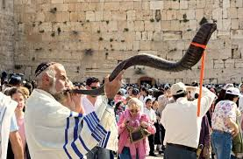
Exodus 9:9-19 No access!!!
A fence
Stone to death or shoot with an arrow those who approach God
Shofar: All Clear!

Slide 15
Hebrews 12:18-24 A New and Better Covenant
Mt. Sinai vs Mt Zion
Exodus 19:12 Kill those who approach God.
Hebrews 10:19 We walk boldly into God’s presence
But… Heb 12:25-28 Even we must worship with reverent fear.

Slide 16
Exodus 20:18-20
The fear of God will keep you from sinning.
Deut 4:10
Deut 5:24

Slide 17
Hebrews 8:6-13 A Better Covenant
God’s law on our hearts, not on stone.
All will know God.
Sins will be forgiven.

Slide 18
Summary
Battle with Amelek: God is our banner!
Jethro: When God does not speak, seek wise counsel.
Exodus 19 God’s Covenant. God’s plan
A treasured possession
A royal priesthood
A holy nation

