Slide 1
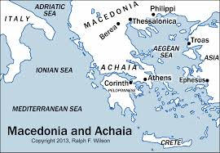
Christian Relationships:
1 Thessalonians
Thessalonica: Acts 17:1-10

Slide 2
Christian Relationships
I. Intimate relationships
II. No impure motives 1 Thess 2:3
III. Like a young child 1 Thess 2:7
IV. Like a nursing mother 1 Thess 2:7-10

Slide 3
Christian Relationships
V. Share our lives 1 Thess 2:8
VI. Like a father with his children 1 Thess 2:11-12
VII. Preached the Word to one another 1 Thess 2:13-16
VIII. Deep emotional connection 1 Thess 2:17-3:5
IX. Great memories 1 Thess 3:6-10

Slide 4
Christian Relationships
Pure motives
Like children
Like mothers
Like fathers
Deep, emotional connection
Share great memories together

