Slide 2
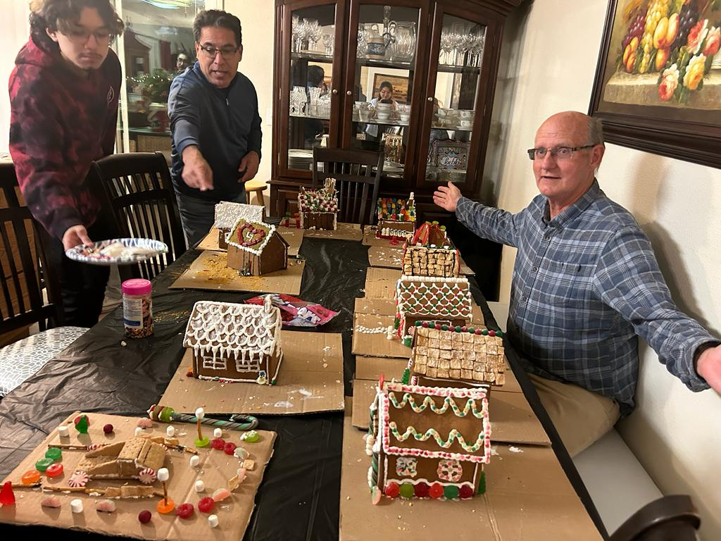
Announcements
Gingerbread Houses Friday 12/13 7:00
Hiking at Pinnacles Park Sat 12/14 6:00
Christmas Party Tu 12/17
Christmas Service 12/22

Slide 3
Christian Friendships

Slide 4
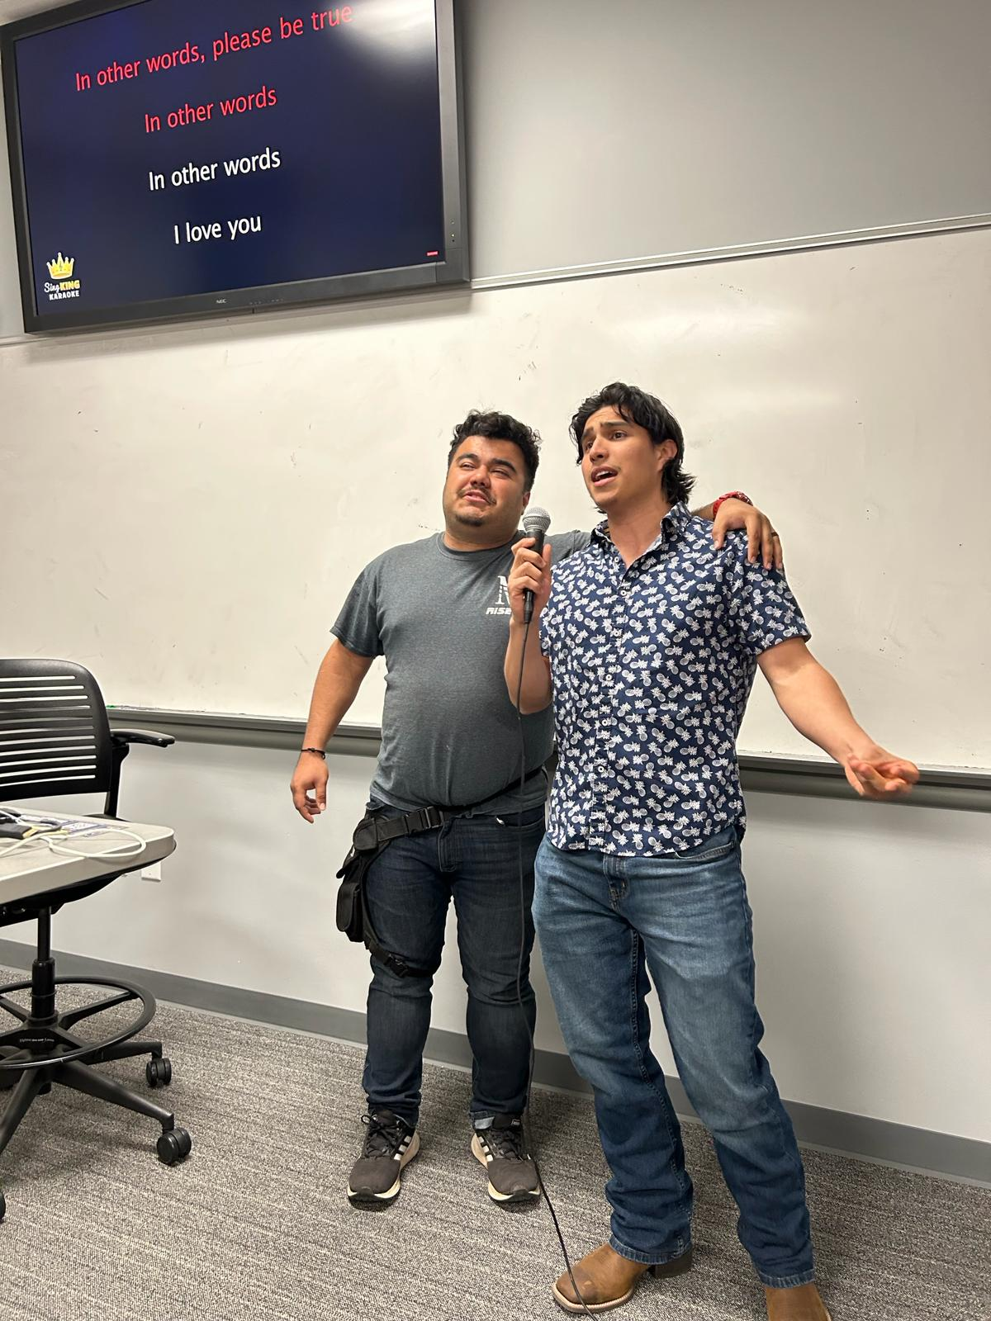
David and Jonathan
1 Samuel 19:1-6
1 Samuel 20:1-42
2 Samuel 1:24-27

Slide 5
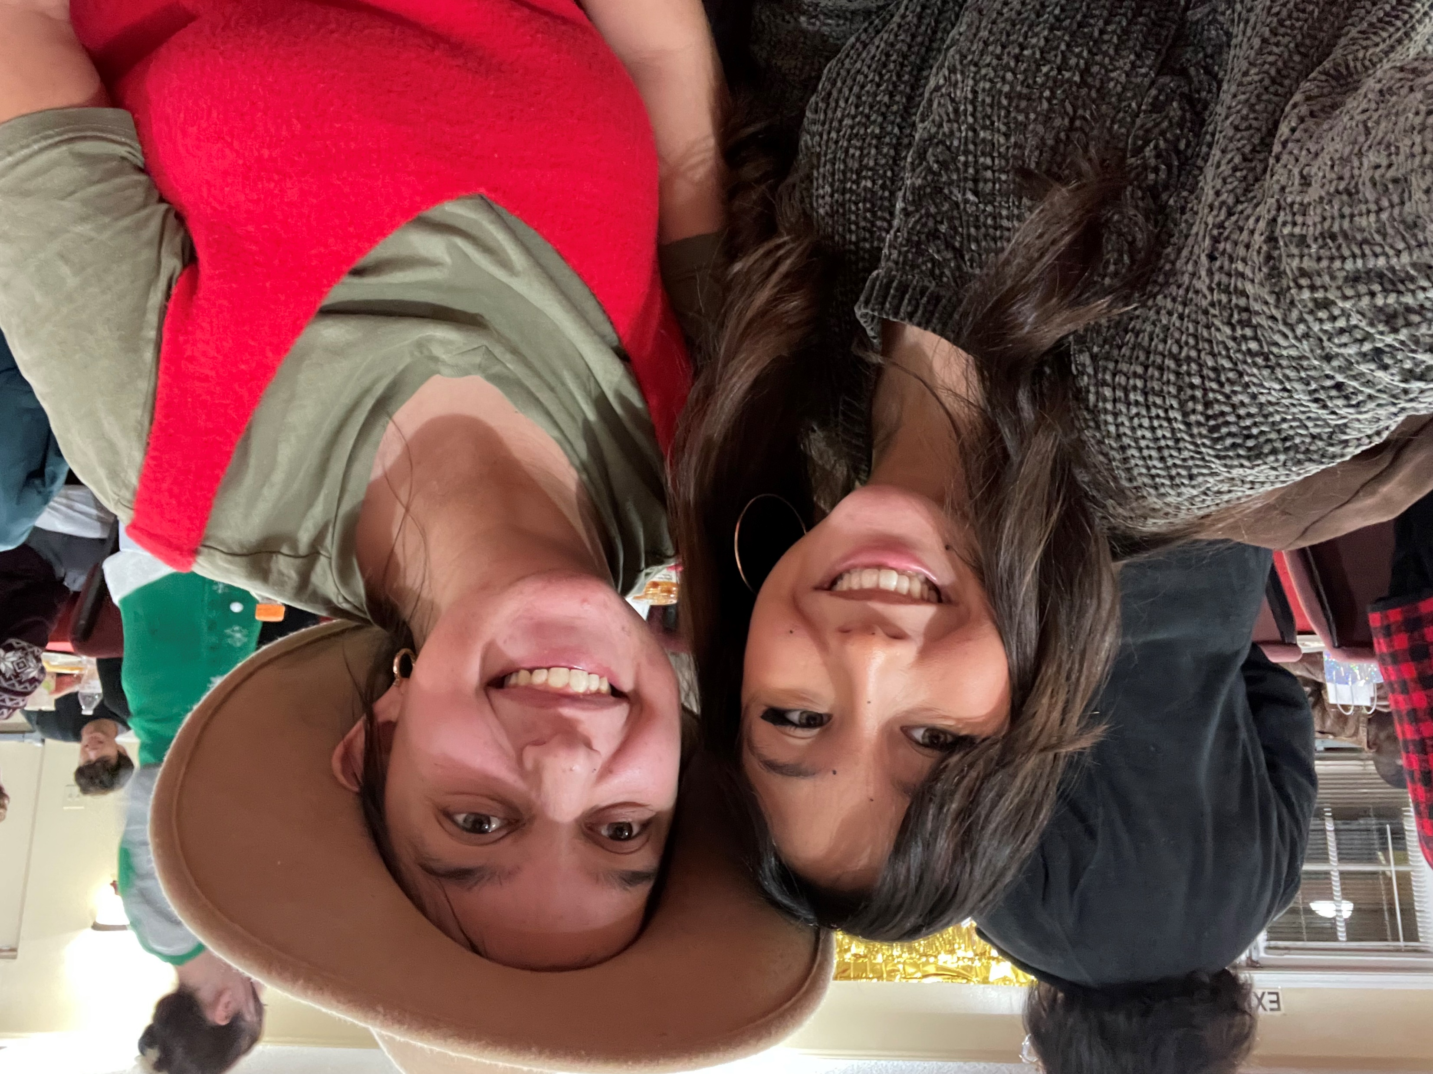
Great Friends
A common bond in God
Something in common.
Shared adventures

Slide 6
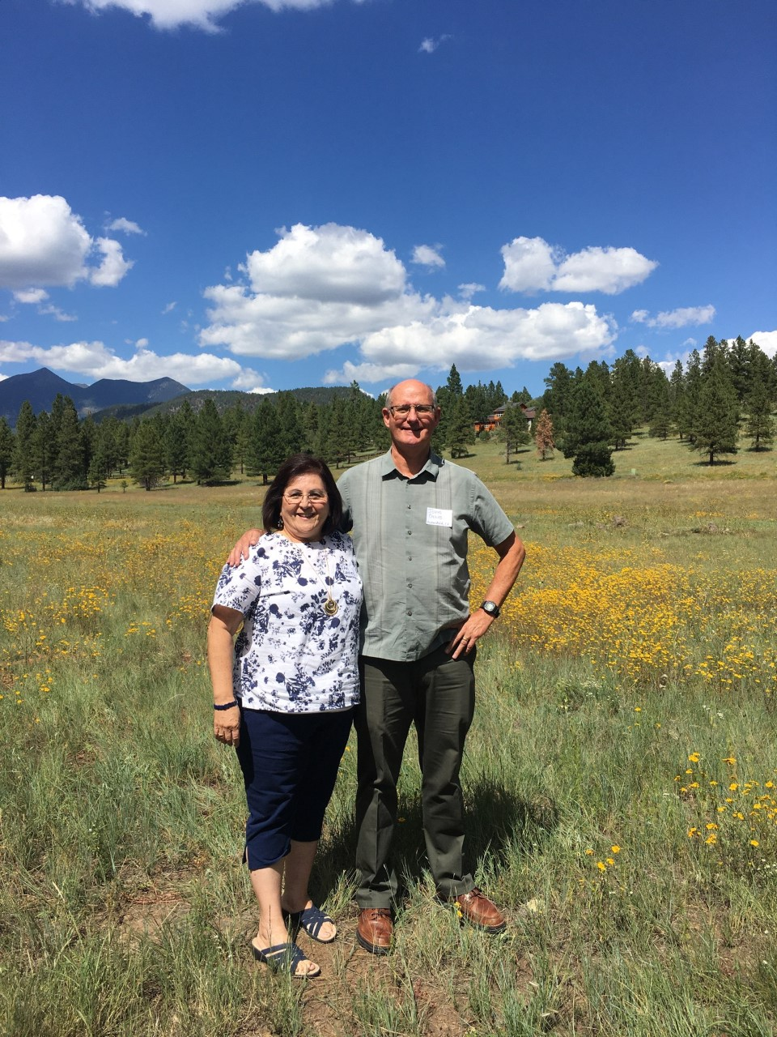
Friendship in Proverbs
Proverbs 27:9
Proverbs 17:17
Proverbs 18:24

Slide 7
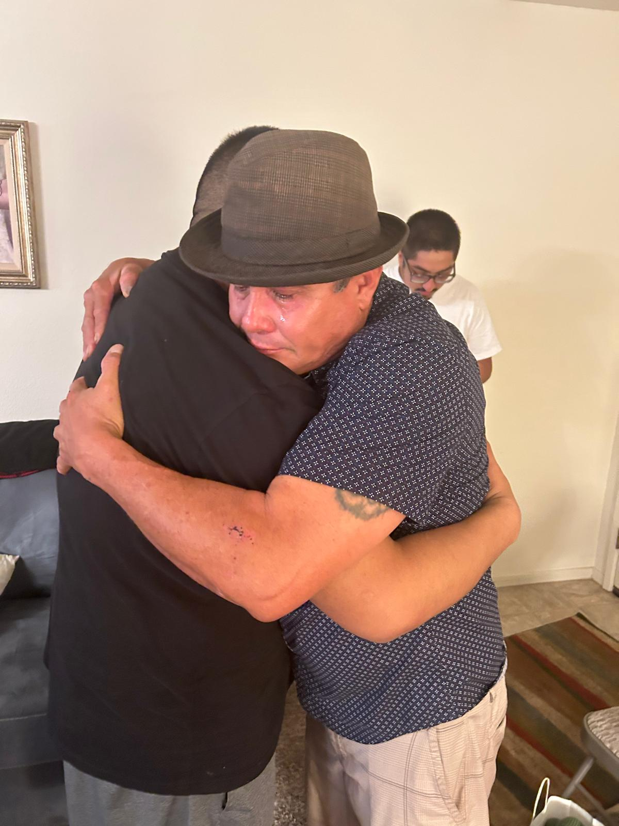
Friendship Based On…
Being in Christ together
A common interest
A personality that works together
Great experiences
Time and consistency

Slide 8
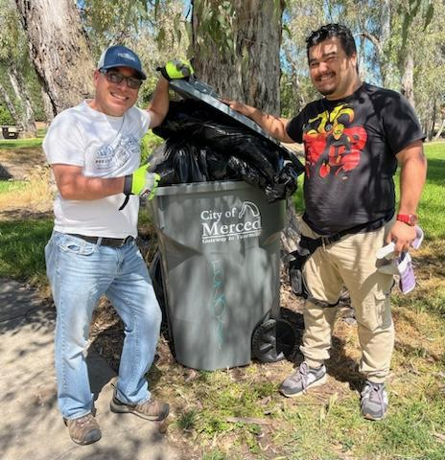
More Examples
Ruth and Naomi Ruth 1:11-18
Jesus, Lazarus, Mary and
Martha
Paul and Timothy 1 Tim 1:1-5

Slide 9
1. What makes for an ideal friend to you personally? What do you look for?
2. Tell us about a really good friend of yours. What do you appreciate?

