Slide 1
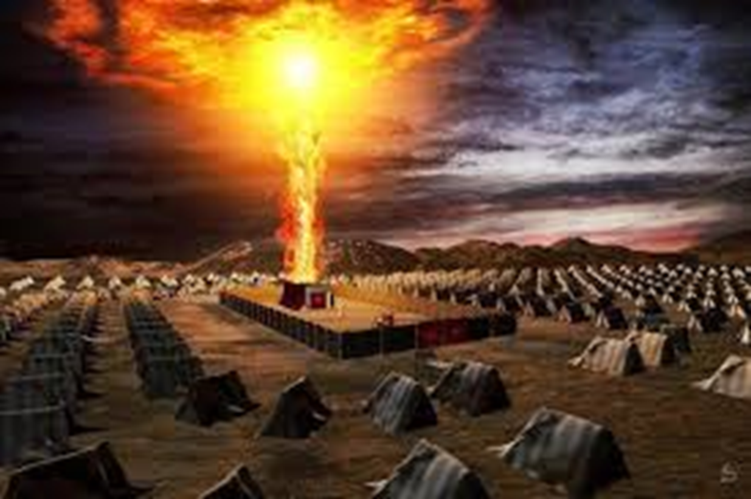
Exodus IX
Jewish Festivals
Party Time!

Slide 2
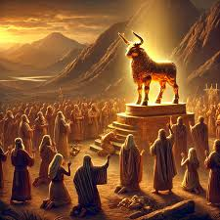
Last Week:
The Golden Calf

Slide 3
Three Stories
The golden calf is the story of the ever-present threat of apostasy—of going back to Egypt
The golden calf is the story of Moses as intercessor for God’s people—as a prefigure of Christ, our mediator.
The golden calf is the story of God’s amazing mercy and patience with his people, despite their stubborn sin and desire to return to Egypt.

Slide 4
Exodus 34:27-35
The Covenant reestablishled based on God’s grace, compassion, patience, mercy and faithfulness, not just on “If you obey me fully and keep my covenant.”

Slide 5
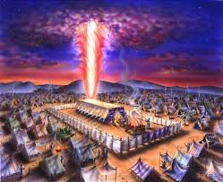
Exodus 40:34-38 The Glory of the Lord Fills the Tabernacle!!!
v. 34 The cloud covered the tent of meeting, and the glory of the Lord filled the tabernacle.
shekina

Slide 6
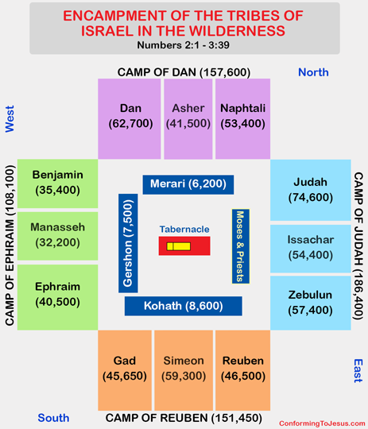
Tribes encamped around the presence of God in the wilderness

Slide 7
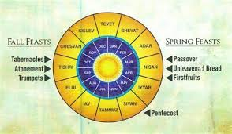
Old Testament Festivals
Seven-day festivals:
Unleavened Bread
Tabernacles
One-day festivals:
Passover
Firstfruits
Pentecost
Trumpets
Day of Atonement

Slide 8
Mosaic Covenant Festivals as Types
Jewish Festival
Christian Antitype
Passover (pesach)
The Sacrificial Death of Jesus
Feast of Firstfruits
The Resurrection of Jesus
Feast of Unleavened Bread
Celebrate Being Free of Sin
Feast of Weeks/Pentecost
Harvest/Holy Spirit
Feast of Trumpets
Judgment Day, Jesus’ Return
Day of Atonement (yom kippur)
Atonement through Christ
Feast of Booths (Tabernacles)
Celebrating God dwelling in us The Holy Spirit

Slide 9
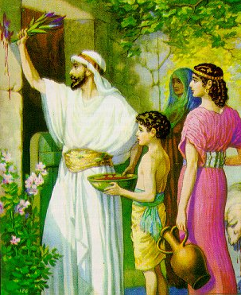
Passover/Pesach (Exodus 12:24-28)
Under a death sentence
Pure, undefiled Passover lamb (1 Cor 5:7-8, Rev 13:8)
Blood sprinkled on the wooden beam above the door.

Slide 10
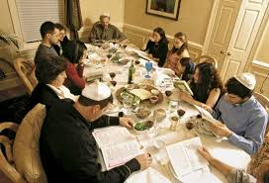
Passover/Pesach (Exodus 12:24-28)
Saved from death
Saved from slavery
Blood shed on a wooden beam
No bone broken (Exodus 12:46 Psalm 22:17 Jn 19:31-33
Remove all the leaven (1 Cor 5:7)
Bitter herbs

Slide 11
Passover
Let us celebrate our salvation and our freedom from slavery to sin

Slide 12
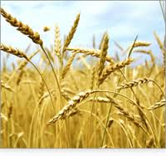
Feast of Firstfruits Lev 23:9-14
A harvest festival when there was no harvest.
A promise of a future harvest.
A foreshadow of the final resurrection.
Nisan 16: The day Jesus was resurrected
A prefigure of the resurrection of Jesus. 1Cor 15:20-21

Slide 13
FEAST OF FIRSTFRUITS
Let us celebrate our present and our future resurrection in Christ.

Slide 14
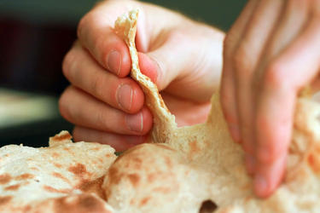
Feast of Unleavened Bread
Exodus 12:17-19 Celebrating a life of freedom in Christ. Freedom from sin.

Slide 15
Feast of Unleavened Bread
Let us celebrate the fact that, in Christ, all of our sins are wiped out—forgiven!

Slide 16
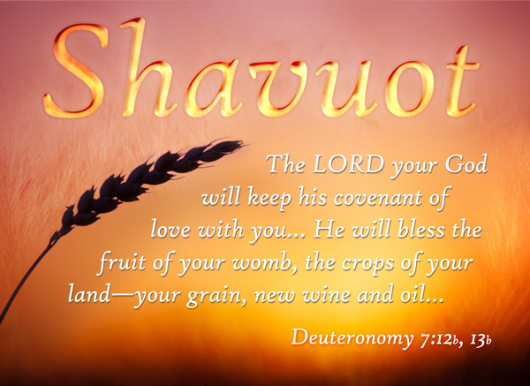
The Feast of Weeks/Pentecost/Shavuot
50 days after the Passover 49 days (7 weeks) after the Feast of Firstfruits.
Leviticus 23:15-17
Celebrating the harvest
of souls for eternity
Celebrating the gift of the Holy Spirit

Slide 17
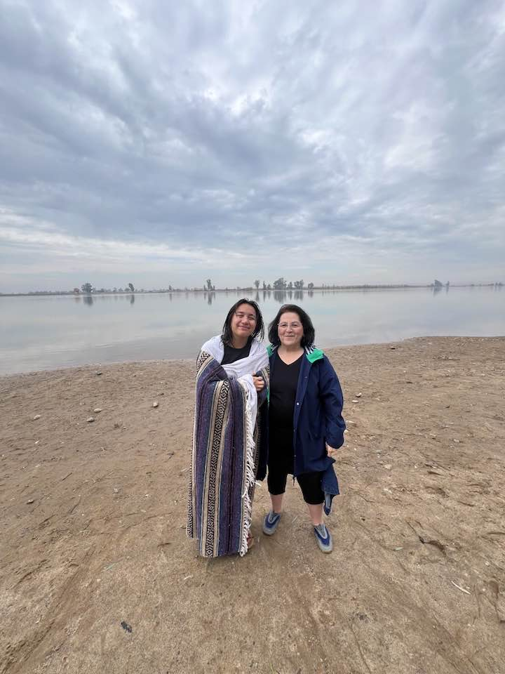
Feast of Weeks/Pentecost
Celebrating the harvest: our own salvation and that of others

Slide 18

Feast of Trumpets Rosh Hashanah
Leviticus 23:23-25 A harvest festival.
A foreshadow of the Return of Jesus.
  Matt 25:30-31, I Thess 4:13-14 Trumpet call.
A foreshadow of Judgment Day
Rabbis: Stay awake all night so you will be prepared.

Slide 19
FEAST OF TRUPMETS
Let us reflect on our lives, repent of our sins, and be prepared for the second coming of Jesus.

Slide 20
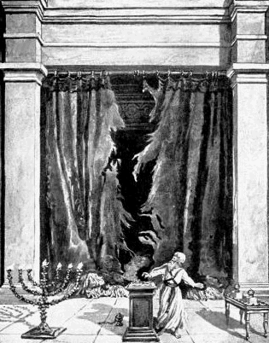
The Day of Atonement Yom Kippur
Sacrificial goat and scape goat.
Sins laid on sacrificial goat, killed outside the camp.
Incense fills the Holy of Holies
Priest enters the Holy of Holies and puts blood on the Mercy Seat

Slide 21
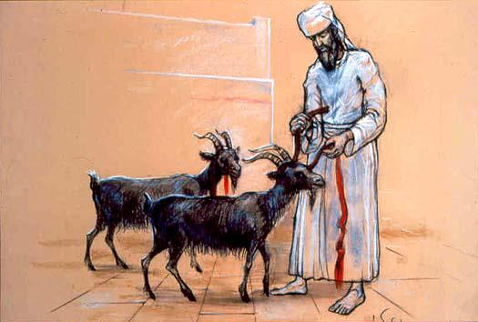
The Day of Atonement Yom Kippur
Scapegoat (Azazel) sent off into the wilderness
Bodies burned outside the camp (Hebrews 13:11-14)
Prefigure of the salvation of Jesus. Hebrews 9:11-15, 23-24

Slide 22
The Day of Atonement
Let us celebrate the sacrifice of Jesus for our sins and remember our own personal day of atonement.

Slide 23
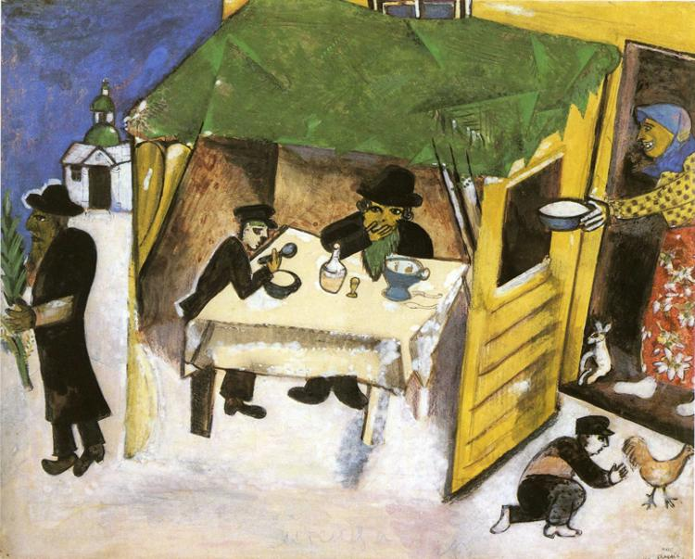
Sukkot/Feast of Booths/Tabernacles
Seven day festival
Harvest Festival
Build a booth and live in Leviticus 23:33-43
Remembering the Presence of God in the Wilderness
John 1:14

Slide 24
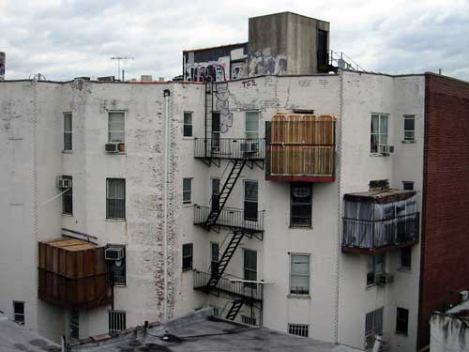
Sukkot in a City

Slide 25
Tabernacles/Booths/Sukkot
A Celebration of Wandering in the Wilderness: Living in Close Fellowship with God (John 1:14 Jesus tabernacled with us)
Tabernacles in the NT 2 Cor 5:1-5

Slide 26
Feast of Tabernacles
Let us celebrate our life in fellowship with Christ and the presence of God in and among us in the Holy Spirit

Slide 27
Summary: Party time!
Exodus 40 Let us celebrate that God has chosen to dwell among us in our wilderness wanderings.
Our salvation
The Resurrection
Our freedom from sin
The future coming of Christ
The day we were saved
God dwelling among us

