Slide 1
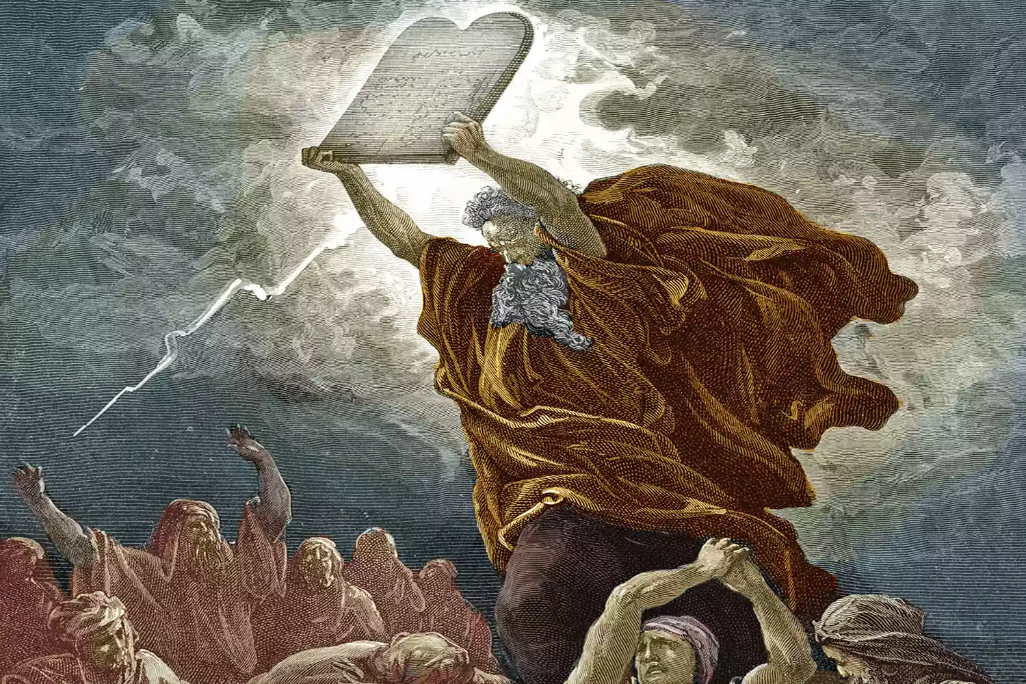
Exodus VI Moses Receives the Law at Sinai

Slide 2
Outline of Exodus
Exodus 1-18 Moses/Jesus as Savior God sets his people free from slavery/sin.
Exodus 19-40 Moses/Jesus as lawgiver and as one who establishes covenant between God and his elect people.

Slide 3
Exodus 19:1-6
The purpose of the covenant at Sinai:
1. A treasured possession.
2. A kingdom of priests.
3. A holy nation.
But… “If you obey me fully.” Lev 18:5
Ex 19:7-8 “We will do everything the Lord has said.”
Good luck!

Slide 4
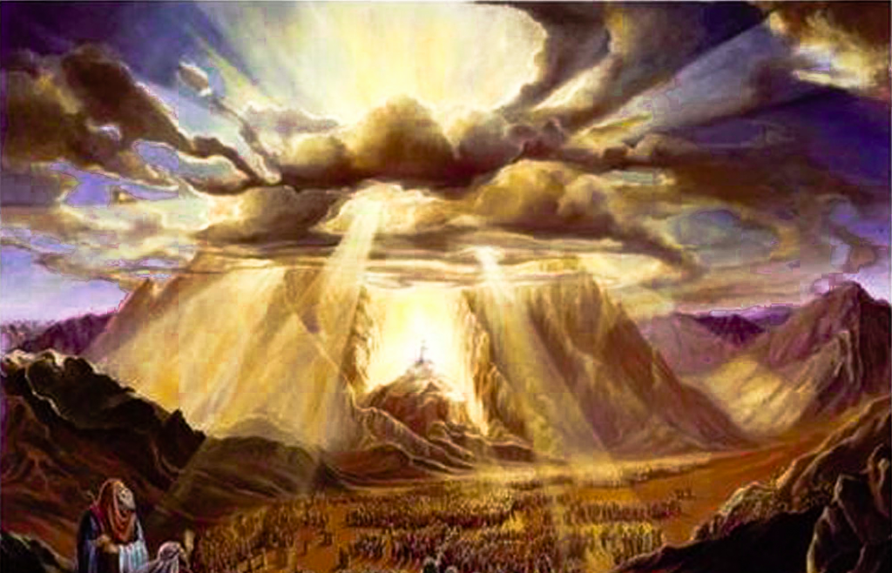
Exodus 19:9-19 An Awesome Event!
A pre-enactment of Mark 9:2-8
The Mount of Transfiguration.
Cloud, consecrated clothes

Slide 5
Hebrews 12:18-24 A New and Better Covenant
Mt. Sinai vs Mt Zion
Exodus 19:12 Kill those who approach God.
Hebrews 10:19 We walk boldly into God’s presence
But… Heb 12:25-28 Even we must worship with reverent fear.

Slide 6
Hebrews 8:6-13 A Better Covenant
God’s law on our hearts, not on stone.
All will know God.
Sins will be forgiven.

Slide 7
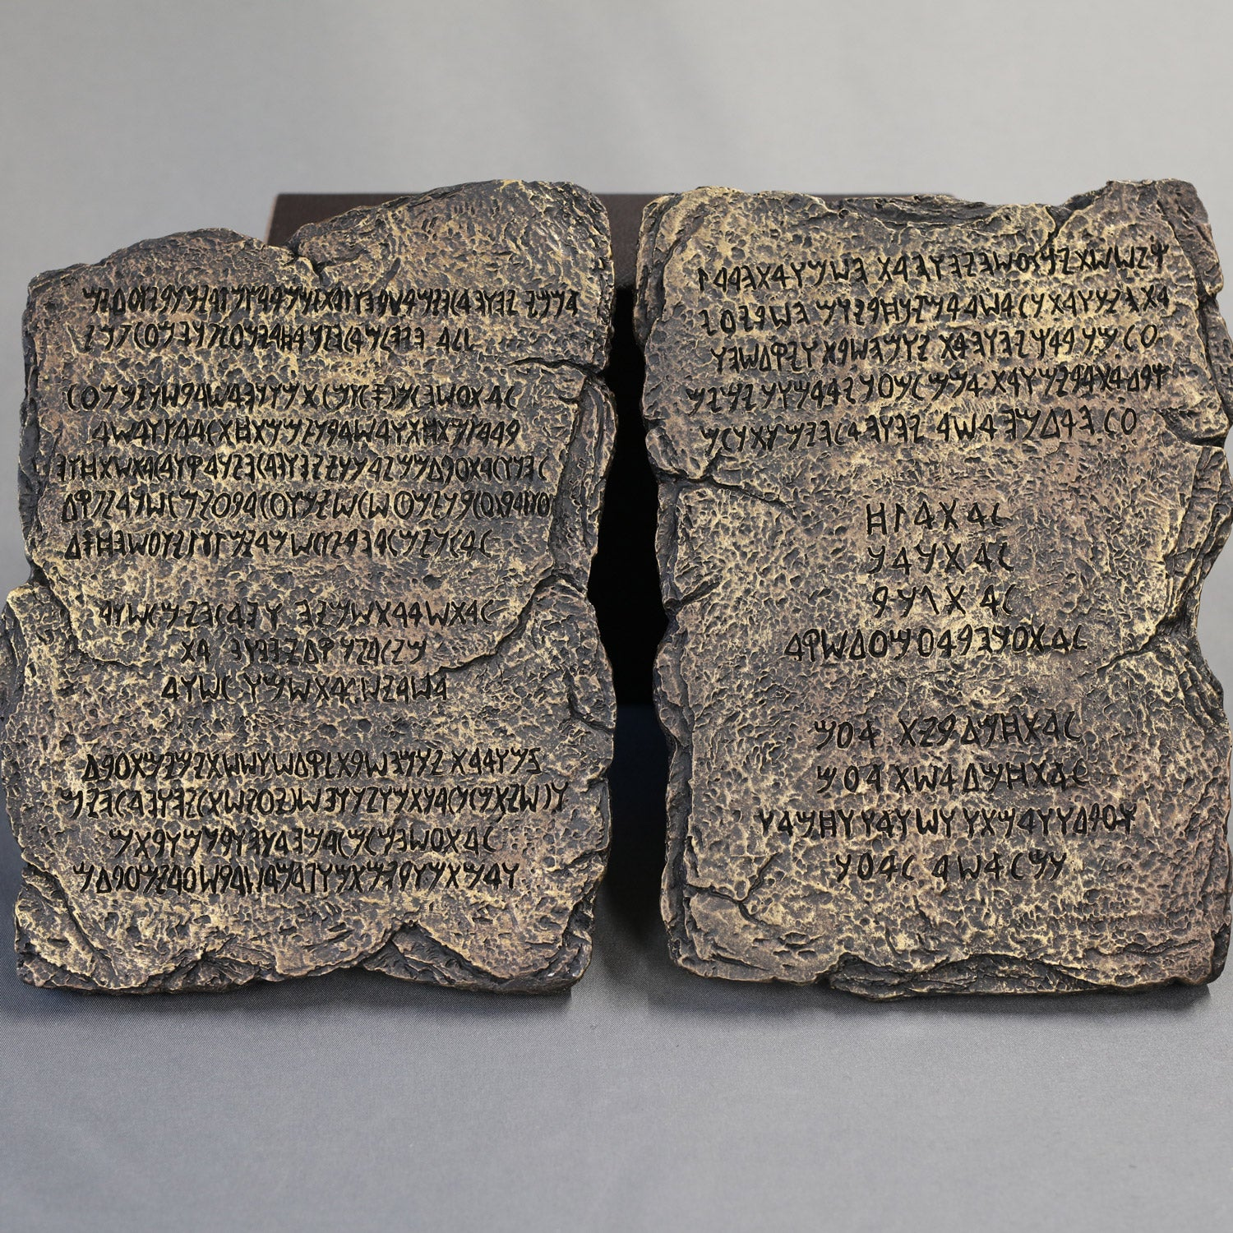
Exodus 20:1-17 The Ten Commandments
Exodus 20:1 The same God who brought the out of Egypt, is the one who is giving the Law.
Moses/Jesus as deliverer and law-giver
Commandment #1-4 Love God.
Commandment #5-10 Love God’s people

Slide 8
Are We Under the 10 Commandments?
Matthew 5:17
Colossians 2:16
Exodus 20:3 Are we to have no other Gods before YHWH?
Exodus 20:4-8 Are we to avoid all forms of idolatry?
Exodus 20:7 Are we to avoid using God’s name in vain?
Exodus 20:12 Are we to honor our parents?

Slide 9
Colossians 2:17 The Reality is found in Christ

Slide 10
Three Divisions of the Law of Moses?
Moral Law: 10 Commandments, law on adultery…
Civil Law: Regulations on slavery, property…
Ceremonial Law: Festivals, sacrifices…
The Jew never recognized this distinction

Slide 11
So, Why Should Christians Learn About the Law
Enabled Israel to worship the Lord, and made them a special people
Prefigures and Foreshadows Christ and the New Covenant.
Shows us how much we need God to forgive our sins.

Slide 12
The Law Leads Us To Christ
Romans 5:20 That trespass might increase.
Romans 7:13. The law makes sin utterly sinful.
Galatians 3:23-25 It is a guardian until the coming of Christ.

Slide 13
Exodus 20:22-23:33 The Law Summarized
Rules for Servants
Exodus 21:23-25 Eye for eye
Rules for property
Ex 22:21 Do not mistreat or oppress a foreigner
Lending money, testifying in court
Sabbath Regulations
Three major festivals (foreshadows in NT)
Exodus 23:19 Cheeseburgers
God’s plan to give the Promised Land to Israel

Slide 14
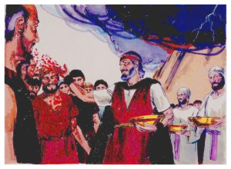
Exodus 24:1-18
Us: We will do everything YHWH has said.
Exodus 24:8 The Covenant and the Law are sealed with blood.

Slide 15
Exodus 25-31
Exodus 25-27 The Tabernacle Prefigures!
Exodus 28-29 The Priesthood Prefigures!
Exodus 30 The Tabernacle (cont.)
Exodus 31 Etc…
Exodus 32 Disaster!!! The Golden Calf

Slide 16
Summary
God gave an amazing covenant at Sinai, but the covenant in Christ is so much better!
God gave the Law at Sinai, but we have superior festivals, tabernacle and sacrifices.
The Law shows us that sin is utterly sinful
We need Jesus?

