Slide 1
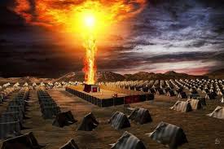
Exodus VII God Tabernacles With His People

Slide 2
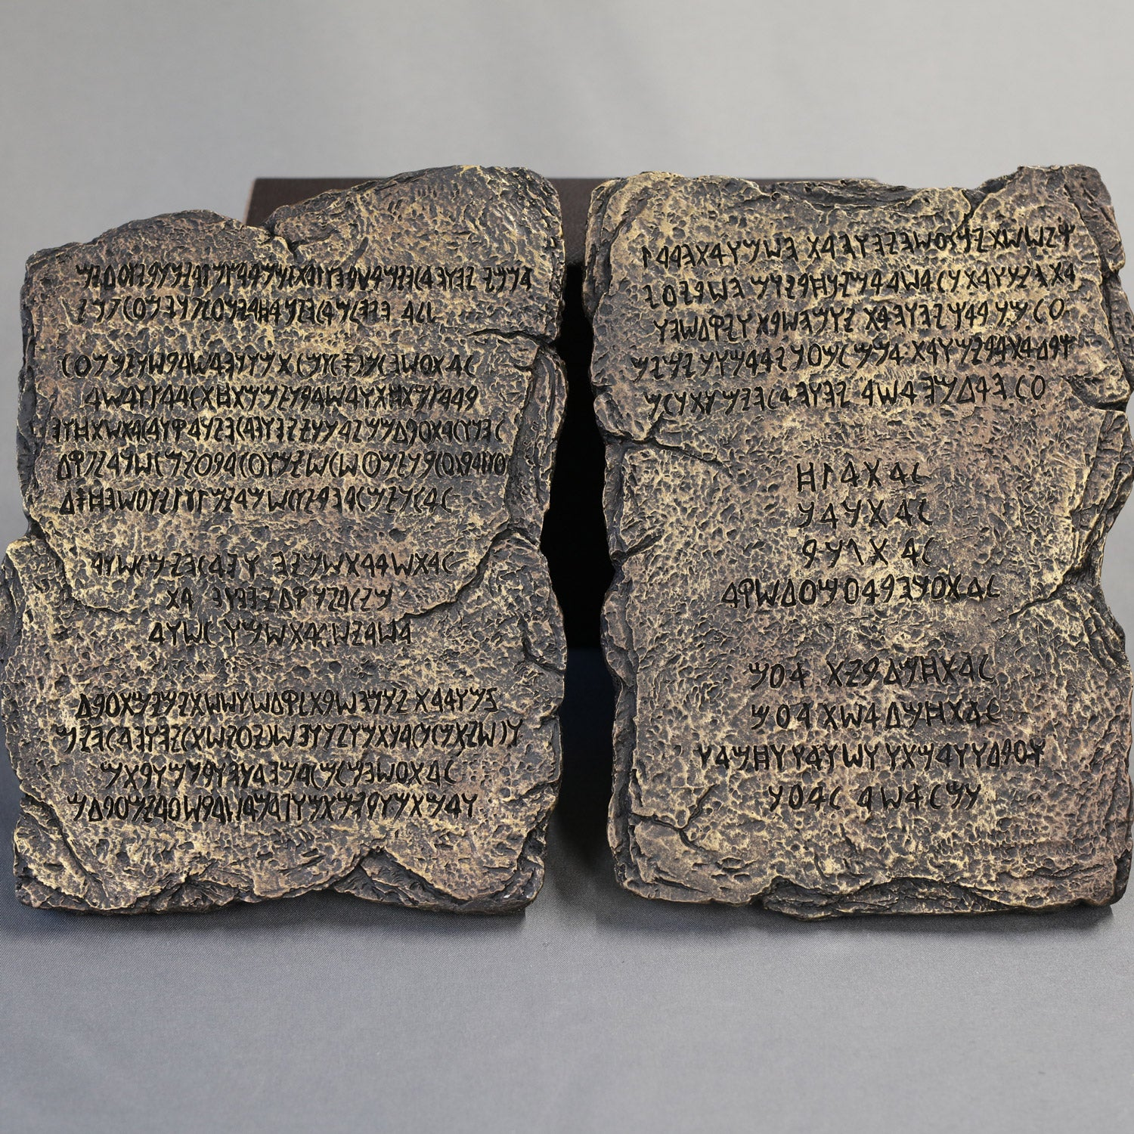
Exodus 20:1-17 The Ten Commandments
Commandment #1-4 Love God.
Commandment #5-10 Love God’s people

Slide 3
The Law Leads Us To Christ
Romans 5:20 That trespass might increase.
Romans 7:13. The law makes sin utterly sinful.
Galatians 3:23-25 It is a guardian until the coming of Christ.

Slide 4
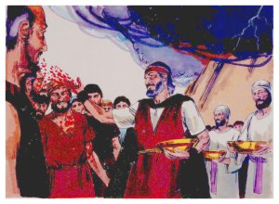
Exodus 24:1-18
Us: We will do everything YHWH has said.
Exodus 24:8 The Covenant and the Law are sealed with blood.

Slide 5
Exodus VII God Tabernacles With His People
Exodus 25:1-9
v. 1-7 Take up a collection… for the tabernacle
Why?
I will dwell (tabernacle) with them

Slide 6
I will tabernacle with them..
John 1:14 God tabernacled among us
v. 18 We beheld his glory…
Follow the exact pattern Exodus 25:8-9,
Hebrews 8:5-6 Ezekiel 43:10 “so that you might be ashamed…”

Slide 7
Follow the Pattern!
Why?
1. A copy of the real one. Heb 8:5
Copy hupodeigma sketch-plan
Shadow skia reflection
2. Ezekiel 43:10 “so that you might be ashamed…”

Slide 8
The Pattern
Ex 25:10-22 The ark
Ex 25:23-30 The table of shew bread
Ex 25:31-40 The menorah
Ex 26 The tabernacle
Ex 27:1-8 The bronze altar
Ex 27:9-19 The courtyard
Ex 30:1-10 The altar of incense

Slide 9
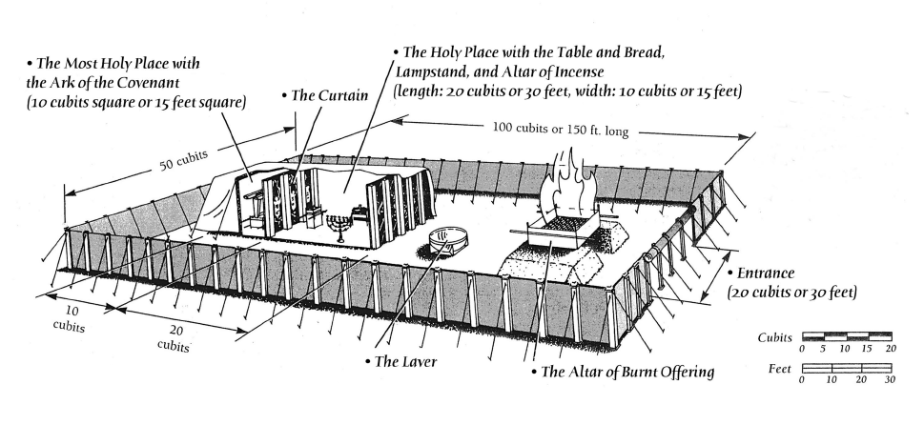

Slide 10
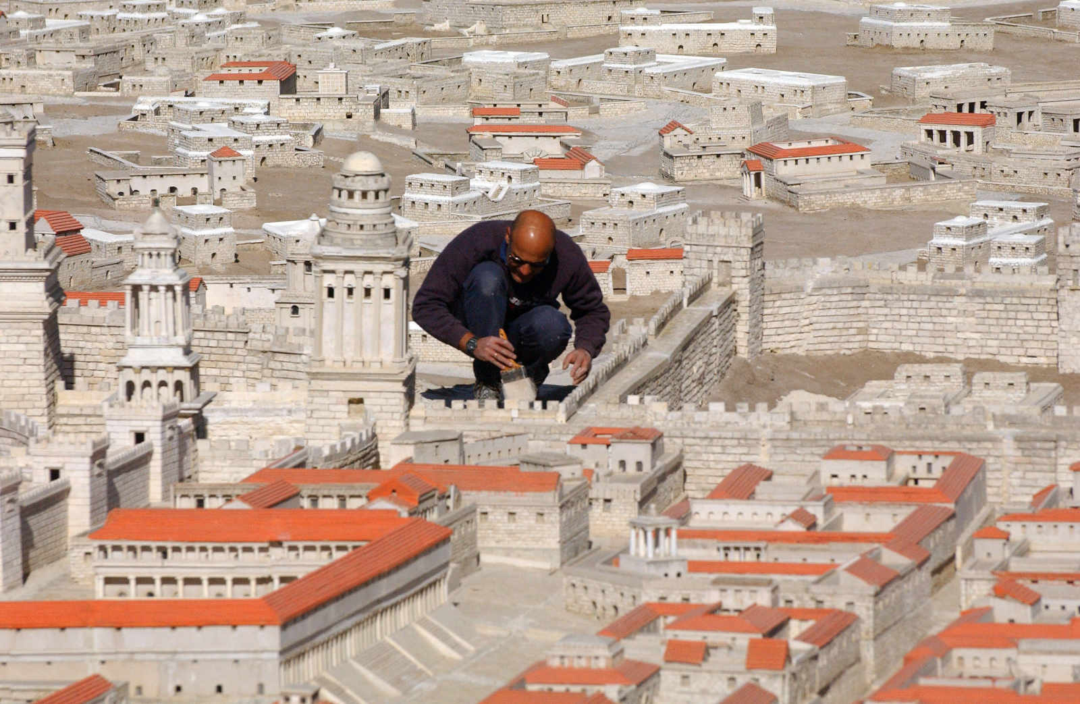
The Tabernacle Pattern
Heb 9:1-5 The pattern
Hebrews 8:1-2 the true tabernacle.
Heb 9:11 A more perfect tabernacle.
Heb 9:23-24 A copy of the real one

Slide 11
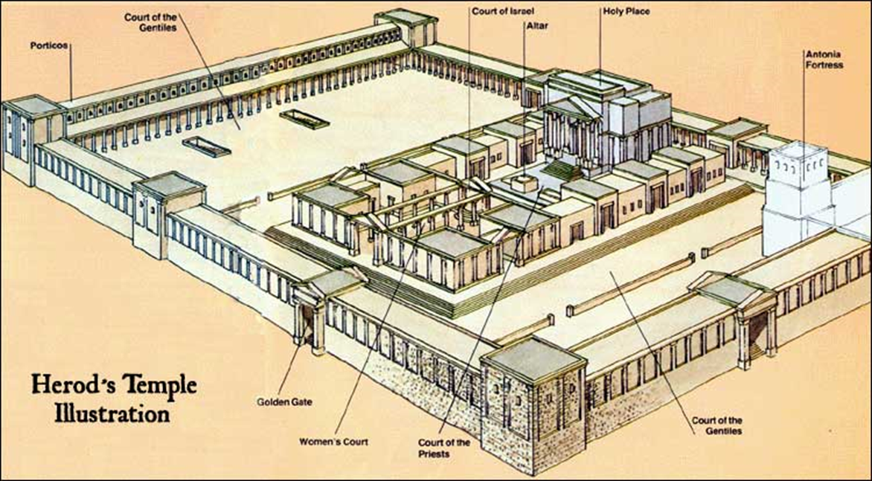
Types and Antitypes: The Courtyard
Solomon’s Temple
Court of Gentiles
Court of Women
The Gate: Male Jews
Levites enter the courtyard
Priests enter the Holy Place
The High Priest enters
the Most Holy Place once a year.
The point: Separation!

Slide 12
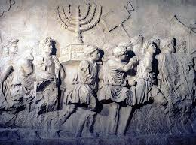
Type and Antitype in the Tabernacle
Bronze Altar: We need a sacrifice for access
Laver = The need for cleansing/baptism to enter God’s presence. 1 Peter 3:21
Shew Bread: Jesus, the bread of life John 6:35
Menorah: The Holy Spirit Zechariah 4:1-6
Altar of incense = Our prayers Rev 5:8

Slide 13
Type and Antitype in the Tabernacle
Curtain: Separation between man (unholy) and God (holy)
Cherubim: Protect God’s holiness
Mercy seat: God’s throne His mercy
Note, the mercy seat covers the Law of Moses

Slide 14
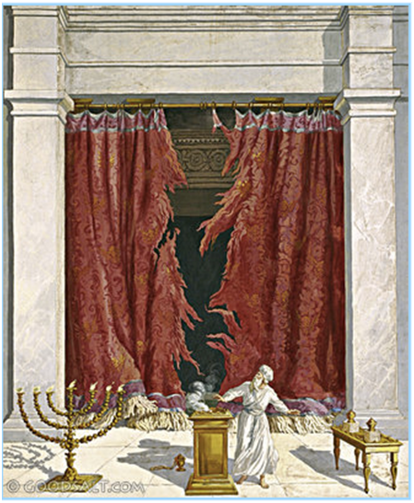
Great News
When Jesus died, the curtain was rent in two.
Now, we walk boldly into the true, the heavenly tabernacle Heb 10:19-22!!!!!!

Slide 15
Tabernacling in the New Testament
1 Corinthians 3:16 You are God’s tabernacle.
Ephesians 2:21-22 The church is the temple/tabernacle in which God dwells.

Slide 16
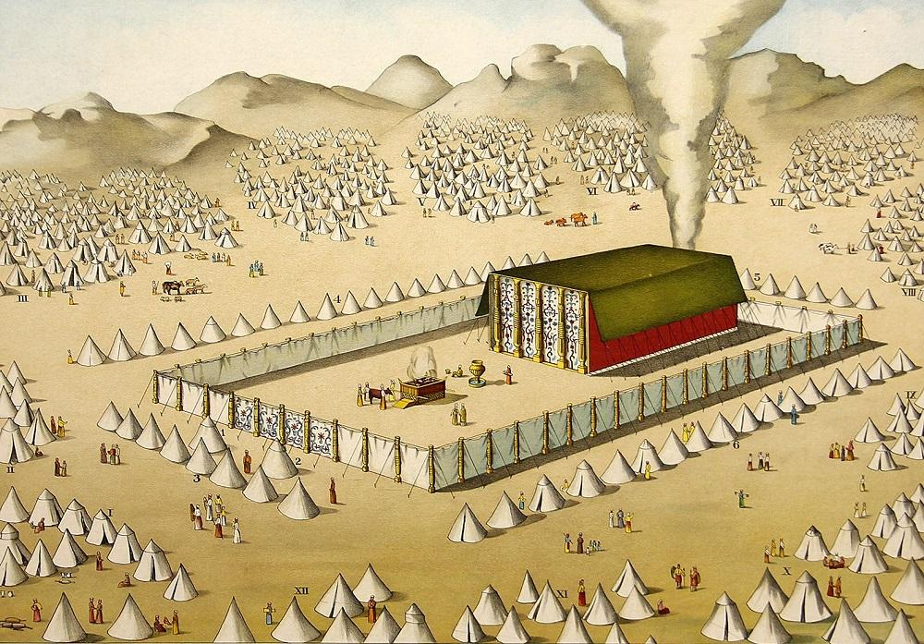
God Dwells With His People
Exodus 40: 34-38 The glory of the Lord
1 Kings 8:10-12 Solomon’s temple.

Slide 17
The Tabernacle Tells Us Two Things
God wants to dwell in an intimite relationship with his people
Outside of Christ, our access to God was VERY limited. In Christ we have full access. That is why Christ came!
John 1:14

