Slide 1
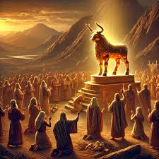
Exodus VIII The Golden Calf

Slide 2
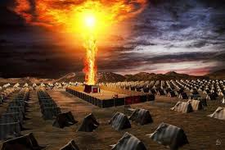
Last Week God Tabernacles With His People

Slide 3
The Tabernacle Tells Us Two Things
God wants to dwell in an intimite relationship with his people
Outside of Christ, our access to God was VERY limited. In Christ we have full access. That is why Christ came!

Slide 4
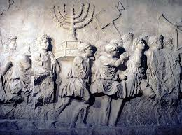
Type and Antitype in the Tabernacle
Bronze Altar: We need a sacrifice for access
Laver = The need for cleansing/baptism to enter God’s presence. 1 Peter 3:21
Shew Bread: Jesus, the bread of life John 6:35
Menorah: The Holy Spirit Zechariah 4:1-6
Altar of incense = Our prayers Rev 5:8

Slide 5
Type and Antitype in the Tabernacle
Curtain: Separation between man (unholy) and God (holy)
Cherubim: Protect God’s holiness
Mercy seat: God’s throne His mercy
Note, the mercy seat covers the Law of Moses

Slide 6
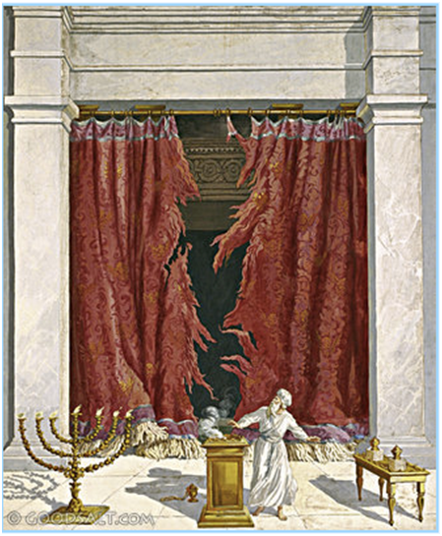
Great News
When Jesus died, the curtain was rent in two.
Now, we walk boldly into the true, the heavenly tabernacle Heb 10:19-22!!!!!!

Slide 7
Exodus VIII The Golden Calf

Slide 8
Three Stories
The golden calf is the story of the ever-present threat of apostasy.
The golden calf is the story of Moses as intercessor for God’s people—as a prefigure of Christ, our mediator.
The golden calf is the story of God’s amazing mercy and patience with his people, despite their stubborn sin and desire to return to Egypt.

Slide 9
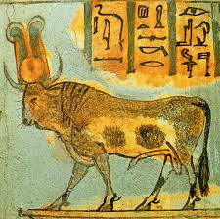
Exodus 32:1-6 Apostasy!
v. 1 “that fellow Moses”
Hebrews 3:15-4:3
1 Cor 10:11-12 If you think you stand, take heed lest you fall.
Psalm 106:19-26 They forgot
Acts 7:38-41 Back to Egypt

Slide 10
Exodus 32:7-14 Moses the Intercessor
Moses the covenant-maker
Moses the law-giver
Moses the bread- and water-giver
Moses the Intercessor for the sins of the people
Note Moses’ boldness before God.

Slide 11
Exodus 32:15-20 God Hates Idolatry
A jealous God!
God really hates rebellion, which is idolatry

Slide 12
Exodus 32:21-35 Moses/Jesus Offers His Life to Save the People
Aaron: Throws the people under the bus.
Moses: Offers his life.
Who will be a Moses for Merced?

Slide 13
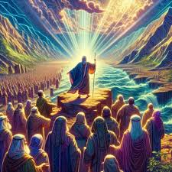
Exodus 33:12-23 The Glory of God
Moses: I will rely on you, YHWH
v. 15 If your presence does not go with us, do not send us from here.

Slide 14
Exodus 34:1-14 The Covenant Renewed
Ex 34:6-7 The basis for the covenant is no longer complete obedience. It is God’s patience and mercy!
“The Lord, YHWH, the compassionate and gracious God, slow to anger, abounding in love and faithfulness…”

Slide 15
Exodus 34:27-35
The Covenant reestablishled based on God’s grace, compassion, patience, mercy and faithfulness, not just on “If you obey me fully and keep my covenant.”

Slide 16
Summary
The golden calf is the story of the ever-present threat of apostasy.
The golden calf is the story of Moses as intercessor for God’s people—as a prefigure of Christ, our mediator.
The golden calf is the story of God’s amazing mercy and patience with his people, despite their stubborn sin and desire to return to Egypt.

