Slide 1
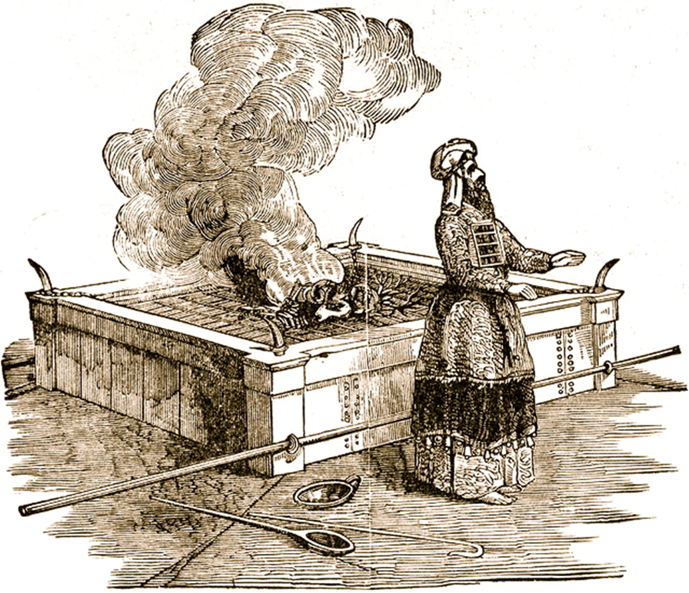
Leviticus I Offerings and Sacrifices

Slide 2
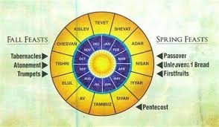
Old Testament Festivals
Seven-day festivals:
Unleavened Bread
Tabernacles
One-day festivals:
Passover
Firstfruits
Pentecost
Trumpets
Day of Atonement
Hannukuh

Slide 3
Mosaic Covenant Festivals as Types
Jewish Festival
Christian Antitype
Passover (pesach)
The Sacrificial Death of Jesus
Feast of Firstfruits
The Resurrection of Jesus
Feast of Unleavened Bread
Celebrate Being Free of Sin
Feast of Weeks/Pentecost
Harvest/Holy Spirit
Feast of Trumpets
Judgment Day, Jesus’ Return
Day of Atonement (yom kippur)
Atonement through Christ
Feast of Booths (Tabernacles)
Celebrating God dwelling in us The Holy Spirit

Slide 4
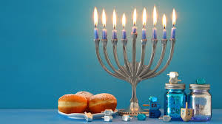
John 10:22-24 Jesus at the Feast of Dedication
Jesus is the antitype to the Feast of Dedication.
Hanukkah
Celebrates the rededication of the temple on 25th of Chislev (December, 164 BC)

Slide 5
Leviticus: Offerings and Sacrifices
Theme verse:
Leviticus 11:45 I am the Lord who brought you up out of Egypt to be your God; therefore be holy because I am holy.
Also:
Lev 18:1-5 You must not do what they do in Egypt or in Canaan. v. 5 “The person who obeys them (these laws) will love by them. I am the Lord.”

Slide 6
Outline of Leviticus
Ch 1-7 The five main sacrifices
Ch 8-10 The Levitical Priesthood
Ch 11-22 The Laws of Moses
Ch 23-25 The Sabbath and Festivals
Ch 26 Punishment and Reward
Ch 27 More laws.
Not covered: The Tabernacle

Slide 7
Leviticus Ch 1-6 Outline
Ch 1 The Burnt Offering.
Ch 2 The Grain Offering.
Ch 3 The Fellowship Offering.
Ch 4,5 The Sin Offering.
Ch 5,6 The Guilt Offering.
Very Exciting.
I promise!

Slide 8
Sacrificial Type and Antitype
Old Testament Sacrifice
New Testament fulfillment
Scriptures
Sweet Savor Sacrifices
The Burnt Offering
Jesus’ and our devotion to God
Ephesians 5:1,2 Romans 12:1,2
The Grain Offering
Giving back to God
Matthew 6:19-21
Romans 8,9
The Drink Offering
Pouring out our life for God
Luke 22:20 Philippians 2:16
The Fellowship Offering
Celebrating blessings from God
John 10:10
1 Thess 5:16
Blood Sacrifices
The Sin Offering
Jesus’ sacrifice for our sins
1 Peter 1:18,19
2 Cor 5:21
The Guilt Offering
Maintain relationship with one another
Matthew 5:23,24

Slide 9
Gifts/Offerings/Sweet Smelling Sacrifices
The Burnt Offering olah Leviticus 1
The Grain Offering minchah Leviticus 2
The Drink Offering nesek Leviticus 23
The Fellowship Offering shelem Lev 3
Hebrews 5:1 Every high priest offers… offerings and sacrifices for sins.

Slide 10
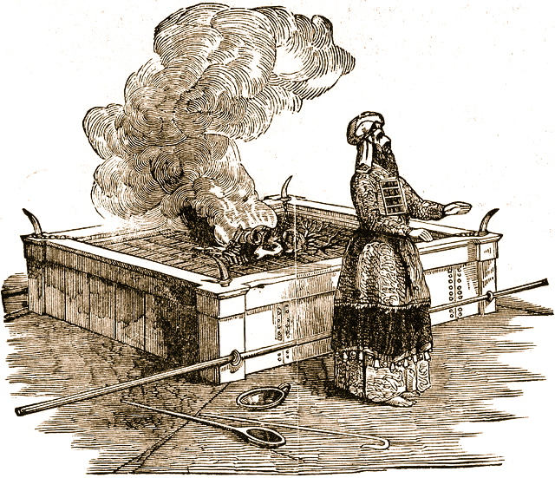
The Burnt Offering Leviticus 1
Lay hands on the animal.
Sacrifice the animal
Clean the body but not the head
Burn them on the altar
Meaning: Total commitment of one’s life to God.

Slide 11
The Burnt Offering
Jesus gave a burnt offering: Ephesians 5:1-2
God calls us to give a burnt offering. Romans 12:1-2 … in view of God’s mercy. Phil 1:20-22
Isaiah 6:8 Here am I, send me
What will you voluntarily lay on the altar?

Slide 12
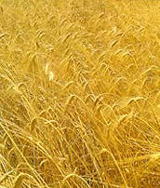
The Grain Offering
Give the FIRST FRUITS of what God has blessed you with.
NOT voluntary.
Grain = hard work
Oil = joy
Incense = prayer
Salt = eternal blessings, “treasures in heaven”
No yeast!!! 1 Cor 5:6-8 (or honey)

Slide 13
The Grain Offering
Some was burned, but the rest was used to support the priests.
Application: Our contribution to God 2 Cor 8,9 to take care of the needs of the church.
For us, 10% is not mandatory, but giving sacrificially is.
Malachi 3:7-10
Matthew 5:20

Slide 14
The Grain Offering: A Summary
Our contribution to the needs of the church should be:
1. Sacrificial. It should be costly.
2. Given joyfully.
3. Offered with prayer.
4. It will produce eternal blessings.
5. Should come from a pure, undefiled heart.

Slide 15
The Drink Offering
Exodus 29:41, Leviticus 23:13, Numbers 28:31
Drink Poured out on the altar.
Application: Pouring out our life on the altar.
Usually given on top of the grain offering.
Application: We give our tithe, but God wants much more. He wants us to be “all in.”

Slide 16
The Drink Offering
Jesus gave a drink offering Luke 22:20
Paul gave a drink offering Phil 2:16-17 2 Tim 4:6-8
The greatest joy comes from giving a drink offering.

Slide 17
Summary
God wants our sweet-smelling offering
1. A burnt offering—our lives as a sacrifice.
2. A grain offering—a sacrifice from the firstfruites of what we earn.
3. A drink offering—pouring our lives out in service to God.

