Slide 1
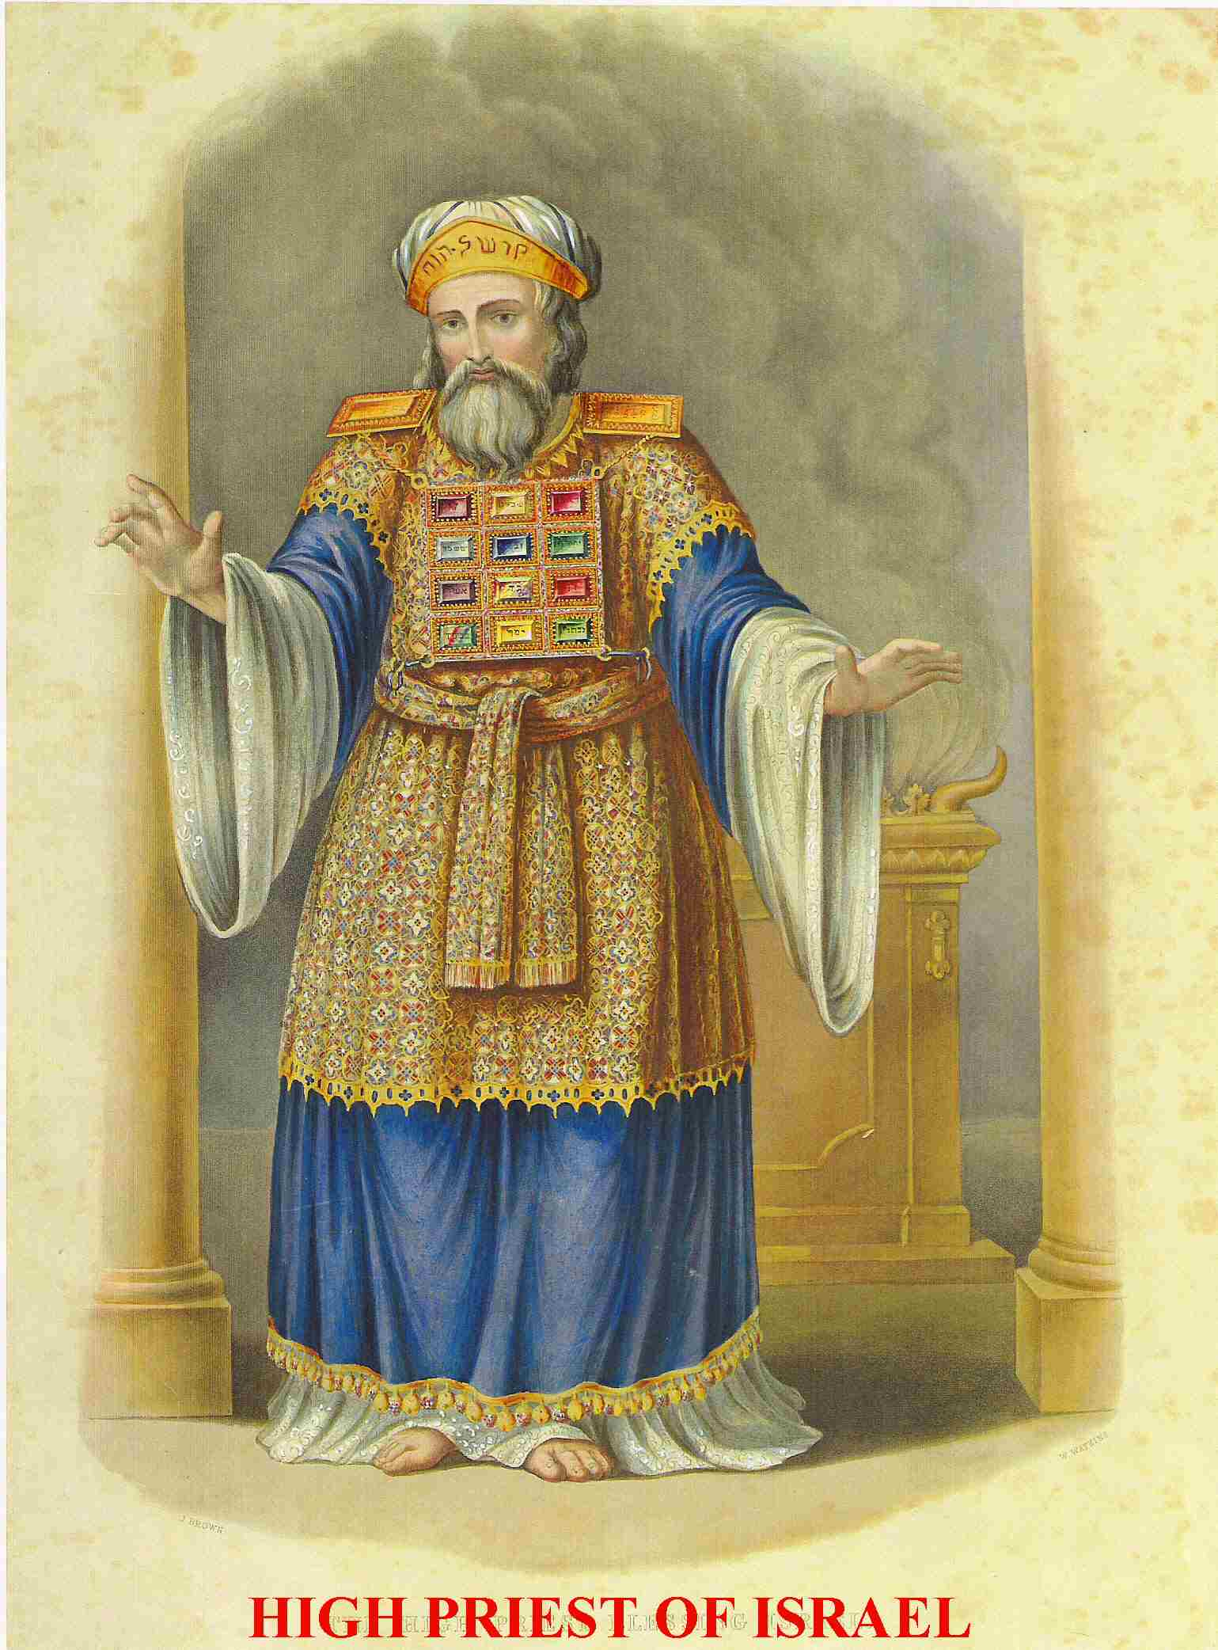
Leviticus: Priesthood and Christianity

Slide 2
Leviticus
Theme verse:
Leviticus 11:45 I am the Lord who brought you up out of Egypt to be your God; therefore be holy because I am holy.

Slide 3
Outline of Leviticus
Ch 1-7 The five main sacrifices
Ch 8-10 The Levitical Priesthood
Ch 11-22 The Laws of Moses
Ch 23-25 The Sabbath and Festivals
Not covered: The Tabernacle

Slide 4
Gifts/Offerings/Sweet Smelling Sacrifices
The Burnt Offering
The Grain Offering
The Drink Offering
The Fellowship Offering

Slide 5
Blood Sacrifices
The Sin Offering chatat Leviticus 4:1-5:13
For sins against God
The Guilt Offering asham Leviticus 5:14-6:7
For offenses against a fellow Jew

Slide 6
A Better Sacrifice Hebrews 9:23 It was necessary, then, for the copies of the heavenly things to be purified with these sacrifices, but the heavenly things with better sacrifices than these.
The lesser sacrifice: Bulls, goats, red heifer | The greater sacrifice: Jesus
Outward (appearance) | Inward (reality)
Temporary, repeated many times | Eternal, done only once for all.
Ceremonial | Real
Not voluntary | Voluntary

Slide 7
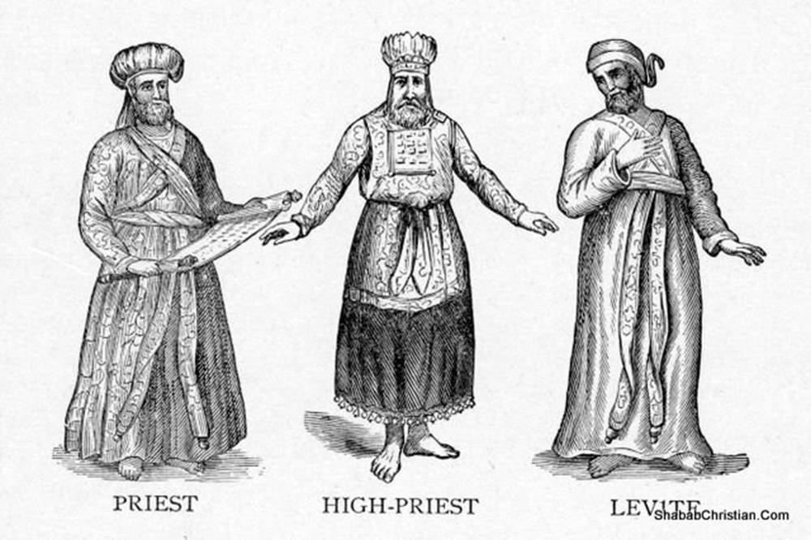
The OT Priesthood prefigures the NT Priesthood
The Levites
The Aaronic Preisthood
The High Priest
The Melchizedek Priesthood

Slide 8
Aaronic Priesthood Prefigures the Priesthood of all believers
Exodus 19:6 A kingdom of priests prophesied
1 Peter 2:9 A royal priesthood
Revelation 5:9-10
Our job?
1 Peter 2:5 Offer spiritual sacrifices
Make intercession? 1 Tim 2:5-6

Slide 9
Lessons from the Priesthood of Aaron
1. Leviticus 10:1-3 Nadab and Abihu
We need to take God’s word very seriously!
v. 3 God: I will be proved holy and I will be honored
2. Leviticus 10:8-10 No wine
Distinguish between the holy and the profane

Slide 10
Lessons from the Priesthood of Aaron
3. Numbers 18:20 No inheritance in the land.
God’s special possession.
Phil 3:20-21 2 Chron 31:4
4. Leviticus 21:1-4 Touch no dead body
Stay holy, separate and specially devoted.
Luke 9:59-60, 2 Cor 6:14

Slide 11
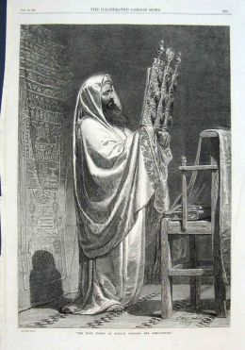
The Zadokites Ezek 44:15f
Ezek 44:23 Teach the difference between the holy and the common.
Ezek 44:28 I am to be their only inheritance.
We are the Christian Zadokites!

Slide 12
5. Our Priestly Duty
Romans 15:15-16 We have the “priestly duty” of proclaiming the gospel of God to the Gentiles.
We make intercession for the lost.
2 Cor 5:18-20 The ministry of reconciliation.

Slide 13
Christian Priesthood: A Summary
Christian priests ought to:
Honor and obey God’s Word
Distinguish between the holy and the profane
Be devoted to the Kingdom of God, not worldly things.
Maintain personal holiness and teach others as well
Fulfill our priestly duty to save the Gentiles

