Slide 1
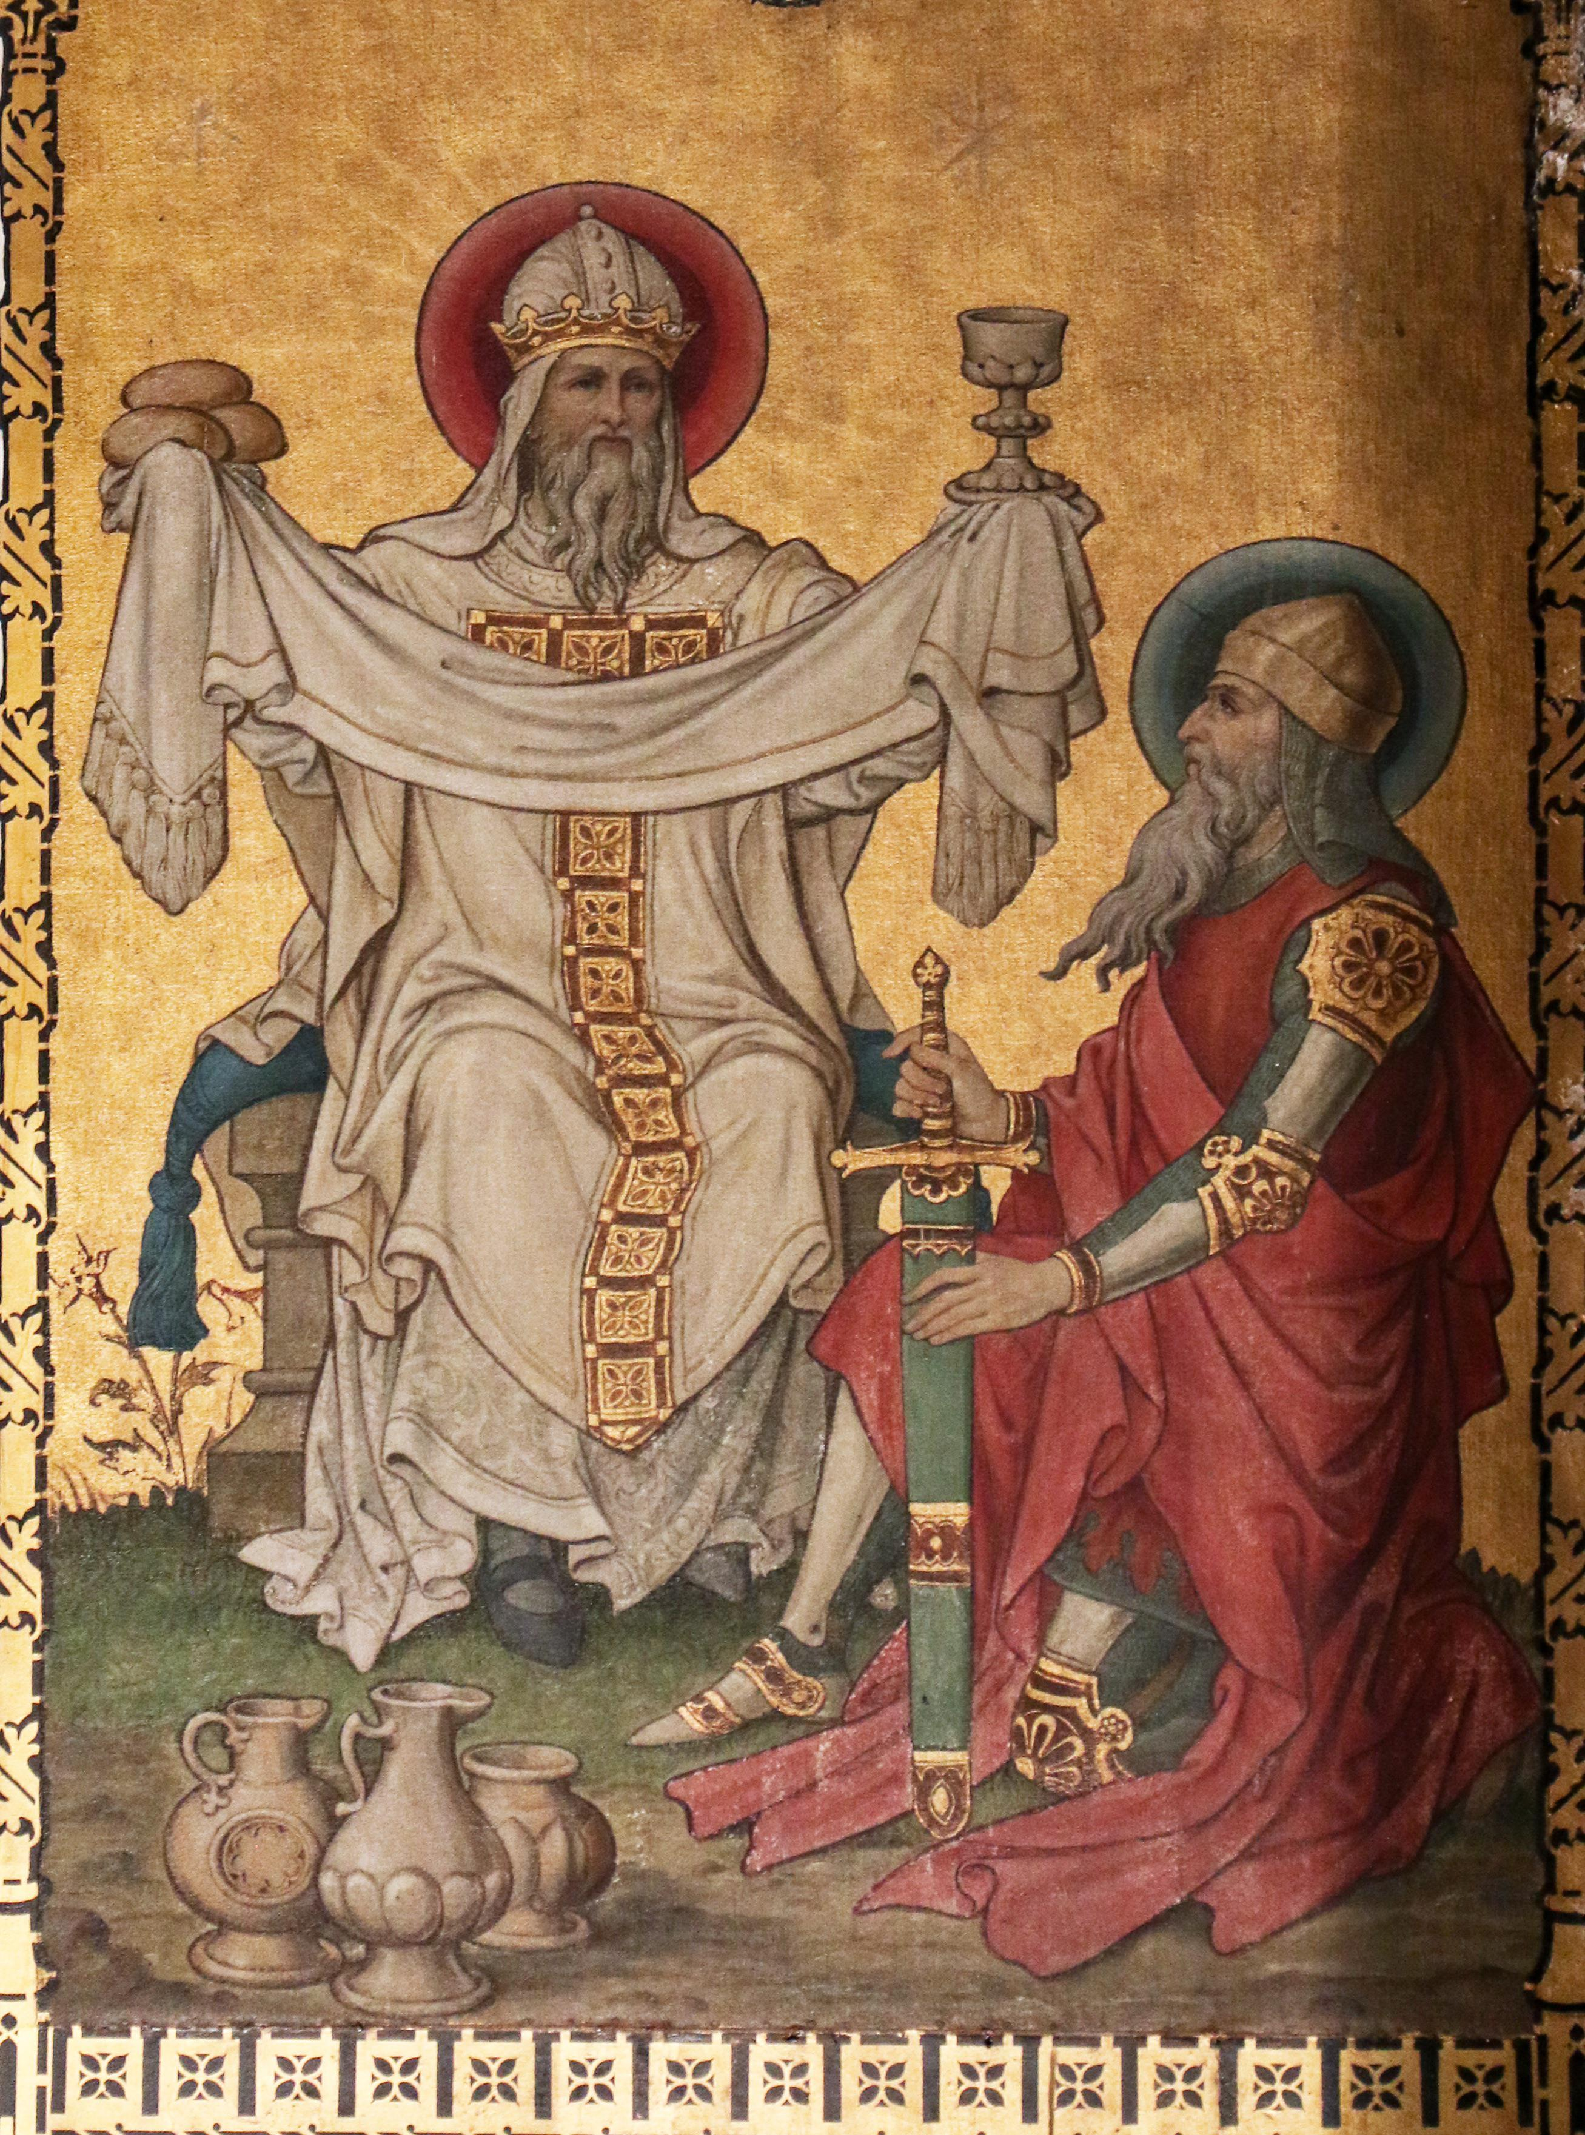
Leviticus V: Jesus: A Priest in the Order of Melchizedek

Slide 2
Leviticus
Theme verse:
Leviticus 11:45 I am the Lord who brought you up out of Egypt to be your God; therefore be holy because I am holy.

Slide 3
Outline of Leviticus
Ch 1-7 The five main sacrifices
Ch 8-10 The Levitical Priesthood
Ch 11-22 The Laws of Moses
Ch 23-25 The Sabbath and Festivals
Not covered: The Tabernacle

Slide 4
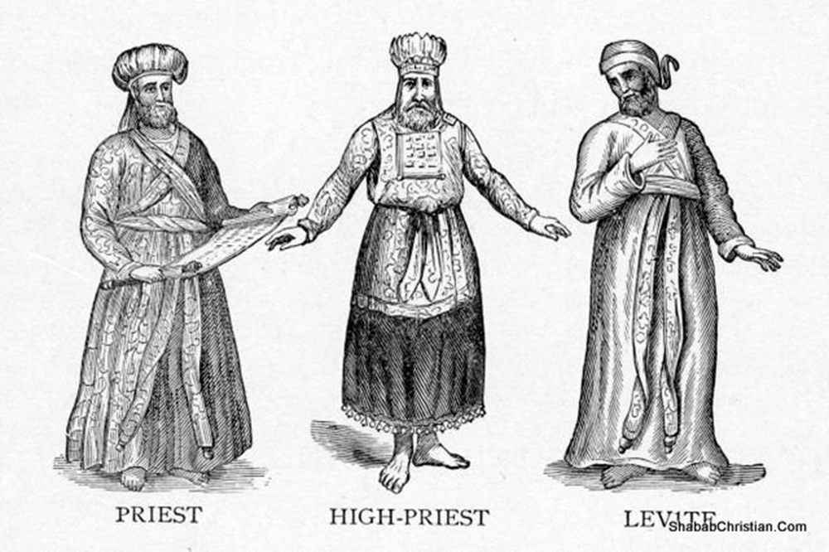
The OT Priesthood prefigures the NT Priesthood
The Levites
The Aaronic Preisthood
The High Priest
The Melchizedek Priesthood

Slide 5
Jesus the Perfect High Priest
What is a priest?
A Pontifex Literally, a bridge-builder. A mediator. An advocate. A representative. One who give access. One who can speak the language of both the worshipper and the one worshipped.

Slide 6
Hebrews 4:15 sympatheo
Jesus can relate to us

Slide 7
A wonderful word…
metriopatheia Heb 5:2
Empathy, Sympathetic feeling,
Bear with people without becoming angry

Slide 8
Hebrews 5:7-9
5:8 Jesus learned obedience through suffering.
5:9 And through suffering Jesus was made a perfect (teleio) high priest.
Hebrews 5:10 A priest forever in the order of Melchizedek.

Slide 9
Hebrews
Purpose: To give heart to Christians who have endured but are being tempted to seek an easier Christianity or even to fall away.
Theme: The preeminence of Jesus Christ!!!

Slide 10
The Greatness of Jesus
1. Greater than the prophets. Hebrews 1:1-3
2. Greater than the angels. Hebrews 1:4-14
3. Greater than Moses. Hebrews 3:1-5
4. Jesus the Great High Priest. Hebrews 4:14-5:10
5. Jesus is greater than Abraham. 6:13-18, 7:4-5
6. A Priest in the Order of Melchizedek. 7:1-28
7. A Better Covenant. Hebrews 8:1-13
8. A better Tabernacle Hebrews 9:1-11.
9. A perfect sacrifice. Hebrews 9:12-10:18.

Slide 11
The Priesthood of Melchizedek
Genesis 14:18-20 Melchizedek:
King of Salem
Gave bread and wine to Abraham
Priest of Jehovah (but not a Jew)
Blessed Abraham
Received a tithe from Abraham
Psalm 110:4 A priest forever

Slide 12
Hebrews 6:20-7:10 The Preacher’s Argument
1. Jesus is of the priestly order of Melchizedek and the priesthood of Melchizedek is greater than that of Aaron.
2. Establish the type/antitype relationship between Jesus and Melchizedek to illustrate his greatness.

Slide 13
Melchizedek Greater than Abraham and Levi
1. Heb 7:2 Abraham gave a tithe to Melchizedek.
2. Heb 7:4 “Just think how great he was.”
3. Heb 7:7 Melchizedek blessed Abraham. “Without a doubt the lesser is blessed by the greater.”
4. Heb 7:9 Levi, who collects a tenth, figuratively gave a tenth to Melchizedek through Abraham.
Conclusion: Melchizedek is greater than Aaron

Slide 14
if A>B and B>C then A>C
Melchizedek is greater than Levi
Jesus is greater than Melchizedek then….
Jesus’ priesthood is greater than Levi’s priesthood

Slide 15
Type/Antitype Relationship
Melchizedek | Jesus
Name means king of righteousness | Is a righteous king
King of a city with the name peace | The king of peace
Without (known) descendants | Has no descendants
Without (known) end of days, therefore a priest forever | A priest forever
Physical king of physical Jerusalem | Spiritual king of spiritual Jerusalem
Both a priest and a king | Both a priest and a king
A priest for Gentiles and Jews | A priest for Gentiles and Jews
A priest due to character, not descent | A priest due to character, not descent
Gave Abraham bread and wine | Remembered by taking bread and wine

Slide 16
Jesus: Perfect High Priest of a New Covenant
Heb 7:11 Perfection could not be obtained through Aaron.
Therefore
Heb 7:12 A new priesthood requires a new covenant and a new covenant requires a new law.
Heb 7:16 A covenant and priesthood based on an indestructible life!
Heb 7:18 The former covenant was weak and useless.
(not exactly… but it did not get the job done)

Slide 17
Jesus: Perfect High Priest of a New Covenant Hebrews 7:21-28
v. 21 God says, “I swear.”
Heb 7:23-25 Levitical priests have a habit of dying.
A priest forever v. 3, 17, 21
Declared to be living v. 8
Has an indestructible life v. 16
Has a permanent priesthood v. 24
Able for all time to save v. 25
He can save completely! v. 25
Get the point?

Slide 18
Jesus: Perfect High Priest of a New Covenant Hebrews 7:21-28
Heb 7:27 And don’t forget… Levitical priests sin. Jesus never did.
Levitical priests offer sacrifices.
Jesus offers but also IS the sacrifice.

Slide 19
Conclusion:
Levitical priests offer a sacrifice.
Jesus IS the sacrifice
Hebrews 7:22 Jesus has become the guarantee of a better covenant.
Hebrews 7:26-28 The law appoints as high priests men who are weak, but the oath, which came after the law, appointed the Son, who has been made perfect forever.

