Slide 1
Numbers II Foreshadows of Jesus

Slide 2
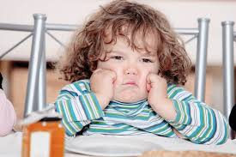
Numbers
Theme: The stubbornness of Israel and God’s patience, mercy and faithfulness
Grumbling!

Slide 3
Numbers Sub-Themes
1. Stubbornness and rebellion among God’s people.
2. God’s judgment for stubbornness and rebellion, but…
3. God’s continued mercy, patience and faithfulness despite our stubbornness and rebellion.
4. Leadership of God’s people

Slide 4
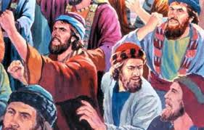
Numbers 11 The Rabble
It was so much better back in Egypt… Grumble, grumble, grumble.

Slide 5
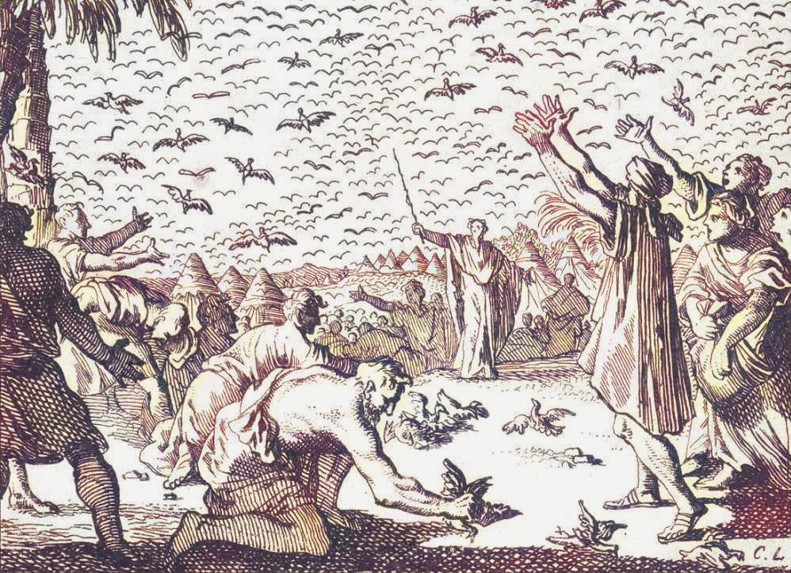
Numbers 11:18-20, 31-34 Consequences!
Our stubbornness and lack of faith has negative consequences.
v. 31-34 A lot of quail!
Message: Do not crave other food.

Slide 6
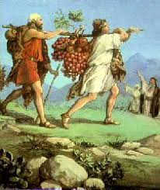
Numbers 13 & 14 Exploring the Land
Numbers 13:16-25 An abundant land! Flowing with milk and honey

Slide 7
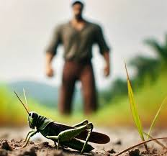
Numbers 13:26-33 Two Different Reports!
The ten: Giants!!!!!
It’s too hard! We felt like grasshoppers.
Caleb: Si’ Se puede!
Which are you? The ten or the two?

Slide 8
Numbers 14 Who Will You Listen To?
Numbers 14:5-24
Not believing in God’s providence and giving in to fear is rebellion.
v. 11 It is contempt for God.
v. 17-19 Two themes: consequences and mercy

Slide 9
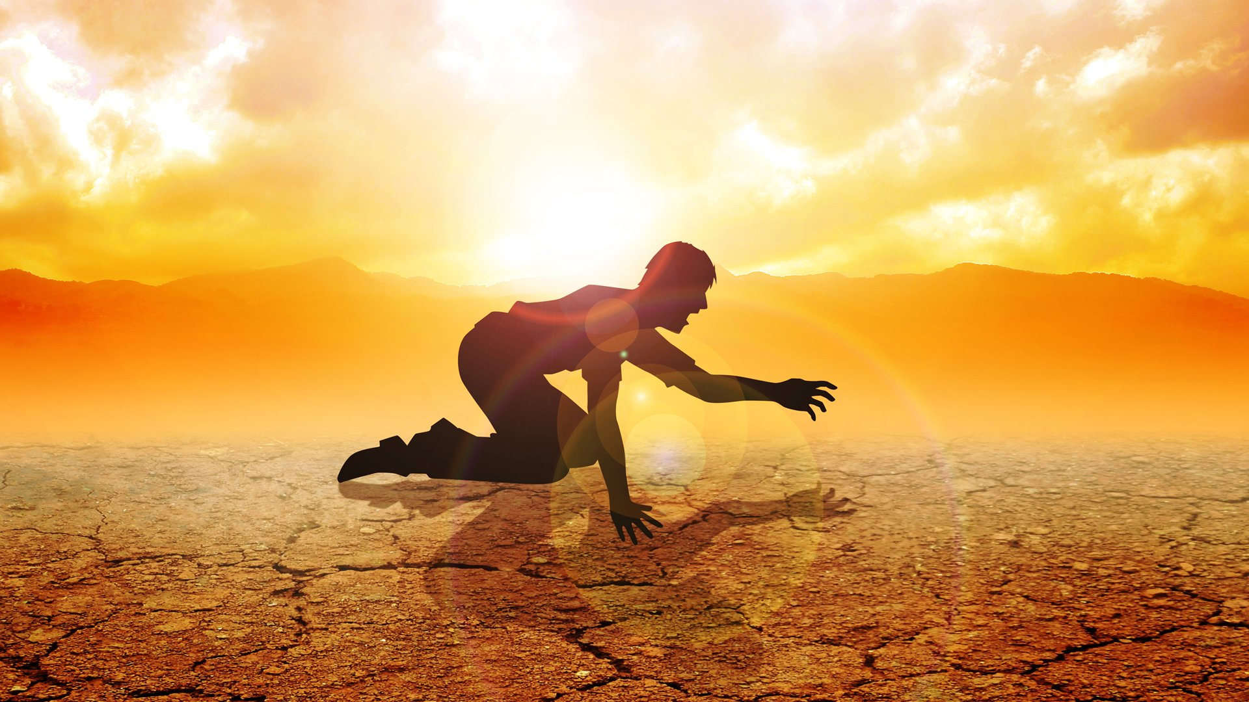
Numbers 14:20-40 Consequences!
Your bodies will fall in the desert.
You will suffer for 40 years!
The next generation will enter.

Slide 10
Numbers 14:39-40
The people: We changed our mind. We will trust God and enter the Promised Land.
God: Too late!
This is a solemn warning!

Slide 11
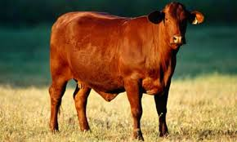
Numbers 19 The Red Heifer
A foreshadow of the sacrifice of Jesus
Pretty interesting science as well!

Slide 12
The Red Heifer Sacrifice
Aspects of the Red Heifer Sacrifices | Antitype in the sacrifice of Jesus
A very rare red heifer | A unique son
Sacrificed outside the camp | Sacrificed outside Jerusalem
Purifies both Jew and Gentile | Atones for the sin of both Jew and Gentile
A sacrifice without blemish | A sacrifice without sin
Had never been yoked | Offered himself voluntarily
Scarlet wool and wood included | Blood was shed on a wooden cross
Hyssop included (for purification from the effects of death) | Purifies us from the effects of sin
Water included for purification | We are baptized into Christ for forgiveness

Slide 13
“Whoever touches the dead body of anyone will be unclean for seven days. He must purify himself with the water on the third and seventh day...take some hyssop, dip it in the water and sprinkle the tent and furnishings and the people who were there.”
Numbers 19:11-12, 18

Slide 14
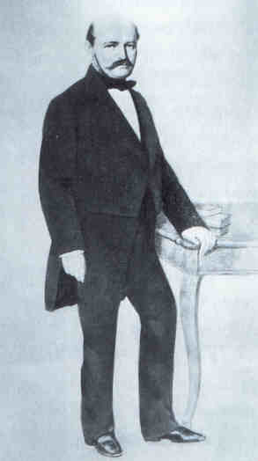
Ingaz
Semelweiss

Slide 15
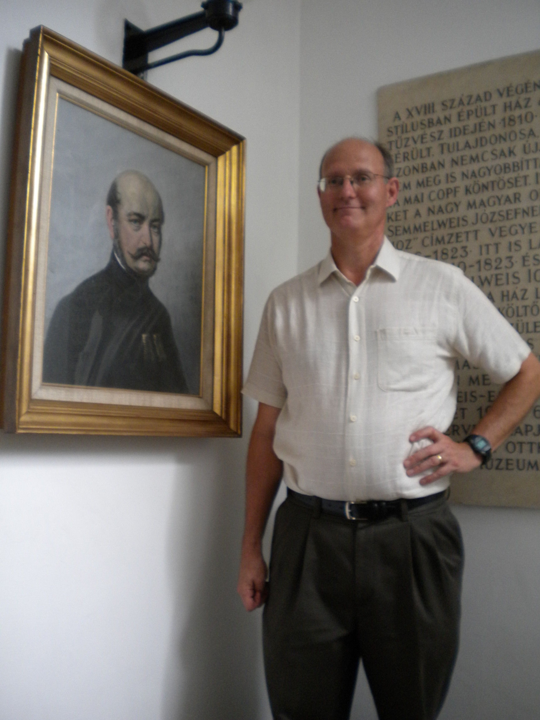

Slide 16
Vienna, 1847
In maternity wards more than one out of every six women dies.
Obstetricians ascribe deaths to constipation, fear and poisonous air.
Semmelweis: Those who touch a dead body are unclean. Wash your hands thoroughly with soap and water before touching another person.

Slide 17
Death Rate falls from 18% to 0.5%

Slide 18
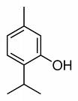
Formula: water, ash and hyssop—a formula for soap
Thymol: A Powerful Disinfectant

Slide 19
A Double Whammy!
Powerful evidence for inspiration from:
Type/antitype fulfillment in Christ.
Scientific evidence for the usefulness of the prescription.

Slide 20
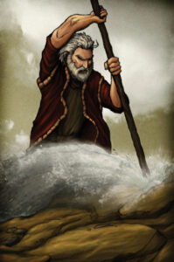
Numbers 20:2-13 Water from a Rock
Israel: Why did you bring us out of Egypt
God to Moses: Speak to the rock.
Moses: Strikes the rock.

Slide 21
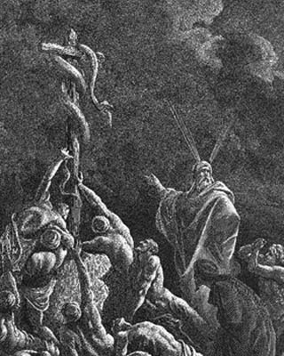
Numbers 21:4-9
Snake-bite = sin. Both result in death Romans 6:23
The solution? Look to the snake, lifted up on a wooden pole John 3:14
Why a snake? 2 Corinthians 5:21

Slide 22
The Entire Gospel Message in Numbers 21
The problem: sin
The result: death
The solution: Look to Jesus on the cross.
How does this work?
Jesus became sin for us on the cross.

Slide 23
So….
Trust God’s providence—do not treat God with contempt.
Celebrate the cleansing sacrifice of Jesus, as prefigured in the Red Heifer.
Don’t quarrel with God’s leader and do obey God in the smallest detail.
Don’t grumble against God
Look to Jesus on the cross for salvation.

