Slide 1
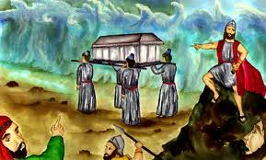
Numbers III Preparing to Enter the Promised Land

Slide 2
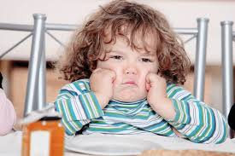
Numbers
Theme: The stubbornness of Israel and God’s patience, mercy and faithfulness
Grumbling!

Slide 3
Numbers Sub-Themes
1. Stubbornness and rebellion among God’s people.
2. God’s judgment for stubbornness and rebellion, but…
3. God’s continued mercy, patience and faithfulness despite our stubbornness and rebellion.
4. Leadership of God’s people
5. Preparing to enter the Promised Land.

Slide 4
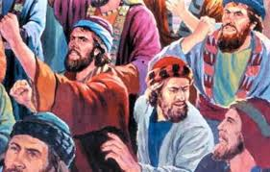
Numbers 11 The Rabble
It was so much better back in Egypt… Grumble, grumble, grumble.

Slide 5
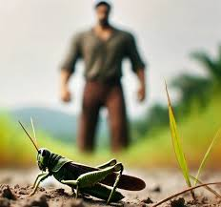
Numbers 13 & 14 Two Different Reports!
The ten: Giants!!!!!
It’s too hard! We felt like grasshoppers.
Caleb: Si’ Se puede!
Which are you? The ten or the two?

Slide 6
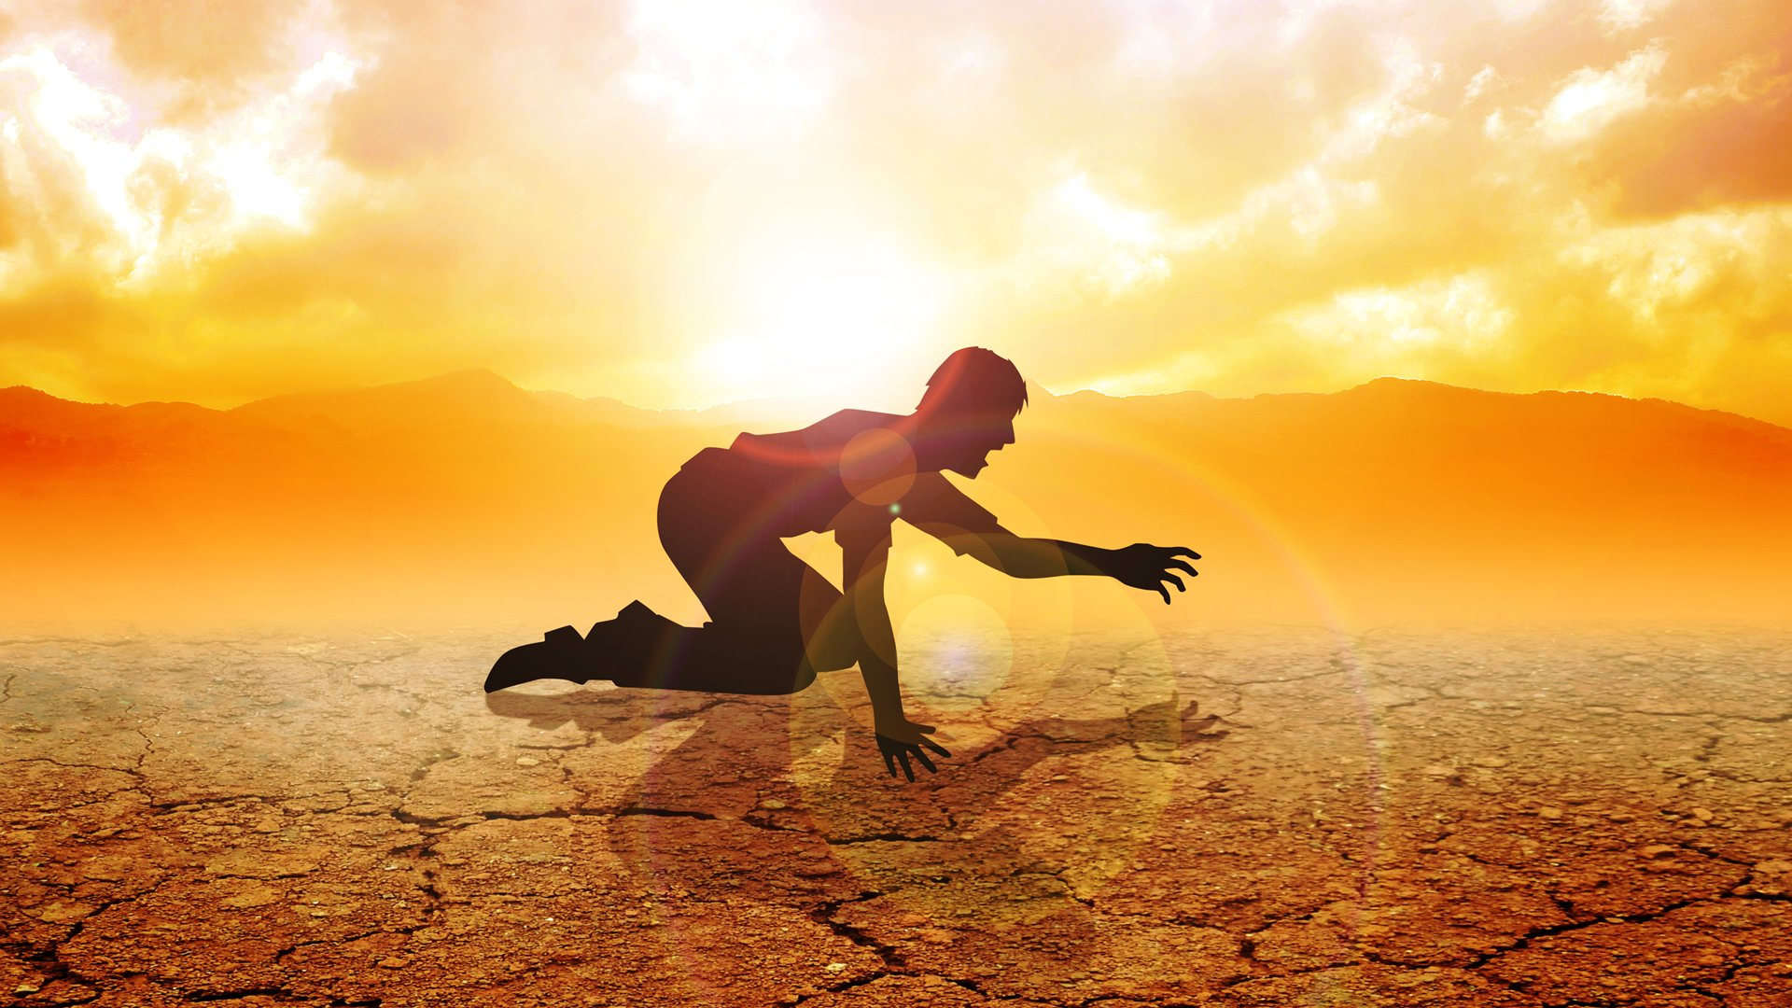
Numbers 14:20-40 Consequences!
Your bodies will fall in the desert.
You will suffer for 40 years!
The next generation will enter.

Slide 7
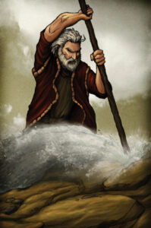
Numbers 20:2-13 Water from a Rock
Israel: Why did you bring us out of Egypt
God to Moses: Speak to the rock.
Moses: Strikes the rock.

Slide 8
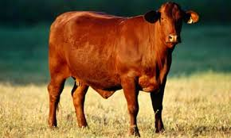
Numbers 19 The Red Heifer
A foreshadow of the sacrifice of Jesus
Pretty interesting science as well!

Slide 9
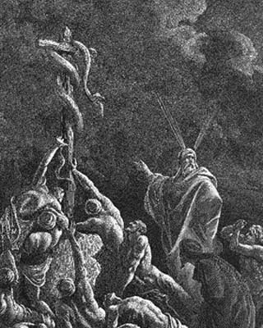
Numbers 21:4-9
Snake-bite = sin. Both result in death Romans 6:23
The solution? Look to the snake, lifted up on a wooden pole John 3:14
Why a snake? 2 Corinthians 5:21

Slide 10
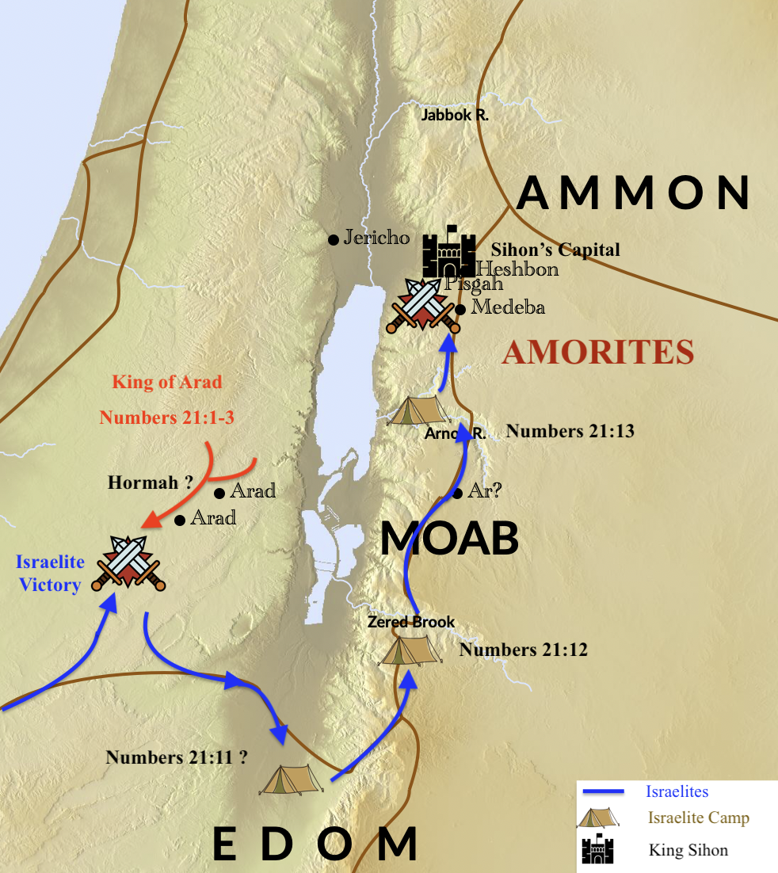
Numbers III Preparing to Enter or… A Talking Donkey

Slide 11
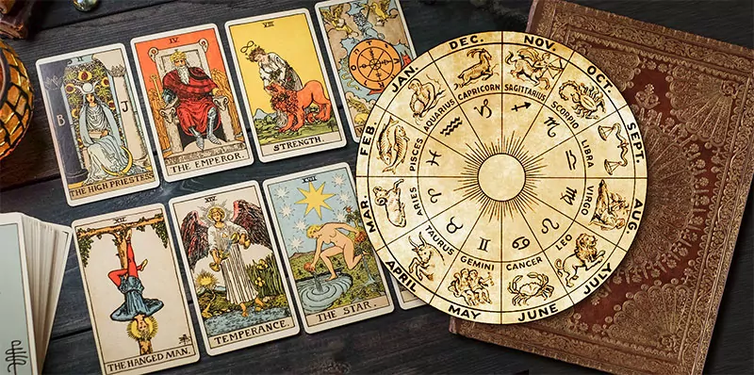
Numbers 22 Balak and Balaam
Balaam: A prophet of YHWH and a diviner!
Balak: Israel is too powerful. Curse them and I will pay you handsomely!
Divination: an example

Slide 12
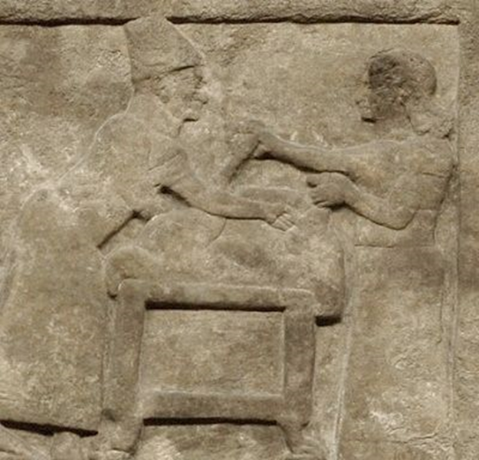
Divination in Ancient Palestine

Slide 13
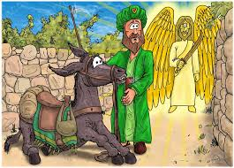
Numbers 22:21-41 God speaks through a donkey

Slide 14
Numbers 23 & 24 Balaam the Prophet
“I must speak only the words YHWH puts in my mouth.”
“Not even for silver or for gold”
Good job, Balaam
But…

Slide 15
Numbers 25 Idolatry and Immorality
A red flag: God’s people are sitting around, doing nothing. The world fills the void.
God: Kill all the leaders who let this happen!
Balaam’s part:
2 Peter 2:15-16 Money for religious service.
Revelation 2:14-15 Too cozy with pagans.

Slide 16
For us…
Be careful spending time doing worldly things with worldly people.
Never put your religious service out there on the open market.
You cannot serve God and money. Matt 6:24
Do not be unequally yoked. 2 Cor 6:14

Slide 17
Phinehas the Zealot!
Zeal for God’s holiness. Check
Deep conviction about and opposition to sin. Check.
Driving a spear through the sinners? Probably not.

Slide 18
End of the Story
Numbers 27 Joshua appointed successor to Moses.
Moses climbs Mt. Nebo. God shows him the Promised Land, but he dies there.
Numbers 31 Balaam killed along with Midianites.
Numbers 32 Reuben and Gad settle east of the Jordan.
Israel now ready to enter the Promised Land.

Slide 19
Summary
Remember what you left behind.
Remember how you escaped.
Do not grumble. Do not look back to Egypt.
Fix your eyes on the Promised Land.
Be like Caleb—trust in God’s providence.
Flee idolatry and immorality like the plague! Be willing to be distinct from the world.

