Slide 1
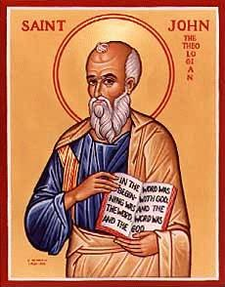
The Gospel of John I Let’s Meet jesus
Joh

Slide 2
In John Jesus is revealed through his miracles and his statements about himself

Slide 3
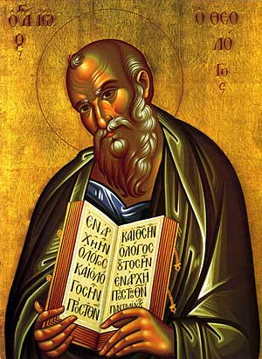
Theme and Purpose of John
Theme: Jesus is the Son of God who reveals the Father, providing eternal life to all who believe.
Theme Passage: John 1:14 (John 3:16
Purpose: John 20:30-31 But these are written that you may believe that Jesus is the Messiah, the Son of God and that by believing you may have life in his name.

Slide 4
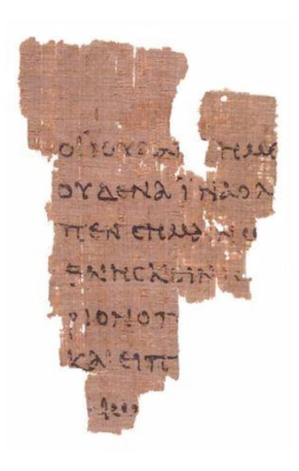
Things to Bear in Mind in John
Things NOT in John: parables, casting out of demons, emphasis on the Kingdom of God,
No birth, baptism, temptation, transfiguration, Lord’s Supper.
Resurrection of Lazarus as a turning point
Chronology based on the Jewish festivals (the three year ministry.
More emphasis on Judean ministry
The Rylands Papyrus
AD 125

Slide 5
Things to Bear in Mind in John
Use of metaphors (light, life, bread, gate, door, lamb, glory…)
Use of irony. John 3:14 When I am lifted up…
Believe 98 times
Life 35 times
Emphasis on who Jesus is
The Rylands Papyrus
AD 125

Slide 6
Seven I Am Statements
I AM the bread of life John 6:35
I AM the light of the world John 8:12, John 9:5
I AM the door (and the gate) John 10:7
I AM the good shepherd John 10:1,14
I AM the resurrection and the life John 11:25
I AM the Way the Truth and the Life John 14:6
I AM the true vine John 15:1

Slide 7
Jesus Revealed Through Seven Signs
Water to wine John 2:1-11
Healing of official’s son John 4:43-54
Healing at pool of Bethesda John 5:1-5
Feeding of 5000 John 6:1-14
Walking on water John 6:16-21
Healing man born blind John 9:1-12
Resurrection of Lazarus John 11:1-44

Slide 8
Prologue John 1:1-18
John 1:1 In the beginning was the Word. The Word was with God and the Word was God.
En archon In the Beginning (Genesis 1:1)
The Word logos
word, underlying principle, omnipresent wisdom, reason

Slide 9
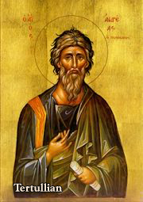
John 1:1 The “Trinity”
The Word was with God and the Word was God.
Yesterday I was with Josh. I am Josh.
Deuteronomy 6:4 Hear, O Israel the Lord is one God.
The “Trinity” is about relationship. God is essentially relational.
A God who would be known.
Tertullian AD 160-220

Slide 10
John 1:2-5 Important Metaphors
Creator Through Him all things were made. Without him nothing was made that has been made.
Life In Him was life
Light The light shines in the darkness and the darkness has not overcome/understood it.

Slide 11
John 1:9-13
To all who did receive him… he gave the right to become children of God.
…born of God.

Slide 12
John 1:14 A Key Verse!
The Word became flesh and made his dwelling among us. We have seen his glory, the glory of the one and only Son, who came from the Father, full of grace and truth.
The Word became flesh. Logos became sarx
A Scandal!!!!!!!
He made his dwelling (tabernacled) among us.
Amazing!!!!! God came to us!!!!!

Slide 13
John 1:14 A Key Verse!
We beheld his glory (doxa)
Full of grace and truth.
Grace and Truth: Which is more important to you?

Slide 14
Grace and Truth!
John 1:17 The Law was given through Moses, grace and truth came through Jesus Christ.
The Law vs Grace and Truth
Which is more important to you?
Grace or Truth?

Slide 15
Let’s Meet Jesus
Jesus is God
Jesus is Creator
Jesus is Light and Life
Jesus is God-become-flesh
Jesus is God-with-us
Jesus is revealer of grace and truth
Glory, Glory, Halleluhia!!!

