Slide 1
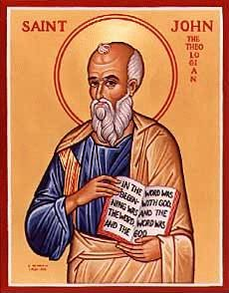
The Gospel of John II
Jesus at Cana
The First Sign:
Water to Wine

Slide 2
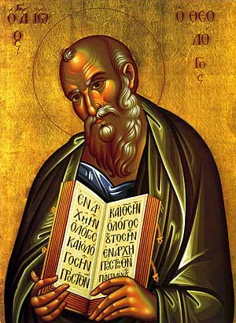
Gospel of John
In John Jesus is revealed as Messiah through his miracles and his statements about himself.
Theme of John
Jesus is the Son of God who reveals the Father, providing eternal life to all who believe.
Theme verse: John 1:14

Slide 3
Seven I Am Statements
I AM the bread of life John 6:35
I AM the light of the world John 8:12, John 9:5
I AM the door (and the gate) John 10:7
I AM the good shepherd John 10:1,14
I AM the resurrection and the life John 11:25
I AM the Way the Truth and the Life John 14:6
I AM the true vine John 15:1

Slide 4
Jesus Revealed Through Seven Signs
Water to wine John 2:1-11
Healing of official’s son John 4:43-54
Healing at pool of Bethesda John 5:1-5
Feeding of 5000 John 6:1-14
Walking on water John 6:16-21
Healing man born blind John 9:1-12
Resurrection of Lazarus John 11:1-44

Slide 5
Prologue John 1:1-18
John 1:1 In the beginning was the Word. The Word was with God and the Word was God.
John 1:14 The Word became flesh
Trinity

Slide 6
John 1:14 A Key Verse!
The Word became flesh. Logos became sarx
He made his dwelling (tabernacled) among us.
We beheld his glory.
Jesus came, full of grace and truth.

Slide 7
John 1:16-18
v. 16 Grace on top of grace. Mountains of grace.
Moses: Law and Judgment
Jesus: Grace and Truth
The only begotten Son monogeneis The only one like that. The unique Son.
Jesus has made God known.

Slide 8
John 1:35-42 Jesus meets Nathanael
John 1:35-42 Jesus: What do you want?
John 1:43-51
Philip to Nathanael: Come and you will see…
What about the contradictions in the Bible? What about all the hypocrites? What about all the killing in the Bible? I am really busy. I’m Catholic. I don’t believe in God.
Come, and you will see!!!

Slide 9
Who Is Jesus?
John 1:41 the Messiah
John 1:49 Rabbi
Son of God
King of Israel!

Slide 10
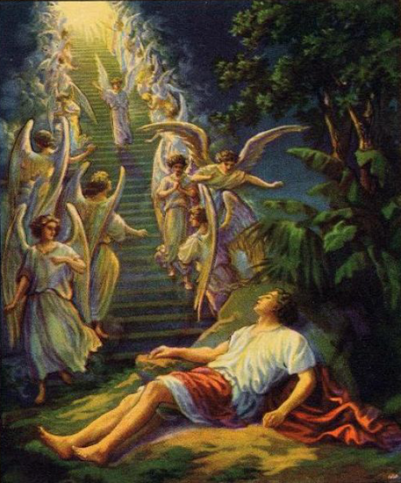
Jacob’s Ladder Gen 28:10-13
John 1:51 Very truly I tell you, you will see heaven open, and the angels of God ascending and descending on the Son of Man.
Jesus is opening a new way for access to God!

Slide 11
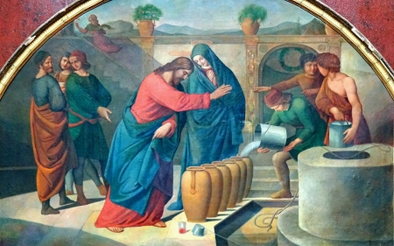
John 2:1-12 Jesus at Cana The First of Seven Signs

Slide 12
On The Third Day A Wedding Took Place

Slide 13
Why Did Jesus Go To a Wedding?
Because he was invited.
Because it would be fun.
But…
v. 4 My time has not yet come

Slide 14
Why Did Jesus Do the Miracle?
Because his mom asked him to.
Because of the symbolic meaning.
We are invited to a marriage feast. (Revelation 19:6-9)
Empty vessels (Judaism) turned into full containers of wine (Jesus’ blood)

Slide 15
John 2:11
What Jesus did here in Cana of Galilee was the first of the signs through which he revealed his glory and his disciples believed in him.
In John, Jesus’ miracles:
Reveal his glory and
Cause us to believe in Him

Slide 16
What did we learn?
Jesus to us: What do you want?
Come and See!
God knows your thoughts and actions.
Jesus is Messiah, A Teacher, Son of God and King of Israel
Jesus is opening a new way to God
Jesus, while son of God is a “regular guy.”
Jesus is a miracle-worker who makes good things that never run out.

