Slide 1
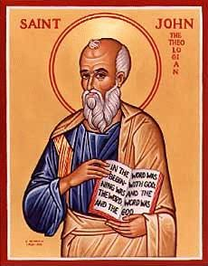
The Gospel of John III
Jesus and Nicodemus

Slide 2
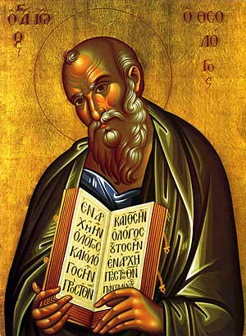
Gospel of John
In John Jesus is revealed as Messiah through his miracles and his statements about himself.
Theme of John
Jesus is the Son of God who reveals the Father, providing eternal life to all who believe.
Theme verse: John 1:14

Slide 3
John 1:14 A Key Verse!
The Word became flesh and made his dwelling among us. We have seen his glory, the glory of the one and only Son, who came from the Father, full of grace and truth.
The Word became flesh. Logos became sarx
He made his dwelling (tabernacled) among us.
Jesus came, full of grace and truth.

Slide 4
John 1:16-18
Moses: Law and Judgment
Jesus: Grace and Truth
No one has ever seen God, but the one and only Son, who is himself God, the one who is at the Father’s side, has made him known.
Jesus explains God.

Slide 5
John 1:35-51 Jesus meets Nathanael
What do you want?
Come, and you will see!!!
Who is Jesus? Messiah
Rabbi/Teacher
Son of God
King of Israel

Slide 6
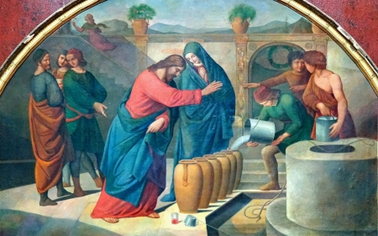
John 2:1-12 Jesus at Cana The First of Seven Signs
Jesus’ miracles do two things:
They reveal God’s glory
And they help us to believe in Jesus

Slide 7
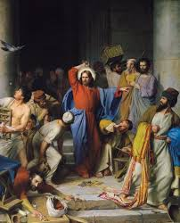
John 2:13-25 Jesus Clears the Temple
“Destroy this temple and I will raise it in three days.”
… at the Passover festival, many people saw the signs he was performing and believed in his name.

Slide 8
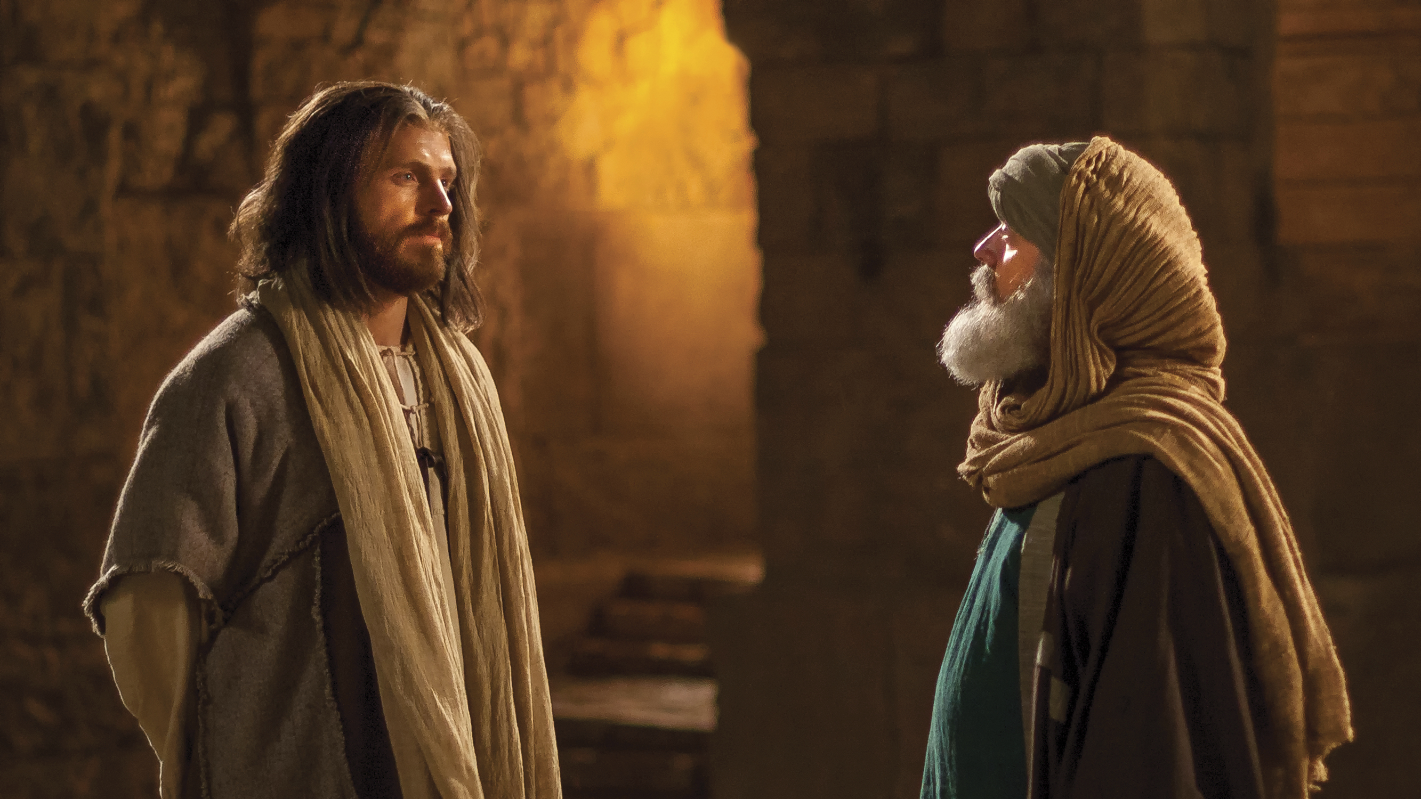
John 3:1-21 Jesus and Nicodemus
Who Is Jesus?

Slide 9
John 3:1-21 Jesus and Nicodemus
Jesus’ interviews: a pattern
Jesus makes an enigmatic statement which provokes thought
Confusion
Jesus explains the statement
Jesus identifies himself

Slide 10
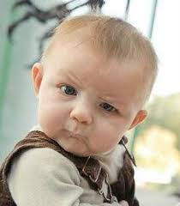
John 3 Nicodemus John 4 Samaritan Woman
John 3 The insider believes
John 4 The outsider believes
Nicodemus: Let’s have a spiritual conversation.
Jesus: You must be born again!

Slide 11
You Must Be Born Again
Truly I tell you, unless you are born again of the water and of the spirit, you will never enter into the kingdom of God.
Nicodemus: How can this be?
Jesus: You are Israel’s teacher, and you do not know Ezekiel 36:24-28? (Acts 2:36-38)

Slide 12
John 3:10-12
v. 11 We testify to what we have seen.
Jesus is talking about John the Baptist and his disciples baptizing people and entering the kingdom of God.
v. 12 Now I will speak of heavenly things.
The Son of Man came to reveal these greater things.

Slide 13
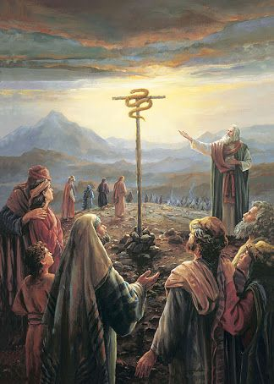
John 3:14
Numbers 21:7-9
Just as Moses lifted up the snake in the wilderness, so the Son of Man must be lifted up.

Slide 14
Jesus Must Be Lifted Up
a. The snake in the desert by Moses.
b. Jesus on the cross.
c. Jesus lifted from the grave.
d. Jesus lifted up (ascended) to heaven.
e. We lift Jesus up as we share our faith in him.
f. So we, too will be lifted up to heaven, as Jesus was lifted up.

Slide 15
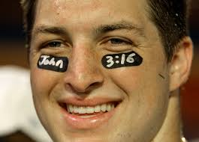
John 3:16
For God loved the world in this way: He gave his One and Only Son, so that everyone who believes in him will not perish, but have eternal life.
Tim Tebow

Slide 16
John 3:16-21 Stark Contrasts!
v. 16 perish vs have eternal life
v. 18 condemned already vs not condemned
v. 19 darkness vs light
Where is the grey area?

Slide 17
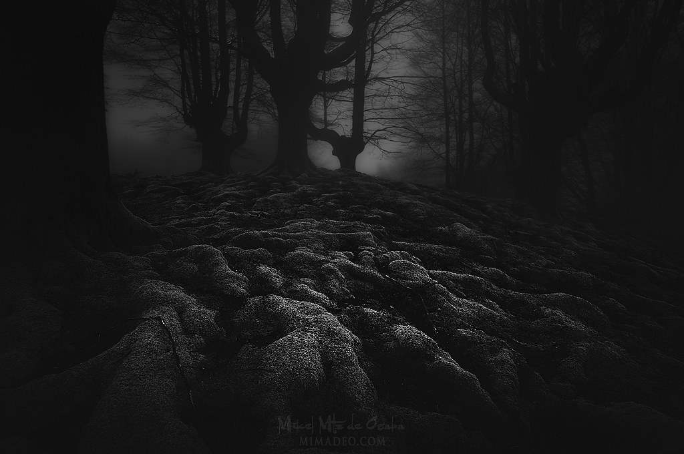
Come Into the Light!
Are there any deeds that you have been keeping in the darkness?
Bring it out into the light!!! Today!!!

Slide 18
Have You Been Born Again?
If not… Make this your absolute #1 priority!!! Now! Today!
If so… Let us live in the light and let us bring our evil deeds into the light

