Slide 1
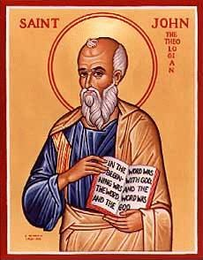
The Gospel of John V
Jesus and the Samaritan Woman at the Well

Slide 2
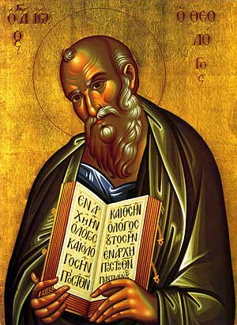
Theme of John
Jesus is the Son of God who reveals the Father, providing eternal life to all who believe.

Slide 3
John 3 Nicodemus: An Insider Believes John 4 A Samaritan Woman Believes
Jesus’ interviews: a pattern
Jesus makes an enigmatic statement which provokes thought
Confusion
Jesus explains the statement
Jesus identifies himself

Slide 4
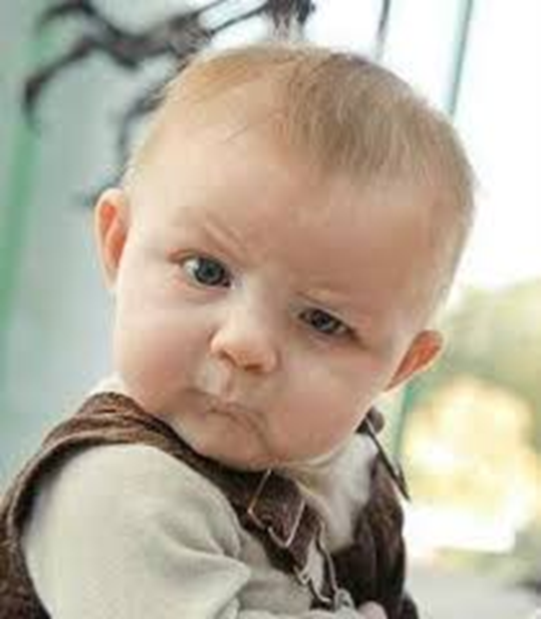
You Must Be Born Again
John 3:3-5
Truly I tell you, unless you are born again of the water and of the spirit, you will never enter into the kingdom of God.

Slide 5
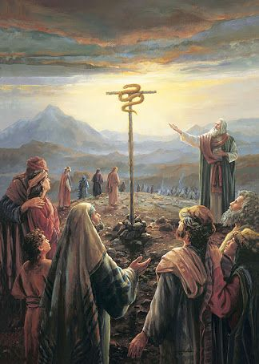
John 3:14
Numbers 21:7-9
Just as Moses lifted up the snake in the wilderness, so the Son of Man must be lifted up.

Slide 6
Jesus Must Be Lifted Up
a. The snake in the desert by Moses.
b. Jesus on the cross.
c. Jesus lifted from the grave.
d. Jesus lifted up (ascended) to heaven.
e. We lift Jesus up as we share our faith in him.
f. So we, too will be lifted up to heaven, as Jesus was lifted up.

Slide 7
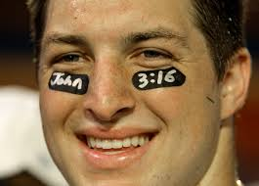
John 3:16
For God loved the world in this way: He gave his One and Only Son, so that everyone who believes in him will not perish, but have eternal life.
Tim Tebow

Slide 8
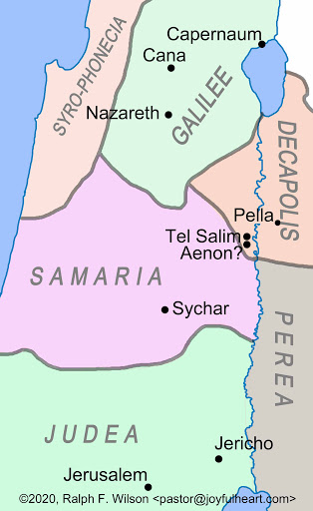
John 4 Jesus and the Samaritan Woman
John 4:1-9
Jesus ministers in Samaria

Slide 9
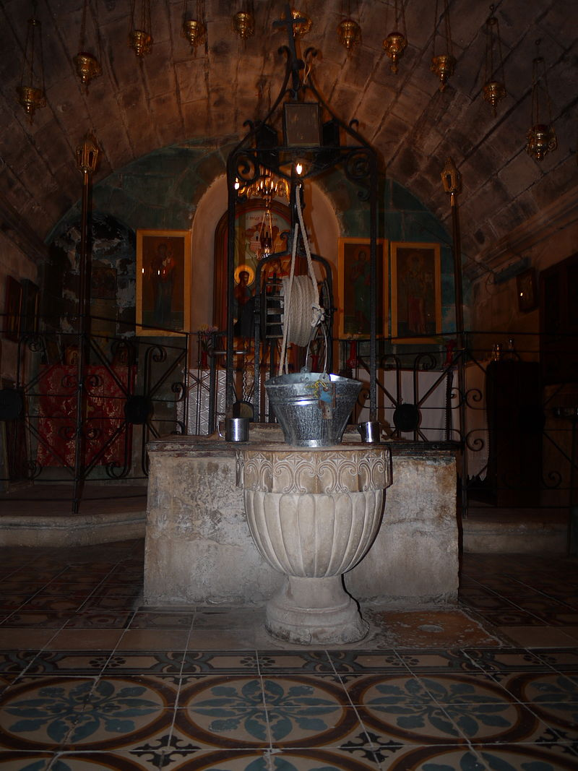
Jacob’s Well
Jesus and Outsiders
A Samaritan
A woman
A “sinful” unmaried Samaritan woman.
Jesus: Will you give me a drink?

Slide 10
John 4:10-26
v. 10 living water
v. 14 Whoever drinks the water I give them will never thirst. Indeed, the water I give them will become in them a spring of water welling up to eternal life.
Jesus is talking about the Holy Spirit. John 7:37-39.

Slide 11
When people put up a spiritual smokescreen:
1. Respectfully and gently answer the question. And
2. Bring the conversation around to the heart of the matter—matters related to eternal life!!!

Slide 12
John 4:17 The third miracle of Jesus
“You are right when you say you have no husband.”
“Sir, I can see that you are a prophet.”
The Samaritan woman puts up another spiritual smokescreen: Mt. Gerizim.

Slide 13
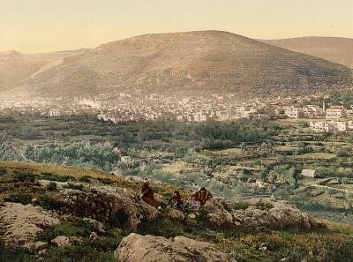
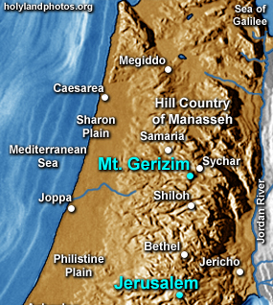
Mt Gerizim and the Samaritans

Slide 14
John 4:24 True Worship
God’s worshipers must worship in spirit and in truth.
I who speak to you—I am He.
Jesus claims to be God!!!!

Slide 15
John 4:27-38 The Disciples are Confused
v. 29 Come and see…
v. 34 My food is to do the will of him who sent me and to finish his work.
Q: What is YOUR food?
Open your eyes! The fields are ripe for harvest.

Slide 16
John 4:39-42
Now, many Samaritans believe.
Faith progresses
1. Thirsty man
2. Jewish man
3. A Rabbi
4. A prophet.
5. Messiah
6. Savior of the world All true!

