Slide 1
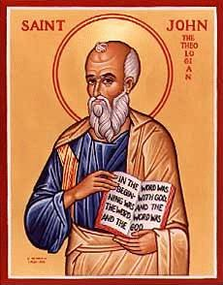
The Gospel of John IX
Jesus and the Feast of Tabernacles

Slide 2
Theme: Jesus Replacing/Greater than the Jewish Festivals
1. Jesus greater than the Sabbath Jn 5:1-18
2. Jesus fulfills the Passover Jn 6:1-70
3. Jesus fulfills Booths/Tabernacles Jn 7:1-9:41
4. Jesus fulfills Feast of Dedication (Hanukkah)
Jn 10

Slide 3
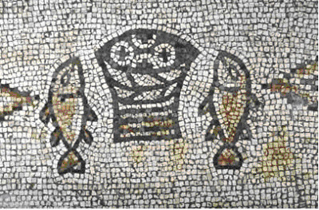
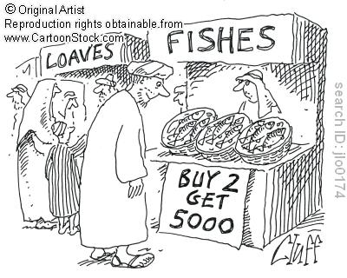
Sign #4 Feeding the 5000
Theme: Jesus the second Moses and
Jesus fulfills the Passover.
Jesus gives bread (like the manna)

Slide 4
Sign #4 Jesus feeds 10,000 +
People’s response: Jn 6:14 “Surely this is the prophet” (Deuteronomy 18:15-19)
Moses:
Gave them bread (sign #4)
Parted the Red Sea (sign #5)
Gave them water (John 4:10, John 7:38)

Slide 5
John 6:16-21 Sign #5 Jesus Walks on Water
Jesus walking on water the antitype to Moses parting the Red Sea.
John 6:20 “It is I”
ego eimi
I, I Am.
Jesus is God.

Slide 6
John 6:35-44 I AM the Bread of Life
I, I AM the bread of life
Not “I have bread”
Not “I offer bread”
Not “I bring bread”
I AM the bread of life
What do you hunger for?
What do you thirst for?
Where do you go for spiritual food?

Slide 7
7 I AM Statements in John

Slide 8
John 6:45-59 Eat of Me!
v. 49, 58 Your ancestors ate bread from Moses and died.
I am greater than Moses!!! I am living bread!
If you eat my flesh me you will not die!
v. 53 Very truly I tell you, unless you eat the flesh of the Son of Man and drink his blood, you have no life in you!!! My flesh is real food.
Wow!!! Are you feeding on Jesus?

Slide 9
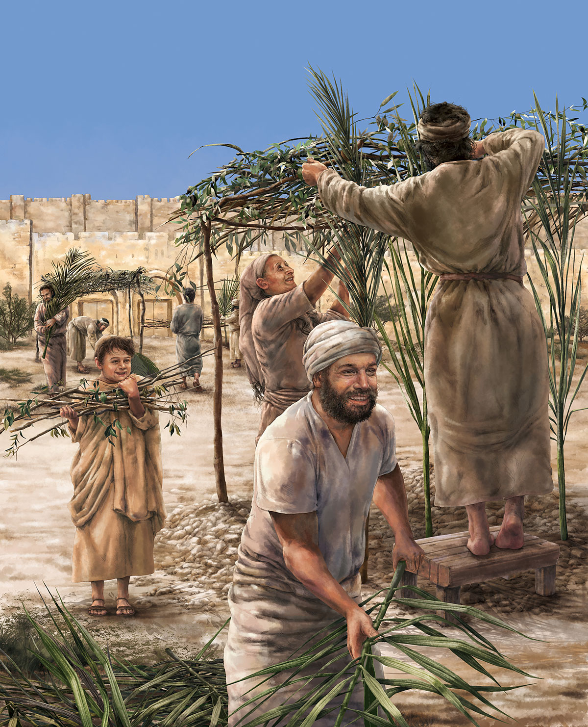
John 7 & 8 Jesus and Tabernacles
Feast of Tabernacles
Feast of Booths
Sukkot
A harvest festival Sept/Oct
Remembering God dwelling with his people

Slide 10
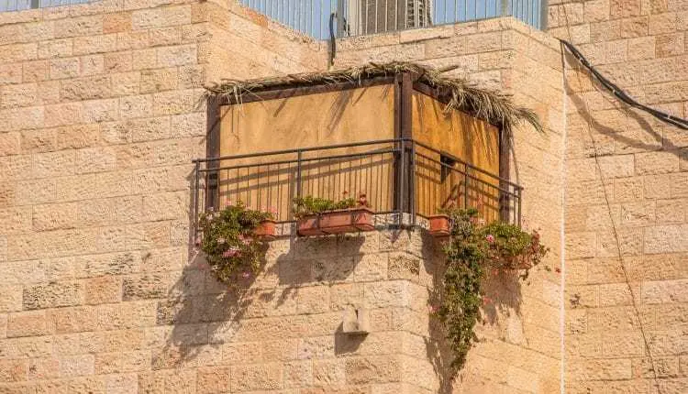
John 7:14-24
Sukkot in a city
John 7:17
If anyone chooses to do God’s will, he will find out whether my teaching comes from God or whether I speak on my own.

Slide 11
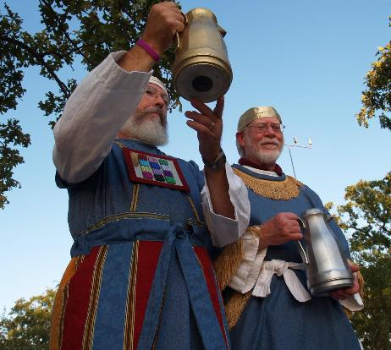
John 7:37-43 Living Water
John 7:37 “Whoever believes in my, as Scripture says, rivers of living water will flow from within them.” By this he meant the Spirit…
Isaiah 12:3 With joy, you will draw water from the well of salvation.
Zechariah 14:6-9, 16-17
Ezekiel 47:1-11
Joel 3:18
The Water Ceremony

Slide 12
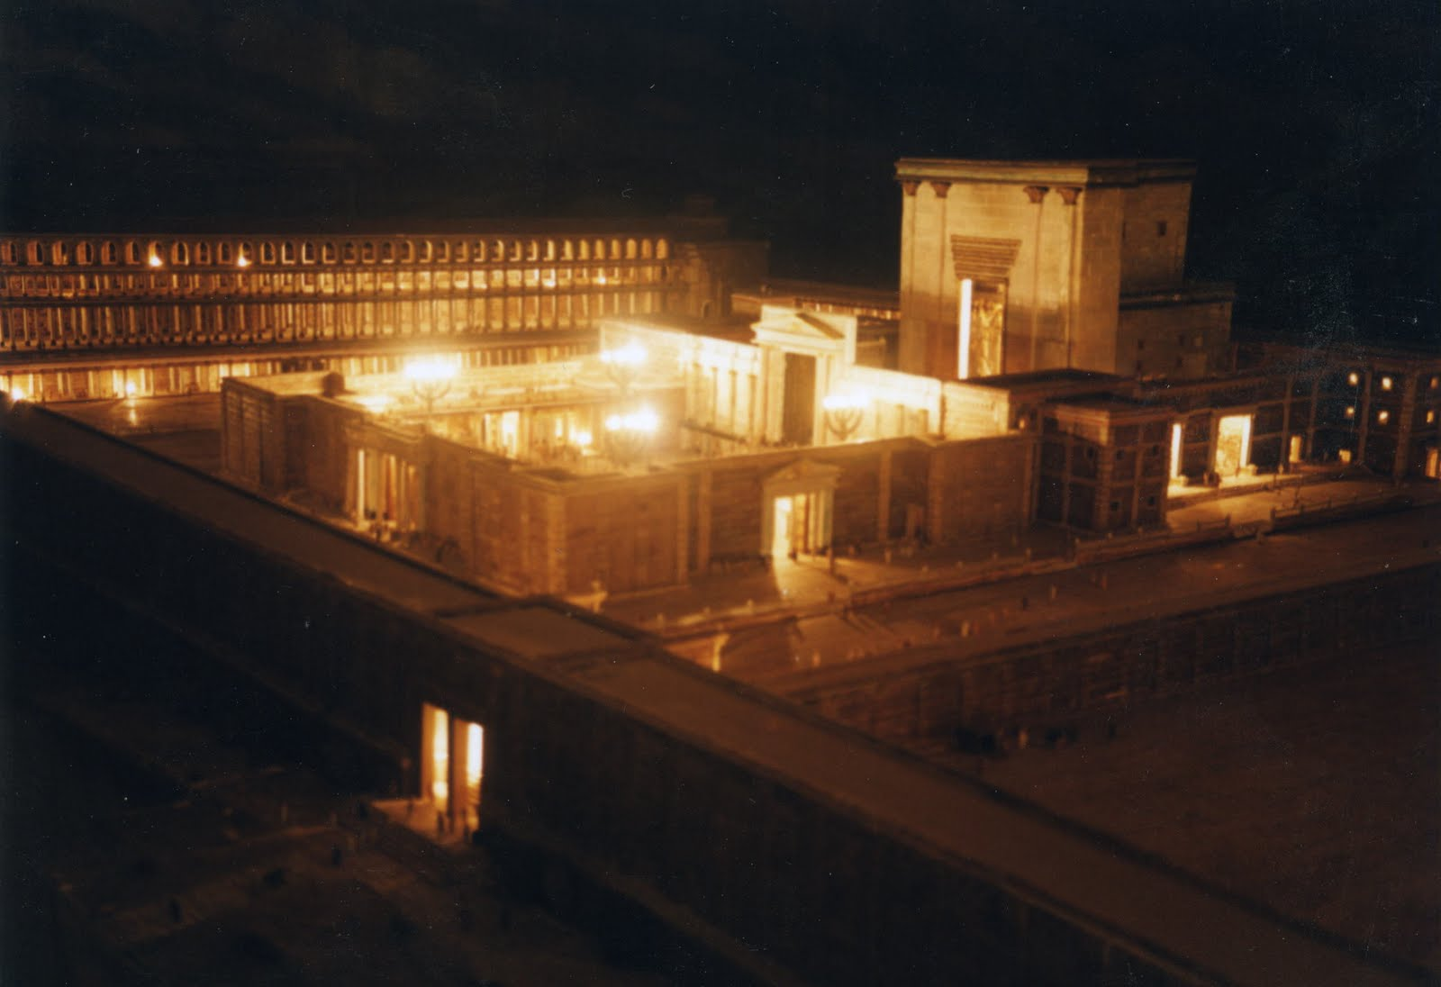
John 8:12-20 I AM the Light of the World
Illumination of the Temple
Purpose: To remember the Shekinah—the Glory of God who dwelt with them in the wilderness

Slide 13
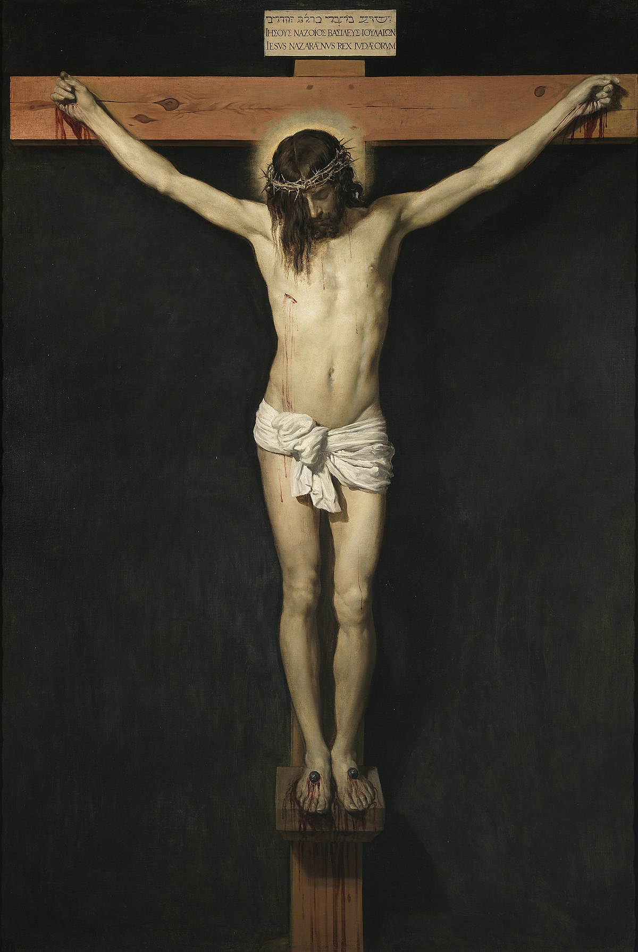
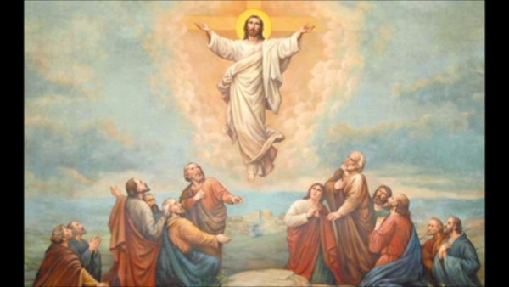
John 8:28 I AM He ego eimi
When you have lifted up the Son of Man, then you will know that I AM He
Have you been lifting Jesus up?

Slide 14
John 8:31-48 True Disciples
John 8:31 “Belief” is not enough.
We need to hold to Jesus’ teachings!
John 8:46 Can any of you prove me guilty of sin?
Jesus was sinless!!!
John 8:48 Response: You are demon-possessed!

Slide 15
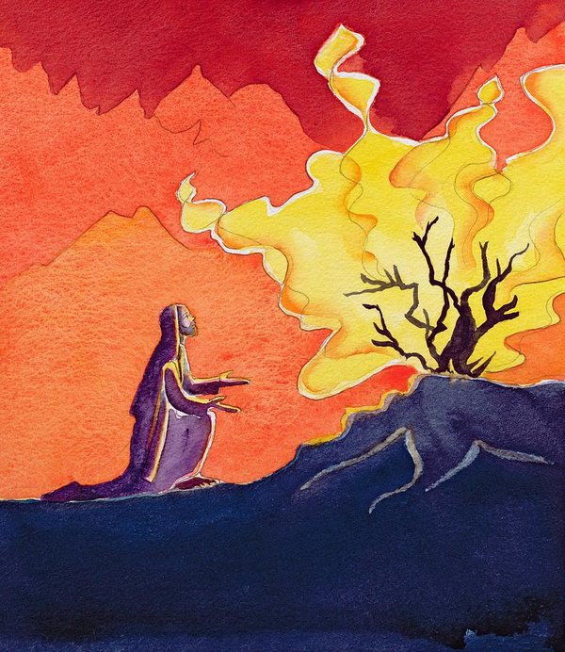
John 8:49-59 I AM
John 8:51 Whoever obeys my word will never see death.
Jesus: I am greater than Abraham.
John 8:58 Before Abraham was born, I AM
They picked up stones…
YHWH I AM

