Slide 1
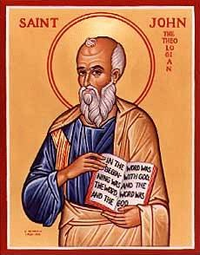
The Gospel of John V
The Healing at the Pool of Bethsaida

Slide 2
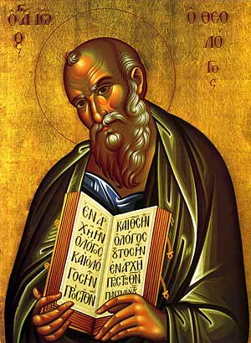
Theme of John
Jesus is the Son of God who reveals the Father, providing eternal life to all who believe.
Theme verse: John 1:14
The Word…

Slide 3
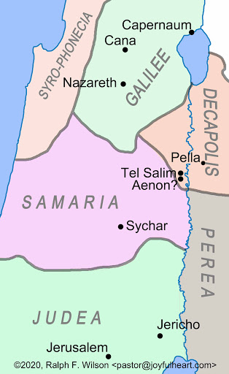
John 4 Jesus and the Samaritan Woman
Jesus Converts an Outsiders
A Samaritan
A woman
Unmarried
“sinful”
Four strikes against her
Jesus: Will you give me a drink?

Slide 4
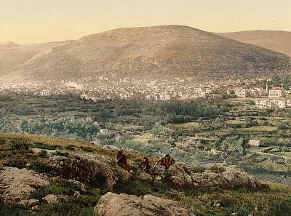
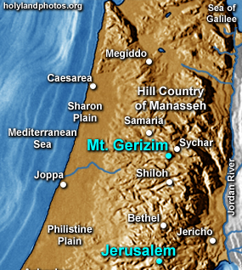
Mt Gerizim and the Samaritans

Slide 5
An Enigmatic Statement
v. 14 Whoever drinks the water I give them will never thirst. Indeed, the water I give them will become in them a spring of water welling up to eternal life.

Slide 6
John 4:26 I Am He
I who speak to you—I am He. ego eimi
Jesus claims to be God!!!! (to a Samaritan woman, no less.)

Slide 7
John 4:39-42
Many Samaritans believe.
Faith progresses
1. Thirsty man v. 7
2. Jewish man v. 9
3. A Rabbi v. 11
4. A prophet. v. 19
5. Messiah v. 29
6. Savior of the world v. 42 All true!

Slide 8
John 5 Healing at Bethsaida
Do you want to get well?
Jesus is Lord of the Sabbath
Testimonies about Jesus

Slide 9
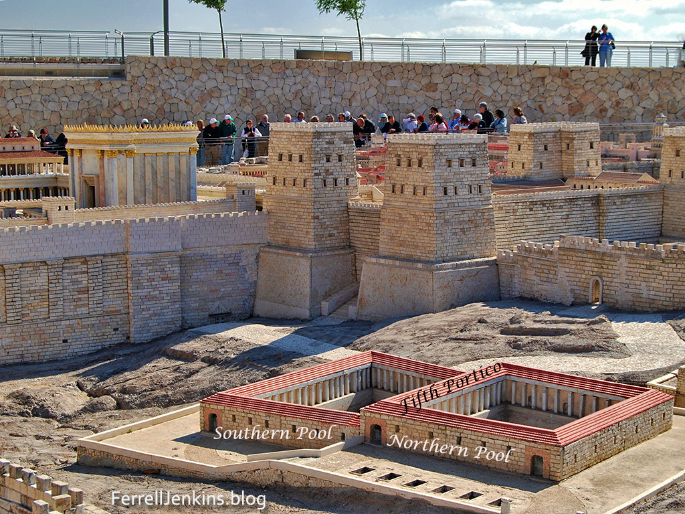
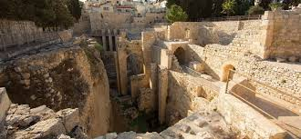
The Pool of
Bethsaida

Slide 10
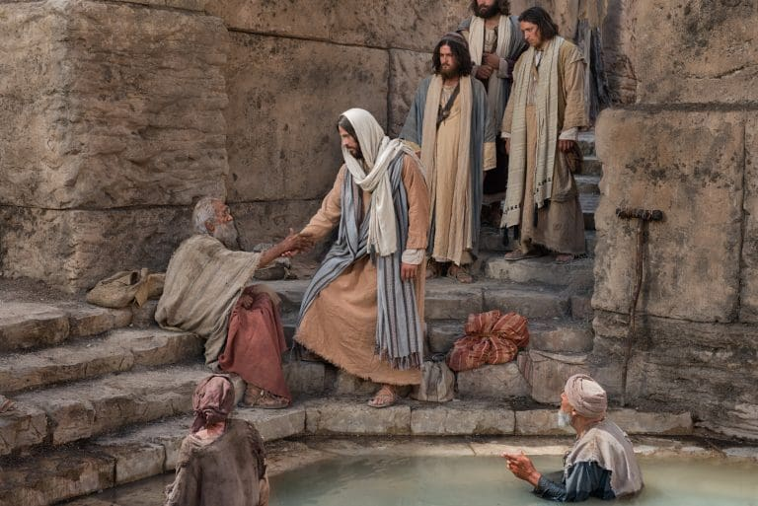
Our Actors
Jesus
The disabled man
The “Jews” (Pharisees)
The crowd

Slide 11
John 5:6 Do You Want to Get Well?
What if Jesus healed you?
What would you have to change?

Slide 12
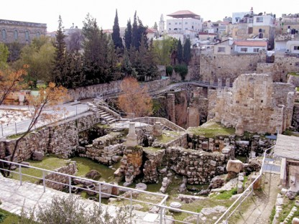
John 5:7-15 Jesus 3rd Sign
John 5:8 Jesus: “Get up your mat and walk”
To be healed:
Trust Jesus
Take action
The cure was
Sudden and complete
Jesus: Stop sinning!

Slide 13
John 5:16-30 Jesus the Lord of the Sabbath
v. 17 My Father is always at work.
v. 18 They tried all the more to kill Jesus.
Why? Because he claims to have authority over the Sabbath.
Jesus Lord of the Sabbath Matthew 12:1-8

Slide 14
Theme: Jesus Replacing/Greater than the Jewish Festivals
1. Jesus greater than the Sabbath Jn 5:1-18
2. Jesus fulfills the Passover Jn 6:1-70
3. Jesus fulfills Booths/Tabernacles Jn 7:1-9:41
4. Jesus fulfills Feast of Dedication (Hanukkah) Jn 10

Slide 15
Testimonies of Jesus John 5:31-40
Jesus: There are three things which testify about me: Do you believe in Jesus? Why?
a. John the Baptist 5:31-35
b. The “works” (miracles) of Jesus 5:36-38
c. Prophecy/Scripture 5:37-40
Jesus: The entire Hebrew Bible is about me!!! Wow!!!!!

Slide 16
John 5:41-47 One Greater than Moses
Who do you accept glory from? God or people?
v. 45 Your accuser is Moses
Deuteronomy 18:15 Jesus, a prophet like (but much greater than) Moses
What about you?
Who will you listen to and who will you seek glory from?

Slide 17
Do you want to get well?
Get up and walk.
Stop sinning
and…
Come to Jesus
Lord of the Sabbath
Fulfillment of Passover
Fulfillment of Tabernacles
The One greateer than Moses.

