Slide 1
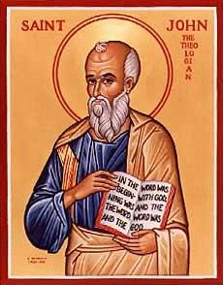
The Gospel of John VIII
Jesus fulfills Passover.
Jesus the Second Moses

Slide 2
Theme: Jesus Replacing/Greater than the Jewish Festivals
1. Jesus greater than the Sabbath Jn 5:1-18
2. Jesus fulfills the Passover Jn 6:1-70
3. Jesus fulfills Booths/Tabernacles Jn 7:1-9:41
4. Jesus fulfills Feast of Dedication (Hanukkah)
Jn 10

Slide 3
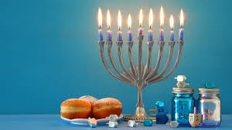
John 10:22-25 Jesus at the Feast of Dedication
Jesus is the antitype to the Feast of Dedication.
Hanukkah
Celebrates the rededication of the temple on 25th of Chislev (December, 164 BC)

Slide 4
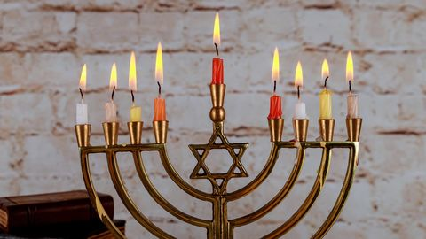
Hanukkah: God Saves His People
What is Hanukkah about? It is about God saving his people.
Judas Maccabeeus is a prefigure of the Messiah.
He defeated Antiochus Epiphanes, and rededicated the temple.
His people are raised from the dead on the 8th day.

Slide 5
Jesus Fulfills Hannukah/Dedication
John 10:36 Jesus: I am the one whom the Father has set apart (dedicated)
1. I am the one dedicated to God.
2. I am God’s Son.
3. The Father is in me and I am in the Father.

Slide 6
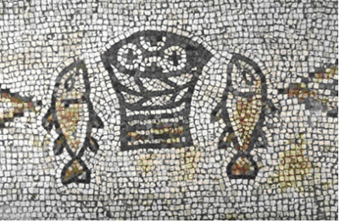
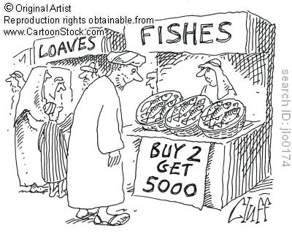
Sign #4 Feeding the 5000
Theme: Jesus the second Moses and
Jesus fulfills the Passover.
Jesus gives bread (like the manna)

Slide 7
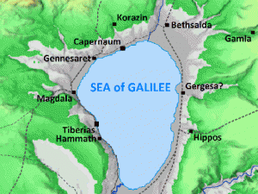
Sign #4 Jesus feeds 10,000 +
People’s response: Jn 6:14 “Surely this is the prophet” (Deuteronomy 18:15-19)
Moses:
Gave them bread (sign #4)
Parted the Red Sea (sign #5)
Gave them water (John 4:10, John 7:38)

Slide 8
John 6:16-21 Sign #5 Jesus Walks on Water
Jesus walking on water the antitype to Moses parting the Red Sea.
John 6:20 “It is I”
ego eimi
I, I Am.
Jesus is God.

Slide 9
John 6:25-71 Jesus the Bread of Life
v. 27 Work for food that will last.
Q: What are you working for?
v. 29 The work that God requires is to believe in Jesus who was sent by God.
v. 30 Give us a sign! Are you greater than Moses?
v. 32 Were you paying attention yesterday? I am greater than Moses. I bring bread from heaven!
v. 34 We want this bread!

Slide 10
John 6:35-44 I AM the Bread of Life
I, I AM the bread of life
Not “I have bread”
Not “I offer bread”
Not “I bring bread”
I AM the bread of life
What do you hunger for?
What do you thirst for?
Where do you go for spiritual food?

Slide 11
7 I AM Statements in John

Slide 12
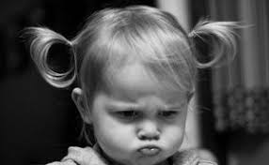
John 6:41 Grumbling
Is this not Jesus, the son of Joseph, whose father and mother we know?
Jesus: stop grumbling!
It is true! I AM the bread of life!

Slide 13
John 6:45-59 Eat of Me!
v. 49, 58 Your ancestors ate bread from Moses and died.
I am greater than Moses!!! I am living bread!
If you eat my flesh me you will not die!
v. 53 Very truly I tell you, unless you eat the flesh of the Son of Man and drink his blood, you have no life in you!!! My flesh is real food.
Wow!!! Are you feeding on Jesus?

Slide 14
John 6:60-70 What Is Your Respose?
v. 60 This is a hard teaching!
v. 67 Do you want to leave too?
Peter: To whom [else] shall we go?
Consider the alternative.
Let us eat the bread and drink the blood of Jesus.

