Slide 1
Welcome to the Alpha Omega Midweek

Slide 2
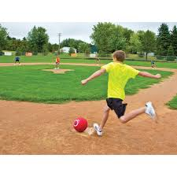
Announcements
Campus Bible Talk Mon 7:00 UCM Glacier 6th floor
Wed 7:30 Midweek UCM GLCR 120
Fri 6:30 Kickball at Merino Park
Saturday 9:00 Serving at Catholic Charities.

Slide 3
Coming Up
Yosemitie Lake Park Service May 25
ICMC in OC July 31-Aug 3

Slide 4
The Church
Alpha Omega Christian Club
April/May 2025

Slide 5
The Church
What is the Church?
The Church and the Kingdom of God
The Purpose of the Church
The Life of the Church

Slide 6
What is church?
ekklesia the assembled, the called-out
1. Church (capital C). The thing that Jesus died for. It is the thing we enter when we are baptized into Christ. (Eph 5:25)
2. church (small c). A local body of believers who submit to a local leadership, who put the one another passages into effect, and who become the city on a hill that seekers are attracted to. (Romans 16:3-5)
Which do we love, give ourselves up for and make radiant?

Slide 7
What Is The Church?
The Bride of Christ
The Body of Christ
The Family of God
The Temply of the Holy Spirit

Slide 8
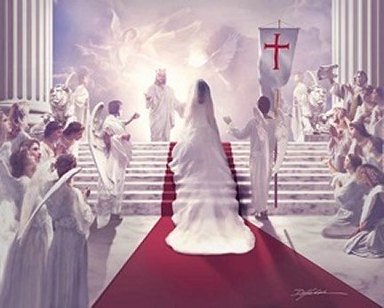
Ephesians 5:25-32 The Bride of Christ
v. 25 Christ loved the Church.
He gave himself up for her.
v. 26 He made her holy
v. 27 He presents us radiant to God.
He wants us to do the same. Have you been doing that?
- give yourself up for the Church
- make her holy
-present her holy

Slide 9
Revelation 19:6-8
At end-time the church is the bride of Christ. (technically, she is merely betrothed now 2 Cor 11:2)

Slide 10
Like a Bride Beautiful Radiant Admired Loved Cared for This is Jesus’ plan for the church

Slide 11
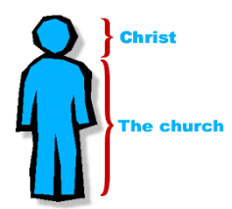
The Church is the Body of Christ
Colossians 1:15-18
The body obeys the head.
The head works in the world through the body.
But… The body concept is largely about unity in the church.

Slide 12
Church: The Body of Christ
Eph 2:12-18 Jew and Gentile are one in Christ
Eph 3:3-6 The mystery… That God could unify Jew and Gentile!!!

Slide 13
The Church: The Family of God
Ephesians 2:19-22
oikos = household = family
You choose friends. You do not choose family.
Family is a place where you are known and cared for.
Families have privileges and obligations

Slide 14
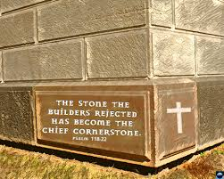
Church: The Family of God
Christ the cornerstone.
The Bible the foundation.

Slide 15
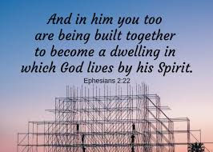
The Church: A Temple of the Holy Spirit
The corporate church is a place where God lives.
Individuality? Not so important.

Slide 16
Discussion Questions
1. What does it mean to you, personally, that the Church is the bride of Christ. What does it tell you God feels about you?
2. Which part of the body are you? A finger? A kidney? In other words, what gift/role do you bring to the local church?
3. What privilege and what obligation of being in the family of God comes to your mind?

Slide 17
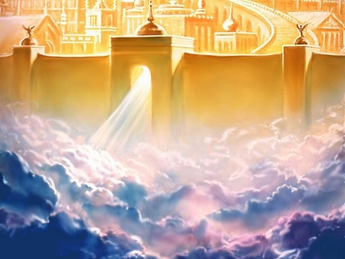
The Kingdom of God and the Church

Slide 18
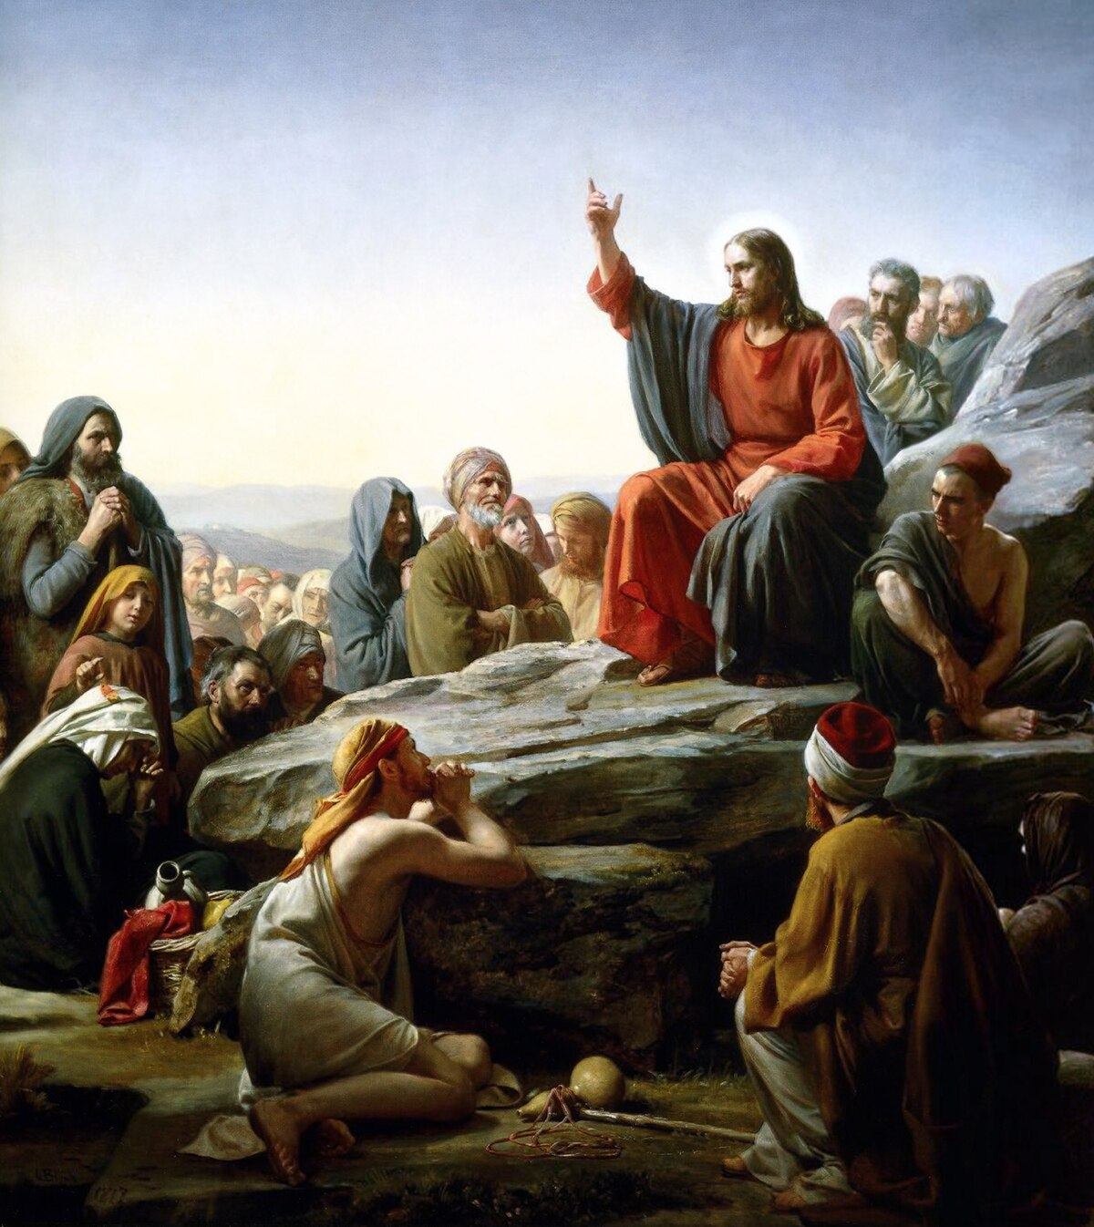
I. The Kingdom of God is the thing Jesus spoke about the most.
Acts 1:3 He appeared to them over a period of forty days and spoke about the Kingdom of God.

Slide 19
II. The Kingdom of God is a “place” where God is king—where God reigns. -It is a life lived in submission to God

Slide 20
What Is The Kingdom of God?
David Lipscomb: The Kingdom of God embraces everything and every person in the universe over which God rules as king.”

Slide 21
III. The Kingdom of God is something much greater than the Church.
The Kingdom of God includes the Church, but it is much greater than the Church.
David Lipscomb: “The Kingdom of God embraces the church, but it is more extensive in its signification.”
Matthew 6:33
Nature
Israel
Church
Heaven

Slide 22
IV. The Kingdom of God is already but not yet.

Slide 23
Already But Not Yet
“God’s colonial outpost, the church, lives as a witness, in the present, of things to come. Through Christ we have experienced resurrection, though we will face death. Because of Golgotha, we have salvation, yet we wait in hope for the revelation of our redemption. We have the “first fruits” (Rom 8:23) of the Spirit as God’s pledge of the rest of the harvest.” [Kingdom Come, Hicks and Valentine]

Slide 24
Already But Not Yet
Saved Already but not yet
Righteous Already but not yet
Holy Already but not yet

Slide 25
V. The Church is the Kingdom of God. (and I am not contradicting myself) Matthew 16:17-19 On this rock I will build my church. And… I will give you the keys to the kingdom of heaven

Slide 26
VI. The Kingdom of God is a radical ethic in complete opposition to the worldly ethic It is best described in the Sermon on the Mount. David Lipscomb: “God calls us to a radical alien mentality, but he provides the power for such a life through his indwelling and empowering Holy Spirit that transforms us into the image of his Son.”

Slide 27
A Radical and Unique Kingdom Ethic
Hebrews 11:8-10 We live in tents
Hebrews 11:13-16 Foreigners and strangers
Philippians 3:20 Citizenship in heaven

Slide 28
VII. The Kingdom of God is best described in the Sermon on the Mount.
Kingdom Valuse: Matthew 5:3-10
Kingdom Ethics: Matthew 5:17-48
The Key: Matthew 6:25-33 Seek first his Kingdom.
Treasures in Heaven Matthew 6:19-21

Slide 29
Discussion Questions
1. What aspect of the Kingdom of God do you find most attractive and interesting?
2. What does it mean to you to be a citizen of the kingdom of God?
3. How ought a citizen of the kingdom of God live? Any changes you can see you ought to make to live that way?

