Slide 1
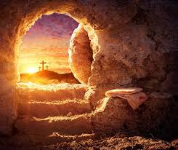
The Gospel of John IX
The Resurrection: We Should Have Known…

Slide 2
Book of John
Theme: Jesus is the Son of God who reveals the Father, providing life to all who believe.
Theme verse: John 1:14
John 1:18 No one has ever seen God, but the one and only Son of God, who is himself God, has made him known.

Slide 3
1 Corinthians 15:3-8 Things of First Importance
Christ Died for our sins according to the Scriptures
Christ was buried.
Christ rose from the dead on the third day according to the Scriptures.
Which Scriptures?

Slide 4
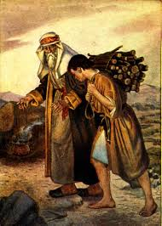
The Third Day…
Genesis 22:1-8
Abraham offered his one and only Son.
Abraham received his one and only son back from death on the third day.
Hebrews 11:19 Figuratively, he received him on the third day.

Slide 5
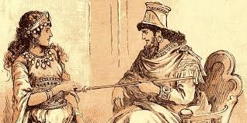
The Third Day
Esther 4:15-5:2
Esther offered her life to save Israel.
“If I perish, I perish”
God saved her from death on the third day.

Slide 6
The Third Day
Hosea 6:2 After two days he will revive us; on the third day he will restore us, that we may live in his presence.

Slide 7
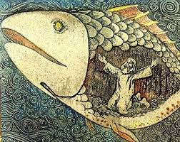
On the Third Day
Jonah 1:12-17, 2:10
Jonah was in the belly of the fish for three days and three nights.
Matthew 12:40 For as Jonah was three days and three nights in the belly of a huge fish, so the Son of Man…

Slide 8
On the Third Day
John 2:19 Destroy this temple and I will raise it again in three days.
Conclusion: One who will willingly give his life for us will indeed die, but will be received back from the dead on the third day so that we may be saved from our sins.
That is the gospel! Let us hold to it firmly!

Slide 9
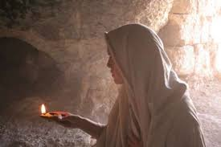
John 20:1-10
Early on the first day of the week… The third day
They have taken his body!
John saw and believed!
What about you?

Slide 10
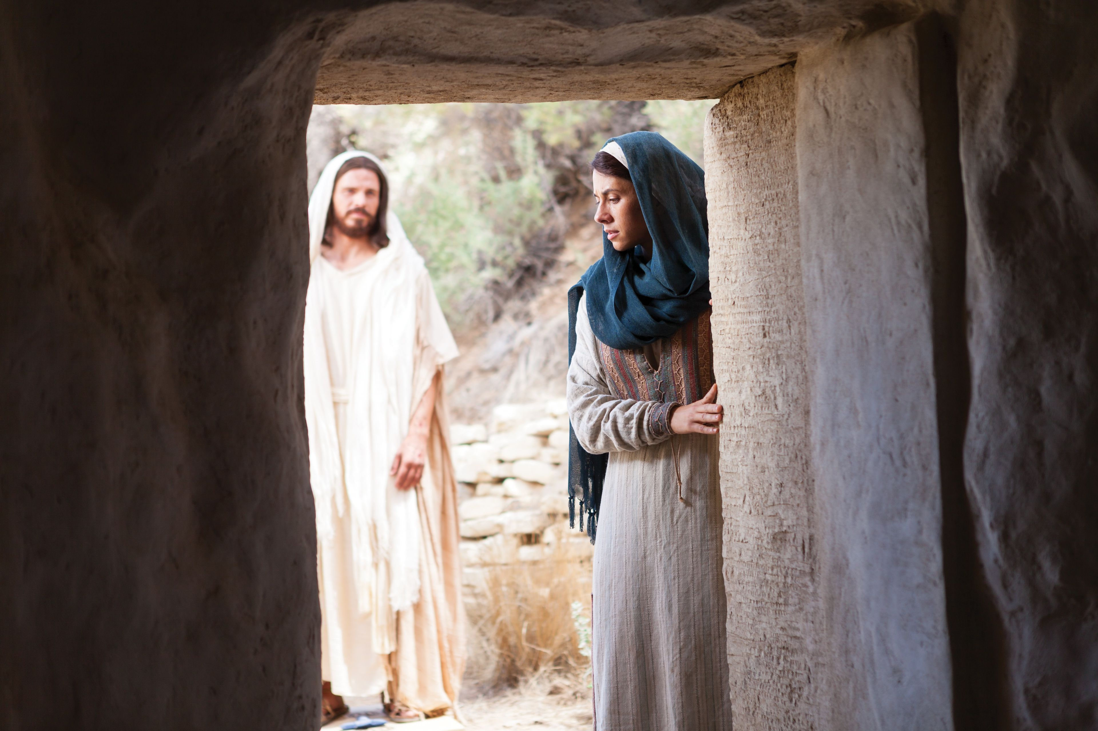
John 20:11-18
Mary…
Teacher! It is you!
I have seen the Lord!

Slide 11
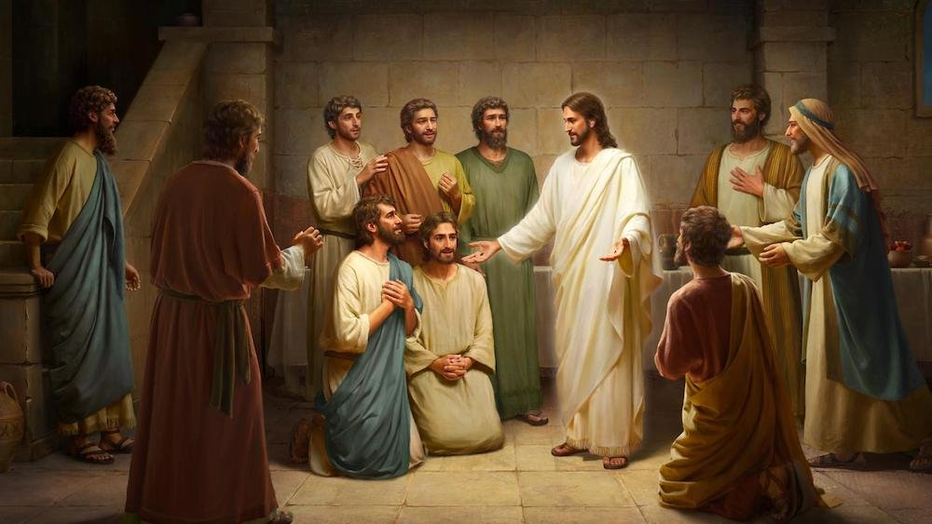
John 20:19-23
Jesus’ Easter message to you:
Peace be with you!

Slide 12
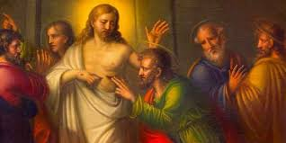
John 20:24-29
Thomas Doubts
Unless I see the nail marks…I will not believe
Stop doubting and believe!

Slide 13
John 20:30-31
These things were written that you may believe that Jesus is the Messiah, the Son of God, and that by believing you may have life in his name.
Jesus offers resurrection to you!!!
Do you believe? If so… Peace to you.

Slide 14
1 Corinthians 15:50-57
Death has been swallowed up in victory.
Thanks be to God. He gives us victory through our Lord Jesus Christ.
We should have known!!! Christ has been raised from the dead on the third day. And he wants to raise you from the dead as well.
Do you believe?

