Slide 1
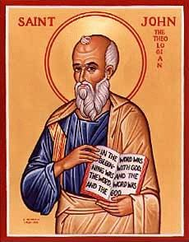
The Gospel of John X
Jesus Heals a Man Born Blind
Do You Want to Be Well?

Slide 2
The Gospel of John
In John, Jesus is revealed as Savior and Messiah through his miracles and through his statements about himself.
Theme verse: John 1:14 The Word of God…

Slide 3
Theme: Jesus Replacing/Greater than the Jewish Festivals
1. Jesus greater than the Sabbath Jn 5:1-18
2. Jesus fulfills the Passover Jn 6:1-70
3. Jesus fulfills Booths/Tabernacles Jn 7:1-9:41
4. Jesus fulfills Feast of Dedication (Hanukkah)
Jn 10

Slide 4
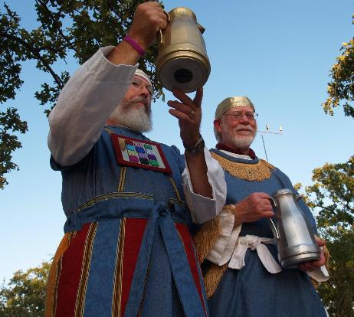
John 7:37-43 Living Water
John 7:37 “Whoever believes in my, as Scripture says, rivers of living water will flow from within them.” By this he meant the Spirit…
The Water Ceremony

Slide 5
John 9 Jesus Heals a Man Born Blind
John 6 Jesus gives bread, then claims “I AM the bread of life.
John 8:12 and John 9:5 Jesus says I AM the light of the world, then in John 9 Jesus heals a man born blind.
In John
Miracles: Give glory to God John 9:3
Create faith (as we will see)
Tell us who Jesus is John 9:5 the light of the world

Slide 6
John 9:1 The Problem of Suffering
Who sinned, this man or his parents that he was born blind?
Jesus: This happened so that God can be glorified.
Has God used suffering in your life to his glory?

Slide 7
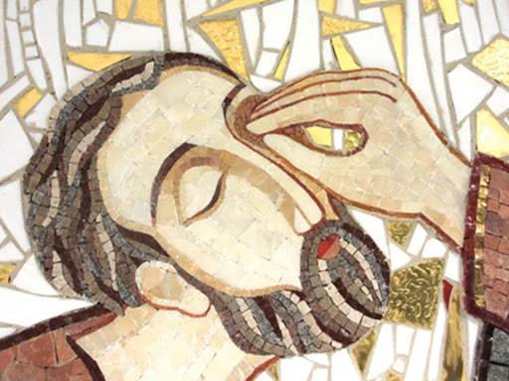
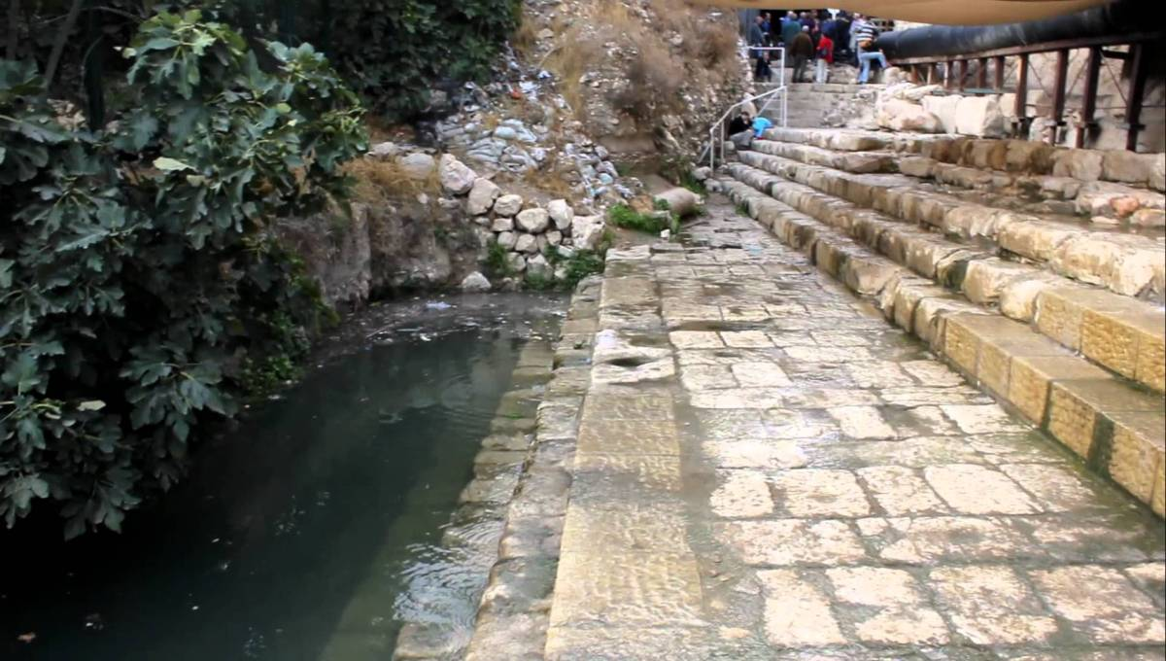
What healed the man?
The dirt?
The saliva?
The water?
The man’s faith?
The man’s obedience?
Jesus’ power?
2 Kings 5:8-15 Namaan

Slide 8
John 9:1-7 What saves us?
Jesus the light of the world saves us.
But not without our faith.
And not without our complete obedience to his command.
It involves water.

Slide 9
John 9:8-34 Who is Blind and Who Can See?
The Man born blind
The Parents
The Pharisees
Which are you?
Requirements to be healed?
Recognize you are sick/blind/a sinner
Go to the right doctor
Take the medicine

Slide 10
The Blind Man Coming to faith
John 9:11 the “man” Jesus
He does not see yet.
John 9:17 He is [the] prophet
He is getting there…

Slide 11
John 9:18-23 The Parents
They believed but they did not believe. They are blind
Why not?
They were afraid of the Jewish leaders
What about you? Whom do you fear?
Matthew 10:38 Do not fear him who can only destroy the body…

Slide 12
John 9:24-34 The Pharisees are Blind
Why?
They can see Moses, but they cannot see “the one like Moses”
They claim that they can see.

Slide 13
John 9:35-41 The Man Now Sees
v. 11 the man named Jesus
v. 17 a prophet
v. 33 He is from God
v. 38 Lord, I believe! He now sees!!!
Where are you in this progression?

Slide 14
The Blind and the Seeing Jesus is the Light of the World
For judgement I have come into the world, so that the blind will see and those who see will become blind.
If you see Jesus, but do not “see” Jesus—if you do not admit you are blind, then your guilt remains.

Slide 15
Summary
Salvation/healing is based on faith and careful obedience on our part, but above all on the power of God to heal us.
Jesus wants us to recognize that we, on our own, are all spiritually blind.
If we combine this with faith and obedience, We will see!

