Slide 1
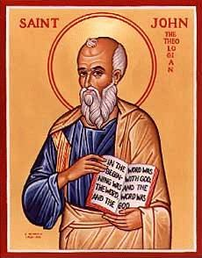
The Gospel of John IX
Jesus and the Feast of Tabernacles
I AM the Light of the World

Slide 2
Gospel of John
In John, Jesus is revealed through his miracles and through his statements about himself.
Theme verse: John 1:14 The Word of God…

Slide 3
Theme: Jesus Replacing/Greater than the Jewish Festivals
1. Jesus greater than the Sabbath Jn 5:1-18
2. Jesus fulfills the Passover/The 2nd Moses Jn 6:1-70
3. Jesus fulfills Booths/Tabernacles Jn 7:1-9:41
4. Jesus fulfills Feast of Dedication (Hanukkah)
Jn 10

Slide 4
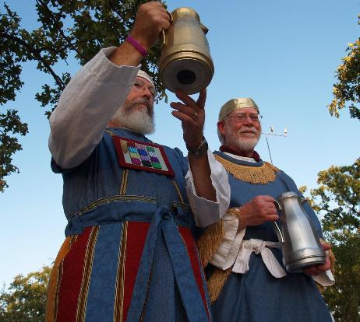
John 7:37-43 Living Water
John 7:37 “Whoever believes in my, as Scripture says, rivers of living water will flow from within them.” By this he meant the Spirit…
Isaiah 12:3 With joy, you will draw water from the well of salvation.
The Water Pouring Ceremony

Slide 5
John 8:12-20 I AM Statement #2
I AM the light of the world
Not I have light
Not I bring light
Not I show light
No!!! I AM the light of the world!

Slide 6
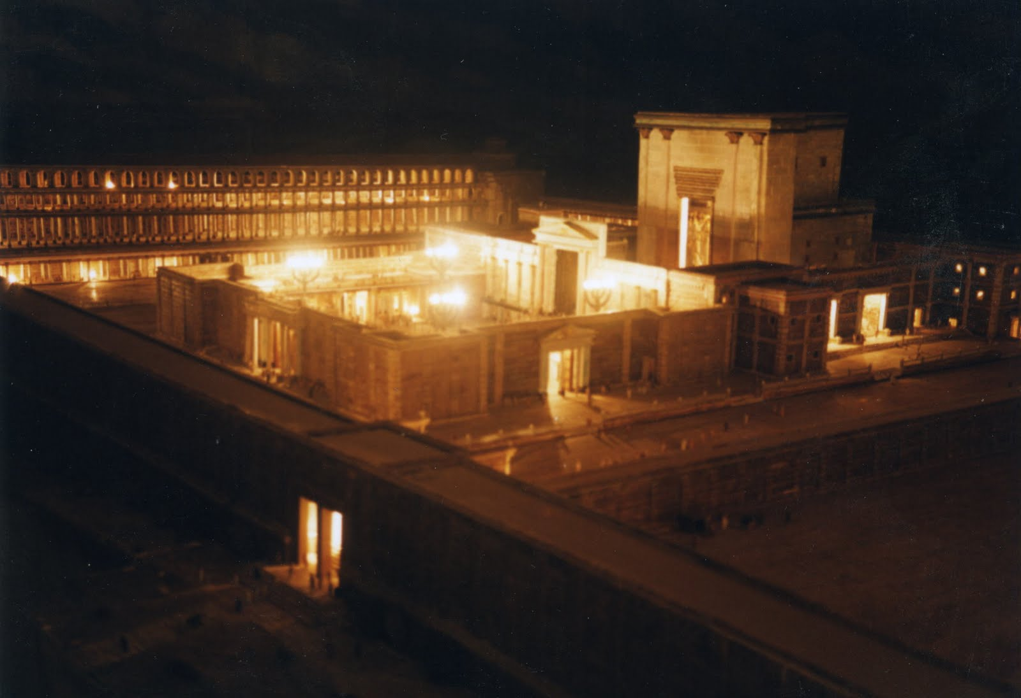
John 8:12-20 I AM the Light of the World
Illumination of the Temple
Purpose: To remember the Shekinah—the Glory of God who dwelt with them in the wilderness

Slide 7
I AM The Light of the World
Jesus is the shekinah—the glory, the pillar of fire.
John 12:36 We are “sons of light.”
John 12:46 Whoever believes in me will not remain in darkness.

Slide 8
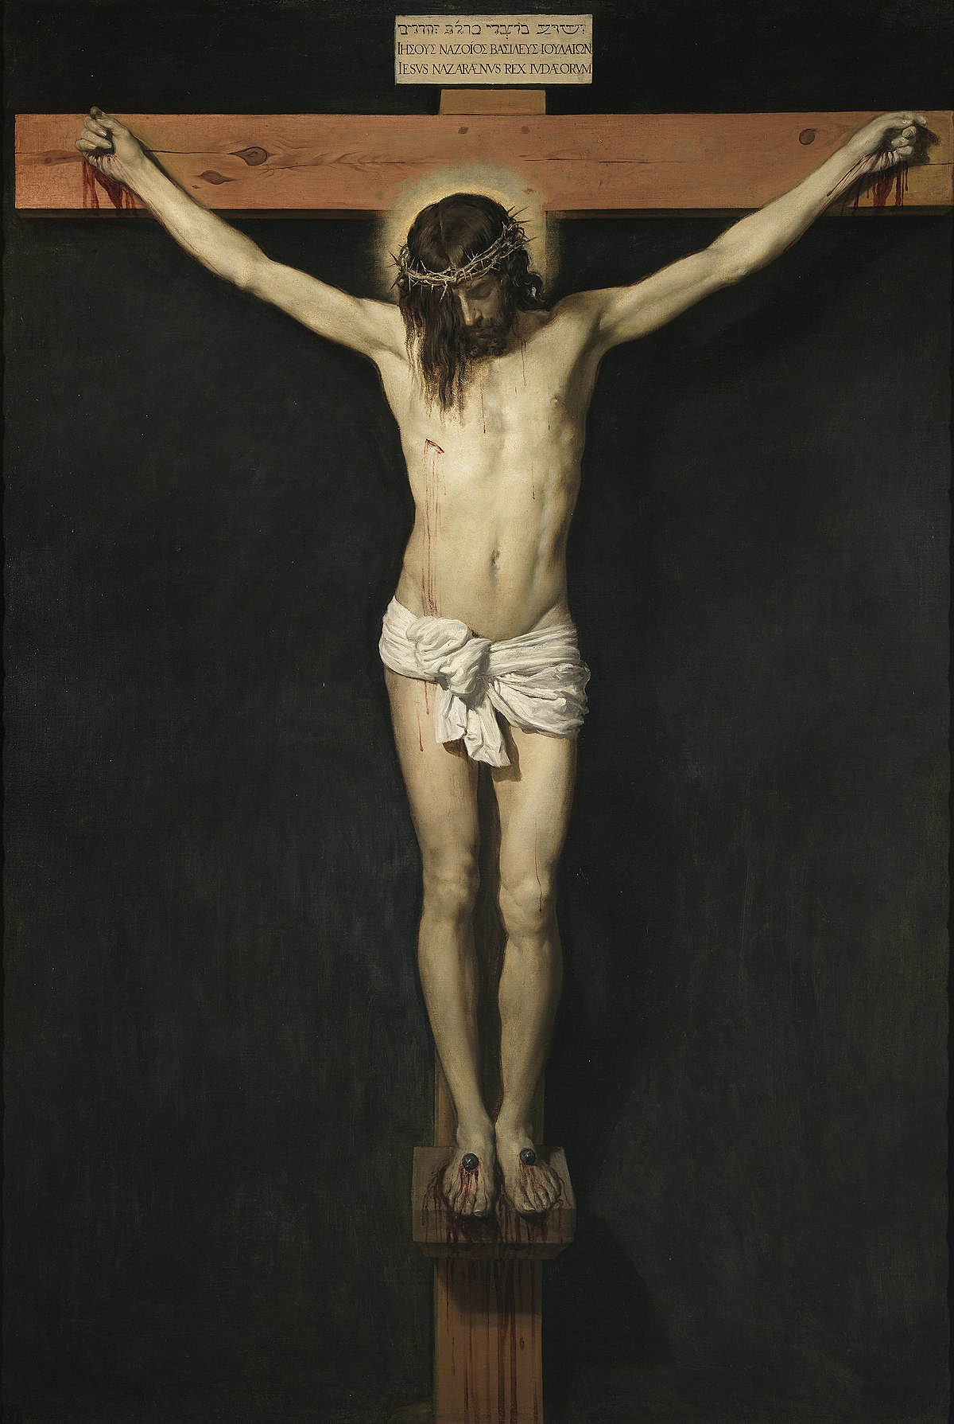
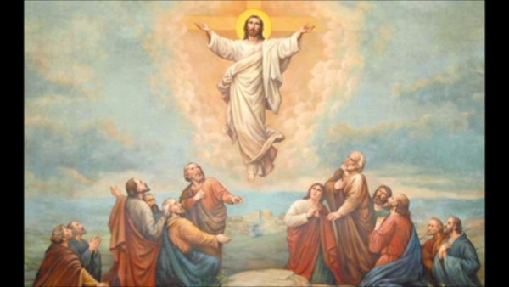
John 8:28 I AM He ego eimi
When you have lifted up the Son of Man, then you will know that I AM He
Have you been lifting Jesus up?

Slide 9
John 8:31-41 True Disciples
John 8:31 “Belief” is not enough.
Are you holding to Jesus’ teachings?
Then you will be set free…
Are you Abraham’s children (walking by faith)?

Slide 10
John 8:42-48
“Can any of you prove me guilty of sin?”
“You are demon-possessed.”
In other words…. No, we cannot!

Slide 11
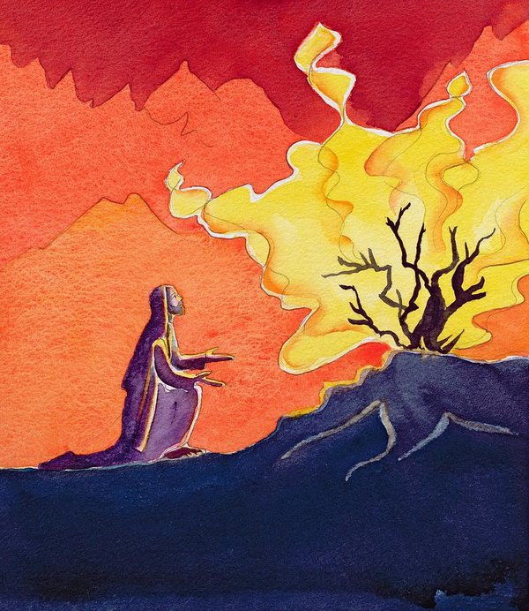
John 8:49-59 I AM
John 8:51 Whoever obeys my word will never see death.
Jesus: I am greater than Abraham.
John 8:58 Before Abraham was born, I AM
They picked up stones…
YHWH I AM

Slide 12
Summary
Jesus is the Light of the World
Jesus is the one who will be lifted up
Jesus lived a sinless life
Jesus is God
Do you believe this?

Slide 13
Then…
Will you be the light of the world?
Will you hold out his teachings to the world?
Will you lift up Jesus?
Will you, like Abraham, walk by faith?

