Slide 1
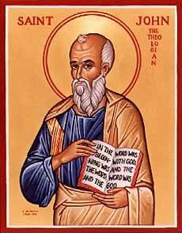
The Gospel of John XIII
Jesus Raises Lazarus
I AM the Resurrection and the Life

Slide 2
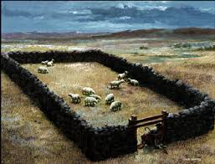
Last Week: John 10
I AM statements #3
John 10:7-9 I am the gate. I am the only way to enter into the kingdom of God.

Slide 3
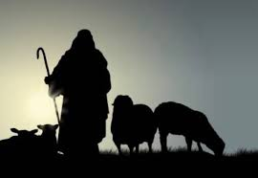
I AM Statement #4
I AM the Good Shepherd.
I came that you may have life, and life to the full.

Slide 4
John 11 Jesus Raises Lazarus
A Pattern: Jesus does a miracle and makes a statement about himself proved by that miracle.
John 6 Jesus makes bread then Jesus says “I AM the Bread of Life.”
John 8:12, 9:5 Jesus says “I AM the light of the world, then he heals the man born blind.
John 11 Jesus says “I AM the resurrection and the life.” Then Jesus resurrects Lazarus.

Slide 5
Seven I Am Statements
I AM the bread of life John 6:35
I AM the light of the world John 8:12, John 9:5
I AM the door (and the gate) John 10:7
I AM the good shepherd John 10:1,14
I AM the resurrection and the life John 11:25
I AM the Way the Truth and the Life John 14:6
I AM the true vine John 15:1

Slide 6
Jesus Performs Seven Signs
Water to wine John 2:1-11
Healing of official’s son John 4:43-54
Healing at pool of Bethesda John 5:1-5
Feeding of 5000 John 6:1-14
Walking on water John 6:16-21
Healing man born blind John 9:1-12
Resurrection of Lazarus John 11:1-44

Slide 7
John 11:1-16 Jesus Comes to Bethany

Slide 8
John 11:26-27
Jesus: I AM the resurrection and the life. He who believes in me will live, even though he dies; and whoever lives and believes in me will never die.
Do you believe this?
Martha: Yes, Lord, I believe that you are the Christ, the Son of God, who was to come into the world.

Slide 9
Jesus Raises Lazarus
Jesus was deeply moved.
Jesus wept.
Jesus: Take away the stone!
Martha: By this time there is a bad odor.
You too, were dead in your sins. You, too, were royally stinking it up.
But Jesus says, “Take away the stone!”

Slide 10
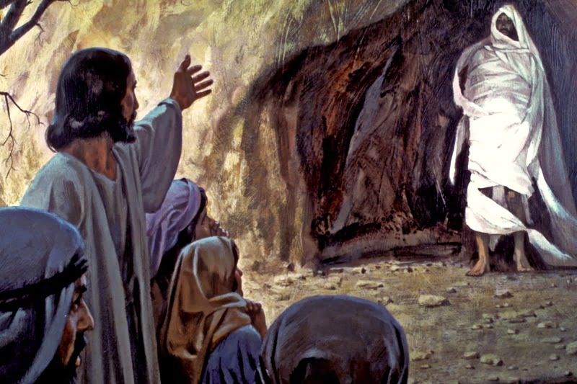
Lazarus, Come Out!

Slide 11
Jesus says to you ___________ come out!
Jesus says to you, unbind him!

Slide 12
John 11:45-51 Responses to Jesus
John 11:45 Many believed. What a shock!
What about you? Do you believe?
Did the Pharisees believe Jesus raised Lazarus? Yes!!! Did they believe? No!!!
Caiaphas: You do not realize that it is better for you that one man die for the people than that the whole nation perish. How ironic!

Slide 13
John 11:53-57
From that day on they plotted to take his life.
The die is cast.
The Passover is at hand.
Jesus no longer says “the time has not yet come.”
Do you believe?

