Slide 1
Mary, A Mother’s Heart
Mary in the Book of Luke

Slide 2
Ruth Seabury Oakes d. Jan 31, 2025 age 98 yrs. Miss you, Mom!

Slide 4
In Luke, Jesus is revealed as Messiah through his earthly ministry to outsiders, the poor, “sinners,” Samaritans and most especially to women.

Slide 5
Women Come Into the Kingdom Before Men
Luke lists 13 women not mentioned in the other Gospels
Women with great faith:
Elizabeth
Mary
Ana
Widow of Nain Luke 7:12-15
Woman who anoints Jesus’ feet Luke 7:36-50

Slide 6
Jesus and Women
Women supported Jesus financially Luke 8:1-3
Woman healed of bleeding Luke 8:43-48
Mary and Martha Luke 10:38-42
Crippled woman healed on the Sabbath Luke 13:10-17
The poor widow Luke 21:1-4
Women were the chief witnesses and comforters of Jesus at the crucifixion Luke 23:49
Women were the first to witness the resurrection Luke 23:55-24:11

Slide 7
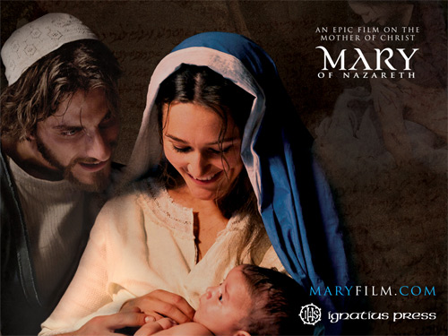
Mary: The Favored of the Lord
Facts about Mary:
1. She was very young.
2. She was female.
3. She was poor.
4. She was defenseless
and vulnerable

Slide 8
Mary: The Favored of the Lord
What does God say about Mary? Luke 1:26-28
1. You are highly favored.
2. God is with you.
Who is favored of the Lord? The young, the female, the poor, the weak and the defenseless.

Slide 9
Why is Mary Favored? Luke 1:38
I am the Lord’s servant.
May it be as you have said.
Luke 1:45 (Memory verse) Blessed is she who has believed that what the Lord has said to her will be accomplished.

Slide 10
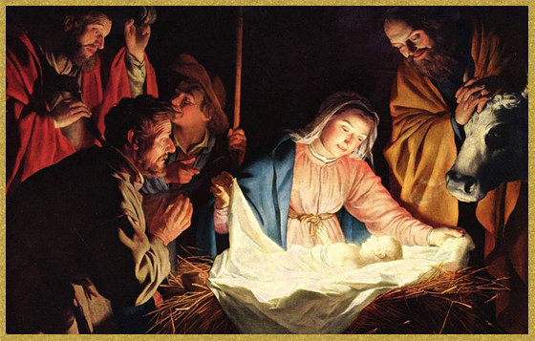
Luke 2:19
Mary treasured up all these things in her heart.

Slide 11
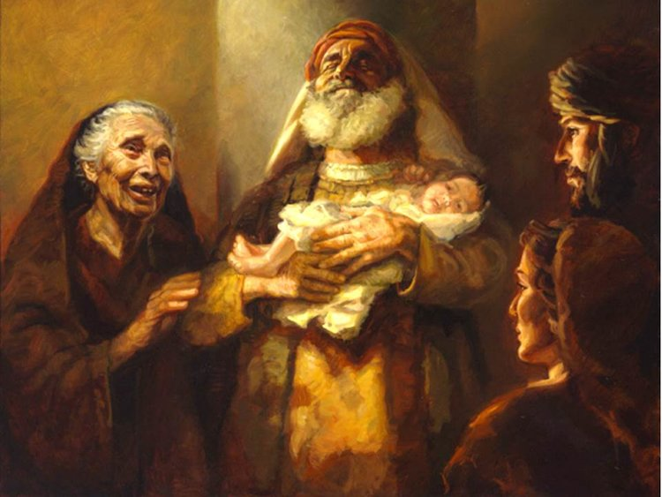
Luke 2:21-35 The Dedication
A sword will pierce your own soul too.

Slide 12
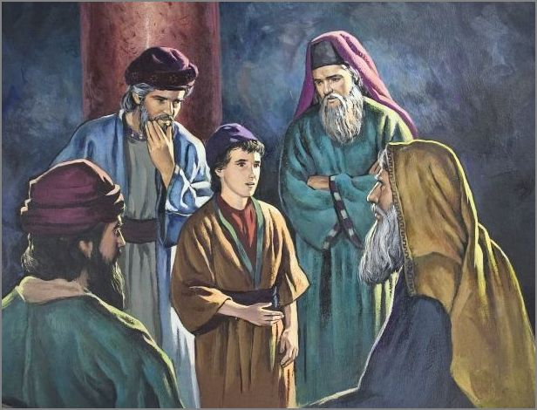
Jesus at the Temple Luke 2:41-52
Mary:
What does this portend about my son?
Her response: I am the Lord’s servant, may it be as you said.

Slide 13
Jesus’ Galilean Ministry Begins
Luke 4:16-30 Jesus’ first sermon (in Luke, anyway)
Q: What will the message of his first sermon be?

Slide 14
Jesus Brings Good News Luke 4:18-19 Isaiah 61:1-2
1. Good news for the poor
2. Freedom for prisoners
3. Healing for the sick.
4. Release the oppressed.
5. The favor of the Lord.
Jesus: “Today this Scripture is
fulfilled in your hearing”

Slide 15
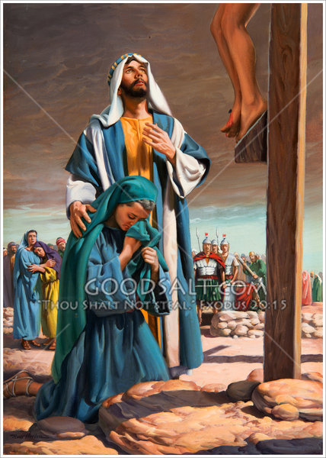
John 19:25-27
To Mary:
Dear woman, here is your son.
To John:
Here is your mother.

Slide 16
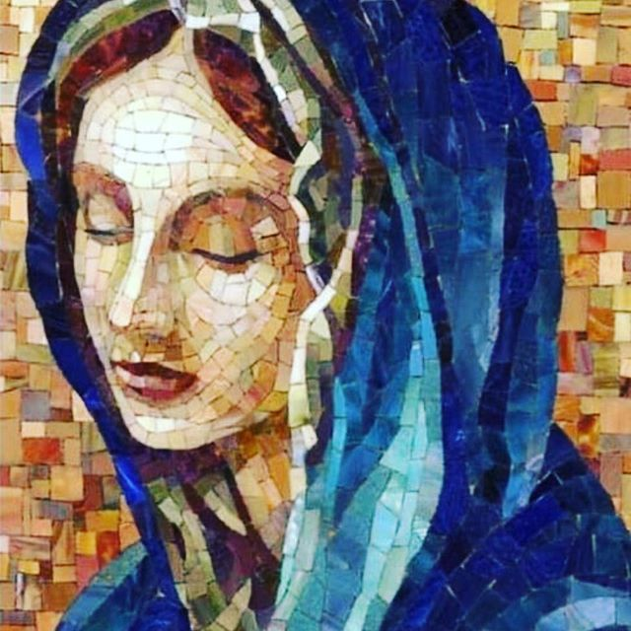
Acts 1:14 At the ascension
They all joined together constantly in prayer, along with the women and Mary the mother of Jesus….
Mary: I am the Lord’s servant, may it be as you have said.

Slide 17
Mary, A Mother’s Heart
Happy Mother’s Day

